Slide 1
Representing Data: Logical Operations on Bits + Beyond Integers Part 1: Logical Operations
For use in Fall 2020 CSE6010/CX4010 only
Not for distribution

Slide 2
Logical Operations
Operations involving logical TRUE or FALSE
two states -- takes one bit to represent: TRUE=1, FALSE=0 Truth tables show the results of logical operations for all possible input combinations (for n source operands, 2^{n} rows)
View n-bit number as a collection of n logical values
operation applied to each bit independently
A | B | A AND B
0 | 0 | 0
0 | 1 | 0
1 | 0 | 0
1 | 1 | 1
A | B | A OR B
0 | 0 | 0
0 | 1 | 1
1 | 0 | 1
1 | 1 | 1
A | NOT A
0 | 1
1 | 0

Slide 3
Examples of Logical Operations
AND
useful for clearing bits (to 0)
AND with zero = 0
AND with one = no change
OR
useful for setting bits (to 1)
OR with zero = no change
OR with one = 1
NOT
unary operation -- one argument
complements each bit
11000101
AND 00001111
00000101
11000101
OR 00001111
11001111
NOT 11000101
00111010

Slide 4
Logical Operations Examples
Find the bitwise AND and the bitwise OR of the two inputs 1001 0011 and 0111 1010.
OR represents an inclusive or and is set to true if either or both of the inputs are 1. Consider the exclusive OR operation XOR, which will not evaluate to true if the inputs are the same. Complete the truth table and then calculate XOR for the same inputs as above.
View n-bit number as a collection of n logical values
operation applied to each bit independently
A | B | A XOR B
0 | 0
0 | 1
1 | 0
1 | 1

Slide 5
Logical Operations Examples
Find the bitwise AND and the bitwise OR of the two inputs 1001 0011 and 0111 1010. AND: 1001 0011 OR: 1001 0011 0111 1010 0111 1010 0001 0010 1111 1011
XOR: 1001 0011 0111 1010 1110 1001
A | B | A XOR B
0 | 0 | 0
0 | 1 | 1
1 | 0 | 1
1 | 1 | 0

Slide 7
Representing Data: Logical Operations on Bits + Beyond Integers Part 2: Binary Representations of Fractions
For use in Fall 2020 CSE6010/CX4010 only
Not for distribution

Slide 8
The Problem with Integers…
What about really large numbers?
Integers have limited range
32-bit integers
Signed: from -2,147,483,648 to 2,147,483,647 (inclusive)
Unsigned: from 0 to 4,294,967,295 (inclusive)
What about fractions?
Floating point numbers address both of these concerns
Floating point numbers increase range, not precision.
Why?
The number of available bits is (or can be) the same.

Slide 9
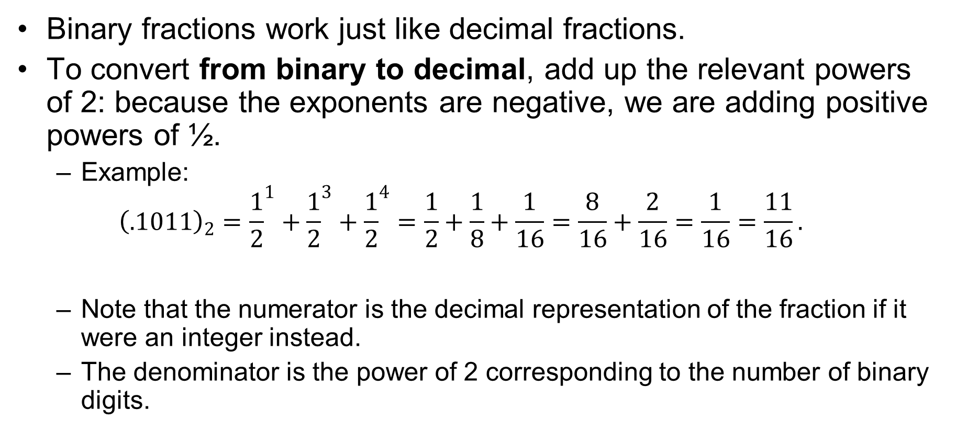
Fractions in Base 2
Binary fractions work just like decimal fractions.
To convert from binary to decimal, add up the relevant powers of 2: because the exponents are negative, we are adding positive powers of ½.
Example: ${\left(.1011\right)}_{2}={\frac{1}{2}}^{1}+{\frac{1}{2}}^{3}+{\frac{1}{2}}^{4}=\frac{1}{2}+\frac{1}{8}+\frac{1}{16}=\frac{8}{16}+\frac{2}{16}=\frac{1}{16}=\frac{11}{16}.$
Note that the numerator is the decimal representation of the fraction if it were an integer instead.
The denominator is the power of 2 corresponding to the number of binary digits.

Slide 10
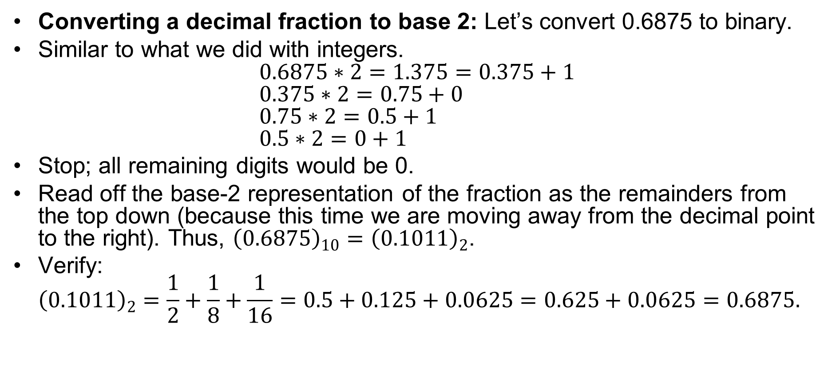
Fractions in Base 2
Converting a decimal fraction to base 2: Let’s convert 0.6875 to binary.
Similar to what we did with integers. $0.6875∗2=1.375=0.375+1$ $0.375∗2=0.75+0$ $0.75∗2=0.5+1$ $0.5∗2=0+1$
Stop; all remaining digits would be 0.
Read off the base-2 representation of the fraction as the remainders from the top down (because this time we are moving away from the decimal point to the right). Thus, ${\left(0.6875\right)}_{10}={\left(0.1011\right)}_{2}$.
Verify: ${\left(0.1011\right)}_{2}=\frac{1}{2}+\frac{1}{8}+\frac{1}{16}=0.5+0.125+0.0625=0.625+0.0625=0.6875.$

Slide 11
Fraction Examples
Convert from decimal to binary, then verify by converting the result back to decimal.
0.28125
12.5625

Slide 12
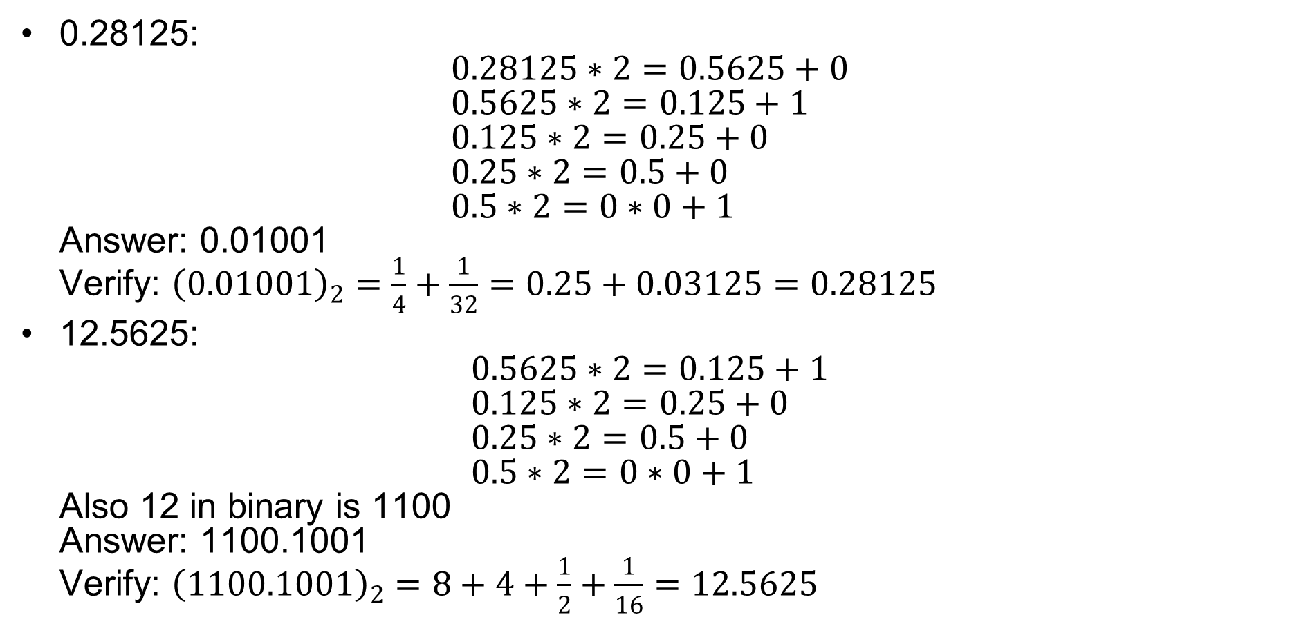
Fraction Examples
0.28125: $0.28125∗2=0.5625+0$ $0.5625∗2=0.125+1$ $0.125∗2=0.25+0$ $0.25∗2=0.5+0$ $0.5∗2=0∗0+1$ Answer: 0.01001 Verify: ${\left(0.01001\right)}_{2}=\frac{1}{4}+\frac{1}{32}=0.25+0.03125=0.28125$
12.5625: $0.5625∗2=0.125+1$ $0.125∗2=0.25+0$ $0.25∗2=0.5+0$ $0.5∗2=0∗0+1$ Also 12 in binary is 1100 Answer: 1100.1001 Verify: ${\left(1100.1001\right)}_{2}=8+4+\frac{1}{2}+\frac{1}{16}=12.5625$

Slide 13
Operations with Fractions
Binary fractions work just like decimal fractions
Two’s complement addition/subtraction work same as integer operations
2⁻¹ = 0.5
2⁻² = 0.25
2⁻³ = 0.125
0 0 1 0 1 0 0 0 . 1 0 1 = 40.625
+ 1 1 1 1 1 1 1 0 . 1 1 0 = -1.25
0 0 1 0 0 1 1 1 . 0 1 1 = 39.375

Slide 15
Representing Data: Logical Operations on Bits + Beyond Integers Part 3: Floating Point Numbers
For use in Fall 2020 CSE6010/CX4010 only
Not for distribution

Slide 16
Floating Point Numbers
IEEE 754 Floating Point Standard
Based on scientific notation
Example (decimal): 6.02214 x 10²³
Normalized: one non-zero digit before decimal point
Binary scientific notation: F x 2E
Non-zero digit before binary point must be ‘1’ so no need to explicitly represent it
Magnitude: fraction (F) + sign (S) in sign-magnitude format
Exponent: value is E-127 (excess 127 representation)
1b
8b
23b
S
E
F
Single-precision (32-bit) For double precision (64-bit), use 11 bits for exponent, 52 for fraction (mantissa)
N = (-1)^{S} x 1.F x 2^{E-127}, 1 ≤ E ≤ 254
(E = 0, 255 are special cases)
Notes:
Normalized: one non-zero digit before decimal point
Excess notation allows easy comparison of exponents
Exponent = 255 used for special values:
If Fraction is non-zero, NaN (not a number).
If Fraction is zero and sign is 0, positive infinity.
If Fraction is zero and sign is 1, negative infinity.

Slide 17
Floating Point Example
Single-precision IEEE floating point number:
10111111010000000000000000000000
Sign is 1: number is negative.
Exponent field: 01111110 = 126 (decimal).
Fraction: 0.100000000000… = 0.5 (decimal).
Value = -1.5 x 2⁽¹²⁶⁻¹²⁷⁾ = -1.5 x 2⁻¹ = -0.75
What is the reason for the E-127 offset (exponent bias)?
Want to be able to represent both large and small numbers! With 8 bits, 2⁸=256 possible exponents; half are small (<0), half large (>0).
sign
exponent
fraction

Slide 18
Floating Point Numbers
While we can find a decimal representation for each floating-point number, not all real numbers can be represented exactly using floating-point: finite precision.
In converting a real number to floating-point, we usually will have to round.
Individual roundoff errors are small, but they can have large consequences, especially when accumulated.
Hexadecimal can be a convenient way to write 32- or 64-bit numbers (8 or 16 hexadecimal digits).

Slide 19
Floating Point Examples
Write -6.625 as a single-precision floating point number.
What number does the single-precision value 0011 1101 1000 0000 0000 0000 0000 0000 represent?
What number does the single-precision value 3FF0 0000 represent?

Slide 20
Floating Point Examples
Write -6.625 as a single-precision floating point number. 6: 4+2 = 110 0.625: 0.5 + 0.125 = 0.101 -6.25: -110.101

Slide 21
Floating Point Examples
Write -6.625 as a single-precision floating point number. 6: 4+2 = 110 0.625: 0.5 + 0.125 = 0.101 -6.25: -110.101 Normalize: -1.10101 x 10² Sign bit: 1 (because negative) Exponent: 2 = E-127 -> E = 129, which is 1000 0001 Fraction: delete leading one to get 10101 (followed by 0’s)

Slide 22
Floating Point Examples
Write -6.625 as a single-precision floating point number. 6: 4+2 = 110 0.625: 0.5 + 0.125 = 0.101 -6.25: -110.101 Normalize: -1.10101 x 2² Sign bit: 1 (because negative) Exponent: 2 = E-127 -> E = 129, which is 1000 0001 Fraction: delete leading one to get 10101 (followed by 0’s) Answer: 1 1000 0001 10101 00 0000 0000 0000 0000 (18 zeros)

Slide 23
Floating Point Examples
What number does the single-precision value 0011 1101 1000 0000 0000 0000 0000 0000 represent? Sign bit: 0, positive Exponent: 0111 1011, which is 2⁶+2⁵+2⁴+2³+2¹+2⁰= 64+32+16+8+2+1 = 123. exponent is 123-127 = -4 Fraction: all 0’s Normalize: 1.0… (all zeros) Together: 1 x 2⁻⁴ = 1/16
What number does the single-precision value 3F80 0000 represent? Expand to 0011 1111 1000 (followed by 20 zeros) Sign bit: 0, positive Exponent: 0111 1111, which is 2⁷-1 = 127. exponent is 127-127=0. Fraction: all 0’s Normalize: 1.0… (all zeros) Together: 1 x 2⁰ = 1

Slide 24
Special Cases
Exponent value of 0 (subnormal numbers)
Used to represent very small numbers by relaxing the normalization requirement
1b
8b
23b
S
E
F
Usual (non-zero exponent): N = (-1)^{S} x 1.F x 2^{E-127}, 1 ≤ E ≤ 254
Special case: N = (-1)^{S} x 0.F x 2⁻¹²⁶, E = 0
Example: 0 00000000 00001000000000000000000
Value = + 0.00001 x 2⁻¹²⁶ = 2⁻¹³¹
Other special cases (exponent=255):
+infinity, -infinity, NaN (not a number, e.g., 0/0)
Notes:
Exponent = 255 used for special values:
If Fraction is non-zero, NaN (not a number).
If Fraction is zero and sign is 0, positive infinity.
If Fraction is zero and sign is 1, negative infinity.

Slide 25
Other Data Types: Text Using ASCII Characters
ASCII: Maps 128 characters to 7-bit code
both printable and non-printable (ESC, DEL, …) characters
Successive numbers and letters have sequential codes
What do these statements yield?
‘a’ + 2;
‘A’ + 5;
c – ‘0’
(c holds a digit character)
d + (‘a’ – ‘A’)
(d holds an upper case character)
00 | nul | 10 | dle | 20 | sp | 30 | 0 | 40 | @ | 50 | P | 60 | ` | 70 | p
01 | soh | 11 | dc1 | 21 | ! | 31 | 1 | 41 | A | 51 | Q | 61 | a | 71 | q
02 | stx | 12 | dc2 | 22 | " | 32 | 2 | 42 | B | 52 | R | 62 | b | 72 | r
03 | etx | 13 | dc3 | 23 | # | 33 | 3 | 43 | C | 53 | S | 63 | c | 73 | s
04 | eot | 14 | dc4 | 24 | $ | 34 | 4 | 44 | D | 54 | T | 64 | d | 74 | t
05 | enq | 15 | nak | 25 | % | 35 | 5 | 45 | E | 55 | U | 65 | e | 75 | u
06 | ack | 16 | syn | 26 | & | 36 | 6 | 46 | F | 56 | V | 66 | f | 76 | v
07 | bel | 17 | etb | 27 | ' | 37 | 7 | 47 | G | 57 | W | 67 | g | 77 | w
08 | bs | 18 | can | 28 | ( | 38 | 8 | 48 | H | 58 | X | 68 | h | 78 | x
09 | ht | 19 | em | 29 | ) | 39 | 9 | 49 | I | 59 | Y | 69 | i | 79 | y
0a | nl | 1a | sub | 2a | * | 3a | : | 4a | J | 5a | Z | 6a | j | 7a | z
0b | vt | 1b | esc | 2b | + | 3b | ; | 4b | K | 5b | [ | 6b | k | 7b | {
0c | np | 1c | fs | 2c | , | 3c | < | 4c | L | 5c | \ | 6c | l | 7c | |
0d | cr | 1d | gs | 2d | - | 3d | = | 4d | M | 5d | ] | 6d | m | 7d | }
0e | so | 1e | rs | 2e | . | 3e | > | 4e | N | 5e | ^ | 6e | n | 7e | ~
0f | si | 1f | us | 2f | / | 3f | ? | 4f | O | 5f | _ | 6f | o | 7f | del

Slide 26
Other Data Types
Text strings
sequence of characters, terminated with NULL (0)
typically, no hardware support
Image
array of pixels
monochrome: one bit (1/0 = black/white)
color: red, green, blue (RGB) components (e.g., 8 bits each)
other properties: transparency
hardware support:
typically none, in general-purpose processors
MMX instruction set (Intel): multiple 8-bit operations on 32-bit word
Sound
sequence of fixed-point numbers

Slide 27
Final Comments on Representing Data
Most computers use IEEE floating point representation
Many real numbers cannot be represented exactly on computers
There is a whole field (numerical analysis) to study the impacts of finite-precision arithmetic on accuracy of calculations

