Slide 1
Chapter 17
Recursion

Slide 2
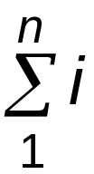
What is Recursion?
A recursive function is one that solves its task
by calling itself on smaller pieces of data.
  Similar to recurrence function in mathematics.
  Like iteration -- can be used interchangeably;
  sometimes recursion results in a simpler solution.
Example: Running sum ( )
Mathematical Definition:
RunningSum(1) = 1
RunningSum(n) =
n + RunningSum(n-1)
Recursive Function:
int RunningSum(int n) {
if (n == 1)
return 1;
else
return n + RunningSum(n-1);
}
16-<number>

Slide 3
Executing RunningSum
res = RunningSum(4);
return value = 10
RunningSum(4)
return 4 + RunningSum(3);
return value = 6
RunningSum(3)
return 3 + RunningSum(2);
return value = 3
RunningSum(2)
return 2 + RunningSum(1);
return value = 1
RunningSum(1)
return 1;
16-<number>

Slide 4
High-Level Example: Binary Search
Given a sorted set of exams, in alphabetical order,
find the exam for a particular student.
1. Look at the exam halfway through the pile.
2. If it matches the name, we're done;
if it does not match, then...
3a. If the name is greater (alphabetically), then
search the upper half of the stack.
3b. If the name is less than the halfway point, then
search the lower half of the stack.
16-<number>

Slide 5
Binary Search: Pseudocode
Pseudocode is a way to describe algorithms without
completely coding them in C.
FindExam(studentName, start, end)
{
halfwayPoint = (end + start)/2;
if (end < start)
ExamNotFound(); /* exam not in stack */
else if (studentName == NameOfExam(halfwayPoint))
ExamFound(halfwayPoint); /* found exam! */
else if (studentName < NameOfExam(halfwayPoint))
/* search lower half */
FindExam(studentName, start, halfwayPoint - 1);
else /* search upper half */
FindExam(studentName, halfwayPoint + 1, end);
}
16-<number>

Slide 6
High-Level Example: Towers of Hanoi
Task: Move all disks from current post to another post.
Rules:
(1) Can only move one disk at a time.
(2) A larger disk can never be placed on top of a
smaller disk.
(3) May use third post for temporary storage.
Post 1
Post 2
Post 3
16-<number>

Slide 7
Task Decomposition
Suppose disks start on Post 1, and target is Post 3.
1. Move top n-1 disks to
Post 2.
2. Move largest disk to
Post 3.
3. Move n-1 disks from
Post 2 to Post 3.
1
2
3
1
2
3
1
2
3
16-<number>

Slide 8
Task Decomposition (cont.)
Task 1 is really the same problem,
with fewer disks and a different target post.
  "Move n-1 disks from Post 1 to Post 2."
And Task 3 is also the same problem,
with fewer disks and different starting and target posts.
  "Move n-1 disks from Post 2 to Post 3."
So this is a recursive algorithm.
  The terminal case is moving the smallest disk -- can move
  directly without using third post.
  Number disks from 1 (smallest) to n (largest).
16-<number>

Slide 9
Towers of Hanoi: Pseudocode
MoveDisk(diskNumber, startPost, endPost, midPost)
{
if (diskNumber > 1) {
/* Move top n-1 disks to mid post */
MoveDisk(diskNumber-1, startPost, midPost, endPost);
printf("Move disk number %d from %d to %d.\n",
diskNumber, startPost, endPost);
/* Move n-1 disks from mid post to end post */
MoveDisk(diskNumber-1, midPost, endPost, startPost);
}
else
printf("Move disk number 1 from %d to %d.\n",
startPost, endPost);
}
16-<number>

Slide 10
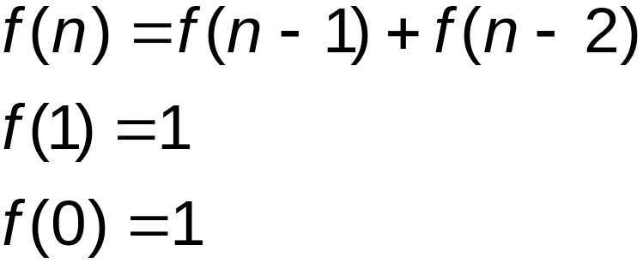
Detailed Example: Fibonacci Numbers
Mathematical Definition:
In other words, the n-th Fibonacci number is
the sum of the previous two Fibonacci numbers.
16-<number>

Slide 11
Fibonacci: C Code
int Fibonacci(int n)
{
if ((n == 0) || (n == 1))
return 1;
else
return Fibonacci(n-1) + Fibonacci(n-2);
}
16-<number>

Slide 12
Tracing the Function Calls
If we are debugging this program,
we might want to trace all the calls of Fibonacci.
  Note: A trace will also contain the arguments
  passed into the function.
For Fibonacci(3), a trace looks like:
Fibonacci(3)
Fibonacci(2)
Fibonacci(1)
Fibonacci(0)
Fibonacci(1)
What would trace of Fibonacci(4) look like?
16-<number>

Slide 13
A Final C Example: Printing an Integer
Recursively converts an unsigned integer
as a string of ASCII characters.
  If integer <10, convert to char and print.
  Else, call self on first (n-1) digits and then print last digit.
void IntToAscii(int num) {
int prefix, currDigit;
if (num < 10)
putchar(num + '0'); /* prints single char */
else {
prefix = num / 10; /* shift right one digit */
IntToAscii(prefix); /* print shifted num */
/* then print shifted digit */
currDigit = num % 10;
putchar(currDigit + '0');
}
}
16-<number>

Slide 14
Trace of IntToAscii
Calling IntToAscii with parameter 12345:
IntToAscii(12345)
IntToAscii(1234)
IntToAscii(123)
IntToAscii(12)
IntToAscii(1)
putchar('1')
putchar('2')
putchar('3')
putchar('4')
putchar('5')
16-<number>

