Slide 1
Course Overview
For use in Fall 2020 CSE6010/CX4010 only
Not for distribution

Slide 2
Computer Levels of Abstraction
Application
(word processor, simulator, web browser, …)
Algorithms
(sorting, optimization, equation solver, …)
Programming Language
(C, FORTRAN, Matlab, Java, …)
Operating System
(UNIX, Windows, iOS, …)
Machine Instruction Set Architecture
(Intel i86, ARM, …)
Machine Organization
(Main memory, registers, adders, …)
Logic Gates
(NAND, NOR, inverter, …)
Transistors
(CMOS, NMOS, …)
Physics (Semiconductors)
(electrons, holes, …)

Slide 3
This Course
Problem
Application
(word processor, simulator, web browser, …)
This course spans all levels of abstraction, focusing on algorithms, software, and computer system hardware/software.
Algorithms
(sorting, optimization, equation solver, …)
Programming Language
(C, FORTRAN, Matlab, Java, …)
Operating System
(UNIX, Windows, iOS, …)
Machine Instruction Set Architecture
(Intel i86, ARM, …)
Machine Organization
(Main memory, registers, adders, …)
Logic Gates
(NAND, NOR, inverter, …)
Program
Execution
Transistors
(CMOS, NMOS, …)
Physics (Semiconductors)
(electrons, holes, …)

Slide 4
Recurring Themes
Abstraction
Essential to understanding complicated systems to hide unnecessary details
Key skills in computing and other fields
Understanding system at one level of abstraction
Moving up and down levels of abstraction
Hardware and Software: Need to understand both hardware and software to some level of detail
Understanding hardware necessary for understanding software performance

Slide 5
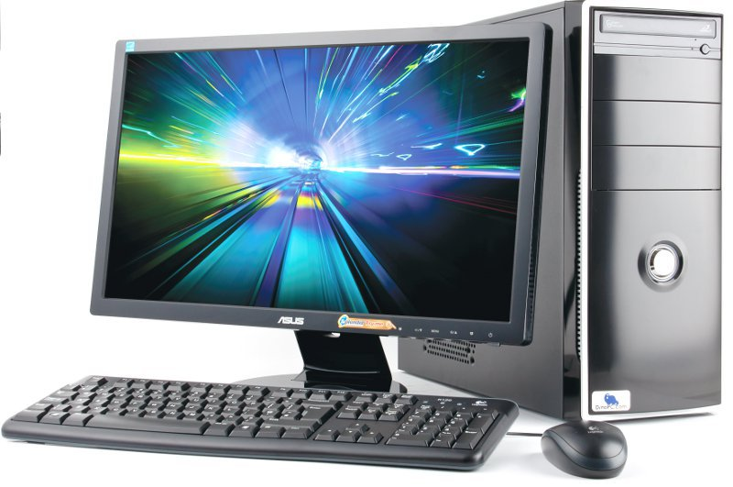
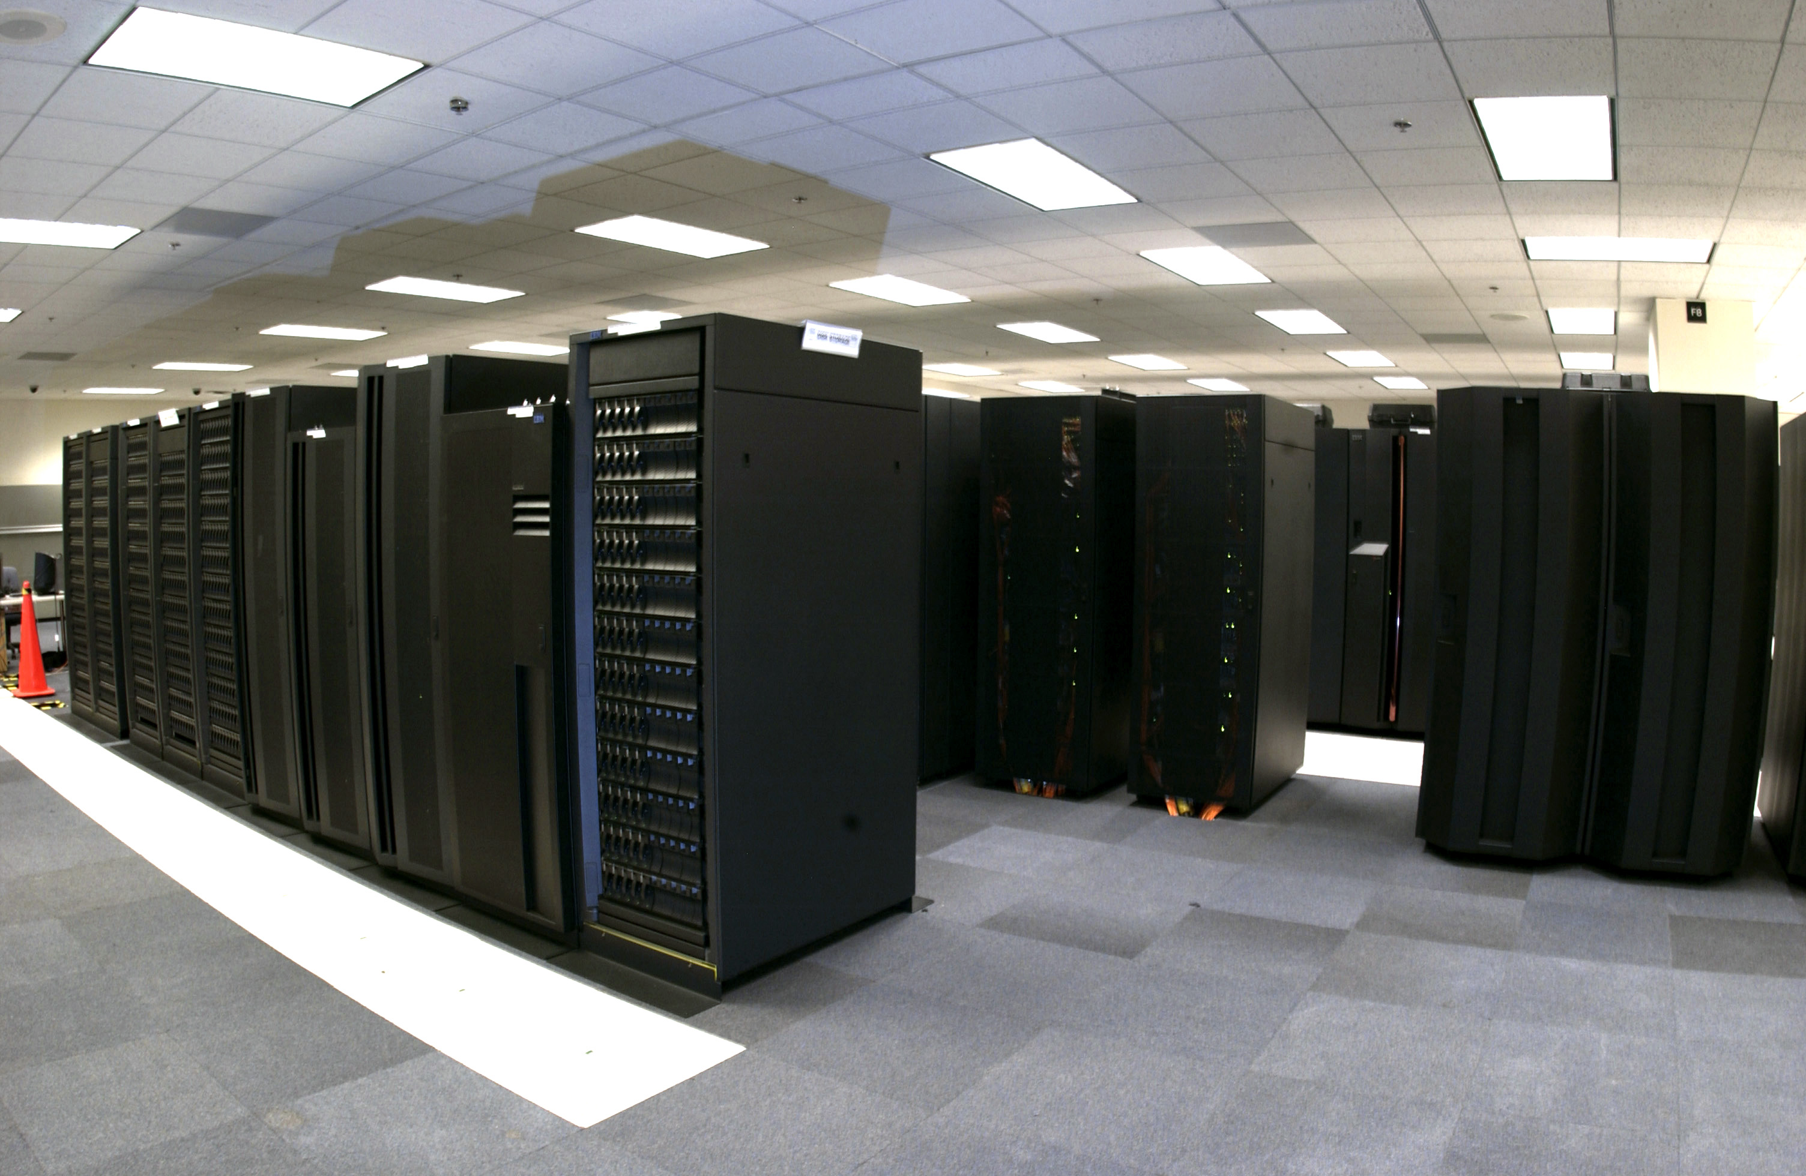

About Different Computers
The functionality (what can be computed) of all computers is the same, they only differ in the time required to complete the computation, and their cost
Equivalent to a Turing machine
Computational problem solving is about designing computations under certain constraints
Time to compute a result
Cost of the computer
Energy required to complete the computation
Memory needed to compute a result

