Slide 1
Welcome to CX 4010 / CSE 6010 Computational Problem Solving
Instructor: Elizabeth Cherry
For use in Fall 2020 CSE6010/CX4010 only
Not for distribution

Slide 2
The Adventure Begins
This is going to be an interesting semester, but I’ll be with you every step of the way and we will make it work!
My guiding principles:
Certainty: no big surprises (dates set, consistent format)
Responsiveness: small adjustments: will try to support what will make this easier for you
Flexibility in grading: built-in ways to account for bad days
Flexibility in general: I care about your health and your individual situations

Slide 3
Meeting Schedule
This is a hybrid course and we will be operating in “hybrid with touchpoints” mode
We will mostly be online: recorded lectures, electronic assessment and assignment submission, online interactions (ready for a possible move to fully remote)
We will only meet on campus a few times
I will seek your input for what to do in these meetings
Attendance will not be taken
I am trying to incorporate opportunities for you to participate and will seek your input regarding ways I can help you to feel connected to the course and to each other

Slide 4
Learning Outcomes
Identify suitable algorithms and data structures for solving specified computational problems
Translate knowledge of algorithms and data structures into operational software
Utilize software engineering best practices such as modularity and appropriate programming style and documentation to develop software
Develop software that executes efficiently on modern computer architectures by understanding key concepts of algorithm complexity and computer systems and how software is executed on modern machine architectures
Develop software able to execute on multiple processor systems by addressing issues arising from concurrent execution.

Slide 5
Course Structure
Tuesdays (mostly Cormen book)
Thursdays (mostly Patt&Patel book)
Data structures
Analysis of algorithms
Computer architecture and operating systems
Software development in C
If this sounds familiar (if you are a CS or ECE student), maybe you should not be taking this course!
Course is aimed at non-CS/ECE students with 1-2 previous programming/CS courses
But you should have some prior programming experience

Slide 6
Teaching Style
The slides will include opportunities for active learning that you are highly encouraged to take advantage of.
Each lecture will include blue slides that have problems for you to try.
I highly recommend you pause playback when you reach a blue slide and continue only after you have tried to work on the problem on your own.
Solutions will be given after.

Slide 7
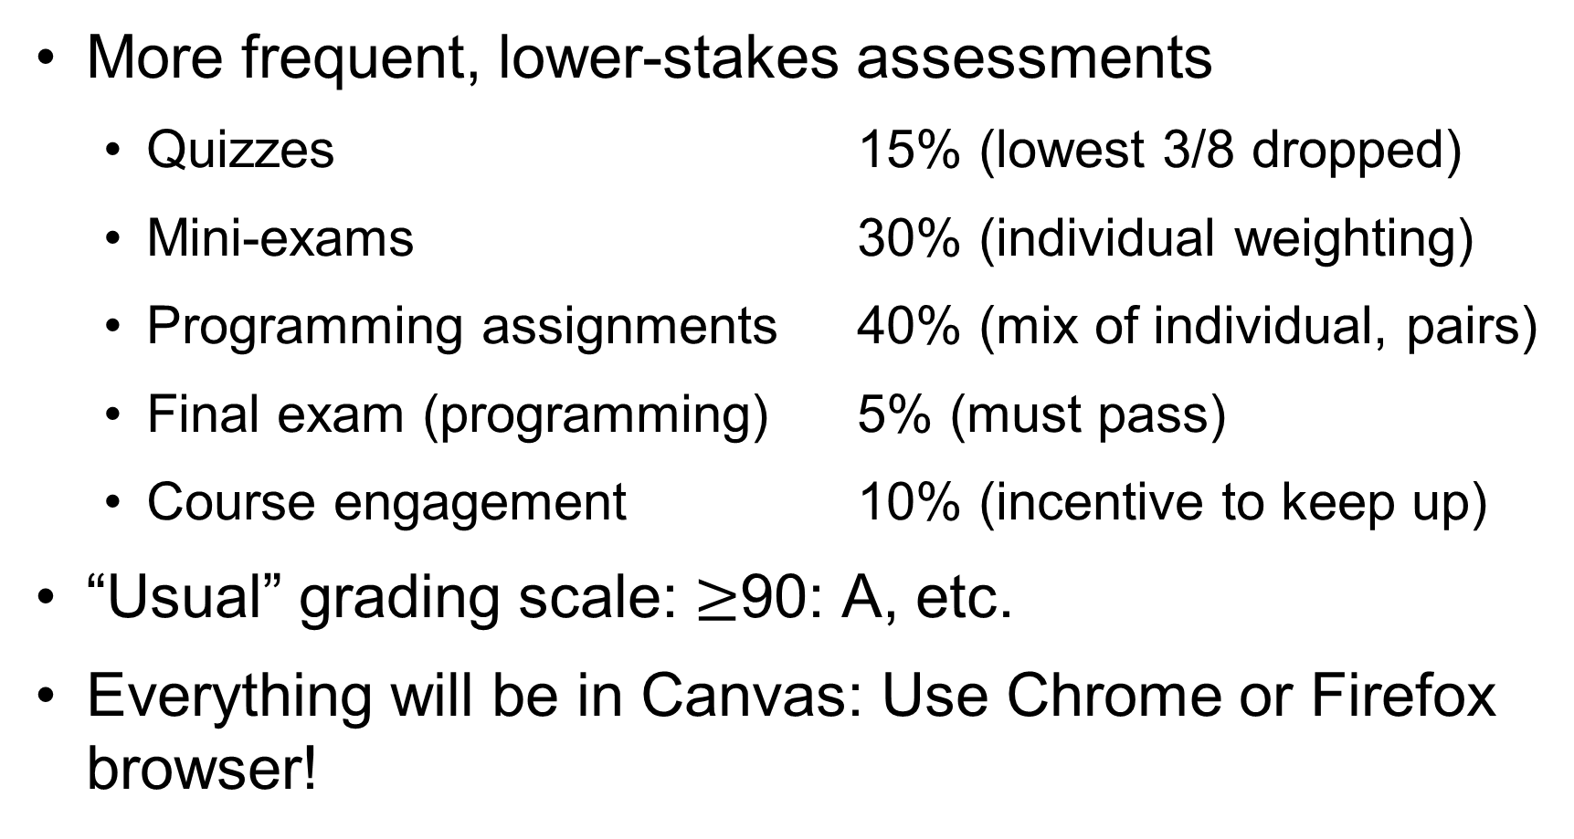
Assessment
More frequent, lower-stakes assessments
Quizzes 15% (lowest 3/8 dropped)
Mini-exams 30% (individual weighting)
Programming assignments 40% (mix of individual, pairs)
Final exam (programming) 5% (must pass)
Course engagement 10% (incentive to keep up)
“Usual” grading scale: $≥$90: A, etc.
Everything will be in Canvas: Use Chrome or Firefox browser!

Slide 8
Late Policy
Programming assignments will be due at 11:59pm Eastern time. (You may want to set your course time zone to US Eastern if you are not located in this time zone: Course settings -> Time zone)
Automatic 48-hour grace period: no approval needed
Quizzes and exams: make-up only for extenuating circumstances (dropped quizzes, weighted exams)

Slide 9
Course Materials
We will primarily use 2 textbooks and will use parts of 3 others
All but 1 can be accessed electronically through GT library; the last (Patt&Patel) is an older edition and should be affordable for rent/purchase
You will need a computer for programming assignments; many ways to get set up depending on your OS choice

Slide 10
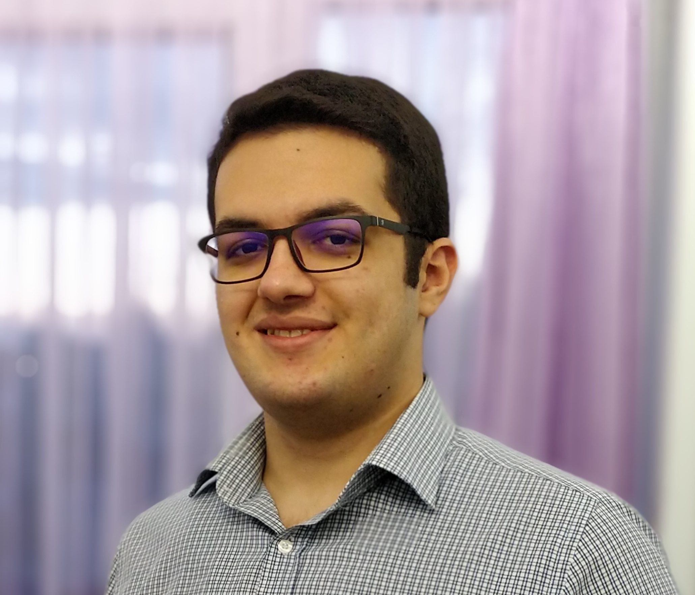
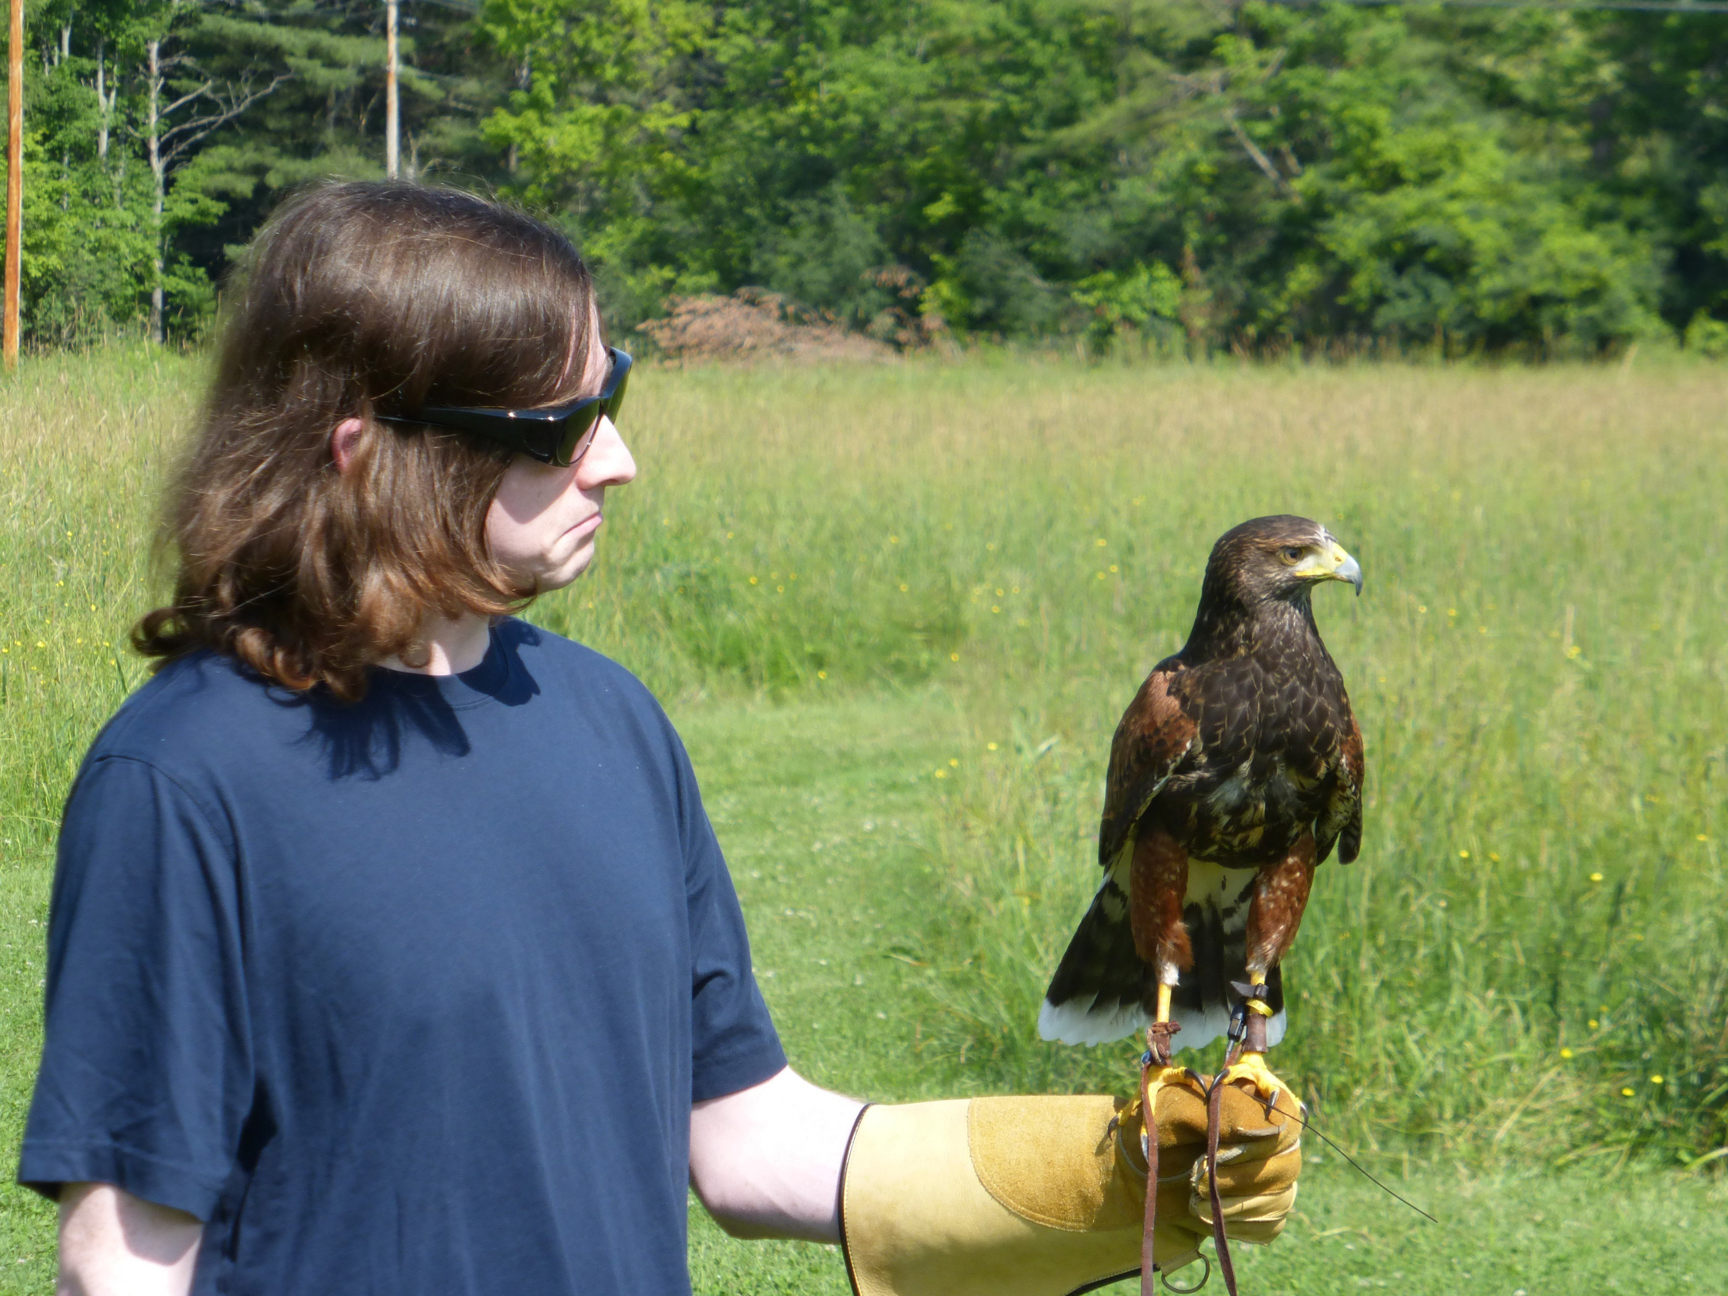
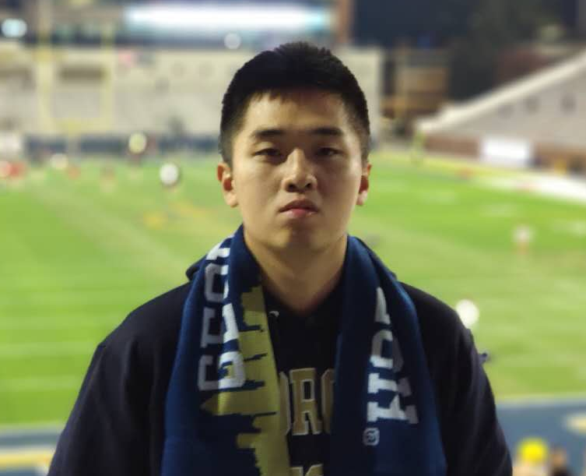
Support: C Programming
TAs:
Piazza encouraged for programming questions
Office hours
Mucahid Benlioglu | Darby Cairns | Hanning Chen

Slide 11
Academic Integrity
Working together is encouraged (study groups, Piazza) … but …
All work you turn in must be written entirely by you; see Syllabus in Canvas for more details on why
Copying code from the web or from others violates the Honor Code
If you are unsure what is permissible, ask the instructor or a TA

Slide 12
Other Items
Practice proper etiquette in discussions/interactions
Make sure you discuss accommodations with me
We are committed to creating an inclusive learning environment
The Syllabus in Canvas includes more details and a list of campus Resources you may find useful
There is a Syllabus “Quiz” course engagement activity for you to take to ensure you understand the syllabus

Slide 13
Stay Healthy!
Follow GT and public health guidelines!
Don’t come to campus if you feel sick.

Slide 14
Advice on How to Succeed in This Course
For the lecture-based part:
Pause to try the problems/questions in the lectures.
Try the suggested practice problems—at least review them, since many quiz/mini-exam questions will be drawn from them.
Keep up—don’t fall behind!
For the programming assignments:
Start early! Ask the TAs sooner rather than later if you don’t know how to start.
Break the problem into pieces. Start with something tiny and make sure your code compiles and runs, then progressively add functionality.
Forget about the grace period. Only use it if you need it.
For both:
Use Piazza.
Ask questions in office hours.

