Slide 1
Combinational Logic Continued; Memory and Sequential Circuits Part 1: Boolean Functions
For use in Fall 2020 CSE6010/CX4010 only
Not for distribution

Slide 2
Road Map
materials
✔
electricity
✔
transistors
✔
circuits
✔
logic gates
✔
combinational logic
Memory
Sequential circuits
Central processing unit (CPU)
(microprocessors)

Slide 3
Boolean Functions
Goal: Design a circuit to implement an arbitrary Boolean function on n binary inputs:
y = f (x₁, x₂, … x_{n})
x₁
f()
x₂
x₃
y
…
x_{n}

Slide 4
Example: Adder Circuit
Binary addition: Add two n-bit numbers
A_{n-1} … A₁A₀ + B_{n-1} … B₁B₀ -> S_{n-1} … S₁S₀
C_{i+1}
C_{i}
carry
Ripple Carry Adder
A_{i}
0 0 1 1 0 1
0 0 1 1 0 0
0 1 1 0 0 1
B_{i}
A_{n-1}
B_{n-1}
A₁
B₁
A₀
B₀
+
C_{n}
C_{n-1}
…
C₂
C₁
C₀
S_{i}
FA
FA
FA
1 bit adder: full adder (FA)
Inputs: A_{i}, B_{i}, C_{i}
Outputs: S_{i}, C_{i+1}
S_{n-1}
S₁
S₀
A_{i}
B_{i}
Assuming 2’s complement:
What is C₀?
What do we do with C_{n}?
C_{i+1}
FA
C_{i}
Our strategy for addition is to develop a Boolean function (and then a circuit) whose output is equivalent to addition
S_{i}
Notes:
Related: How do we detect overflow?

Slide 5
Example: Sum Output
Consider addition with inputs A_{i} and B_{i} along with a carry bit C_{i}. Determine the corresponding sum bit S_{i} and the next carry bit C_{i+1}.
A_{i} B_{i} C_{i}
S_{i}
C_{i+1}

Slide 6
Example: Sum Output
A_{i} B_{i} C_{i}
0 0 0
0 0 1
0 1 0
0 1 1
1 0 0
1 0 1
1 1 0
1 1 1
S_{i}
0
1
1
0
1
0
0
1
C_{i+1}
0
0
0
1
0
1
1
1

Slide 7
Full Adder: Sum Output
A_{i} B_{i} C_{i}
0 0 0
0 0 1
0 1 0
0 1 1
1 0 0
1 0 1
1 1 0
1 1 1
S_{i}
0
1
1
0
1
0
0
1
S_{i} = A_{i}B_{i}C_{i}
+ A_{i}B_{i}C_{i} + A_{i}B_{i}C_{i} + A_{i}B_{i}C_{i}
A
B
C
A
B
C
Output
A
B
C
A
B
C
Any logic function can be completely specified by a truth table
Any truth table can be converted to a Boolean equation
Any Boolean equation can be implemented by a circuit
Therefore, any logic function can be realized with a circuit
Caveats: (1) In practice, number of inputs (fanin), outputs (fanout) for a gate limited, but there are ways around this; (2) above approach may not yield optimal circuits in terms of number of gates or delay

Slide 8
Canonical Sum of Products Form
A_{i} B_{i} C_{i}
0 0 0
0 0 1
0 1 0
0 1 1
1 0 0
1 0 1
1 1 0
1 1 1
S_{i}
0
1
1
0
1
0
0
1
Every row whose output is one gets a term; these terms are added (OR’d)
Each term is the product (AND) of each input or its complement (whichever is 1) with the other inputs (or their complements)
minterm
S_{i} = A_{i}B_{i}C_{i}
+ A_{i}B_{i}C_{i} + A_{i}B_{i}C_{i} + A_{i}B_{i}C_{i}
Canonical sum of products representation
Boolean equation is a sum (i.e., or) of product terms (i.e., and)
Each product term includes all input variables, either complemented or not complemented (aka minterm)
One can often derive simpler Boolean equations which typically leads to fewer gates (not discussed here)
Methods exist to minimize the number of gates

Slide 9
Full Adder Circuit
A
B
C
A_{i} B_{i} C_{i}
0 0 0
0 0 1
0 1 0
0 1 1
1 0 0
1 0 1
1 1 0
1 1 1
S_{i}
0
1
1
0
1
0
0
1
C_{i+1}
0
0
0
1
0
1
1
1
A
B
C
S_{i}
A
B
C
A
B
C
A
B
C
A
B
C
C_{i+1}
A
B
C
2³=8 different input combinations
4 lead to S_{i}=1
4 lead to C_{i+1}=1
1 overlaps; 1 results in S_{i}=C_{i+1}=0
A
B
C

Slide 10
Examples: Circuits ⬄ Truth Tables
A
B
Z
Write the truth table that corresponds to the circuit.
A
B
A
B
A_{i} B_{i}
0 0
0 1
1 0
1 1
Z
1
1
0
0
Draw the circuit that corresponds to the truth table.

Slide 11
Examples: Circuits ⬄ Truth Tables
A_{i} B_{i}
0 0
0 1
1 0
1 1
Z
1
1
0
1
A
B
Z
A
B
A
B
A_{i} B_{i}
0 0
0 1
1 0
1 1
Z
1
1
0
0
A
B
Z
A
B

Slide 13
Combinational Logic Continued; Memory and Sequential Circuits Part 2: Combinational Logic Ciruits
For use in Fall 2020 CSE6010/CX4010 only
Not for distribution

Slide 14
DeMorgan’s Law
A or B is equivalent to not (not A and not B)
E.g.: “The pen is red or blue” is equivalent to “it is not the case that the pen is both not red and not blue”
A+B = AB
This:
is equivalent to
Start with OR function:
Complement inputs
Perform an AND
Complement output
A B A+B
0 0 0
0 1 1
1 0 1
1 1 1
A
1
1
0
0
B
1
0
1
0
AB
1
0
0
0
AB
0
1
1
1
One can create an equivalent circuit by (1) converting an OR gate into an AND gate and (2) complement the gate’s inputs and outputs
It can be shown: one can also create an equivalent circuit by (1) converting an AND gate to an OR gate and (2) complementing the gate’s inputs and outputs

Slide 15
Applying DeMorgan’s Law
Output = ABC + ABC + ABC + ABC
Replace OR gate with a NAND gate with complemented inputs
A
B
C
A
B
C
A
B
C
A
B
C
Output
Output
A
B
C
A
B
C
A
B
C
A
B
C
We can implement any logic circuit using only NAND gates
Inverter is a NAND gate with a single input (equivalent to X nand X)
Recall our CMOS circuits readily implemented NAND (and NOR), but AND (and OR) required an extra inverter
NAND implementation faster, requires less silicon area than AND/OR

Slide 16
NAND-Only Full Adder Circuit
Original
NAND-only
A
B
C
A
B
C
A_{i} B_{i} C_{i}
0 0 0
0 0 1
0 1 0
0 1 1
1 0 0
1 0 1
1 1 0
1 1 1
S_{i}
0
1
1
0
1
0
0
1
C_{i+1}
0
0
0
1
0
1
1
1
A
B
C
A
B
C
S_{i}
S_{i}
A
B
C
A
B
C
A
B
C
A
B
C
A
B
C
A
B
C
A
B
C
C_{i+1}
A
B
C
C_{i+1}
A
B
C
A
B
C
A
B
C
A
B
C

Slide 17
Fast Addition
A_{n-1}
B_{n-1}
A₁
B₁
A₀
B₀
Ripple
Carry
Adder
C_{n}
C_{n-1}
…
C₂
C₁
C₀
FA
FA
FA
S_{n-1}
S₁
S₀
Assume delay of 𝝉 for a signal to travel through a single gate
How many gate delays for one addition (Big-O)?
Carry Lookahead (CLA) adder
Cluster full adders into groups (e.g., 4 full adders per group)
CLA circuit computes carry out of a group of full adders quickly
CLA tree can perform N-bit addition in O(log N) gate delays
CLA
CLA
FA
FA
FA
FA
FA
FA
FA
FA
FA
FA
FA
FA

Slide 18
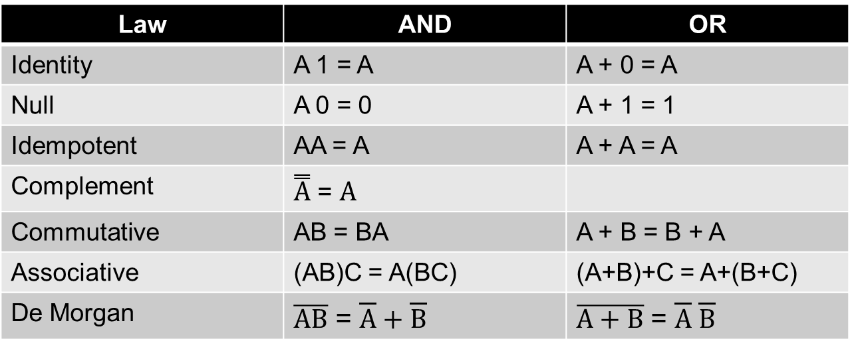
Useful Boolean Algebra Laws
A, B, and C are Boolean variables
Law | AND | OR
Identity | A 1 = A | A + 0 = A
Null | A 0 = 0 | A + 1 = 1
Idempotent | AA = A | A + A = A
Complement | $\overset{̿}{A}$ = $A$
Commutative | AB = BA | A + B = B + A
Associative | (AB)C = A(BC) | (A+B)+C = A+(B+C)
De Morgan | $\overline{AB}$ = $\overline{A}+\overline{B}$ | $\overline{A+B}$ = $\overline{A} \overline{B}$
De Morgan’s Law: the gates within each box are equivalent
NAND
NOR

Slide 19
Logical Completeness
For any Boolean logic function a circuit realization can be obtained using AND, OR, NOT gates
The set {AND, OR, NOT} is said to be logically complete (sufficient to implement any Boolean function)
The set {NAND} is also logically complete
Convert OR into (NOT A) NAND (NOT B)
NOT
AND
OR
One can show that {NOR} is logically complete
Logical completeness + memory allow one to create a machine that can compute anything that is computable (Turing machine)

Slide 20
Arithmetic / Logic Unit (ALU)
A
(n bits)
B
(n bits)
Op
(operation)
n-bit ALU
R
(n bits)
Generalization of adder circuit that can perform
Arithmetic (addition, subtraction)
Logic operations (AND, OR, NOT)
More sophisticated ALUs can perform multiplication, division, however these operations take much longer to perform

Slide 21
Combinational Logic Circuits
The circuits discussed so far are called combinational logic circuits
Combinational
Logic
Outputs
y₁,y₂, … y_{s}
y_{i} = f_{i} (x₁,x₂, … x_{r})
Inputs
x₁,x₂, … x_{r}
Properties
No feedback signals
Output only a function of current inputs; change the inputs and the outputs immediately (ignoring circuit delays) change
No memory; output independent of previous operations and inputs

Slide 22
Summary
Boolean Algebra enables us to create arbitrary Boolean functions from logic gates (logical completeness)
Logic functions enable us to implement basic computational operations (e.g., arithmetic)

Slide 24
Combinational Logic Continued; Memory and Sequential Circuits Part 3: Memory and Sequential Circuits
For use in Fall 2020 CSE6010/CX4010 only
Not for distribution

Slide 25
Road Map
materials
✔
electricity
✔
transistors
✔
circuits
✔
logic gates
✔
combinational logic
memory
✔
sequential circuits
central processing unit (CPU)
(microprocessors)

Slide 26
Clock Signal
A
Ā
A
Ā
Clock
𝝉
Introduce feedback
A=Ā ???
𝝉 = switching time of gate
A_{next}=Ā
clock cycle
‘1’
Clock
‘0’
3𝝉
time→
Clock signal used in all CPUs today
“Advertised” clock rate indicates the frequency of this clock signal, e.g. 1.0 GHz, or 1 nanosecond (10⁻⁹ second) clock cycle time
Used in synchronous circuits (state machines)
Asynchronous circuits do not use a clock

Slide 27
Memory: D Latch (aka D Flip Flop)
‘1’
Stores 1 bit of information
Inputs:
D: data input
WE: write enable
State only changes on rising edge of clock (C)
Output:
Q: data stored
‘0’
time→
clock
signal
C
D
Q
WE
D Latch
(flip flop)
C WE D Q operation
1 d d write D into flip flop storage
0 - q maintain current state (no action)
- - q maintain current state
anything
else

Slide 28
n-Bit Register
WE
D₀
WE
D
Q₀
Q
WE
D₁
D
Q
Q₁
WE
D₂
D
Q
Q₂
D
Q
WE
…
…
D_{n-1}
D
Q
Q_{n-1}
WE
Clock signal not shown
A register is an array of D flip flops
WE=1: write data (D) into register (next rising edge of clock)
WE=0: register retains data last written into it

Slide 29
Random Access Memory (RAM)
Circuit view
Logical view
D: data
A: address
DI (k bits)
k
bits
Write
RAM
Read
2^{n}
registers
A
(n bits)
DO (k bits)
Array of registers (2D array of D flip flops)
2^{n} registers each holds a single “chunk” of data (k bits)
Can read or write a single “chunk” at a time
Control lines: Read, Write (assert to read/write data at address A)
Address: n-bit binary number indicating which chunk (2^{n} chunks)

Slide 30
Binary and Unary Encoding
Given a set of N items: 0, 1, 2, … N-1
We want to select one of them
Example, N=8
0
1
2
3
4
5
6
7
Binary encoding: 011
Unary encoding:
0 0 0 1 0 0 0 0
Decoder circuit converts binary encoding to unary

Slide 31
Decoder: Circuit to Select a Register from a Binary Number
A
B
C
1 if ABC=000, 0 otherwise
A
B
C
1 if ABC=001, 0 otherwise
address
select lines
A
B
C
1 if ABC=010, 0 otherwise
A
B
C
1 if ABC=011, …
A
B
C
1 if ABC=100, …
n inputs, 2^{n} outputs
Exactly one output is asserted (1) for any possible input (other outputs not asserted, i.e., are 0)
Used in memory components to select a memory location
A
B
C
1 if ABC=101, …
A
B
C
1 if ABC=110, …
A
B
C
1 if ABC=111, …

Slide 32
RAM Implementation
8x4 RAM
Read
Write
DI₃
DI₂
DI₁
DI₀
…
…
D
D
D
D
decoder
Q
Q
Q
Q
address
WE
WE
WE
WE
…
…
Switch
DO₃
DO₂
DO₁
DO₀
C = 0 open
C = 1 closed
Static RAM: implement each D flip flop with gates

Slide 33
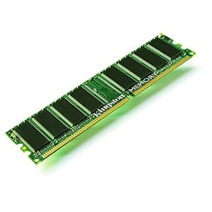
Dynamic RAM
DRAM Cell
Data Line
Select Line
Capacitor
DRAM circuit board
Interface similar to that defined already (addr, data, rd/wr)
Capacitor has ability to store charge
0: no charge stored on capacitor
1: charge stored on capacitor
Reading cell discharges capacitor (if it held a charge)
Charge “leaks” from capacitor
Additional circuitry required to periodically “refresh” data (read data and immediately write it back)

Slide 34
SRAM vs. DRAM
Static RAM
Dynamic RAM
Retains data as long as the circuit continues to receive power
Fast access time for read and write operations
Requires more Si area than DRAM
Used in processor registers, register file, fast memory (cache)
Charge must be “refreshed” to retain data, even with continuous power
Slower access time for read and write operations
Very compact, high density (more bits/unit Si area)
Used in “main memory” for processor
Other types of memory:
ROM, PROM, Flash, disk/tape: retain data w/o power

Slide 35
Observations
Memory implemented as NxM array of bits
N always a power of 2 (binary address)
M typically a power of 2 also (e.g., 32 or 64 bits) sometimes called a “word”
Computers designed to only operate on a few specific sizes of data; sizes which can be easily packed into M bit words
8 bits (byte): character
16 bits: short integer
32 bits: integer, single precision floating point
64 bits: double precision floating point

Slide 36
Road Map
materials
✔
electricity
✔
transistors
✔
circuits
✔
logic gates
✔
combinational logic
memory
✔
✔
sequential circuits
central processing unit (CPU)
(microprocessors)

Slide 37
Sequential vs. Combinational Circuits
Combinational Circuits
Outputs only depend on current input
Output same, independent of time
Circuit has no memory (no feedback)
Sequential Circuits (aka state machines)
Contains memory within the circuit
Output can depend on past inputs (history)
Mealy machine: Output depends on current state and current inputs (not used here)
Moore machine: Output depends on current state only

Slide 38


Combinational vs. Sequential
Two types of “combination” locks
Combinational
Success depends only on the values, not the order in which they are set.
Sequential
Success depends on the sequence of values
(e.g, R-13, L-22, R-3).
Combinational: no internal memory
Sequential requires “remembering” previous input values; the memory is internal to the lock

Slide 39
Sequential Circuits (aka Finite State Machines [FSM])
inputs
combinational logic
(output function)
f_{o}
outputs
state
register
combinational logic
(next state function)
f_{ns}
next
state
current
state
Two key functions must be determined
Next state function: f_{ns} (current state, input)
Output function: f_{o} (current state)

Slide 40
Finite State Machine Design
The behavior of combinational logic is specified by a truth table
The behavior of a finite state machine is specified by a state diagram
Finite state machine design procedure
Develop state diagram
Determine next state function (comb. logic)
Determine output function (comb. logic)

Slide 41
Example: Candy Machine
Design controller for a vending machine
Candy costs $0.15
Input signals
N: asserted (is ‘1’) if $0.05 coin inserted
D: asserted if $0.10 coin inserted
At most one input asserted at a time
N/D ignored while candy being dispensed
Output signal
C: asserted for 1 clock cycle to dispense candy
No other coins are accepted
Machine gives no change!

Slide 42
State Diagram
Try to put together the pieces for a state diagram for this setup.
What are the states for the system?
What are the transitions that can exist among the states?
Hint: aim for 4 states and 9 transitions. Note that a transition can include staying in the same state!
Design controller for a vending machine
Candy costs $0.15
Input signals
N: asserted (is ‘1’) if $0.05 coin inserted
D: asserted if $0.10 coin inserted
At most one input asserted at a time
N/D ignored while candy being dispensed
Output signal
C: asserted for 1 clock cycle to dispense candy
No other coins are accepted
Machine gives no change!

Slide 43
State Diagram
What are the states for the system?
0 cents accepted
5 cents accepted
10 cents accepted
>=15 cents -> triggers candy release
What are the transitions that can exist among the states?
From 0 cents, to 5 or 10 cents.
From 5 cents, to 10 or candy.
From 10 cents, to candy.
From candy, to 0 cents.
From 0/5/10 cents, can stay put.
Design controller for a vending machine
Candy costs $0.15
Input signals
N: asserted (is ‘1’) if $0.05 coin inserted
D: asserted if $0.10 coin inserted
At most one input asserted at a time
N/D ignored while candy being dispensed
Output signal
C: asserted for 1 clock cycle to dispense candy
No other coins are accepted
Machine gives no change!

Slide 44












State Diagram
Circle indicates a state
Output specified in state
Arc indicates state transition
Arc label: <input>
Assign each state a unique binary value (state assignment)
Candy
C=1
11
C=1
$$\overline{N}$$
$$\overline{N}$$
$$\overline{D}$$
$$\overline{D}$$
start
00
$$N$$
$$N$$
$$\overline{N}$$
$$\overline{N}$$
$$\overline{D}$$
$$D$$
$$\overline{D}$$
$$D$$
$.05
$$D$$
01
$$D$$
$$N$$
$$N$$
$$\overline{N}$$
$$\overline{N}$$
$$\overline{D}$$
$$\overline{D}$$
$.10
10
$$N+D$$
$$N+D$$

Slide 45
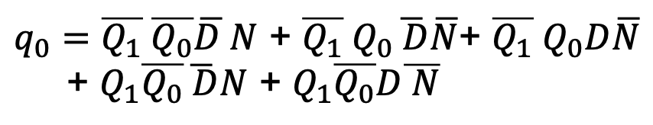
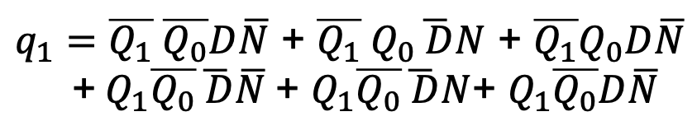


Next State and Output Functions
11
C=1
Current State = Q₁Q₀
Next State = q₁q₀
One coin at a time: D and N cannot both be 1, so 12 states, not 16
$$\overline{N}$$
$$\overline{D}$$
00
Q₁ Q₀ D N q₁ q₀ C
0 0 0 0
0 0 0 1
0 0 1 0
0 1 0 0
0 1 0 1
0 1 1 0
1 0 0 0
1 0 0 1
1 0 1 0
1 1 0 0
1 1 0 1
1 1 1 0
0 0 0
0 1 0
1 0 0
0 1 0
1 0 0
1 1 0
1 0 0
1 1 0
1 1 0
0 0 1
0 0 1
0 0 1
$$N$$
$$\overline{N}$$
$$\overline{D}$$
$$D$$
01
$$D$$
$$N$$
$$\overline{N}$$
$$\overline{D}$$
10
$$N+D$$
$q_{1}=\overline{Q_{1}} \overline{Q_{0}}D\overline{N}$ + $\overline{Q_{1}} Q_{0}\overline{ D}N$ + $\overline{Q_{1}}Q_{0}D\overline{N}$
+$Q_{1}\overline{Q_{0}}\overline{ D}\overline{N}$+ $Q_{1}\overline{Q_{0}}\overline{ D}N$+ $Q_{1}\overline{Q_{0}}D\overline{N}$
$q_{0}=\overline{Q_{1}} \overline{Q_{0}}\overline{D }N$ + $\overline{Q_{1}} Q_{0}\overline{ D}\overline{N}\text{+ }\overline{Q_{1}} Q_{0}D\overline{N}$
+ $Q_{1}\overline{Q_{0}}\overline{ D}N$ + $Q_{1}\overline{Q_{0}}D\overline{ N}$
$$C={ Q1 Q}_{0}$$

Slide 46
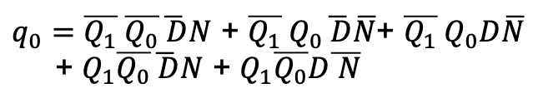
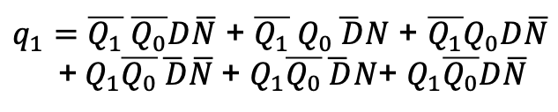

Candy Machine Circuit
C
$q_{1}=\overline{Q_{1}} \overline{Q_{0}}D\overline{N}$ + $\overline{Q_{1}} Q_{0}\overline{ D}N$ + $\overline{Q_{1}}Q_{0}D\overline{N}$
+$Q_{1}\overline{Q_{0}}\overline{ D}\overline{N}$+ $Q_{1}\overline{Q_{0}}\overline{ D}N$+ $Q_{1}\overline{Q_{0}}D\overline{N}$
$q_{0}=\overline{Q_{1}} \overline{Q_{0}}\overline{ D}N$ + $\overline{Q_{1}} Q_{0}\overline{ D}\overline{N}\text{+ }\overline{Q_{1}} Q_{0}D\overline{N}$
+ $Q_{1}\overline{Q_{0}}\overline{ D}N$ + $Q_{1}\overline{Q_{0}}D\overline{ N}$
q₁
$$C={ Q1 Q}_{0}$$
q₀
current state
Q₁
Q₀
D N
Clock,WE=1
next state

Slide 47
Time to Complete FSM Operations
State diagram can be used to determine time to perform operations
A state transition arc is followed each clock cycle
Example (assume 1 Hz clock)
State 00: 4 clocks waiting*, then N is asserted (5 clock cycles)
State 01: 3 clocks waiting*, then D is asserted (4 clock cycles)
State 11: 1 clock cycle
Total: 10 clock cycles or 10 seconds
11
C=1
$$\overline{N}$$
$$\overline{D}$$
00
$$N$$
$$\overline{N}$$
$$\overline{D}$$
$$D$$
01
$$D$$
$$N$$
$$\overline{N}$$
$$\overline{D}$$
10
$$N+D$$
* 3 and 4 are arbitrary values used for this example

Slide 48
Summary
Memory
Organized as a 2D array of 1-bit cells
Well suited for fixed-sized data (e.g., 32 bits)
Sequential circuits needed whenever output depends on prior inputs (memory)
Sequential circuit design
Construct state diagram
Design next state function (combinational logic)
Design output function (combinational logic)
Put it all together (state register, next state function, output function)

