Slide 1
Shortest Path Algorithms Part 1: Overview
For use in Fall 2020 CSE6010/CX4010 only
Not for distribution

Slide 2
Outline
Basic concepts
Bellman-Ford algorithm: Relaxation
Dijkstra’s algorithm

Slide 3
Problem Statement
Given an undirected Graph G = (V, E)
V = Vertex set = {0, 1, 2, … n-1}
E = Edge set = {(v_{i}, v_{j}) where v_{i}, v_{j} ∈ V and an edge exists between v_{i} and v_{j}}
w(v_{i}, v_{j}) = non-negative weight of edge (v_{i}, v_{j})
Path p is a sequence of distinct vertices (v₀, v₁, v₂ … v_{m-1}) where (v_{i}, v_{i+1}) ∈ E
A distance d = Σ_{i=0,m-2} w(v_{i}, v_{i+1}) (sum of weights of edges along path)
0
420
1
175
150
2
400
3
Example:
Path 0, 1, 3, 4: d=670
100
4
Find the minimum weight path from vertex s₀ to every other vertex

Slide 4
Breadth-first Search Revisited
Consider breadth-first search, with link distance any positive value (not necessarily 1)
0
1
0
1
-
0 is black
2 is gray
No updates done
0
1
1
1
Update 1, color gray
Update 2, color gray
0 becomes black
3
10
1+3 < 10
Update node 2 to 4
2
10
-
10
10
Incorrect distance computed
Breadth-first search may not compute shortest (lowest-weight) path
Idea: rather than ignoring marked vertices, check if a better (shorter) path has been found, update if it has

Slide 5
Bellman-Ford Algorithm: Relaxation
Each vertex v stores:
v.d=minimum weight path from source node s₀ computed so far (upper bound on length of shortest path)
v.p=predecessor in minimum weight path computed so far
Basic idea: progressively compute better and better shortest path upper bounds until no further improvement occurs
Final state is referred to as a “fixed point”
Algorithm
Repeatedly scan through all edges in graph, updating d and p at each vertex by examining d at neighbor vertices

Slide 6
Relaxation Step
Node s₀
…
Node u
u.d
w
Node v
v.d
Check if shortest path to node v can be updated by using u as a predecessor
v.d is current estimate of shortest path from s₀ to v
u.d is current estimate of shortest path from s₀ to u
If u.d+w < v.d
The path through u is a better (shorter) path to v
Update v to use the path through u
Repeatedly apply this relaxation step to all edges, until no further improvement (shorter paths) can be computed
The result is we have computed the shortest path to all nodes

Slide 7
Relaxation Algorithm
// relaxation step for edge from vertex u to v
Relax (u,v)
if (u.d + w(u,v) < v.d)
v.d = u.d + w(u,v);
v.p = u;
return true
else return false;
// Initialization
for each vertex u: u.d=∞; u.p=NULL;
for source vertex s0: s0.d=0;
flag = true;
// Algorithm
while (flag) {
flag = false;
for each edge (x, y) {
if (Relax(x,y) or Relax(y,x)) flag=true;
}
}
Node s₀
…
Node u
u.d
w
Node v
v.d

Slide 8
Relaxation
We scan all edges in the graph and update d and p
We will do this multiple times
Let’s work through an example, and then we will discuss the algorithm stops and how many iterations are performed

Slide 10
Shortest Path Algorithms Part 2: Example
For use in Fall 2020 CSE6010/CX4010 only
Not for distribution

Slide 11
Execution Example
// relaxation for edge from u to v
Relax (u,v)
if (u.d + w(u,v) < v.d)
v.d = u.d + w(u,v);
v.p = u;
return true
else return false;
// Algorithm
while (flag) {
flag = false;
for each edge (x, y) {
if (Relax(x,y) or Relax(y,x))
flag=true; } }
Edge label:
<order of evaluation>:<edge weight>
Order of evaluation is specified in advance
Source (s₀) = 0
Changes circled just to call attention
2: d=420
p=0
5: d=420
p=0
2: d=420
p=0
5: d=420
p=0
No updates to
node 0 will occur
d=0
p=NULL
2: d=∞
p=NULL
5: d=420
p=0
0
5:420
1
d=∞
p=NULL
4:175
2:150
2
3:400
3
d=∞
p=NULL
1: d=∞
p=NULL
2: d=∞
p=NULL
3: d=∞
p=NULL
Algorithm will cycle through the edges again, but no further updates occur
Solution:
4<-0: 3, 1, 0 (670)
3<-0: 1, 0 (570)
2<-0: 0 (175)
1<-0: 0 (420)
4: d=175
p=0
3: d=∞
p=NULL
d=∞
p=NULL
1:100
1: d=∞
p=NULL
2: d=570
p=1
3: d=570
p=1
4
4: d=175
p=0
3: d=175
p=0
1: d=570
p=1
2: d=570
p=1
3: d=570
p=1
d=∞
p=NULL
4: d=175
p=0
3: d=175
p=0
1: d=∞
p=NULL
1: d=∞
p=NULL
1: d=670
p=3

Slide 12
Analysis of Relaxation Algorithm
Use the relaxation algorithm to repeat the previous example, this time using node 3 as the source node (keeping the same edge order). Track how the distances change with each iteration over all edges.
Is the algorithm guaranteed to terminate?
Does the algorithm compute the shortest path from s₀?
How much computation is required in each iteration?
How many iterations are needed in the worst case?
Can you think of how the algorithm could be more efficient?
0
5:420
1
4:175
2:150
2
3:400
3
1:100
4

Slide 13
Analysis of Relaxation Algorithm
Use the relaxation algorithm to repeat the previous example, this time using node 3 as the source node (keeping the same edge order). Track how the distances change with each iteration over all edges.
0
5:420
1
4:175
2:150
2
3:400
3
1:100
4
0 | 1 | 2 | 3 | 4
∞; NULL | ∞; NULL | ∞; NULL | 0; NULL | ∞; NULL
∞; NULL | 150; 3 | 400; 3 | 0; NIL | 100; 3
2; 575 1; 570 | 150; 3 | 400; 3 | 0; NIL | 100; 3

Slide 14
Analysis of Relaxation Algorithm
Is the algorithm guaranteed to terminate?
u.d is an upper bound of distance from s₀ to u
The algorithm repeatedly computes better (smaller) upper bounds for u.d (monotonically improves upper bound)
It must terminate because the shortest path distance is the true bound
Does the algorithm compute the shortest path from s₀?
Consider a shortest path s₀, v₁, v₂, … v_{m-1} from s₀ to v_{m-1}, and apply the relaxation step on each edge along this path in the order (s₀,v₁), (v₁,v₂), (v₂,v₃) … (v_{m-2},v_{m-1}). This will compute the distance of the shortest path from s₀ to v_{m-1}. This holds regardless of any other relaxation steps that occur, even if they are intermixed with other relaxations on the edges of this path.
It can be shown the algorithm correctly computes a shortest path based on this property; see [Cormen et al, p.653]

Slide 15
Analysis of Relaxation Algorithm (cont.)
How much computation is required in each iteration?
O(e) where e is the number of edges
How many iterations are needed in the worst case?
Distance of the shortest path is computed one hop at a time.
In the worst case, the shortest path will go through each node and each iteration adds only 1 edge to shortest path
Therefore, at most n-1 iterations will be needed where n is the number of vertices
Worst case, must call relax function e*(n-1) times (or 2*e*(n-1))
Can we be more efficient?
Edges far from s₀ will not be updated until later in the execution of the algorithm; process edges closer to s₀ first
Note the original relaxation algorithm is well suited for parallel processing

Slide 17
Shortest Path Algorithms Part 3: Dijkstra’s Algorithm
For use in Fall 2020 CSE6010/CX4010 only
Not for distribution

Slide 18
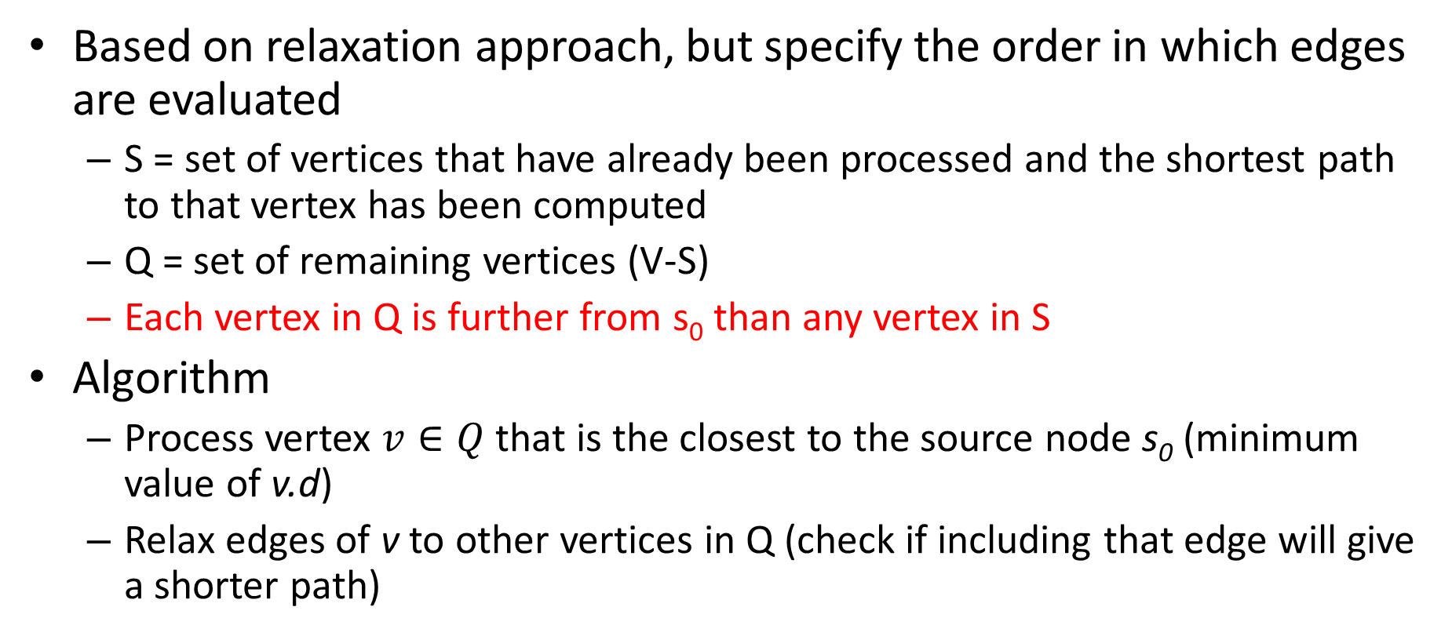
Dijkstra’s Algorithm: Main Ideas
Based on relaxation approach, but specify the order in which edges are evaluated
S = set of vertices that have already been processed and the shortest path to that vertex has been computed
Q = set of remaining vertices (V-S)
Each vertex in Q is further from s₀ than any vertex in S
Algorithm
Process vertex $v∈Q$ that is the closest to the source node s₀ (minimum value of v.d)
Relax edges of v to other vertices in Q (check if including that edge will give a shorter path)

Slide 19
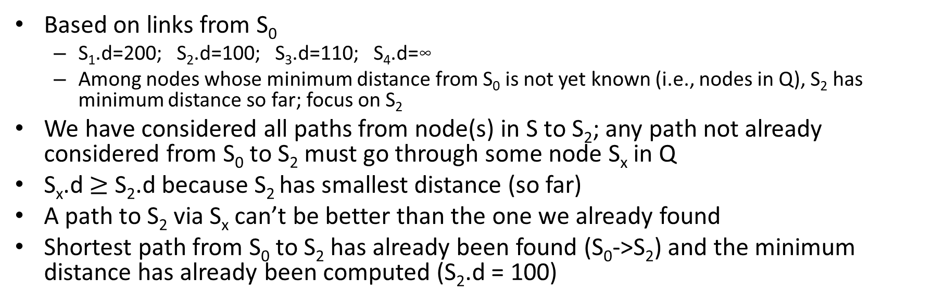
An Illustration
S
S₀
200
S₁
Q
Source: S₀
S₀.d=0
1
110
5
S₄
100
3
S₂
S₃
1
20
Based on links from S₀
S₁.d=200; S₂.d=100; S₃.d=110; S₄.d=∞
Among nodes whose minimum distance from S₀ is not yet known (i.e., nodes in Q), S₂ has minimum distance so far; focus on S₂
We have considered all paths from node(s) in S to S₂; any path not already considered from S₀ to S₂ must go through some node S_{x} in Q
S_{x}.d $≥$ S₂.d because S₂ has smallest distance (so far)
A path to S₂ via S_{x} can’t be better than the one we already found
Shortest path from S₀ to S₂ has already been found (S₀->S₂) and the minimum distance has already been computed (S₂.d = 100)

Slide 20
An Illustration
S
Q
S₀
200
S₁
Source: S₀
S₀.d=0
1
110
5
S₄
100
3
S₂
S₃
1
S₂.d=100
20
Based on links from S₀
S₁.d=200; S₂.d=100; S₃.d=110; S₄.d=∞
Among nodes whose minimum distance from S₀ is not yet known (i.e., nodes in Q), S₂ has minimum distance so far; focus on S₂
We have considered all paths from node(s) in S to S₂; any path not already considered from S₀ to S₂ must go through some node S_{x} in Q
S_{x}.d $≥$ S₂.d because S₂ has smallest distance (so far)
A path to S₂ via S_{x} can’t be better than the one we already found
Shortest path from S₀ to S₂ has already been found (S₀->S₂) and the minimum distance has already been computed (S₂.d = 100)

Slide 21
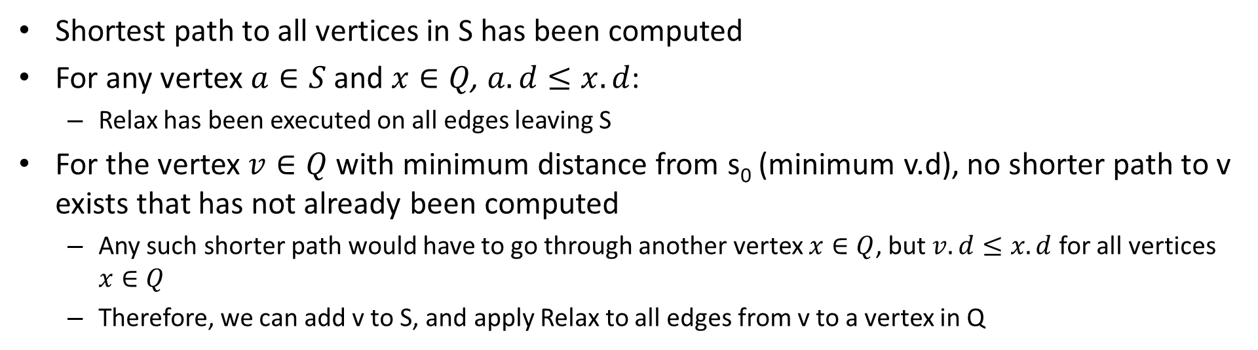
Dijkstra’s Algorithm: Intuition
x
s₀
Q
S
v
Shortest path to all vertices in S has been computed
For any vertex $a∈S$ and $x∈Q$, $a.d≤x.d$:
Relax has been executed on all edges leaving S
For the vertex $v∈Q$ with minimum distance from s₀ (minimum v.d), no shorter path to v exists that has not already been computed
Any such shorter path would have to go through another vertex $x∈Q$, but$v.d≤x.d$ for all vertices $x∈Q$
Therefore, we can add v to S, and apply Relax to all edges from v to a vertex in Q

Slide 22
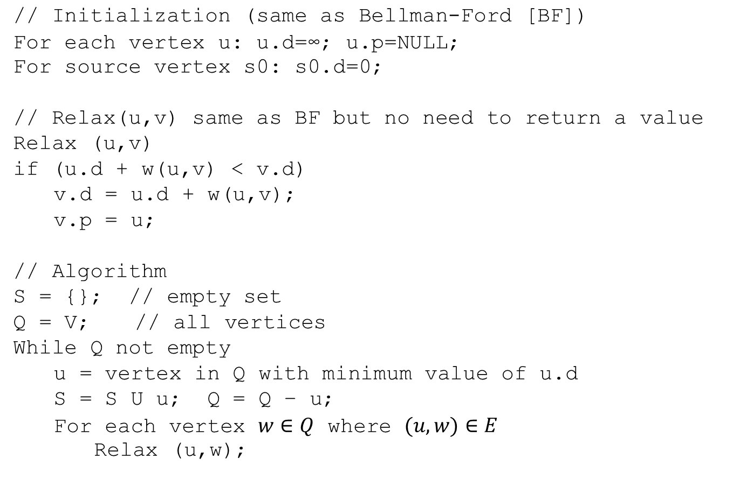
Dijkstra’s Algorithm
// Initialization (same as Bellman-Ford [BF])
For each vertex u: u.d=∞; u.p=NULL;
For source vertex s0: s0.d=0;
// Relax(u,v) same as BF but no need to return a value
Relax (u,v)
if (u.d + w(u,v) < v.d)
v.d = u.d + w(u,v);
v.p = u;
// Algorithm
S = {}; // empty set
Q = V; // all vertices
While Q not empty
u = vertex in Q with minimum value of u.d
S = S U u; Q = Q – u;
For each vertex $w∈Q$ where $(u,w)∈E$
Relax (u,w);

Slide 23
Execution Example
Edge label:
<edge number>:<edge weight>
Solution:
1<-0: 0 (420)
2<-0: 0 (175)
3<-0: 1, 0 (570)
4<-0: 3, 1, 0 (670)
d=0
p=NULL
5: d=420
p=0
Q:
0
1
2
3
4
0
5:420
1
d=∞
p=NULL
S:
0
2
1
3
4
4:175
2:150
2
3:400
3
d=∞
p=NULL
3: d=575
p=2
2: d=570
p=1
4: d=175
p=0
d=∞
p=NULL
1:100
4
d=∞
p=NULL
1: d=670
p=3

Slide 24
Example
Use Dijkstra’s algorithm to find the shortest paths from s₀ to each node. Include the distance to each node along with the specific path that gives that distance.
Repeat, but using s₃ as the source node.
S₀
200
S₁
1
110
5
S₄
100
3
S₂
S₃
1
20

Slide 25
Example
S₀
200
S₁
Source: S₀
S₀.d=0
1
110
5
S₄
100
3
S₂
S₃
1
20
S | Q | s0 | s1 | s2 | s3 | s4
NULL | s0 s1 s2 s3 s4 | 0; NULL | ∞; NULL | ∞; NULL | ∞; NULL | ∞; NULL
s0 | s1 s2 s3 s4 | 0; NULL | 200; s0 | 100; s0 | 110; s0 | ∞; NULL
s0 s2 | s1 s3 s4 | 0; NULL | 105; s2 | 100; s0 | 110; s0 | ∞; NULL
s0 s2 s1 | s3 s4 | 0; NULL | 105; s2 | 100; s0 | 108; s1 | 106; s1
s0 s2 s1 s4 | s3 | 0; NULL | 105; s2 | 100; s0 | 107; s4 | 106; s1
Shortest paths:
s1: 105; s1<-s2<-s0 s2: 100; s2<-s0 s3: 107; s3<-s4<-s1<-s2<-s0 s4: 106; s4<-s1<-s2<-s0

Slide 26
Example
S₀
200
S₁
Source: S₃
S₃.d=0
1
110
5
S₄
100
3
S₂
S₃
1
20
S | Q | s0 | s1 | s2 | s3 | s4
NULL | s0 s1 s2 s3 s4 | ∞; NULL | ∞; NULL | ∞; NULL | 0; NULL | ∞; NULL
s3 | s0 s1 s2 s4 | 110; s3 | 3; s3 | 20; s3 | 0; NULL | 1; s3
s3 s4 | s0 s1 s2 | 110; s3 | 2; s4 | 20; s3 | 0; NULL | 1; s3
s3 s4 s1 | s0 s2 | 110; s3 | 2; s4 | 7; s1 | 0; NULL | 1; s3
s3 s4 s1 s2 | s0 | 107; s2 | 2; s4 | 7; s1 | 0; NULL | 1; s3
Shortest paths:
s0: 107; s0<-s2<-s1<-s4<-s3 s1: 2; s1<-s4<-s3 s2: 7; s2<-s1<-s4<-s3 s4: 1; s4<-s3

Slide 27
Dijkstra’s Algorithm: Notes
Requires a data structure to efficiently select the vertex in Q with minimum distance d
Q can be implemented as a priority queue
Insertions required to initialize Q
Deletion required at start of each while loop iteration
If u.d is modified, need to update priority queue (delete+insert)
Need to take time to access queue into account in analyzing runtime
Alternatively, rather than using a priority queue you could simply scan all the nodes in Q to find the one with minimum distance
Uses a “greedy” optimization strategy: always select vertex with shortest distance to “optimize” next
Can show when u is selected from Q, u.d is shortest path distance from s₀ to u
Implies algorithm computes shortest paths for all nodes
Greedy strategy works here, but in general, does not guarantee converging to an optimal solution

Slide 28
Summary: Shortest Path Algorithms
Relaxation is a general algorithmic technique where one attempts to repeatedly refine and improve a solution until some termination condition is satisfied
Greedy optimization strategy works well for shortest path problem
Bellman-Ford algorithm offers simplicity
Dijkstra’s algorithm more efficient, but requires a priority queue
Other variations on shortest path problem
Edges with negative weights (what about negative cycles?)
Computing shortest path between a specific pair of nodes
Computing shortest path between any pair of nodes

