Slide 1
Hardware: Materials, Circuits and Combinational Logic Part 1: Materials and Circuits
For use in Fall 2020 CSE6010/CX4010 only
Not for distribution

Slide 2
Outline
Application
(word processor, simulator, web browser, …)
Algorithms
(sorting, optimization, equation solver, …)
Programming Language
(C, FORTRAN, Matlab, Java, …)
Operating System
(UNIX, Windows, iOS, …)
Machine Instruction Set Architecture
(Intel i86, ARM, …)
Machine Organization
(Main memory, registers, adders, …)
Combinational Logic
Logic Gates
(NAND, NOR, inverter, …)
Transistors
(CMOS, NMOS, …)
Digital Circuits
Physics (Semiconductors)
(electrons, holes, …)
Materials,
Physics,
Electricity

Slide 3
Road Map
materials
electricity
transistors
circuits
logic gates
combinational logic
Memory
Sequential circuits
Central processing unit (CPU)
(microprocessors)

Slide 4
Hardware
We only need three components:
Wire
Power source
Switch (transistor)

Slide 5
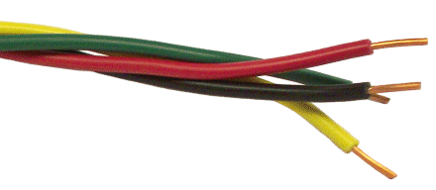
Wires
There are two types of materials:
Conductors:
conduct electricity
Insulators: do not conduct electricity
Electrical symbol
(wire):

Slide 6
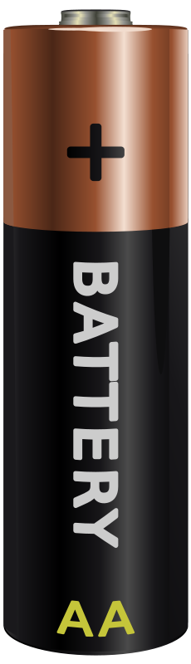
Power Source
Electrical symbol:
+V
“high”
voltage
+
−
“low”
voltage
(ground)
Computers manipulate binary data
Within a circuit, voltage is used to represent data
At any instant, a wire has either a high or low voltage
By convention, a high voltage represents binary ‘1’, and a low voltage (aka ground) represents binary ‘0’

Slide 7
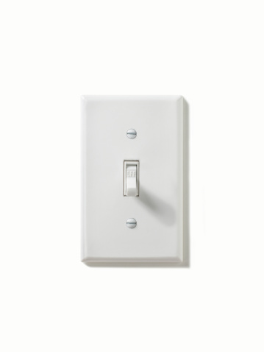
Switch
“high”
voltage
+
~
−
“low”
voltage
switch
Switch either open or closed
We need an electronically controlled switch

Slide 8
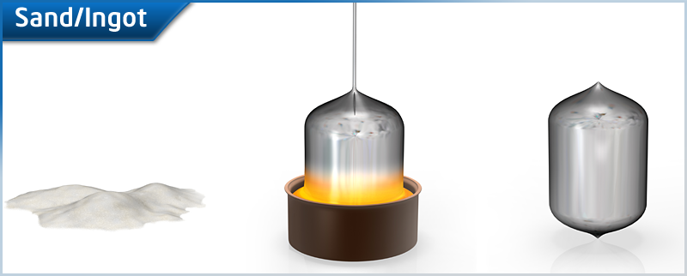
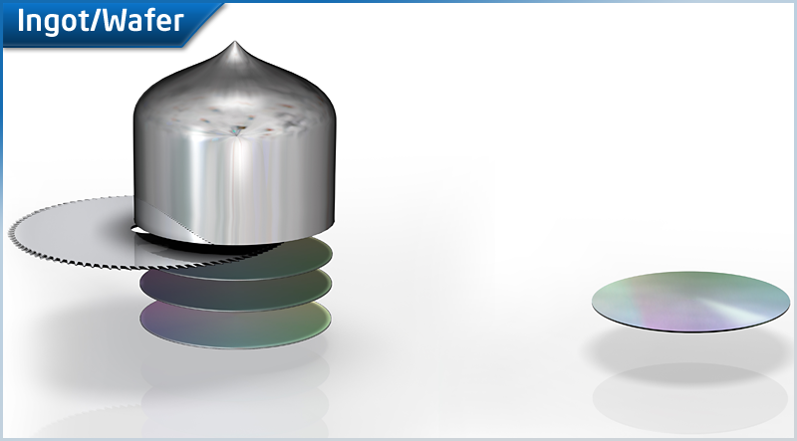
Transistor (Switch)
Semiconductors (e.g., silicon): conduct electricity, sometimes
Source: Intel
Metal Oxide Semiconductor, Field Effect Transistor (MOSFET)
Source (S)
Gate (G)
Drain (D)
Electrical symbol:
conductor
Silicon (Si) in natural form does not conduct electricity
It can be made into a conductor by implanting positive or negative ions in selected areas of the Si wafer (doping)
D
n+
n+
insulator
G
Si substrate (p)
Si “doped” with arsenic or phosphorus effectively creates supply of extra electrons
S

Slide 9
MOSFET: Operation (metal-oxide-semiconductor field-effect transistor)
apply voltage to gate
conducting channel forms
Source (S)
Gate (G)
Drain (D)
n+
n+
n+
n+
Si substrate (p)
Si substrate (p)
Conduct electricity (between source and drain)?
S
D
S
D
n-channel
MOS transistor
G=0V
G=+V
Voltage-controlled switch
No voltage (logic 0) on gate leaves the switch open
Apply voltage (logic 1) to gate to close switch

Slide 10
MOSFET as a Circuit Component
n-type
p-type
gate
gate
Gate = “low” voltage
(logic 0)
Gate = “hi” voltage
(logic 1)
Gate = “low” voltage
(logic 0)
Gate = “hi” voltage
(logic 1)
 | n-type transistor | p-type transistor
Low voltage (0) | Open (Non-conducting) | Closed (Conducting)
High voltage (1) | Closed (Conducting) | Open (Non-conducting)

Slide 11
Complementary MOS (CMOS)
+V
Inverter
P-MOS
Out = 1
Out = 0
In
Out
In
Out
N-MOS
0
1
1
0
In = 0
In = 1
Truth table
CMOS is the dominant technology used for integrated circuits today
Low power consumption

Slide 12
CMOS Circuit
A
A B
Out
Out
Out
B
0 0
1
0

Slide 13
CMOS Circuit
A
A B
Out
Out
Out
B
0 0
0 1
1
1
0
0

Slide 14
CMOS Circuit
A
A B
Out
Out
Out
B
0 0
0 1
1 0
1
1
1
0
0
0

Slide 15
CMOS Circuit
NAND (not-and)
A
A B
Out
Out
Out
B
0 0
0 1
1 0
1 1
1
1
1
0
0
0
0
1
Out = 0 if A and B are 1; otherwise, Out = 1
Out (complement Out) implements “AND” function
Circuit can extend to more inputs (e.g., 3-input NAND)

Slide 16
Another CMOS Circuit
A
Out
A B
Out
B
0 0
0 1
1 0
1 1
Fill in the truth table for this circuit.
What does this circuit do?

Slide 17
Another CMOS Circuit
A
Out
A B
Out
B
0 0
0 1
1 0
1 1
1

Slide 18
Another CMOS Circuit
A
Out
A B
Out
B
0 0
0 1
1 0
1 1
1
0

Slide 19
Another CMOS Circuit
A
Out
A B
Out
B
0 0
0 1
1 0
1 1
1
0
0

Slide 20
Another CMOS Circuit
NOR (not-or)
A
Out
A B
Out
B
0 0
0 1
1 0
1 1
1
0
0
0
Out = 0 if A or B are 1; otherwise, Out = 1
Circuit can extend to more inputs (e.g., 3-input NOR)

Slide 21
AND / OR Functions
For circuits, it is easier to implement the NAND and NOR functions
For people, it is easier to work with the AND and OR functions
A B
A+B
A B
AB
0 0
0 1
1 0
1 1
0
1
1
1
0 0
0 1
1 0
1 1
0
0
0
1
A
AB
A
A+B
B
B
AND
OR
AND (OR) can be implemented with NAND (NOR) plus an inverter

Slide 22
Circuits: Other Cases
In
Out
Out = ??
large
current
Out = ??
Out = 1
In = 0
Cannot occur with gates discussed so far, but if it did occur
Output neither ‘1’ nor ‘0’
Output said to be “floating” or “high impedance” (Hi-Z)
Hi-Z input to gate gives unpredictable results
Sometimes useful in circuit design
“Short circuit”
Permanent damage to circuit !
Out = 0
‘1’
‘0’
large
current
In = 1
Gate outputs should never be directly wired together !

Slide 23
Summary: Gates (commit this to your memory!)
NAND
AND
Inverter
NOR
OR
logic inversion
We can ignore lower level abstractions (electricity/materials, circuits, switches) and concentrate on logic gates
Behavior completely specified by truth table
Circle (or “bubble”) denotes logic inversion/complement, i.e., 0 becomes 1, 1 becomes 0)

Slide 25
Hardware: Materials, Circuits and Combinational Logic Part 2: Combinational Logic: Boolean Algebra
For use in Fall 2020 CSE6010/CX4010 only
Not for distribution

Slide 26
Road Map
materials
✔
electricity
✔
transistors
✔
circuits
✔
logic gates
✔
combinational logic
Memory
Sequential circuits
Central processing unit (CPU)
(microprocessors)

Slide 27
Boolean Algebra
Need to be able to manipulate binary data (e.g., add)
Boolean Algebra: a mathematical system including
Two values: 0 (false), 1 (true)
Binary variables (one bit signal): A, B, etc.
Operators on binary variables
AND: AB (A and B)
OR: A+B (A or B)
NOT: Ā (not A)
A
B
A
B
AB
AB
A
Ā
A
B
A
B
A+B
A+B

Slide 28
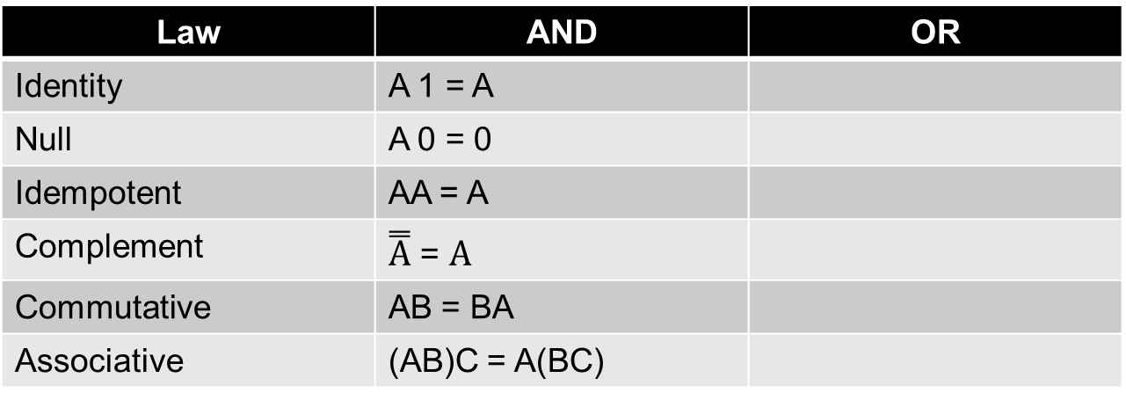
Useful Boolean Algebra Laws
Given the listed Boolean algebra laws for AND, fill in the corresponding laws for “OR”.
A, B, and C are Boolean variables
Law | AND | OR
Identity | A 1 = A
Null | A 0 = 0
Idempotent | AA = A
Complement | $\overset{̿}{A}$ = $A$
Commutative | AB = BA
Associative | (AB)C = A(BC)

Slide 29
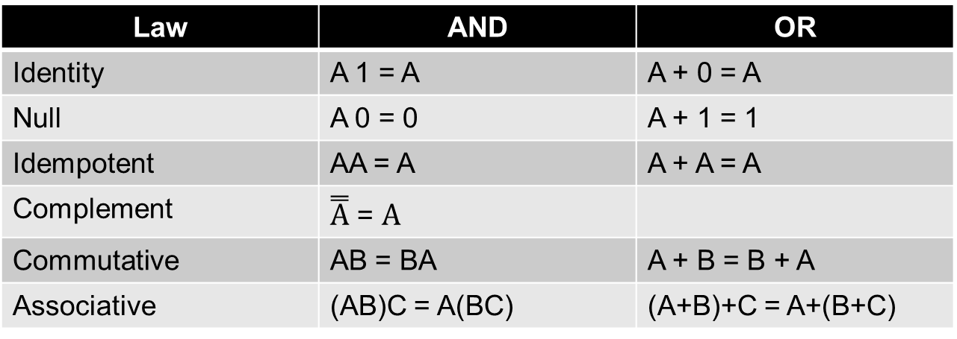
Useful Boolean Algebra Laws
Given the listed Boolean algebra laws for AND, fill in the corresponding laws for “OR”.
A, B, and C are Boolean variables
Law | AND | OR
Identity | A 1 = A | A + 0 = A
Null | A 0 = 0 | A + 1 = 1
Idempotent | AA = A | A + A = A
Complement | $\overset{̿}{A}$ = $A$
Commutative | AB = BA | A + B = B + A
Associative | (AB)C = A(BC) | (A+B)+C = A+(B+C)

Slide 30
Boolean Functions
Goal: Design a circuit to implement an arbitrary Boolean function on n binary inputs:
y = f (x₁, x₂, … x_{n})
x₁
f()
x₂
x₃
y
…
x_{n}

Slide 31
Summary
Start with wires, power source
Semiconductors enable us to create transistors (voltage controlled switch)
Switches enable us to create basic logic gates (NOT, NAND, NOR)
Boolean Algebra enables us to create arbitrary Boolean functions from logic gates (logical completeness)

