Slide 1
A Brief Introduction to Parallel Computing and Concurrency Part 1: Motivation and Overview
For use in Fall 2020 CSE6010/CX4010 only
Not for distribution

Slide 2
Outline
Motivation and overview
Multiprocessors
Concurrency issues with shared memory
Types of parallel algorithms

Slide 3
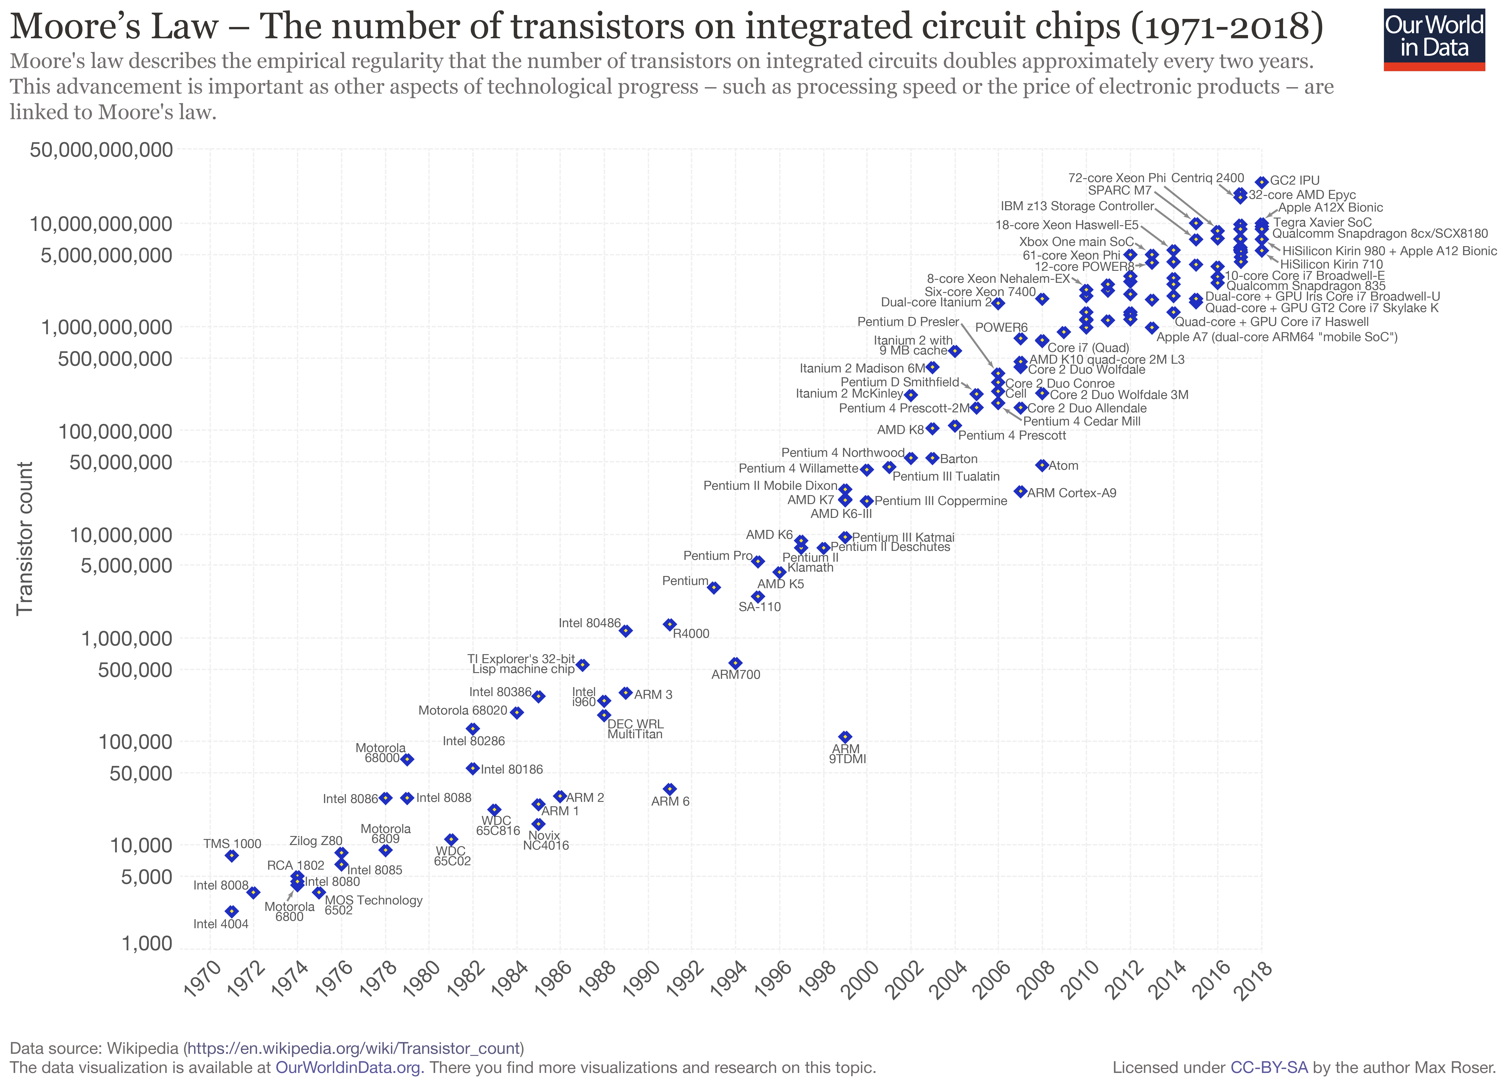
Moore’s Law
Number of circuits that can be implemented in a fixed area of silicon has been doubling every 2 years
Source: Max Roser [CC BY-SA 4.0 (https://creativecommons.org/licenses/by-sa/4.0)]

Slide 4
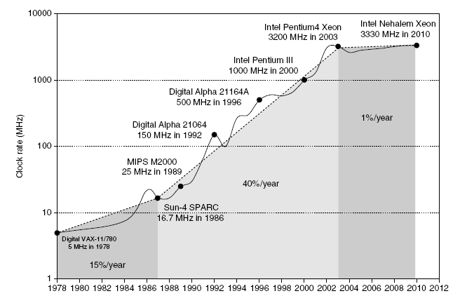
Dennard Scaling
Source: Hennessy & Patterson, Computer: Architecture: A Quantitative Approach, 5th Edition.
Clock speed doubles every 18 months
Broke down around 2005 due to power dissipation

Slide 5
What Next?
Single processor performance not increasing significantly
There is no clear consensus where future performance improvements will come from
Parallel computing
Multiple Von Neumann style processors
Hardware accelerators
Graphical Processing Units (GPUs)
Field Programmable Gate Arrays (FPGA)
Special-purpose computers
Quantum computing
Neuromorphic computing

Slide 6
Parallel Architecture Families: Flynn’s Taxonomy
Many classes of parallel architectures
Individual architectures may be hybrids with more than one type
Flynn’s taxonomy categorizes based on relationships of data and instruction (control) with respect to parallelism of “streams”
Data stream “D”: single “S” or multiple “M”
Instruction stream “I”: single “S” or multiple “M”
E.g., SISD: single instruction, single data stream; conventional sequential (serial) processor with a single thread of control that guides operations on a single set of data
Actually more simplistic than current uniprocessors

Slide 7
Parallel Computing: MIMD & SIMD
MIMD = multiple instruction stream, multiple data stream parallel computing
Different threads of execution can operate concurrently and execute different instructions (multiple instruction streams)
Different streams of data can be operated upon concurrently (multiple data streams)
SIMD = Single instruction stream, multiple data stream computing
Single stream of instructions are executed
Different streams of data can be operated upon concurrently (multiple data streams)
SPMD (single program, multiple data stream) is a practical variation
Useful in computations such as matrix operations

Slide 8
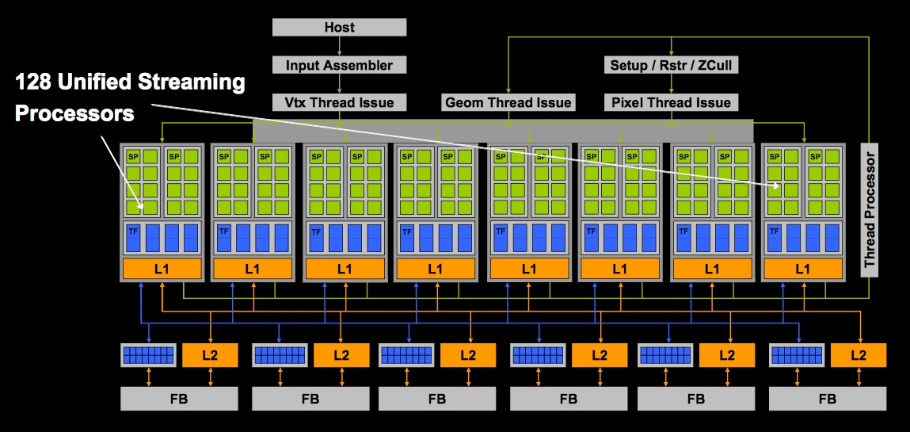
SIMD vs. MIMD
MIMD
SIMD
CPU
CPU
CPU
CPU
cache
cache
cache
cache
interconnection switch
memory
Graphical processing unit (GPU)
Multicore processor
Separate programs running concurrently on different processors
Multiple CPUs
Multiple control units
Single stream of instructions, each operates on different data
Multiple ALUs in data path
Single control unit

Slide 9
Programming Models
Shared Memory Model (MIMD)
Can define variables shared between different threads of computation
OpenMP an industry standard
Widely used on shared memory architectures
Message-Passing Model (MIMD)
No shared variables; all communications via message passing
Message Passing Interface (MPI) industry standard
Widely used on both shared-memory and message-based parallel computers
GPGPU Computing (SIMD/SPMD)
CUDA (NVIDIA), OpenGL, OpenACC widely used
Note: Software can be used to
implement message passing on shared-memory computers
implement shared memory on message-passing computers

Slide 10
Sources of Performance Degradation
Parallel computing is all about solving problems faster (and solving bigger problems). Can you think of some general reasons why parallel computing may run into trouble, causing performance to degrade?

Slide 11
Sources of Performance Degradation
General reasons for performance degradation with parallel computing:
Starvation: not enough parallelism to keep all resources busy or uneven distribution of work
Latency: information takes too long to travel from one part of the system to another
Overhead: additional work beyond what is actually required to perform the computation
Contention: multiple requests at the same time must be serviced by the same resource (e.g., I/O)

Slide 13
A Brief Introduction to Parallel Computing and Concurrency Part 2: Multiprocessors
For use in Fall 2020 CSE6010/CX4010 only
Not for distribution

Slide 14
Outline
Motivation and overview
Multiprocessors
Concurrency issues with shared memory
Types of parallel algorithms

Slide 15
Multiprocessors
Multiprocessor class of parallel computer is the dominant form of supercomputer
Self-controlled computers
Integrated by a communications network
Coordinated to perform a single workload
How would Flynn’s taxonomy categorize a multiprocessor?
MIMD: each processor has its own data-processing units controlled by its own local instruction stream controller
Three mainstream configurations in use:
Shared-memory multiprocessors (SMP)
Massively parallel processors (MMP)
Commodity clusters

Slide 16
Shared-memory mutiprocessors
Modest number of processors
All have direct (hardware) access to system main memory
Interconnection network directly connects all processors to memory
Currently SMPs serve as
Enterprise servers
Deskside machines
Laptops with multicore chips
Nodes within much larger MPPs

Slide 17
Shared-memory Programming Model
private
variables
private
variables
thread
thread
private
variables
private
variables
thread
thread
Shared variables
Thread: sequentially executing program
Private variables: only visible within thread
Shared variables: visible across all threads

Slide 18
Processes and Threads
A thread is a sequentially executing program
Code
Runtime stack (local variables): private in OpenMP
Global variables: shared in OpenMP
Operating system (OS) can schedule threads to execute on different cores (processors)
May be more threads than cores
Threads execute asynchronously (independent) of each other
Asynchronous execution can lead to races (unexpected timing)
Not to be confused with an operating system “process” (program executing on computer)
Similar in that both allow concurrent execution
The OS protects processes from interfering with each other; OS does not do this for threads!
A process typically includes multiple threads
Less overhead (time) to switch execution among threads; threads sometimes referred to as “lightweight processes”

Slide 19
Creating (Forking) Threads Removing (Join) Threads
Fork
Join
“Fork” primitive used to create threads
Each begins executing a block of code
The threads may execute concurrently on different processors (cores)
“Join” used to combine/delete threads

Slide 20
Potential Problems with Threads/Concurrency
Can you think of any problems that could arise with the programming model of threads?
Can you think of some ways in which such problems could be mitigated?
private
variables
private
variables
thread
thread
private
variables
private
variables
thread
thread
Shared variables

Slide 21
Potential Problems with Threads/Concurrency
Can you think of any problems that could arise with the programming model of threads?
Multiple threads can access shared variables
Thread 0 and Thread 1 may update the same variable, which may affect execution in unpredictable ways
Multiple threads may compete for access to a resource at the same time, which can lead to “deadlock” in which each thread is waiting for an event that can only be caused by another thread that is also waiting.
We will discuss some ways to handle these problems.

Slide 22
Other Multiprocessor Architectures
Massively parallel processors (MPPs)
Most easily scales to extremes of computing system size and performance (e.g., millions of processor cores)
Memory is distributed:
Groups of processors (nodes) are directly connected to their own local memory
No sharing of memory across nodes: message-passing across fast network
Commodity clusters
Both compute node and network are off-the-shelf commercial products
Not as large or efficient as MPPs, but much cheaper

Slide 24
A Brief Introduction to Parallel Computing and Concurrency Part 3: Concurrency Issues with Shared Memory
For use in Fall 2020 CSE6010/CX4010 only
Not for distribution

Slide 25
Outline
Motivation and overview
Multiprocessors
Concurrency issues with shared memory
Types of parallel algorithms

Slide 26
Concurrent Accesses to Shared Variables
Consider the following code:
int i; // shared variable
int main (void)
{ i = 0;
// fork two threads
#pragma omp parallel
{
i = i + 1;
}
// join threads here
printf (“i=%d\n”, i);
}
With 2 threads, what should be printed?
The statement i = i+1; will compile to a sequence of machine instructions:
Read i from memory into a CPU register
Increment register by 1
Store register into the memory location where i is stored

Slide 27
Concurrent Accesses to Shared Variables
The interleaving of execution of machine instructions from different threads is arbitrary
Assume i initially holds the value 0
Thread 1
Read i into register (0)
Increment register by 1
Store register into memory location for i (1)
Thread 2
Read i into register (0)
Increment register by 1
Store register into memory location for i (1)
time
Final value of i is 1!

Slide 28
Race Condition
Bug resulting from an unexpected sequence of operations executed by different threads, leading to erroneous results
Race conditions are typically not repeatable because rerunning can result in a different sequence (order) that operations are performed
Perhaps the most difficult type of bug that can arise in programming, especially if the error due to the race condition occurs only rarely

Slide 29
Solution: Critical Section
Critical section: A section of code where it is guaranteed that at most one thread can be executing in a critical section at one time
Code that accesses and modifies shared variables, must be placed within a critical section

Slide 30
Solution Using Critical Section
Place statement i=i+1; into a critical section
Thread 1
<enter critical section>
Read i into register (0)
Increment register by 1
Store register into memory
location for i (1)
<exit critical section>
Thread 2
<attempt to enter critical
section>
wait …
<enter critical section>
Read i into register (1)
Increment register by 1
Store register into memory
location for i (2)
<exit critical section>
Final value of i is 2
time

Slide 31
Implementation of Critical Sections
How can we implement a critical section?
Shared “flag” variable (lock) for each shared data structure; lock==1 if a thread is executing within the critical section, 0 otherwise
int lock; // shared; init to 0 (unlocked)
// busy wait loop (or “spin lock”)
while (lock == 1) ;
lock = 1; // in critical section
<critical section code>
lock = 0;
Does this work?

Slide 32
Race Condition?
while (lock == 1) ;
lock = 1;
<critical section>
Two threads attempt to take lock at the same time
Solution: perform the read-then-write as a single, atomic operation
Thread 1
Read lock (read 0)
Set lock to 1
Enter critical section
Thread 2
Read lock (read 0)
Set lock to 1
Enter critical section
time
Both threads are simultaneously in the critical section!

Slide 33
Hardware to the Rescue!
To address the race condition problem, hardware support is needed to read, modify, and write a memory location as one indivisible (atomic) operation
Example: “test-and-set(variable)” machine instruction
Sets the variable to 1, and returns the old value of the variable (prior to setting it), all as one atomic operation
int L; // init to 0 (unlocked)
while (test_and_set(L) == 1) ; // lock (L)
<critical section code>
L = 0; // unlock (L)
Different variations (e.g., fetch-and-add …) devised for different machine architectures; OpenMP has direct support for critical sections

Slide 34
Another Potential Problem: Deadlock
Execution
Thread 1 Thread 2
Thread 1:
Lock (A)
…
Lock (B)
…
Unlock (B)
…
Unlock (A)
Thread 2:
Lock (B)
…
Lock (A)
…
Unlock (A)
…
Unlock (B)
Lock (A)
Lock (B) (wait for thread 2)
Lock (B)
Lock (A) (wait for thread 1)
Each thread waiting for other thread, neither can progress
Program is deadlocked

Slide 35
Deadlock
Cycle develops where each thread is waiting for the next thread in the cycle
Thread i waits for j, j waits for k, k waits for l, … thread x waits for i
Deadlocks easy to detect (the program stops when one occurs)
Deadlocks can be prevented by imposing a fixed sequence in which locks must be obtained (e.g., always lock A before attempting to lock B)

Slide 37
A Brief Introduction to Parallel Computing and Concurrency Part 4: Types of Parallel Algorithms
For use in Fall 2020 CSE6010/CX4010 only
Not for distribution

Slide 38
Outline
Motivation and overview
Multiprocessors
Concurrency issues with shared memory
Types of parallel algorithms

Slide 39
Types of Parallel Algorithms
Several classes of parallel algorithms share key characteristics and are driven by the same underlying mechanism from which the parallelism is derived
Fork-join
Divide and conquer
Manager-worker
Embarrassingly parallel
Halo exchange
Note that it is not always straightforward to differentiate!

Slide 40
Fork-Join
Frequently used with shared memory (key for OpenMP)
In regions of a sequential algorithm where work can proceed concurrently, threads are created to perform that work
Once completed, the results from the threads are accumulated during the “join” phase

Slide 41
Divide and Conquer
Related to divide-and-conquer algorithms
Recursively break problem into smaller independent subproblems
Natural concurrency for exploiting parallel computation
Can perform very well on shared-memory architectures

Slide 42
Manager-Worker
Manager-worker uses two different workflows
Single manager process is used to coordinate and issue task actions
Worker processes carry out the main work under the direction of the manager
Useful when the nature or scale of the problem changes dynamically during the program

Slide 43
Embarrassingly Parallel
Lots of available parallelism with very limited communication or coordination
Highly partitionable workload
May require gathering of results (“reduction”) into a manager process at the end (sometimes considered a subclass of manager-worker algorithms)
Example: Monte Carlo algorithms, such as computing the value of π:
Define a unit square (side = 1) and inscribe a circle (diam = 1)
Randomly generate points within the square; count the points also inside the circle
π /4 is the fraction of points that lie in the circle

Slide 44
Halo Exchange
Used when each parallel task executes the same algorithm on different data without a manager
Each task typically is responsible for a particular area
The “halo” is exterior to the data subset for a particular task and is used to store information computed by other tasks
Halo exchange enables each task to perform computations using only local data
Examples: solving partial differential equations, linear algebra

Slide 45
Examples of Parallel Algorithms Types
Match each example with its corresponding parallel algorithm type
Graph problem with dynamic rewiring
Isolated parallel for-loop (each task executes a subset of the loop indices)
Monte Carlo integration algorithm
Parallel quicksort
Sparse matrix-vector multiplication
Divide and conquer
Embarrassingly parallel
Fork-join
Halo exchange
Manager-worker

Slide 46
Examples of Parallel Algorithms Types
Match each example with its corresponding parallel algorithm type
Graph problem with dynamic rewiring -> e. Manager-worker
Isolated parallel for-loop (each task executes a subset of the loop indices) -> c. Fork-join
Monte Carlo integration algorithm -> b. Embarrassingly parallel
Parallel quicksort -> a. Divide and conquer
Sparse matrix-vector multiplication -> d. Halo exchange

Slide 47
Wrapping Up: Things You Should Know
Single processor performance is not improving significantly
Parallel computing becoming increasingly more important
Interactions among concurrently executing threads can lead to difficult race conditions
Use synchronization primitives (e.g., locks) around access to shared variables
Deadlocks can occur
If holding a lock, don’t try to acquire another lock
If this is not possible, ensure ordered acquisition of locks

Slide 48
Other Points
Modern CPUs are not von Neumann:
Data “near” previously loaded data can be loaded faster (locality)
Can operate on multiple instructions at the same time
Instructions can be executed out of sequence
Algorithms can be CPU-bound or memory-bound
Faster processors cannot help memory-bound algorithms/ applications

Slide 49
Where We Are Going
In the remainder of our “systems” classes, we will be covering topics related to these points:
OpenMP: utilize multiple cores
Pipelining: make maximum use of hardware to execute multiple instructions simultaneously
Cache memory: organize memory hierarchically with levels in between registers (fast but small) and main memory (slow but large)

