Slide 1
More Sorting in O(n) Time Part 1: Radix Sort
For use in Fall 2020 CSE6010/CX4010 only
Not for distribution

Slide 2
Outline
Radix Sort
Bucket Sort

Slide 3
Radix Sort
Radix sort is another O(n) sorting algorithm
So we know right away that it is not based on comparisons!
There will need to be some other “trick”

Slide 4
Radix Sort History
Radix sort dates back from punch card readers
Cards had 80 columns, in each column a machine could punch a hole in one of 12 places (only 10 used for digits)
The sorting machine could examine a given column and distribute the card into one of 12 bins based on which place was punched
An operator would gather the cards by bin (cards with first place punched on top of cards with second place punched, etc.)
Sort on one digit at a time

Slide 5
Radix Sort
Key idea: sort on the least significant digit first (counterintuitive!)
Combine cards into a single deck, with cards in the 0 bin preceding cards in the 1 bin, etc.
Do not do any other reordering
Then sort again on the second-least significant digit until entire all cards have been sorted on all d digits
Requires d passes through the cards to sort completely

Slide 6
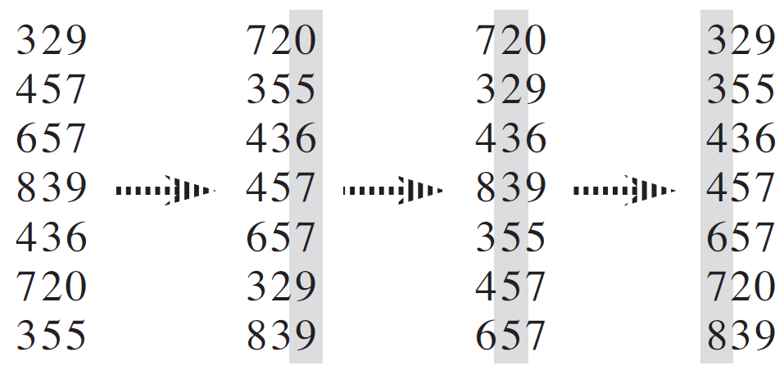
Radix Sort Example
We have not yet specified how to do the individual sorts for each digit

Slide 7
Radix Sort: Your Turn
Use radix sort to sort the following 4-digit numbers: 2984 8429 8829 4298 4422 2948 8292 9429 2889 9422
What would happen if you tried to sort by most-significant digit first (reverse order)?

Slide 8
Radix Sort: Your Turn
2984
8429
8829
4298
4422
2948
8292
9429
2889
9422

Slide 9
Radix Sort: Your Turn
2984 | 4422
8429 | 8292
8829 | 9422
4298 | 2984
4422 | 4298
2948 | 2948
8292 | 8429
9429 | 8829
2889 | 9429
9422 | 2889

Slide 10
Radix Sort: Your Turn
2984 | 4422 | 4422
8429 | 8292 | 9422
8829 | 9422 | 8429
4298 | 2984 | 8829
4422 | 4298 | 9429
2948 | 2948 | 2948
8292 | 8429 | 2984
9429 | 8829 | 2889
2889 | 9429 | 8292
9422 | 2889 | 2498

Slide 11
Radix Sort: Your Turn
2984 | 4422 | 4422 | 8292
8429 | 8292 | 9422 | 4422
8829 | 9422 | 8429 | 9422
4298 | 2984 | 8829 | 8429
4422 | 4298 | 9429 | 9429
2948 | 2948 | 2948 | 2498
8292 | 8429 | 2984 | 8829
9429 | 8829 | 2889 | 2889
2889 | 9429 | 8292 | 2948
9422 | 2889 | 2498 | 2984

Slide 12
Radix Sort: Your Turn
2984 | 4422 | 4422 | 8292 | 2498
8429 | 8292 | 9422 | 4422 | 2889
8829 | 9422 | 8429 | 9422 | 2948
4298 | 2984 | 8829 | 8429 | 2984
4422 | 4298 | 9429 | 9429 | 4422
2948 | 2948 | 2948 | 2498 | 8292
8292 | 8429 | 2984 | 8829 | 8429
9429 | 8829 | 2889 | 2889 | 8829
2889 | 9429 | 8292 | 2948 | 9422
9422 | 2889 | 2498 | 2984 | 9429

Slide 13
Radix Sort: Your Turn
If we tried to work in the other direction, from most significant digit:
2984
8429
8829
4298
4422
2948
8292
9429
2889
9422

Slide 14
Radix Sort: Your Turn
If we tried to work in the other direction, from most significant digit:
Now must keep the 2xxx’s, 4xxx’s, etc. together!
Sort each group separately
2984 | 2984
8429 | 2948
8829 | 2889
4298 | 4298
4422 | 4422
2948 | 8429
8292 | 8829
9429 | 8292
2889 | 9429
9422 | 9422

Slide 15
Radix Sort: Your Turn
If we tried to work in the other direction, from most significant digit:
Now must keep the 2xxx’s, 4xxx’s, etc. together!
Sort each group separately
2984 | 2984 | 2889
8429 | 2948 | 2984
8829 | 2889 | 2948
4298 | 4298 | 4298
4422 | 4422 | 4422
2948 | 8429 | 8292
8292 | 8829 | 8429
9429 | 8292 | 8829
2889 | 9429 | 9429
9422 | 9422 | 9422
Now we have to keep the 28xx’s together, and the 29xx’s together, etc.
Already too cumbersome!

Slide 16
Radix Sort and Stability
Radix sort is dependent on the digit sorts being stable
Recall that an algorithm is stable if data elements with the same key appear in the sorted array in the same order that they appeared in the original array
Stable algorithms include insertion sort, merge sort, and counting sort
Heapsort and quicksort are not stable

Slide 17
Radix Sort Algorithm
Algorithm is simple (sort on d digits)
Requires a stable sort to keep things in order (don’t mess up digits already sorted)
If counting sort (O(k+N)) is used, d iterations mean radix sort is O(d(k+N))
For constant d and k=O(N), this becomes O(N)
radixSort(A,d) for (i=0; i<d; i++) {
Use a stable sort to sort array A on digit d
}

Slide 18
Radix Sort Comments
Radix sort’s linear runtime appears better than the O(N log N) sorts but…
Constants matter, so although radix sort may make fewer passes than something like quicksort, each pass may take significantly longer
Using counting sort for the intermediate sorts means sorting is not in place -> more memory

Slide 20
More Sorting in O(n) Time Part 2: Bucket Sort
For use in Fall 2020 CSE6010/CX4010 only
Not for distribution

Slide 21
Outline
Radix Sort
Bucket Sort

Slide 22
Bucket Sort
Another linear-time sort
Again, we know comparisons are not involved and we must get information about keys some other way
Here we assume that the numbers to sort are drawn from a uniform random distribution over [0,1)

Slide 23
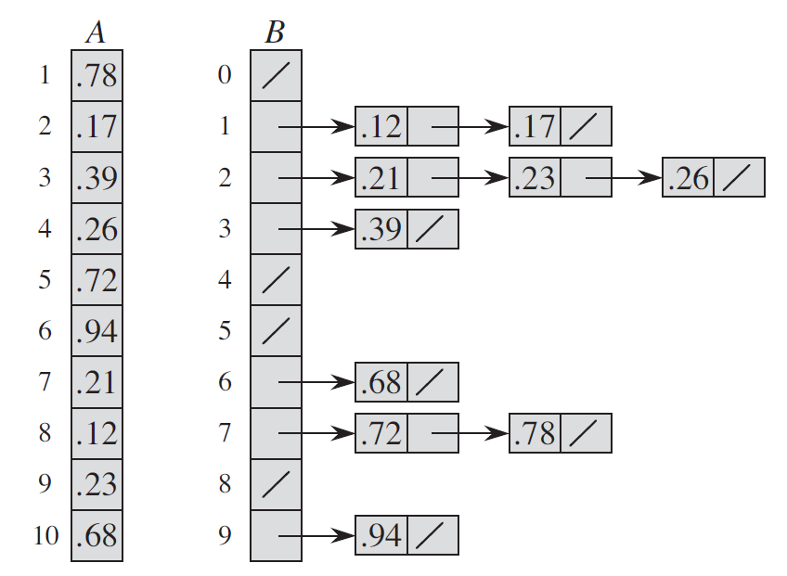
Bucket Sort: Idea
Divide [0,1) into n equal-size buckets
Distribute the n input values into the buckets
Sort each bucket
Go through buckets in order, listing elements in each

Slide 24
Bucket Sort: Idea
Divide [0,1) into n equal-size buckets
Distribute the n input values into the buckets
Sort each bucket
Go through buckets in order, listing elements in each

Slide 25
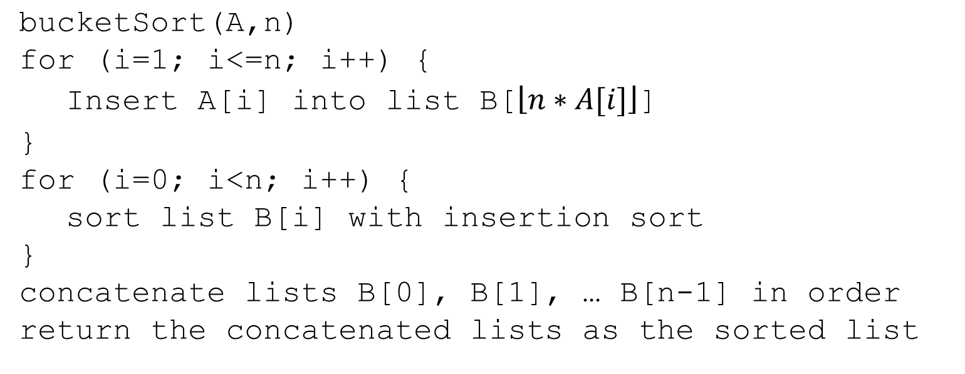
Bucket Sort: Algorithm
Input: A[1..n], with each entry in [0,1)
Auxiliary array: B[0..n-1] of linked lists, each empty initially
bucketSort(A,n) for (i=1; i<=n; i++) { Insert A[i] into list B[$\left\lfloor n∗A[i]\right\rfloor$]
} for (i=0; i<n; i++) { sort list B[i] with insertion sort } concatenate lists B[0], B[1], … B[n-1] in order return the concatenated lists as the sorted list
Recall: fast for small list

Slide 26
Bucket Sort Analysis
Relies on no bucket getting too many values
All lines of algorithm except insertion sort are O(n)
If each bucket gets a constant number of elements, it takes O(1) to sort each bucket and thus O(n) to sort all buckets
Average is 1 element per bucket; expect some buckets to have few elements
A probabilistic analysis is needed to calculate expected running time

Slide 27
Bucket Sort Comments
Not a comparison sort; uses a function of key values to index into an array
Probabilistic analysis (which we will not do) shows expected runtime is linear
If input is not drawn from a uniform distribution on [0,1), the algorithm is correct, but the performance analysis may no longer hold (may not be linear time)

Slide 28
Wrapping Up O(n) Sorting
Radix sort works by sorting by digit and O(n) time is achieved by using an O(n) algorithm like counting sort to sort by digit.
Bucket sort works by distributing into n bins and then sorting any cases with a few items within the bins.
To beat the lower bound O(n log n) time for comparison sorts, it is necessary to have some restrictions.

