Slide 1
Hash Tables Part 1: Introduction to Hashing
For use in Fall 2020 CSE6010/CX4010 only
Not for distribution

Slide 2
Outline
Content Addressable Memory
Implementation: Hashing
Hash Functions
Conflict Resolution via Open Addressing
Introduction and Operations
Probe Functions

Slide 3
A Motivating Problem
Create a dictionary that provides definitions of four-letter words
Operations:
Insert: add a new word/definition to dictionary
Search: look up the definition of a specific word
Delete: remove a word/definition from the dictionary
We could choose to use an array to implement our dictionary. What would be some advantages and disadvantages of this approach? Are there any potential pitfalls?

Slide 4
Implement with an Array?
Arrays
Advantage: fast and efficient access to individual elements
Disadvantage: requires an integer index to identify the desired item
What if the index number of the desired element is unknown (the search problem)?
What if the index is not easily defined as an integer value?
Example: Looking up an item in a dictionary
Index is a character string (word)
Hash tables provide a solution to this problem

Slide 5
Associative Memory (Content Addressable Memory)
data
data
data
data
data
key | data
key | data
key | data
key | data
key | data
address
Conventional memory
Address a data item by its location (address) in memory
Read (addr), Write (addr)
Associative Memory
Address a data item by its contents (key)
Search (key)
Assume keys are unique

Slide 6
Examples
Dictionary
Key: 4 letter word
Data: Definition
Word | Definition
desk | Furniture used to read, write, or do other work
lamp | Device used to give light
…
Cache Memory (computer systems)
Key: address
Data: block
Address (32 bits) | Block of Data stored at Specified Address (64 bytes)
addr 1 | Data stored at address “addr 1”
addr 2 | Data stored at address “addr 2”
…

Slide 7
Implementation
Hashing: convert the “key” (e.g., character string) into an array index, then access using an ordinary array (called a hash table)
Hashing Approach 1: Map each possible key to a unique array index (direct address table)
Wasteful if the number of elements stored in memory is much less than the number of all possible keys
Limited applicability (works if the number of possible keys is comparable to the hash table size)
Hashing Approach 2: Allow multiple keys to map to the same array index (hash table)
Must handle “collisions” where two items in storage map to the same array index
Widely used (we will focus on this approach here)

Slide 8
Hashing: Overview
Table with m slots: T[0, … m-1]
Each table element x is a structure with two fields: x.key, x.data
Typically, m << # possible keys
Hash Table operations
Insert(T, x): insert x (x.key,x.data) into hash table T
Search(T,k): search for element with x.key==k in hash table T
Delete(T,k): delete element with x.key=k from hash table T
Implementation Issues
Hash function: H(k) -> {0, 1, … m-1}, where k is the key value
Conflict resolution strategy: What to do about conflicts (more than one key hashing to the same value):

Slide 9
Conflict Resolution: Chaining
NULL
Key (word)
Data (definition)
Key (word)
Data (definition)
Key -> index
(hash function)
Key (word)
Data (definition)
Key (word)
Data (definition)
Chaining is a common collision resolution strategy
Store items hashing to the same index in a linked list
Insert(T, x): insert element x at front of list T[H(x.key)]
Search(T,k): search for element with key k in list T[H(k)]
Delete(T,k*): delete element with key k from list T[H(k)]
*If parameter is a pointer to the item, use a doubly linked list

Slide 10
Complexity Analysis
Consider the three base operations for a hash table:
Insert
Search
Delete
What is the expected time complexity for each operation?
Worst case
Average case
Assume
m slots in hash table
n elements stored in the table
Executing hash function is O(1)
For average case, assume any key is equally likely to hash to any of the m slots of the hash table, independent of other items stored in the table (uniform hashing assumption)

Slide 11
Complexity Analysis
Worst case execution time?
Keys for all n elements hash to the same index
Insert: O(1)
Search: O(n), n=number of stored data items
Delete: O(n) (or O(1) if you have a pointer to the item to delete)
Average case?
Use uniform hashing assumption: any key is equally likely to hash to any of the m slots of the hash table, independent of other items stored in the table
Average length of linked list is n/m
Insertion: O(1)
Search and delete: O(n/m)
If m is about equal to n, constant time operations

Slide 13
Hash Tables Part 2: Hash Functions
For use in Fall 2020 CSE6010/CX4010 only
Not for distribution

Slide 14
Outline
Content Addressable Memory
Implementation: Hashing
Hash Functions
Conflict Resolution via Open Addressing
Introduction and Operations
Probe Functions

Slide 15
Hash Function
Ideally, hash function obeys uniform hashing goal
Keys often unknown, not independent; often similarity among keys (e.g., words)
Keys may not be numeric
Convert key to a natural number {0, 1, 2, … }
Example: character string can be viewed as binary number (or radix 128) by considering ASCII codes of the characters
“pt”
112
116
= (112*128) + 116 = 14452
p
t

Slide 16
Hashing: Division Method
Given a key k that is a natural number
Table with m slots {0, 1, 2, … m-1}
Division Method: H(k) = k mod m
Example:
m = 8
k = 10101010
H(k) = 010
6
Key: 76
Data
example
m=7
key: 76
76 mod 7 = 6
5
4
Key: 32
Data
3
2
1
Key: 15
Data
Key: 1
Data
0
How to choose m?
Making m a power of 2 (means only look at low order bits) may result in many collisions!
Prime number often good choice for m, not too close to a power of 2 (or 10)
Value of m matters!

Slide 17
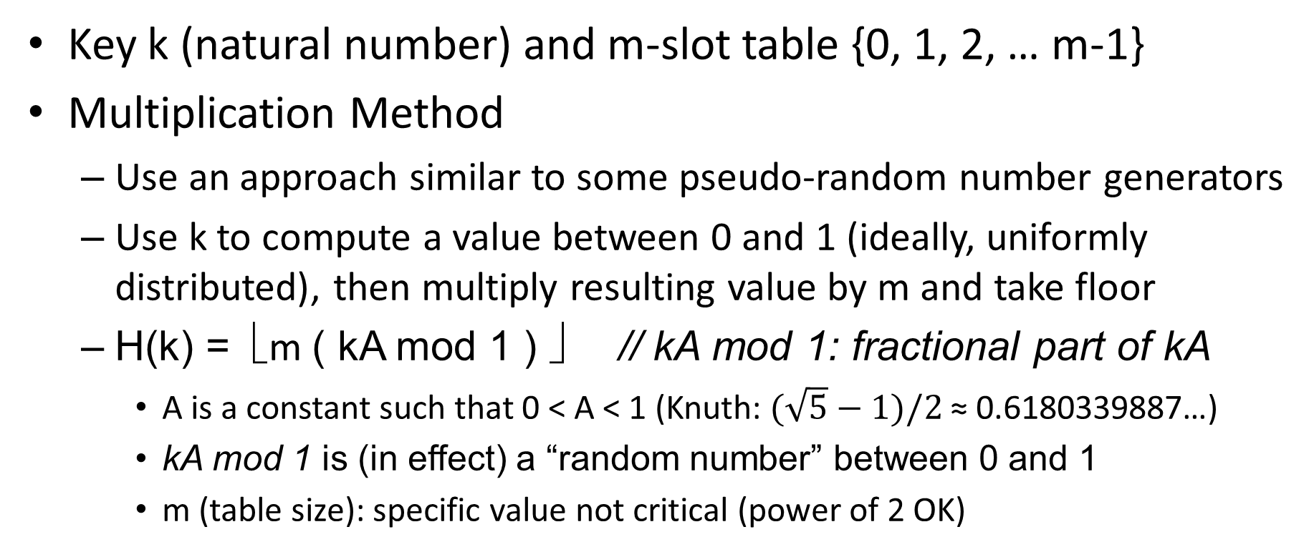
Hashing: Multiplication Method
Key k (natural number) and m-slot table {0, 1, 2, … m-1}
Multiplication Method
Use an approach similar to some pseudo-random number generators
Use k to compute a value between 0 and 1 (ideally, uniformly distributed), then multiply resulting value by m and take floor
H(k) = ⎣m ( kA mod 1 ) ⎦ // kA mod 1: fractional part of kA
A is a constant such that 0 < A < 1 (Knuth: $(\sqrt{5}−1)/2$ ≈ 0.6180339887…)
kA mod 1 is (in effect) a “random number” between 0 and 1
m (table size): specific value not critical (power of 2 OK)
Notes:
Golden ratio: (1+sqrt(5))/2 = 1.61803398…

Slide 18
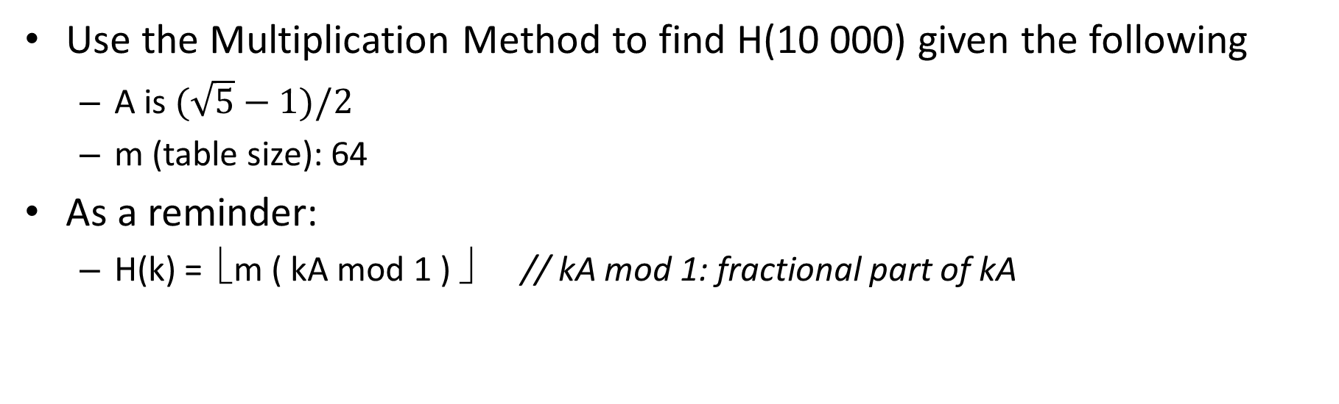
Multiplication Method Example
Use the Multiplication Method to find H(10 000) given the following
A is $(\sqrt{5}−1)/2$
m (table size): 64
As a reminder:
H(k) = ⎣m ( kA mod 1 ) ⎦ // kA mod 1: fractional part of kA
Notes:
Golden ratio: (1+sqrt(5))/2 = 1.61803398…

Slide 19
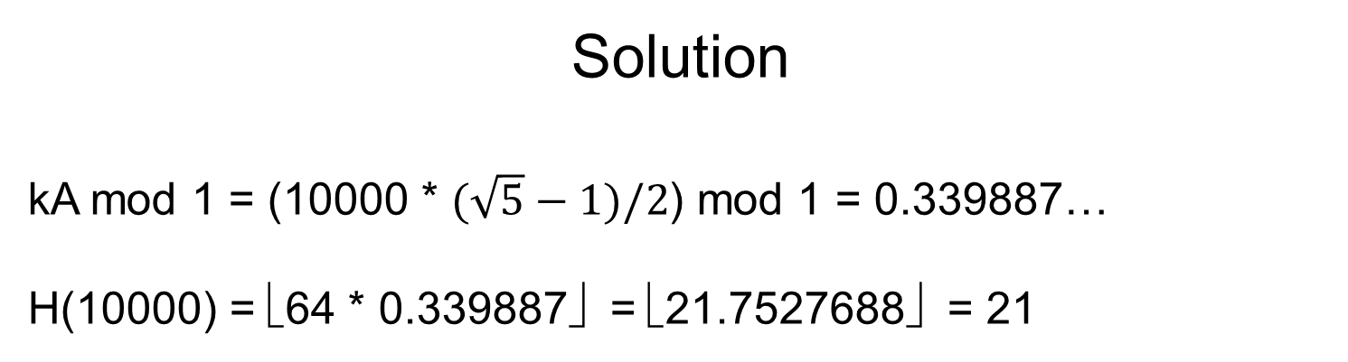
Multiplication Method Example
Use the Multiplication Method to find H(10 000) given the following
A is $(\sqrt{5}−1)/2$
m (table size): 64
As a reminder:
H(k) = ⎣m ( kA mod 1 ) ⎦ // kA mod 1: fractional part of kA
Solution
kA mod 1 = (10000 * $(\sqrt{5}−1)/2$) mod 1 = 0.339887…
H(10000) = ⎣64 * 0.339887⎦ = ⎣21.7527688⎦ = 21
Notes:
Golden ratio: (1+sqrt(5))/2 = 1.61803398…

Slide 21
Hash Tables Part 3: Open Addressing
For use in Fall 2020 CSE6010/CX4010 only
Not for distribution

Slide 22
Outline
Content Addressable Memory
Implementation: Hashing
Hash Functions
Conflict Resolution via Open Addressing
Introduction and Operations
Probe Functions

Slide 23
Open Addressing
Alternate conflict resolution scheme
All data items reside in the table itself (no use of a linked list for conflicts)
Basic idea: If the hashed table entry is taken, select another table entry by computing a 2nd choice (and if need be, 3rd choice, etc.)
Compute H(k,0), H(k,1), H(k,2), … H(k,m-1)
Insert: Use the first empty slot in sequence
Compute sequence of slots rather than following pointers (saves memory)
Sequence of positions examined (probed) depends on the key being inserted, rather than being a fixed order

Slide 24
Open Addressing Example
Key -> index
H(“book”,0)
NULL | -
desk | Furniture used to read, write, or do other work
NULL | -
lamp | Device used to give light
NULL | -
Key -> index
H(“book”,1)
If the Key is NULL, the entry is empty
Insert (“book”, “Something to read”)

Slide 25
Open Addressing Example
Key -> index
H(“book”,0)
NULL | -
desk | Furniture used to read, write, or do other work
NULL | -
lamp | Device used to give light
book | Something to read
Key -> index
H(“book”,1)
If the Key is NULL, the entry is empty
Insert (“book”, “Something to read”)

Slide 26
Search and Deletions
Search: examine hash table entries until
The item is found (return hash table entry),
An empty slot (NULL) is encountered (return “not found”), or
Have tried m times to find the item where m is the size of the hash table (return “not found”)
Deletion?
Mark the slot containing the deleted entry as empty (NULL)?

Slide 27
Deletion Example
Key -> index
H(“book”,0)
NULL | -
desk | Furniture used to read, write, or do other work
NULL | -
lamp | Device used to give light
book | Something to read
NULL
Key -> index
H(“book”,1)
Delete “desk”: mark entry as NULL
Search (“book”): return not found!
Deletion: Cannot simply mark deleted entry as NULL (empty)

Slide 28
Hash Table Operations
Deletion
Mark a deleted entry as “deleted” (different from empty)
Search
If “deleted” entry is encountered, continue search (same as if entry is full)
Insertion
Insert a new item into the first empty or deleted slot that is encountered

Slide 29
Open Addressing Pseudo-code
Insert (T, x)
for (i=0; i<m; i++) {
j=H(x.key,i);
if ((T[j] == ____) || (T[j]==____))
{T[j]=____; return j; }
}
error (“Hash Table Overflow”);
Complete the pseudo-code by finishing the incomplete statements.
Search (T,k)
for (i=0; i<m; i++) {
j=H(k,i);
if (________) return j;
if (________) return (“not found”);
// if ________ keep searching
}
return (“not found”);
Delete (T,k)
for (i=0; i<m; i++) {
j=H(k,i);
if (________) {T[j]=____; return “found”}
if (________) return (“not found”);
}
return (“not found”);

Slide 30
Open Addressing Pseudo-code
Insert (T, x)
for (i=0; i<m; i++) {
j=H(x.key,i);
if ((T[j] == NULL) || (T[j]==DELETED))
{T[j]=x; return j; }
}
error (“Hash Table Overflow”);
Search (T,k)
for (i=0; i<m; i++) {
j=H(k,i);
if (T[j] == k) return j;
if (T[j] == NULL) return (“not found”);
// if T[j] == DELETED keep searching
}
return (“not found”);

Slide 31
Open Addressing Pseudo Code (cont.)
Delete (T,k)
for (i=0; i<m; i++) {
j=H(k,i);
if (T[j] == k) {T[j]=DELETED; return “found”}
if (T[j] == NULL) return (“not found”);
}
return (“not found”);

Slide 33
Hash Tables Part 4: Probe Functions
For use in Fall 2020 CSE6010/CX4010 only
Not for distribution

Slide 34
Outline
Content Addressable Memory
Implementation: Hashing
Hash Functions
Conflict Resolution via Open Addressing
Introduction and Operations
Probe Functions

Slide 35
Probe Functions
Probe function: generates 2nd, 3rd, etc. hash indices
Let H’(k) be the original hash function used to determine the initial probe
Collision: Use hash function H(k,i)
Set i=0 for initial hash
i=1 after first collision, i=2 after second, etc.
Ideally, few collisions will occur
Linear probing
If collision at slot i, try slot (i+1) mod m
H(k,i) = (H’(k)+i) mod m (for i=0,1,2, … m-1)

Slide 36
Linear Probing Example
0
1
2
3
4
5
6
7
8
Keys that hash to the same index on the first hash create a cluster of filled table entries
Results in an increasing number of hashes required for hash table operations
Add A: H’=2
Add B: H’=2
Add C: H’=2
Search C
Add D: H’=4
Add E: H’=3
Search E
1
A
2
B
1
3
C
2
D
3
E
4
Keys that hash to locations near those where collisions previously occurred increase the size of the cluster, increasing the length of searches
Linear Probing can result in clusters of increasing size as more items are added, leading to more collisions and longer searches

Slide 37
Quadratic Probing
H’(k) = hash function for the initial probe
Quadratic probing
H(k,i) = (H’(k) + c₁i + c₂i²) mod m; (c₁ and c₂ constants)
c₁= c₂=1
H(k,i) = (H’(k)+i+i²) mod m
0
1
2
3
4
5
6
7
8
1
A
Avoids clustering seen in linear probing
Add A: H’=2
Add B: H’=2
Add C: H’=2
Search C
2
B
3
C
Keys initially hashing to same entry follow the same sequence of probes; may result in longer search times

Slide 38
Double Hashing
Double hashing
Variation on linear probes; use second hash function (H₂) to determine distance to next probe
H(k,i) = (H₁(k) + i H₂(k)) mod m (i=0,1,2, … m-1)
Inter-probe distance (H₂(k)) depends on key, avoiding repeated collisions for different keys hashing to the same location
H₁(k) = k mod 13
H₂(k) = 1 + (k mod 11)
0
1
2
3
4
5
6
7
8
9
10
11
12
79
69
98
72
50
0
Insert 14
H₁(14) = 14 mod 13 = 1
H₂(14) = 1 + (14 mod 11) = 4
H(k,i) = (H₁(k) + i H₂(k)) mod m
H(14,0) = (1 + 0*4) mod m = 1
H(14,1) = (1 + 1*4) mod m = 5
H(14,2) = (1 + 2*4) mod m = 9
1
2
14

Slide 39
Choosing the Second Hash Function
Need to ensure all values in the hash table can be searched
Value of H₂(k) should be prime relative to m (no common divisors)
Can make m a power of 2 and ensure H₂(k) always produces an odd number
Can make m prime and design H₂ so it returns a positive integer less than m, e.g.:
H₁(k) = k mod m
H₂(k) = 1 + (k mod m’), where m’ is a number slightly less than m (e.g., m-1)
Double hashing improves over linear and quadratic probing because each possible (H₁(k), H₂(k) ) pair yields a distinct probe sequence and, as key is varied, initial probe position (H₁(k)) and offset (H₂(k)) may vary independently: closer to uniform hashing

Slide 40
Summary
Hashing is a common technique used in lookup tables
Software implementation of associative (content addressable) memory
With careful design, hashing can often be used to get, on average, constant time search

