Slide 1
More on Caches Part 1: Cache Design
For use in Fall 2020 CSE6010/CX4010 only
Not for distribution

Slide 2
Outline
Cache Blocks
Cache Design Questions
Placement policy
Replacement policy
Write policy
Multilevel Caches
Virtual Memory
Multiprocessor Caches
Cache coherence
False sharing

Slide 3
Cache Basics
A cache is a small memory located close to the CPU
Frequently used items can be kept here
Fast access; caches misses are costly
Cache is not visible to the instruction set
Caches work because of temporal and spatial locality of reference
Temporal locality: Item recently used is likely to be used again, so once in cache no need to reload the same item from memory
Spatial locality: Items with memory locations near recently used items are likely to be used soon; how is this actually exploited?

Slide 4
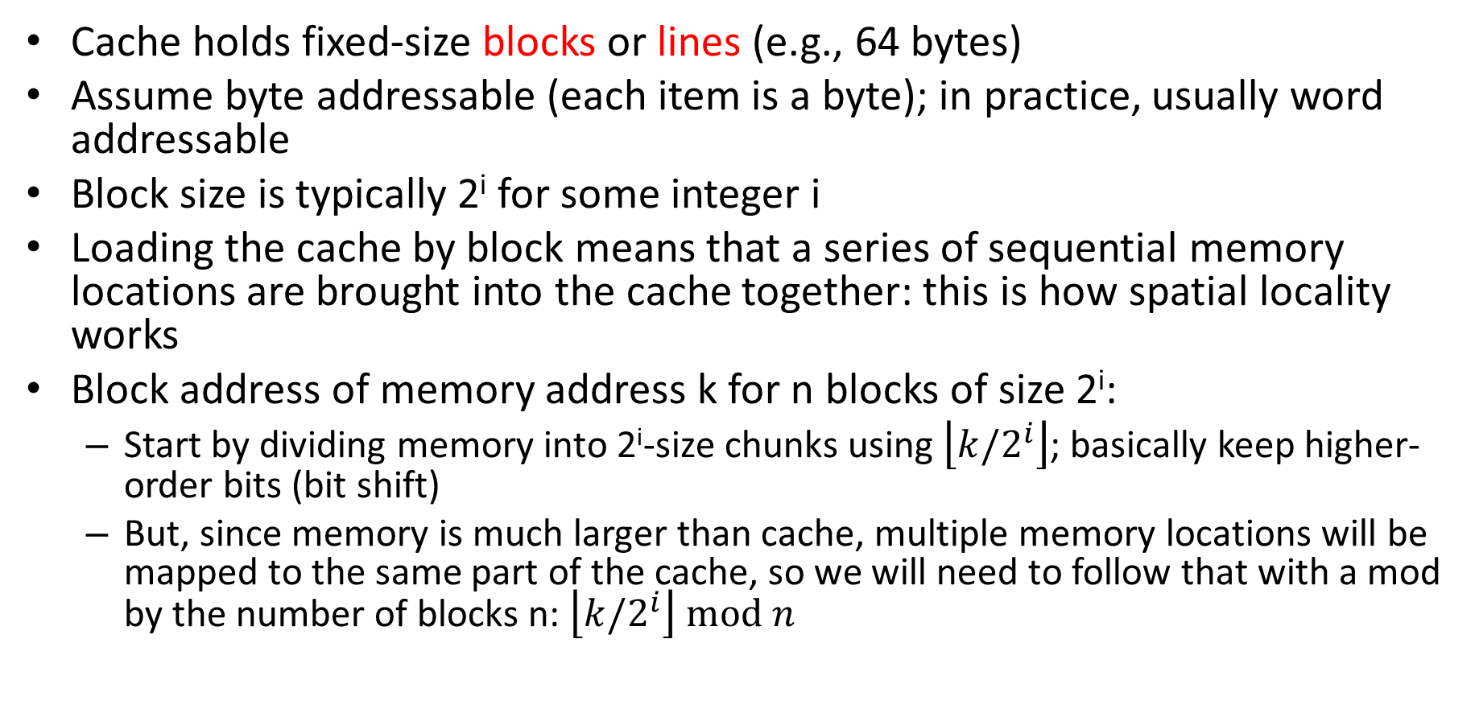
Cache Blocks
Cache holds fixed-size blocks or lines (e.g., 64 bytes)
Assume byte addressable (each item is a byte); in practice, usually word addressable
Block size is typically 2^{i} for some integer i
Loading the cache by block means that a series of sequential memory locations are brought into the cache together: this is how spatial locality works
Block address of memory address k for n blocks of size 2^{i}:
Start by dividing memory into 2^{i}-size chunks using $\left\lfloor k/2^{i}\right\rfloor$; basically keep higher-order bits (bit shift)
But, since memory is much larger than cache, multiple memory locations will be mapped to the same part of the cache, so we will need to follow that with a mod by the number of blocks n: $\left\lfloor k/2^{i}\right\rfloor mod n$

Slide 5
Cache Blocks Example
Consider the following cache:
Cache size is 4096 = 2¹² bytes
Block size is 32 = 2⁵ bytes
Byte addressable
Find the following
The number of blocks in the cache
The block address of a memory address k
The block address of memory address 6795
The other memory addresses included in the same cache block as memory address 6795

Slide 6
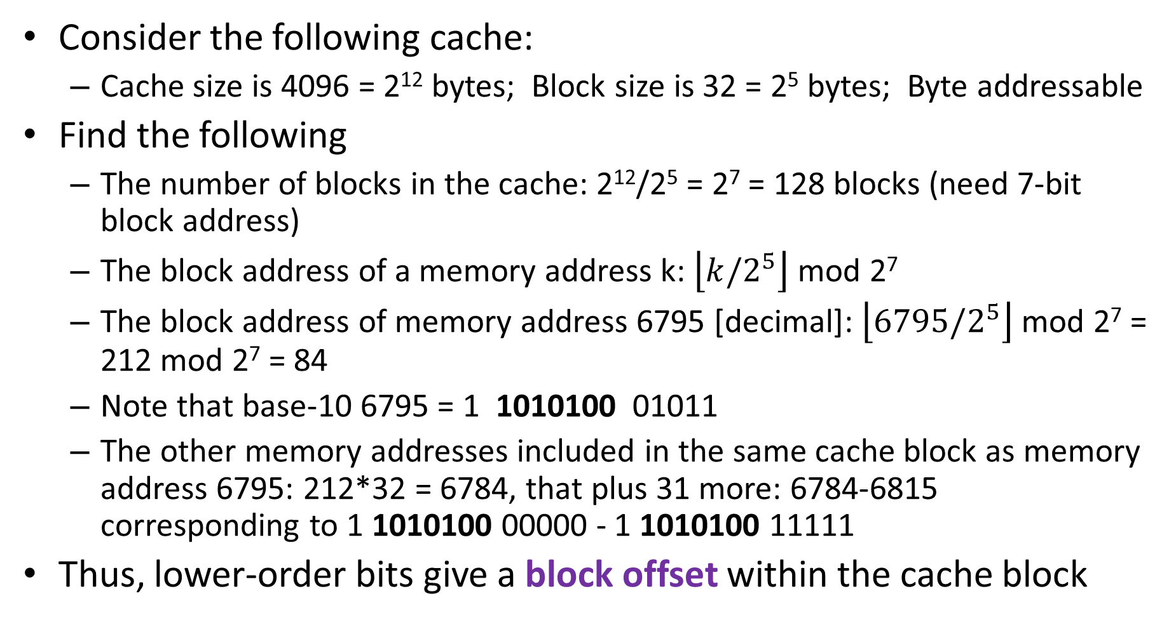
Cache Blocks Example
Consider the following cache:
Cache size is 4096 = 2¹² bytes; Block size is 32 = 2⁵ bytes; Byte addressable
Find the following
The number of blocks in the cache: 2¹²/2⁵ = 2⁷ = 128 blocks (need 7-bit block address)
The block address of a memory address k: $\left\lfloor k/2^{5}\right\rfloor$ mod 2⁷
The block address of memory address 6795 [decimal]: $\left\lfloor 6795/2^{5}\right\rfloor$mod 2⁷ = 212 mod 2⁷ = 84
Note that base-10 6795 = 1 1010100 01011
The other memory addresses included in the same cache block as memory address 6795: 212*32 = 6784, that plus 31 more: 6784-6815 corresponding to 1 1010100 00000 - 1 1010100 11111
Thus, lower-order bits give a block offset within the cache block
7-bit block address; =84
5-bit block offset

Slide 7
Cache Design Questions
Placement Policy
When a block is loaded into the cache, where does it go?
How do we find the block in the cache?
Replacement Policy
When cache becomes full, we need to delete some cache block from the cache to make room
Which block is deleted (replaced)?
Write Policy
What happens on write operations (update main memory?)

Slide 8
Cache Memory
Content Addressable Memory (hashing)
MM
address
Main
Memory
(MM)
key | data
key | data
key | data
key | data
key | data
PC
IR
Cache
Memory
MAR
Register
File
MDR
Control
Unit
Data
Hash Key to an array index, check if key matches
Key: MM address (A)
Data: contents M[A]
Hash MM address to cache memory address
Match:hit; doesn’t match:miss
Conflict resolution: none
CPU: issue request for memory location A (read/write)
Cache: Search the cache; is the contents of memory location A stored in the cache?
Many memory locations, few cache locations: this should remind you of…

Slide 9
Example: LC-3 Cache Memory
Main Memory
16-bit memory address
65K 16-bit words
Cache: 256 16-bit words
Block size: 1 word
16 bits
0A11
FFFF
MAR
Hash
Function
Cache
…
Address
Data
MDR
16 bits
16 bits
0A12
FF
0A11
1234
0A10
XX
CPU
XX
0A11
1234
…
00
Data
0000
==?
Main Memory
hit
Miss: Read data from MM into cache (overwrite that cache location)

Slide 10
Cache: Hash Function
Hash function maps a main memory address to a cache memory address
MAR: memory address
Hash (memory address)
Implemented in hardware; must be fast (simple)
Hashing Function
Use k low-order bits of address (2^{k} cache blocks)
Using low-order bits ensures addresses near each other in main memory (spatial locality) will hash to different locations in the cache

Slide 11
Example: LC-3 Cache Memory
Hash function:
Use low 8 bits of address
(address mod 256)
Main Memory
16-bit memory address
65K 16-bit words
Cache: 256 16-bit words
Block size: 1 word
16 bits
0A11
FFFF
MAR
Cache
…
Address
Data
MDR
16 bits
16 bits
0A12
FF
0A11
1234
11
0A10
XX
CPU
11
XX
0A11
1234
…
00
All addresses hashing to this location have 0x11 in the low 8 bits so no need to store them in cache
Data
0000
==?
Main Memory
hit

Slide 13
More on Caches Part 2: More Cache Design
For use in Fall 2020 CSE6010/CX4010 only
Not for distribution

Slide 14
Outline
Cache Blocks
Cache Design Questions
Placement policy
Replacement policy
Write policy
Multilevel Caches
Virtual Memory
Multiprocessor Caches
Cache coherence
False sharing

Slide 15
Direct Mapped Cache
Main Memory
16-bit memory address
65K 16-bit words
Cache: 256 16-bit words
Block size: 1 word
16 bits
0A11
FFFF
MAR
0A
11
Cache
…
Address
Data
MDR
8 bits
16 bits
0A12
FF
0A11
1234
0A10
CPU
11
0A
1234
…
00
Data
0000
==?
Main Memory
hit
Direct mapped cache: Any given address can only reside on one location in the cache

Slide 16
Placement Policy
Direct Mapped Cache
A given memory address can be placed in only one location in the cache
If two blocks map to the same cache address, the cache can only hold one, even if there is space available in other locations of the cache
Leads to more cache misses than we would like (recall misses are expensive)
Fully Associative Cache
A given memory address can be placed anywhere in the cache
K-way Set Associative Cache
A given memory address can be placed in one among K possible locations in the cache
Direct mapped and fully associative are special cases (K=1 for direct mapped, K=size of cache for fully associative)

Slide 17
Two-Way Set Associative Cache
Memory locations
0A11 and FE11 both
hash to 11 and can both be stored in the cache at the same time
MAR
9
7
9
7
Address
Data
Address
Data
MDR
9 bits
16 bits
9 bits
16 bits
7F
128
words
7F
128
words
CPU
00
00
Data
Data
==?
==?
hit
Any given memory address can reside in one among two possible locations in cache

Slide 18
Placement Policy: Tradeoffs
Direct mapped
2-way set associative
4-way set associative
8-way set associative
…
Fully associative
Simpler
Design
(faster)
Fewer
Cache
Misses
Increasing the degree of associativity results in fewer misses
“Diminishing returns” in improved miss rate as the degree of associativity increases
Higher associativity also means more complex hardware: search all possible locations in parallel to preserve speed
Virtually all caches use associativity 1 (direct mapped), 2, 4 or 8

Slide 19

Addressing in Cache
Tag larger with increasing associativity; more blocks per set so fewer sets
Tag
Higher-order bits written to differentiate among different regions of memory that map to the same location in cache
Compared against the memory address for a hit
Index
Used to select the set (not used in fully associative cache)
Block offset
Address of the desired data within the cache block
Usually a “valid” bit is included and tested if a match

Slide 20
Replacement Policy
Cache block: atomic unit of data stored in cache
LC-3 example: block = 1 word (2 bytes)
Caches usually use much larger blocks (e.g., 64 bytes)
Cache read miss: which cache block is overwritten (replaced)?
set
block
Hash (addr)
4-way set associative cache
Replacement policy selects one block (among four) in the set to be overwritten; but which one?

Slide 21
LRU Replacement
Temporal locality: blocks referenced recently likely to be referenced again soon
Therefore, blocks not referenced recently unlikely to be referenced again soon
Delete the block that has not been referenced for the longest period of time (least recently used)
Implementation:
LRU Stack (one per set)
One entry for each block
Store in stack
Hit (block i): move i to top of stack
LRU item is the one at the bottom
Hit
2
Hit
1
Hit
4
Hit
3
Hit
3
Hit
1
Miss
4
2
1
4
3
3
1
3
4
2
1
4
4
3
2
3
4
2
1
1
4
Delete
2
1
1
3
3
2
2
2
4-way set associative cache

Slide 22
Other Replacement Policies
First-In-First-Out (FIFO)
Random (randomly select one)
Pseudo-LRU:
Set of bits for each set in the cache, one for each way (2-way, 4-way)
When set accessed, bit corresponding to the way with the desired block is set
If all bits are set, reset all but most recently set
When replacing a block, choose any with bit not set
In practice
LRU is preferred approach to maximize hit rate
Relatively complex to implement
In practice, usually use random, FIFO, or an approximation to LRU

Slide 23
Write Policy
What happens on a write operation?
Hit: write data into cache, but what about main memory (MM)?
Write-through [write hit]
Immediately update MM along with cache
May generate unnecessary memory operations
Write-back (aka Copy Back) [write hit]
Do not update MM on a cache write hit
Write to MM when data deleted from cache (overwritten)
”Dirty bit” in cache indicates if the block has been modified
Write miss: Do we load block into cache?
No-write allocate (write around): do not load block in cache; typically used for write-through caches
Write allocate: load block in cache; typically used for write-back
Rationale: consider multiple successive writes to the block

Slide 25
More on Caches Part 3: Multilevel Caches and Virtual Memory
For use in Fall 2020 CSE6010/CX4010 only
Not for distribution

Slide 26
Outline
Cache Blocks
Cache Design Questions
Placement policy
Replacement policy
Write policy
Multilevel Caches
Virtual Memory
Multiprocessor Caches
Cache coherence
False sharing

Slide 27
Multi-Level Caches
Basic idea: Reduce cost of a cache miss with another cache memory
PC
Main
Memory
(MM)
IR
Level 2
Cache
Level 1
Cache
Register
File
256 K Bytes
1 ns access time
4 M Bytes
10 ns access time
Control
Unit
8 G Bytes
100 ns access time
Add second cache (L1 cache: original; add L2 cache)
Good news: L2 cache is larger than the L1 cache
Bad news: L2 cache is slower than the L1 cache
If L1 cache misses, check L2 cache; only access MM if L2 also misses
Can extend to L3, etc.

Slide 28
Cache Access Time Examples
Consider the case with L1 cache only
95% hit rate
Cache: 1ns (hit), MM: 100 ns (miss, including cache access)
What is the average access time?
Consider the case with L1 cache + L2 cache
95% hit rate in L1; 99% in L1 or L2
L1: 1 ns; L2: 10 ns; MM: 100 ns
What is the average access time?
(It will help to calculate L1 miss + L2 hit: what %?
What is the performance increase over L1 cache only?

Slide 29
Cache Access Time Examples
L1 cache only
95% hit rate
Cache: 1ns (hit), MM: 100 ns (miss, including cache access)
Average access time: 0.95*1 + 0.05*100 = 5.95 ns
(~6x performance reduction due to misses)
L1 cache + L2 cache
95% hit rate in L1; 99% in L1 or L2 (4% miss L1, hit L2)
L1: 1 ns; L2: 10 ns; MM: 100 ns
Average access time: 0.95*1+0.04*10+0.01*100 = 2.35 ns
(2.35x performance reduction due to misses)
(over 2x faster than having only an L1 cache)

Slide 30
Virtual Memory
PC
Main
Memory
(MM)
IR
Disk
Level 2
Cache
Level 1
Cache
Register
File
Control
Unit
Use main memory as a “cache” for storage on disk
Each “block” is called a “page” (4 KB or 8 KB typical)
Unlike cache, paging is implemented (mostly) with software
If read/write is to a page not in memory (miss—called a page fault), initiate disk I/O to load the page, suspend the process (run another process)
In principle, programs that use more memory than the amount of physical main memory on the machine!
Keep in mind disk speeds can be extremely slow!
Virtual memory used to keep programs executing on the same machine from interfering with each other

Slide 31
Working Set and Thrashing
For any period of time during a program’s execution it will have some set of pages it will access
Consider the execution of a function or loop
Access memory for code, local variables (stack), dynamically allocated memory, global variables
This preferred set of pages is called the working set
What happens when execution switches to another process?
Danger: If a program spends most of its time loading its working set into memory, then gives up the CPU to another process, it gets little real work accomplished. This is called thrashing.

Slide 32
Virtual Machines
Main
Memory
(MM)
PC
Main
Memory
(MM)
I/O
PC
IR
IR
PC
Main
Memory
(MM)
I/O
Register
IR
File
PC
Main
Memory
(MM)
I/O
Control
Unit
Register
IR
File
PC
Main
Memory
(MM)
I/O
Register
Control
Unit
Register
IR
File
I/O
File
Control
Unit
Register
Control
Unit
File
Control
Unit
Physical Computer
Virtual Machines
Encapsulate a program, operating system, memory, I/O devices into a virtual machine (VM)
Each VM can run a different operating system
System switches execution among different VMs on the physical hardware
System makes sure VMs do not interfere with each other
Used in cloud computing systems

Slide 34
More on Caches Part 4: Multiprocessor Caches: Cache Coherence
For use in Fall 2020 CSE6010/CX4010 only
Not for distribution

Slide 35
Outline
Cache Blocks
Cache Design Questions
Placement policy
Replacement policy
Write policy
Multilevel Caches
Virtual Memory
Multiprocessor Caches
Cache coherence
False sharing

Slide 36
Symmetric Multiprocessor (Uniform Memory Access [UMA] Architecture)
CPU
CPU
. . .
CPU
cache
cache
cache
interconnection network (e.g., bus)
memory

Slide 37
Symmetric Multiprocessor (Uniform Memory Access [UMA] Architecture)
Reads and writes to shared variable i
CPU
. . .
CPU
cache
cache
interconnection network (e.g., bus)
main memory
i = 10
block

Slide 38
Symmetric Multiprocessor (Uniform Memory Access [UMA] Architecture)
Reads and writes to shared variable i
Read i (10)
CPU
. . .
CPU
cache
cache
10
interconnection network (e.g., bus)
main memory
i = 10
block

Slide 39
Symmetric Multiprocessor (Uniform Memory Access [UMA] Architecture)
Reads and writes to shared variable i
Read i (10)
CPU
. . .
CPU
Read i (10)
cache
cache
10
10
interconnection network (e.g., bus)
main memory
i = 10
block

Slide 40
Symmetric Multiprocessor (Uniform Memory Access [UMA] Architecture)
Reads and writes to shared variable i
Read i (10)
CPU
. . .
CPU
Read i (10)
Write i, 5
cache
cache
10 5
10
10
interconnection network (e.g., bus)
main memory
Assume
Write-through
policy
i = 10
block
5

Slide 41
Symmetric Multiprocessor (Uniform Memory Access [UMA] Architecture)
Reads and writes to shared variable i
Read i (10)
CPU
. . .
CPU
Read i (10)
Write i, 5
cache
Read i (??)
cache
10
10 5
Cache hit: CPU gets old value!
10
interconnection network (e.g., bus)
main memory
i = 10
block
5

Slide 42
Cache Coherence
Caches holding “stale” data that is no longer valid is referred to as the cache coherence problem
Solutions
Write invalidate: on write, delete the block in other caches holding that block of memory

Slide 43
Symmetric Multiprocessor (Uniform Memory Access [UMA] Architecture)
Reads and writes to shared variable i
CPU
. . .
CPU
cache
cache
interconnection network (e.g., bus)
main memory
i = 10
block

Slide 44
Symmetric Multiprocessor (Uniform Memory Access [UMA] Architecture)
Reads and writes to shared variable i
Read i (10)
CPU
. . .
CPU
cache
cache
10
interconnection network (e.g., bus)
main memory
i = 10
block

Slide 45
Symmetric Multiprocessor (Uniform Memory Access [UMA] Architecture)
Reads and writes to shared variable i
Read i (10)
CPU
. . .
CPU
Read i (10)
cache
cache
10
10
interconnection network (e.g., bus)
main memory
i = 10
block

Slide 46
Symmetric Multiprocessor (Uniform Memory Access [UMA] Architecture)
Reads and writes to shared variable i
Read i (10)
CPU
. . .
CPU
Read i (10)
Write i, 5
cache
cache
10 5
10
Invalidate cache block
interconnection network (e.g., bus)
main memory
i = 10
block
5

Slide 47
Symmetric Multiprocessor (Uniform Memory Access [UMA] Architecture)
Reads and writes to shared variable i
Read i (10)
CPU
. . .
CPU
Read i (10)
Write i, 5
cache
Read i (5)
cache
10 5
10
5
interconnection network (e.g., bus)
main memory
i = 10
block
5

Slide 48
Cache Coherence
Caches holding “stale” data that is no longer valid is referred to as the cache coherence problem
Solutions
Write invalidate: on write, delete the block in other caches holding that block of memory
Write update: on write, update other caches that hold that block of memory

Slide 49
Symmetric Multiprocessor (Uniform Memory Access [UMA] Architecture)
Reads and writes to shared variable i
CPU
. . .
CPU
cache
cache
interconnection network (e.g., bus)
main memory
i = 10
block

Slide 50
Symmetric Multiprocessor (Uniform Memory Access [UMA] Architecture)
Reads and writes to shared variable i
Read i (10)
CPU
. . .
CPU
cache
cache
10
interconnection network (e.g., bus)
main memory
i = 10
block

Slide 51
Symmetric Multiprocessor (Uniform Memory Access [UMA] Architecture)
Reads and writes to shared variable i
Read i (10)
CPU
. . .
CPU
Read i (10)
cache
cache
10
10
interconnection network (e.g., bus)
main memory
i = 10
block

Slide 52
Symmetric Multiprocessor (Uniform Memory Access [UMA] Architecture)
Reads and writes to shared variable i
Read i (10)
CPU
. . .
CPU
Read i (10)
Write i, 5
cache
cache
10
10 5
Update cache protocol
10 5
10
interconnection network (e.g., bus)
main memory
i = 10
block
5

Slide 53
Symmetric Multiprocessor (Uniform Memory Access [UMA] Architecture)
Reads and writes to shared variable i
Read i (10)
CPU
. . .
CPU
Read i (10)
Write i, 5
cache
Read i (5)
cache
10
10 5
10 5
10
interconnection network (e.g., bus)
main memory
i = 10
block

Slide 54
Cache Coherence: Issues
Protocol details
Various details (e.g., when to update main memory) differ from one design to the next
Implementation: How does a cache know which other caches have a copy of a cached block?
Broadcast cache operations
Bus-based systems: monitor operations on the global bus
Known as “snooping cache protocols”
Does not scale to large multiprocessor systems
Directory-based system
Directory indicates which other caches hold a copy
To achieve scalability, many approaches involve defining different semantics of what is “correct” behavior
Cache coherence can result in significant computational overheads when reading and writing shared variables

Slide 56
More on Caches Part 5: Multiprocessor Caches: False Sharing
For use in Fall 2020 CSE6010/CX4010 only
Not for distribution

Slide 57
Outline
Cache Blocks
Cache Design Questions
Placement policy
Replacement policy
Write policy
Multilevel Caches
Virtual Memory
Multiprocessor Caches
Cache coherence
False sharing

Slide 58
Parallel Dot Product
#include <omp.h>
#include <stdio.h>
#include <stdlib.h>
#define NUM_THREADS 4
#define NUM_ELEM 100
double A[NUM_ELEM], B[NUM_ELEM]; // inputs; initialization not shown
double C[NUM_THREADS]; // result computed by each thread
double Result; // final result
int main (void)
{
int i, nthreads; // shared variables
omp_set_num_threads(NUM_THREADS);
#pragma omp parallel
{ int i, id, nthrds; // private variables
id = omp_get_thread_num();
nthrds = omp_get_num_threads();
if (id == 0) nthreads = nthrds; // one thread writes nthreads
for (i=id, C[id]=0.0; i<NUM_ELEM; i+=nthrds) C[id] += A[i]*B[i];
}
for (i=0, Result=0.0; i<nthreads; i++) Result += C[i];
printf ("result = %f\n", Result);
}
C[] is a shared variable
Each thread reads and modifies its own separate element of C

Slide 59
False Sharing
for (i=id, C[id]=0.0; i<NUM_ELEM; i+=nthrds)
C[id] += A[i]*B[i];
Thread 0
Thread 1
Thread 2
CPU
CPU
CPU
Read C[0]
Write C[0]
. . .
cache
cache
cache
Invalidate
C[0]
C[1]
C[2]
C[3]
C[4]
Invalidate
C[0]
C[1]
C[2]
C[3]
C[4]
C[0]
C[1]
C[2]
C[3]
C[4]
interconnection network (e.g., bus)
main memory
C[0]
C[1]
C[2]
C[3]
C[4]
block

Slide 60
False Sharing
for (i=id, C[id]=0.0; i<NUM_ELEM; i+=nthrds)
C[id] += A[i]*B[i];
Thread 0
Thread 1
Thread 2
CPU
CPU
CPU
. . .
cache
cache
cache
C[0]
C[1]
C[2]
C[3]
C[4]
interconnection network (e.g., bus)
main memory
C[0]
C[1]
C[2]
C[3]
C[4]
block

Slide 61
False Sharing
for (i=id, C[id]=0.0; i<NUM_ELEM; i+=nthrds)
C[id] += A[i]*B[i];
Thread 0
Thread 1
Thread 2
CPU
CPU
CPU
Read C[1]
Write C[1]
. . .
cache
cache
cache
C[0]
C[1]
C[2]
C[3]
C[4]
Invalidate
C[0]
C[1]
C[2]
C[3]
C[4]
interconnection network (e.g., bus)
main memory
C[0]
C[1]
C[2]
C[3]
C[4]
block

Slide 62
False Sharing
for (i=id, C[id]=0.0; i<NUM_ELEM; i+=nthrds)
C[id] += A[i]*B[i];
Thread 0
Thread 1
Thread 2
CPU
CPU
CPU
. . .
cache
cache
cache
C[0]
C[1]
C[2]
C[3]
C[4]
interconnection network (e.g., bus)
main memory
C[0]
C[1]
C[2]
C[3]
C[4]
block

Slide 63
False Sharing
for (i=id, C[id]=0.0; i<NUM_ELEM; i+=nthrds)
C[id] += A[i]*B[i];
Thread 0
Thread 1
Thread 2
CPU
CPU
CPU
Read C[2]
Write C[2]
. . .
cache
cache
cache
Invalidate
C[0]
C[1]
C[2]
C[3]
C[4]
C[0]
C[1]
C[2]
C[3]
C[4]
interconnection network (e.g., bus)
main memory
C[0]
C[1]
C[2]
C[3]
C[4]
block

Slide 64
False Sharing
for (i=id, C[id]=0.0; i<NUM_ELEM; i+=nthrds)
C[id] += A[i]*B[i];
Thread 0
Thread 1
Thread 2
CPU
CPU
CPU
. . .
cache
cache
cache
C[0]
C[1]
C[2]
C[3]
C[4]
interconnection network (e.g., bus)
main memory
C[0]
C[1]
C[2]
C[3]
C[4]
block

Slide 65
False Sharing
for (i=id, C[id]=0.0; i<NUM_ELEM; i+=nthrds)
C[id] += A[i]*B[i];
Thread 0
Thread 1
Thread 2
CPU
CPU
CPU
Read C[0]
. . .
cache
cache
cache
C[0]
C[1]
C[2]
C[3]
C[4]
C[0]
C[1]
C[2]
C[3]
C[4]
interconnection network (e.g., bus)
main memory
C[0]
C[1]
C[2]
C[3]
C[4]
block

Slide 66
False Sharing
for (i=id, C[id]=0.0; i<NUM_ELEM; i+=nthrds)
C[id] += A[i]*B[i];
Thread 0
Thread 1
Thread 2
CPU
CPU
CPU
Read C[0]
Write C[0]
. . .
cache
cache
cache
Invalidate
C[0]
C[1]
C[2]
C[3]
C[4]
C[0]
C[1]
C[2]
C[3]
C[4]
interconnection network (e.g., bus)
main memory
C[0]
C[1]
C[2]
C[3]
C[4]
block

Slide 67
False Sharing
for (i=id, C[id]=0.0; i<NUM_ELEM; i+=nthrds)
C[id] += A[i]*B[i];
Thread 0
Thread 1
Thread 2
CPU
CPU
CPU
. . .
cache
cache
cache
C[0]
C[1]
C[2]
C[3]
C[4]
interconnection network (e.g., bus)
main memory
C[0]
C[1]
C[2]
C[3]
C[4]
block

Slide 68
Observations
Each read/write sequence on C[i] results in a cache miss and an invalidation operation, resulting in poor performance
Each thread is referencing a different element of the shared variable, but the shared variable maps to the same cache block
This phenomenon is called false sharing; the processors believe the threads are accessing the same variable because it does not differentiate among references to different variables within the same block—the block is shared, but no word in the block is shared
Update protocols do better, but also have performance issues: unnecessary copying of data among the caches, especially for large numbers of processors

Slide 69
Solutions
Make sure shared variables accessed by different threads are placed in different cache blocks
Requires knowledge of details of cache (e.g., block size)
Moving to a different machine can degrade performance
A better solution is to redesign data structures to reduce the frequency of references to shared variables or eliminate them altogether when not essential

Slide 70
Revised Parallel Dot Product
double A[NUM_ELEM], B[NUM_ELEM]; // inputs to computation
double Result=0.0; // final result
int main (void)
{ int i, nthreads; // shared variables
#pragma omp parallel
{
int i, id, nthrds; // private variables
double MyC;
id = omp_get_thread_num();
nthrds = omp_get_num_threads();
for (i=id, MyC=0.0; i<NUM_ELEM; i+=nthrds) MyC += A[i]*B[i];
// above, no other threads modify A[] and B[]
// critical section to sum up results
#pragma omp critical
{
Result += MyC;
}
}
printf ("result = %f\n", Result);
}
Eliminates false sharing by replacing C[] with a private variable

Slide 71
Things You Should Know About Caches
Caches are used extensively throughout computer systems (not just CPUs)
Cache memory essential because memory is slow
Concept applies throughout all computer systems (virtual memory; web caching on the Internet)
Key design questions include the replacement policy (e.g., LRU)
Programs exhibit spatial and temporal locality
Caches can have a significant impact on execution time
Increasing locality can improve performance
Multiprocessors: Be aware that cache coherence and false sharing can significantly impact performance

