Slide 1
Parallel Programming Using OpenMP
Part 1: Overview

Slide 2
References
Sterling, Thomas, Matthew Anderson, Maciej Brodowicz, and C. Gordon Bell. High Performance Computing: Modern Systems and Practices. 2018. https://gatech-primo.hosted.exlibrisgroup.com/permalink/f/1vgrnp4/01GALI_GIT_ALMA51319920530002947
OpenMP web site: http://openmp.org/wp/
Online tutorial: https://computing.llnl.gov/tutorials/openMP/

Slide 3
Outline
Overview
Threads and How to Create Them
Shared and Private Variables
Synchronization
Barriers
Mutual Exclusion

Slide 4
Introduction
OpenMP a widely used parallel programming environment for shared memory multiprocessors
Supports C, C++, FORTRAN
OpenMP primitives for
Creating and executing “threads”
Shared and private variables
Synchronization to order operations among concurrent threads
Other features to improve programability and/or performance

Slide 5
OpenMP Overview
Augment C programs with OpenMP primitives
Compiler directives (#pragma) to support parallel execution
OpenMP library including functions to manage execution
Compiler extension
gcc foo.c –o foo -fopenmp

Slide 6
Approach to Parallelization
Main Steps:
Develop a strategy for what parts of the computation will execute in parallel
Develop sequential code for the computation, roughly structured around the parallelization strategy (e.g., anticipating parallelization of loops)
Modify code, adding OpenMP primitives
Measure and optimize performance

Slide 7
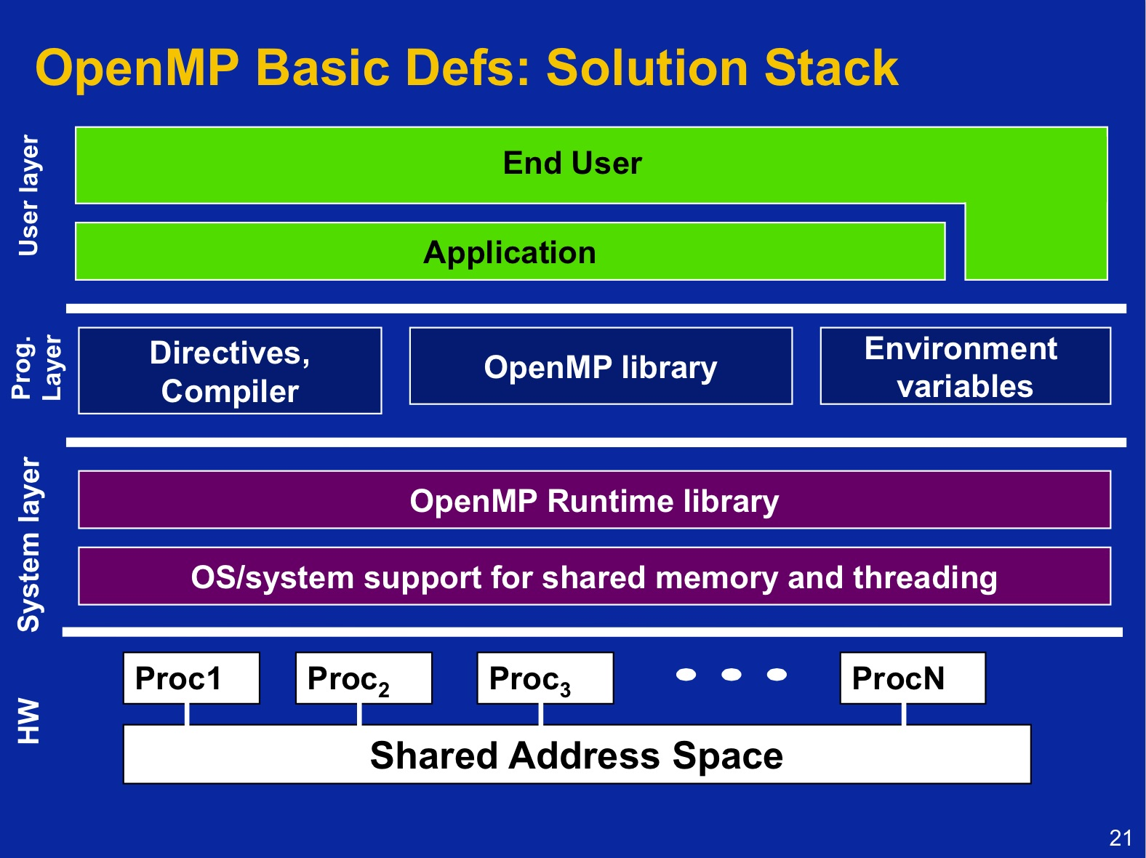
From T. Mattson, “A ‘Hands-on’ Introduction to OpenMP”.

Slide 8
Structured Block
Used in most OpenMP constructs
Structured Block: one or more statements that have one point of entry at the top, and one point of exit at the bottom
In C, code within braces: { C code }
Function calls within block are allowed
Branches into or leaving the block at locations other that the start or end are not allowed
Exception: may call exit() within the structured block

Slide 10
Parallel Programming Using OpenMP
Part 2: Threads

Slide 11
Outline
Overview
Threads and How to Create Them
Shared and Private Variables
Synchronization
Barriers
Mutual Exclusion

Slide 12
Programming Model
private
variables
private
variables
thread
thread
private
variables
private
variables
thread
thread
Shared variables
Thread: sequentially executing program
Private variables: only visible within thread
Shared variables: visible across all threads

Slide 13
Processes and Threads
A thread is a sequentially executing program
Code
Runtime stack (local variables): private in OpenMP
Global variables: shared in OpenMP
Operating system (OS) schedules the threads to execute on different cores (processors)
May be more threads than cores
Not to be confused with an operating system “process” (program executing on computer)
Similar in that both allow concurrent execution
The OS protects processes from interfering with each other; OS does not do this for threads!
A process typically includes multiple threads
Less overhead (time) to switch execution among threads; threads sometimes referred to as “lightweight processes”

Slide 14
Parallel Hello World
printf (“hello world\n”);
printf (“hello world\n”);
resume
main()
main()
printf (“hello world\n”);
Fork
Join
time
Phase 1: main() program (same as sequential)
Phase 2: fork – create threads; concurrently execute threads
Phase 3: join – terminate threads; resume execution of main() when all threads done executing

Slide 15
Creating (Forking) Threads
#pragma omp parallel {structured block}
A set of threads are created
Each begins executing the code for the structured block within the braces { … }
The threads may execute concurrently on different processors (cores)
The code following the above statement only begins executing when all of the threads have completed execution

Slide 16
Hello World Code
Defines OpenMP prototypes and types
#include <stdio.h>
#include <stdlib.h>
int main (void)
{ printf ("Hello ”);
printf (" World\n”);
printf (“Done\n”);
}
#include <omp.h>
#include <stdio.h>
#include <stdlib.h>
int main (void)
{ omp_set_num_threads(2);
#pragma omp parallel
{
int ID=omp_get_thread_num();
int num_threads = omp_get_num_threads();
printf ("Hello(%d) ", ID);
printf (" World(%d)\n”, ID);
}
printf (“Done\n”);
}
Specify number of threads to be created
Create (fork) the parallel threads
Return the id of this thread (0, 1, 2, …)
Return the number of threads
Only execute here when all of the threads have completed execution

Slide 17
Output from Parallel Hello World
Typical output:
Hello(0) World(0)
Hello(1) World(1)
Done
The operating system may interleave the execution of the two threads in arbitrary ways. Another possible output:
Hello(1) Hello(0) World(0)
World(1)
Done

Slide 19
Parallel Programming Using OpenMP
Part 3: Shared and Private Variables

Slide 20
Outline
Overview
Threads and How to Create Them
Shared and Private Variables
Synchronization
Barriers
Mutual Exclusion

Slide 21
Shared and Private Variables
Private variables can only be accessed by a single thread
Local variables declared within a parallel thread
Local variables in functions called by the thread
Essentially, variables stored on the thread’s stack
Shared variables can be accessed by different threads
Global variables
Local variables declared outside the thread scope (e.g., variables declared inside main())
Access to private variables is generally faster than access to shared variables

Slide 22
Memory Map
code segment
main(){ … }
foo() { … }
double x,y,z;
int main (void)
{ int i, j;
#pragma omp parallel
{
int ID;
int num_threads;
printf ("Hello(%d) ", ID);
printf (" World(%d)\n”, ID);
foo ();
}
printf (“Done\n”);
}
int foo (void)
{ int a, b;
}
shared variables
(only one copy)
i:
J:
stack variables for
main()
dynamically allocated memory
(malloc)
x:
y:
z:
global variables
ID:
num_theads:
a:
b:
stack variables for thread 1
private variables
(one copy per
thread)
…
ID:
num_theads:
a:
b:
stack variables for thread n

Slide 23
Example: Dot Product
Problem statement
Compute C = Σ (A[i]*B[i]) for i=0, 1, … N-1
Sequential code
double A[N], B[N], C;
int i;
for (i=0, C=0.0; i<N; i++) {
C = C + A[i]*B[i];
}
Parallelization strategy
Assume we have T threads
Map different iterations of the for loop to the T threads
Compute a global sum of the values computed by the different threads

Slide 24
Allocation of Iterations to Threads
Round-Robin allocation, e.g., for 4 threads
Iteration 0
Iteration 1
Iteration 2
Iteration 3
Iteration 4
Iteration 5
Iteration 6
Iteration 7
Iteration 8
…
Thread 0
Thread 1
Thread 2
Thread 3
Iterations 0, 4, 8, 12, …
Iterations 1, 5, 9, 13, …
Iterations 2, 6, 10, 14, …
Iterations 3, 7, 11, 15, …
// code for each thread
id = omp_get_thread_num(); // 0,1,2,…
nthrds = omp_get_num_threads();
for (i=id; i<NUM_ITERATIONS; i+=nthrds) {
…
}

Slide 25
Example: Parallel Dot Product
#include <omp.h>
#include <stdio.h>
#include <stdlib.h>
#define NUM_THREADS 4
#define NUM_ELEM 100
double A[NUM_ELEM], B[NUM_ELEM]; // inputs; initialization not shown
double C[NUM_THREADS]; // result computed by each thread
double Result; // final result
int main (void)
{
int i, nthreads; // shared variables
omp_set_num_threads(NUM_THREADS);
#pragma omp parallel
{ int i, id, nthrds; // private variables
id = omp_get_thread_num();
nthrds = omp_get_num_threads();
if (id == 0) nthreads = nthrds; // one thread writes nthreads
for (i=id, C[id]=0.0; i<NUM_ELEM; i+=nthrds) C[id] += A[i]*B[i];
}
for (i=0, Result=0.0; i<nthreads; i++) Result += C[i];
printf ("result = %f\n", Result);
}
One result per thread
Accumulate (sequentially) results from different threads

Slide 26
Private vs. Shared Variables
In general, accesses to private (local to thread) variables are usually faster than access to shared variables
If accessed often, private variables will be kept in the processor’s cache memory
Shared variables will also be cached, but there are some additional overheads required to manage them if more than one processor accesses and modifies the variables
Maximize use of local / private variables to achieve best performance

Slide 27
Example: Parallel Dot Product
#include <omp.h>
#include <stdio.h>
#include <stdlib.h>
#define NUM_THREADS 4
#define NUM_ELEM 100
double A[NUM_ELEM], B[NUM_ELEM]; // inputs; initialization not shown
double C[NUM_THREADS]; // result computed by each thread
double Result; // final result
int main (void)
{
int i, nthreads; // shared variables
omp_set_num_threads(NUM_THREADS);
#pragma omp parallel
{ int i, id, nthrds; // private variables
double MyC; // private variable; sum results from thread
id = omp_get_thread_num();
nthrds = omp_get_num_threads();
if (id == 0) nthreads = nthrds; // one thread writes nthreads
for (i=id, MyC=0.0; i<NUM_ELEM; i+=nthrds) MyC += A[i]*B[i];
C[id] = MyC; // write result from this thread
}
for (i=0, Result=0.0; i<nthreads; i++) Result += C[i];
printf ("result = %f\n", Result);
}
Private variable holds result from each thread

Slide 29
Parallel Programming Using OpenMP
Part 4: Synchronization

Slide 30
Outline
Overview
Threads and How to Create Them
Shared and Private Variables
Synchronization
Barriers
Mutual Exclusion

Slide 31
Sequence of Parallel Computations
Many parallel computations are structured as a sequence of steps, where each step computes results used by the next step
Each step involves a parallel computation
Intermediate
result
Intermediate
result
…
…
Step i
Step i+1
Step i+2
Mechanism needed to ensure no thread begins the next step until all threads complete the current step
Barrier synchronization performs this function

Slide 32
Barrier Synchronization
Thread 1
Thread 2
Thread 3
Thread 4
- barrier -
wallclock
time
wait
- barrier -
- barrier -
wait
wait
- barrier -
Barrier Synchronization: when a thread invokes the barrier primitive, it will block until all other threads have also invoked the barrier primitive.
When the last thread invokes the barrier, all threads can resume execution

Slide 33
Barrier Synchronization in Open MP
OpenMP provides a simple barrier primitive
#pragma omp parallel
{
<computation 1>
# pragma omp barrier
<computation 2>
}
// OpenMP automatically inserts a
// barrier at the end of the
// parallel pragma

Slide 34
Outline
Overview
Threads and How to Create Them
Shared and Private Variables
Synchronization
Barriers
Mutual Exclusion

Slide 35
Problem: Concurrent Access to Shared Variables
Thread 1
Insert into linked list
Thread 2
Insert into linked list
time
Incorrect results can occur when more than one thread concurrently modifies shared variables
Such errors called “race conditions”
Execution is often not repeatable
Bugs due to race conditions can be very difficult to detect/fix
Need a mechanism to guarantee “one at a time” access to shared data structures

Slide 36
Critical Sections
Critical section: A section of code where it is guaranteed that at most one thread can be executing in a critical section at one time
Code that accesses and modifies shared variables, should be placed within a critical section

Slide 37
Critical Sections in OpenMP
Use OpenMP “critical” primitive to create critical sections
#pragma omp critical
{
code for critical section
}
Example
#pragma omp parallel
{
#pragma omp critical
{
i = i + 1;
}
}

Slide 38
Dot Product Revisited
double A[NUM_ELEM], B[NUM_ELEM]; // inputs to computation
double Result=0.0; // final result
int main (void)
{ int i, nthreads; // shared variables
#pragma omp parallel
{
int i, id, nthrds; // private variables
double MyC;
id = omp_get_thread_num();
nthrds = omp_get_num_threads();
for (i=id, MyC=0.0; i<NUM_ELEM; i+=nthrds) MyC += A[i]*B[i];
// above, no other threads modify A[] and B[]
// critical section to sum up results
#pragma omp critical
{
Result += MyC;
}
}
printf ("result = %f\n", Result);
}
Sum collectively computed by the threads
Note: critical section needed

Slide 39
Key Point
Whenever multiple threads can concurrently access and modify one or more common, shared variables or data structures, a critical section is needed!
Failure to do this can lead to very difficult-to-fix bugs that often cannot be easily be reproduced (race condition)!

Slide 40
Summary
Threads
Key aspect of parallelization is deciding how to distribute the computation across multiple threads
Tradeoff between number of threads (parallelism), computation per thread (shared variables, synchronization overheads)
Shared and private variables
Critical to understand which variables are private, which are shared, both for correctness and performance
Use private variables whenever possible for best performance
Synchronization
Barriers separate parallel computations in time
Critical sections for access to shared variables
Synchronization time consuming; use sparingly

