Slide 1
Priority Queues, Trees and Heaps Part 1: Motivation and Binary Trees
For use in Fall 2020 CSE6010/CX4010 only
Not for distribution

Slide 2
Outline
Motivation; priority queue operations
Binary trees
Heaps and the “heap property”
Delete operation
Insert operation
Array implementation of heaps

Slide 3

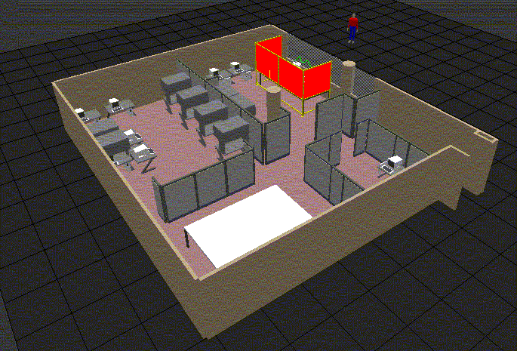
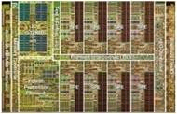
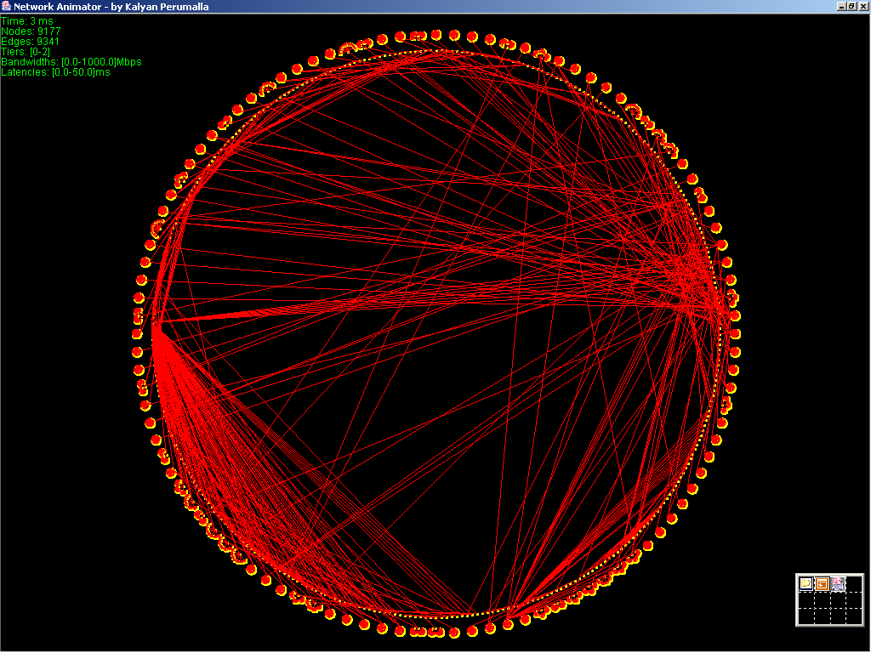
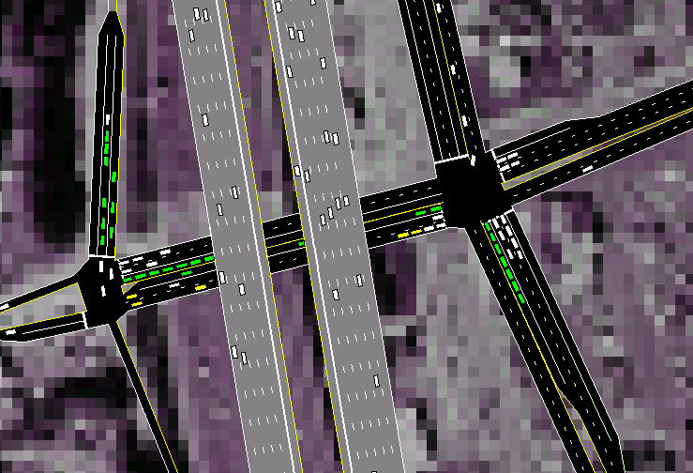
Motivation Discrete Event Simulation Applications
Healthcare Systems
Manufacturing and supply chains
Transportation
Computer Systems
Communication networks, Cybersecurity

Slide 4
Discrete Event Simulation
example: air traffic at an airport
events: aircraft arrival, landing, departure
arrival
8:00
schedules
departure
9:15
arrival
9:30
processed event
current event
unprocessed event
landed
8:05
schedules
simulation time
Execution consists of a sequence of event computations
Unprocessed events stored in a priority queue
Events are processed in timestamp order

Slide 5
Priority Queue: Operations
Each item in priority queue contains a priority (timestamp)
Here, assume a smaller priority value means higher priority
Discrete event simulation: priority = event timestamp
Required Operations
Insert (data, priority);
Add new “data” with priority to the queue
Data = Delete ();
Remove highest priority (smallest timestamp) item, return pointer to data
Constraints
Maximum number of items required at one time unknown
Maximum number may be very large
Memory allocation issues
Sequence of Insert and Delete operations unknown
Distribution of priority values on successive insert operations unknown
Would like efficient access, especially for queues with a large number of items

Slide 6
Consider data structures we know
Given the constraints just listed (and repeated below), list some advantages and disadvantages to using implementations we have already seen for queues and stacks:
Array
Singly linked list
Doubly linked list
Constraints
Maximum number of items required at one time unknown
Maximum number may be very large
Memory allocation issues
Sequence of Insert and Delete operations unknown
Distribution of priority values on successive insert operations unknown
Would like efficient access, especially for queues with a large number of items

Slide 7
Consider data structures we know
Given the constraints just listed (and repeated below), list some advantages and disadvantages to using implementations we have already seen for queues and stacks:
Array + Simple - Inconvenient in terms of memory requirements and access (find a particular event)
Singly linked list + Better memory usage compared to an array, less memory intensive to preserve sort when adding - Still inconvenient in terms of access as well as maintaining sort (hard to find right spot to insert)
Doubly linked list Same advantages and disadvantages as singly linked list; no real advantage from the double linking
We would like a better option to help with ordering by priority – today we will discuss the use of a heap data structure for this purpose

Slide 8
(Binary) Tree Data Structure
A connected, directed, acyclic graph of n nodes
One node special, called the root
Each node has links to 0, 1, or 2 child nodes (could be more if not binary)
A node with no child nodes is called a leaf
Each node, except the root, has exactly 1 parent node
Parent of node p referred to as p->parent
root
Level 1
Level 2
leaf
leaf
leaf
Level 3

Slide 9
Binary Tree Node Data Structure
root
Level 1
Level 2
parent
In many situations a pointer to the parent is not needed
priority (for PQ)
leaf
leaf
leaf
Level 3
left
right
Node Data
Structure
struct node {
struct node *parent; // pointer to parent
double priority; // priority of item (for priority queue)
struct node *left; // left child
struct node *right; // right child
… // other event fields
}

Slide 10
Things You Should Know About Binary Trees
Recursive definition: the child of any node in a tree is the root of another tree (subtree); suggests recursive algorithms!
What is the maximum number of nodes in a tree with L levels?
1 level:
1 node
2 levels:
3 node
3 levels:
7 node
4 levels:
15 node
Each new level approximately doubles the number of possible nodes: up to 2^{L} – 1 nodes with L levels
Number of nodes grows exponentially with the number of levels
Sometimes defined in terms of tree “height”, which is L-1

Slide 11
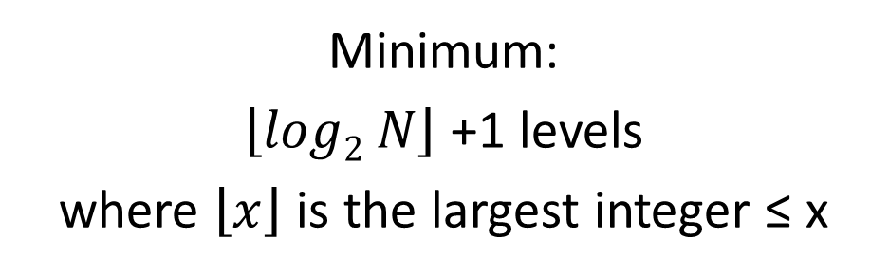
Things You Should Know About Binary Trees
How many levels can there be in a binary tree with N nodes (maximum, minimum)?
N | Min | N | min
1 | 1 | 9 | 4
2 | 2 | 10 | 4
3 | 2 | 11 | 4
4 | 3 | 12 | 4
5 | 3 | 13 | 4
6 | 3 | 14 | 4
7 | 3 | 15 | 4
8 | 4 | 16 | 5
1
1
2
2
3
3
~ log(N) levels
4
5
6
7
N levels
…
8
9
10
11
12
13
14
15
…
N
Minimum:
$\left\lfloor log2 N\right\rfloor$ +1 levels
where $\left\lfloor x\right\rfloor$ is the largest integer ≤ x
Maximum:
N levels
Notes:
Floor(x): take X and round down to the integer value

Slide 12
Full Binary Tree
Full binary tree
Each level, except (possibly) last, is completely filled
OK if the last level is completely full
Last level: nodes filled from left to right (no empty spots)
10
50
30
100
70
40
60
110
150
100
90
200
210
80

Slide 14
Priority Queues, Trees and Heaps Part 2: Getting to Know Heaps
For use in Fall 2020 CSE6010/CX4010 only
Not for distribution

Slide 15
Outline
Motivation; priority queue operations
Binary trees
Heaps and the “heap property”
Delete operation
Insert operation
Array implementation of heaps

Slide 16
Heap Data Structure
Full binary tree
Heap property: each node has a smaller priority than that of either of its children (or equal)
p->priority ≤ p->left->priority
p->priority ≤ p->right->priority
p->parent->priority ≤ p->priority
Left child may have smaller or larger priority compared to the right child
Where is the node w/ smallest priority?
root
leaf
leaf
leaf
The root node has the smallest priority!

Slide 17
Examples: Heaps?
Full binary tree
Node’s priority (timestamp) field less than or equal to that of each child node
Are these heaps? Why or why not?
Consider how to implement delete and insert with a heap.

Slide 18
Examples: Heaps?
Full binary tree
Node’s priority (timestamp) field less than or equal to that of each child node
Are these heaps? Why or why not?
X
X
Heap?
No
Heap?
No
Heap?
Yes
Note that a heap does not have to be sorted!

Slide 19
Heap Operations: Delete
10
50
30
100
70
40
60
110
150
100
90
200
210
80
Delete():
Which node do we delete? The one with the smallest priority value! Remove root
Move “last” node (rightmost node in last level) to root: easiest way to ensure full binary tree
Migrate root down tree as far as necessary to maintain heap property
(compare node w/ left/right child, swap node w/ smaller child if necessary)

Slide 20
Heap Operations: Delete
delete
10
50
30
100
70
40
60
110
150
100
90
200
210
80
Delete():
Remove root
Move “last” node to root
Migrate root down tree as far as necessary to maintain heap property
(compare node w/ left/right child, swap node w/ smaller child if necessary)

Slide 21
Heap Operations: Delete
Is heap property satisfied?
80
50
30
100
70
40
60
110
150
100
90
200
210
Delete():
Remove root
Move “last” node to root
Migrate root down tree as far as necessary to maintain heap property
(compare node w/ left/right child, swap node w/ smaller child if necessary)

Slide 22
Heap Operations: Delete
swap with smaller child
80
50
30
100
70
40
60
110
150
100
90
200
210
Delete():
Remove root
Move “last” node to root
Migrate root down tree as far as necessary to maintain heap property
(compare node w/ left/right child, swap node w/ smaller child if necessary)

Slide 23
Heap Operations: Delete
30
Is heap property satisfied?
50
80
100
70
40
60
110
150
100
90
200
210
Delete():
Remove root
Move “last” node to root
Migrate root down tree as far as necessary to maintain heap property
(compare node w/ left/right child, swap node w/ smaller child if necessary)

Slide 24
Heap Operations: Delete
30
50
80
swap
100
70
40
60
110
150
100
90
200
210
Delete():
Remove root
Move “last” node to root
Migrate root down tree as far as necessary to maintain heap property
(compare node w/ left/right child, swap node w/ smaller child if necessary)

Slide 25
Heap Operations: Delete
30
50
40
100
70
80
60
Is heap property satisfied?
110
150
100
90
200
210
Delete():
Remove root
Move “last” node to root
Migrate root down tree as far as necessary to maintain heap property
(compare node w/ left/right child, swap node w/ smaller child if necessary)

Slide 26
Heap Operations: Delete
30
50
40
100
70
80
60
Done!
110
150
100
90
200
210
Delete():
Remove root
Move “last” node to root
Migrate root down tree as far as necessary to maintain heap property
(compare node w/ left/right child, swap node w/ smaller child if necessary)

Slide 27
Insert Operation
Insert (p)
Add p to next available node in last level (easiest way to maintain full binary tree)
Move node up toward root preserving the heap property

Slide 28
Example
30
50
40
100
70
80
60
110
150
100
90
200
210
Insert(35)

Slide 29
Example (cont.)
30
50
40
100
70
80
60
New node
110
150
100
90
200
210
35
Insert(35)

Slide 30
Example (cont.)
30
50
40
Is heap property satisfied?
100
70
80
60
110
150
100
90
200
210
35
Insert(35)

Slide 31
Example (cont.)
30
50
40
100
70
80
60
swap
110
150
100
90
200
210
35
Insert(35)

Slide 32
Example (cont.)
30
Is heap property satisfied?
50
40
100
70
80
35
110
150
100
90
200
210
60
Insert(35)

Slide 33
Example (cont.)
30
50
40
swap
100
70
80
35
110
150
100
90
200
210
60
Insert(35)

Slide 34
Example (cont.)
30
Is heap property satisfied?
50
35
100
70
80
40
110
150
100
90
200
210
60
Insert(35)

Slide 35
Example (cont.)
30
Done!
50
35
100
70
80
40
110
150
100
90
200
210
60
Insert(35)

Slide 36
Heaps
Note that what we have been working with is often called a min-heap, meaning that each node must be no larger than either of its children (root is MIN).
We could also use a max-heap, where each node must be no smaller than either of its children (root is MAX).

Slide 37
Heaps: Examples
1
Start from the heap shown
Specify the steps involved in inserting 5 into the min-heap and show the heap after doing so
Then, specify the steps involved in deleting from the updated min-heap and show the heap after doing so
3
6
4
11
7
9
7
6
12
15
8
19

Slide 38
Heaps: Examples
To insert 5: add to next available position and heapify-up
1
1
3
6
3
5
4
11
7
9
4
11
7
6
7
6
12
15
8
19
7
6
12
15
8
19
9

Slide 39
Heaps: Examples
To delete: delete the root, move the last node to the root, and heapify-down
1
3
3
5
4
5
4
11
7
6
6
11
7
6
7
6
12
15
8
19
9
7
9
12
15
8
19

Slide 41
Priority Queues, Trees and Heaps Part 3: Array Implementation for Heaps
For use in Fall 2020 CSE6010/CX4010 only
Not for distribution

Slide 42
Outline
Motivation; priority queue operations
Binary trees
Heaps and the “heap property”
Delete operation
Insert operation
Array implementation of heaps

Slide 43
Array Implementation of Trees
Eliminate pointers! Get direct access!
Root is 0; number nodes sequentially from left to right, level by level
0
30
1
50
0
2
35
30
3
100
1
2
4
70
50
35
5
80
6
40
3
4
5
6
7
110
100
70
80
40
8
150
9
100
7
8
9
10
11
12
13
10
90
110
150
100
90
200
210
60
11
200
12
210
Node number used as array index
Left child of node i = 2i+1; right child = 2i+2
13
60

Slide 44
Node Numbering
Multiplication by 2: Shift binary representation left 1 bit
(rightmost bit: 0)
example: 00000011->00000110
i
2i+1
2i+2
Division by 2: Shift binary representation right 1 bit
(leftmost bit: copy most sig. bit)
example: 00000011->00000001
Aside: these operations also work for negative numbers using 2’s complement representation (most significant bit has negative weight)
In C left shift is <<, right shift is >>
Left child of i: (i<<1)+1
Right child of i: (i<<1)+2
Parent of j: (j-1)>>1
2i+1: ((2i+1) -1)=2i
2i+2: ((2i+2) -1)=2i+1

Slide 45
Pseudo-code: Deletion
Side note on pseudo-code:
Basically a way to specify an algorithm without focusing on specific syntax
Written for humans, not a compiler
Goal is to be easy to read/understand
There is no one “right way”!
Global variables:
heap[]
elementNumber // number of elements in heap
Code:
function heap_delete()
heap[0] = heap[elementNumber-1]
elementNumber = elementNumber-1
heapify_down(0)
function heapify_down(i)
if heap[i]<heap[2*i+1] and heap[i]<heap[2*i+2] // check heap property
return
if heap[2*i+1]<heap[2*i+2] // left node < right
swap heap[i] and heap[2*i+1]
heapify_down(2*i+1) // note: recursive function call!
else // right node >= left
swap heap[i] and heap[2*i+2]
heapify_down(2*i+2)
What if node i has no child?
What if node i has only one child?
Need to modify code to handle these cases
root
leaf
leaf
leaf

Slide 46
Pseudo-code: Insertion
Global variables:
heap[]
elementNumber // heap indexed from 1 to elementNumber-1
Code:
heap_insert(the_new_value)
heap[elementNumber] = the_new_value
heapify_up(elementNumber)
elementNumber = elementNumber+1
function heapify_up(i)
if i==0, return // this is the root
if heap[i]<heap[(i-1)/2] // if this node < its parent
swap heap[i] and heap[(i-1)/2]
heapify_up((i-1)/2)
root
leaf
leaf
leaf

Slide 47
Recursive Functions
A function that calls itself is called a recursive function
Arises from the recursive nature of the problem
Here: parent of a heap node forms a heap with the parent as its root
All recursive functions have
A place where the function calls itself
Termination condition (no additional recursive calls for this invocation of the function)
Global variables:
heap[]
elementNumber
Code:
heap_insert(the_new_value)
heap[elementNumber] = the_new_value
heapify_up(elementNumber)
elementNumber = elementNumber+1
function heapify_up(i) // parameter is heap rooted at i
if i==0, return
if heap[i]<heap[(i-1)/2]
swap heap[i] and heap[(i-1)/2]
heapify_up((i-1)/2)
Recursive call
Termination
Condition

Slide 48
Dynamic Memory Allocation
What if we run out of space in the heap array?
Solution: Allocate a new larger array (e.g., 2x original heap), and copy the heap into the new array
If the new array becomes small, may want to reduce the size of the heap
Side note: C function realloc() can help you resize, but be careful if there are pointers into the array because realloc() may move the array!

Slide 49
Summary
Binary trees
Used in many applications
Recursive structure makes use of recursive programs useful
Number of nodes in “full tree” increases exponentially with the number of levels (equivalently, number of levels increases with the logarithm [base 2] of the number of nodes)
Heap provides a very efficient data structure for implementing priority queues
Heap using arrays (implicit heap) widely used
But for “small” priority queue, linked list may be faster

