Slide 1
Representing Data: Integers Part 1: Overview and Positive Integers
For use in Fall 2020 CSE6010/CX4010 only
Not for distribution

Slide 2
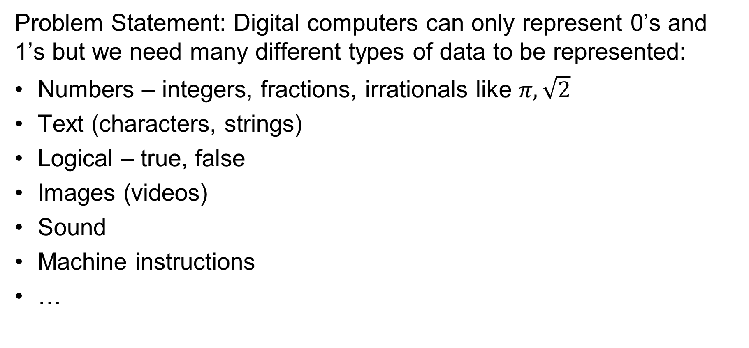
Representing Data
Problem Statement: Digital computers can only represent 0’s and 1’s but we need many different types of data to be represented:
Numbers – integers, fractions, irrationals like $π, \sqrt{2}$
Text (characters, strings)
Logical – true, false
Images (videos)
Sound
Machine instructions
…

Slide 3
Binary Numbers
weight:
10³
10²
10¹
10⁰
Decimal Number System (base 10)
3,108
digit (0, 1, 2, …9)
value: 3*10³ + 1*10² + 0*10¹ + 8*10⁰ = 3,108
Binary Number System (base 2)
weight:
2³
2²
2¹
2⁰
0101
binary digit, bit (0 or 1)
value: 0*2³ + 1*2² + 0*2¹ + 1*2⁰ = 4 + 1 = 5

Slide 4
n-bit Values
An n-bit unsigned integer can represent 2^{n} different values: from 0 to 2^{n}-1
2² | 2¹ | 2⁰
0 | 0 | 0 | 0
0 | 0 | 1 | 1
0 | 1 | 0 | 2
0 | 1 | 1 | 3
1 | 0 | 0 | 4
1 | 0 | 1 | 5
1 | 1 | 0 | 6
1 | 1 | 1 | 7

Slide 5
Examples
Express each of the following binary numbers in decimal. Note that we often write bits in groups of 4 for convenience.
1011
1101 1001
Express each of the following decimal numbers in binary. Also try to think of a general algorithm for conversion from decimal to binary!
12
53

Slide 6
Examples
Express each of the following binary numbers in decimal. Note that we often write bits in groups of 4 for convenience.
(1011)₂ = 2³ + 2¹ + 2⁰ = 8 + 2 + 1 = 11
(1101 1001)₂ = 2⁷ + 2⁶ + 2⁴ + 2³ +2⁰ = 128 + 64 + 16 + 8 + 1 = 217
Express each of the following decimal numbers in binary. Also try to think of a general algorithm for conversion from decimal to binary!
12 = 8 + 4 = 2³ + 2² = 1100
53 = 32 + 21 = 32 + 16 + 5 = 32 + 16 + 4 + 1 = 2⁵ + 2⁴ + 2² + 2⁰ = 11 0101
For a general algorithm, we can use something like long division.

Slide 7
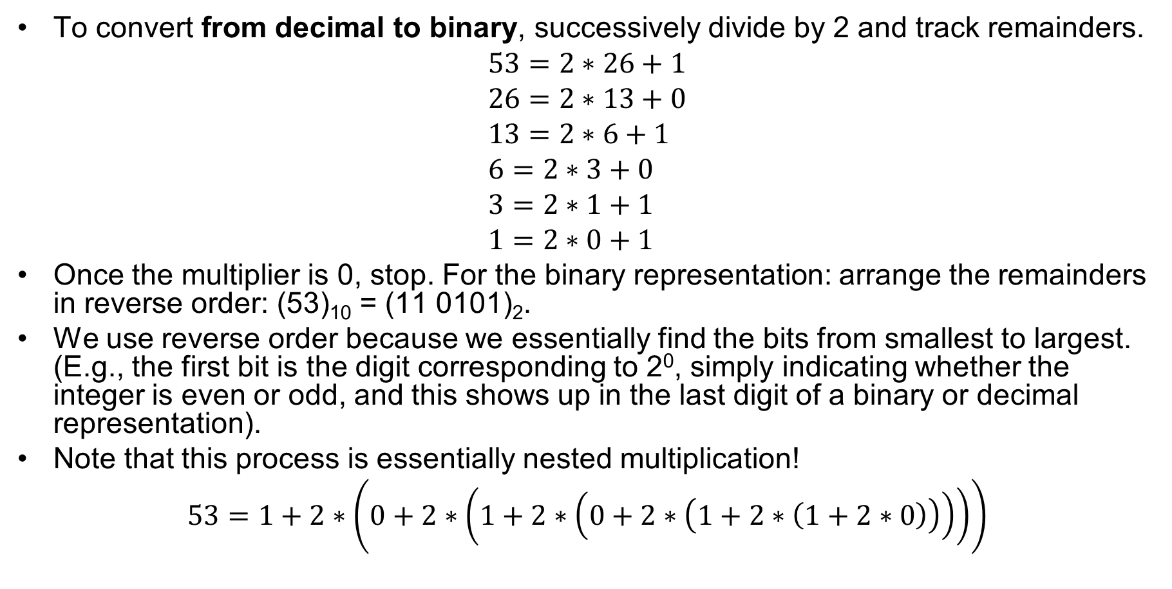
Converting from decimal to binary
To convert from decimal to binary, successively divide by 2 and track remainders.
$$53=2∗26+1 \\ 26=2∗13+0 \\ 13=2∗6+1 \\ 6=2∗3+0 \\ 3=2∗1+1 \\ 1=2∗0+1$$
Once the multiplier is 0, stop. For the binary representation: arrange the remainders in reverse order: (53)₁₀ = (11 0101)₂.
We use reverse order because we essentially find the bits from smallest to largest. (E.g., the first bit is the digit corresponding to 2⁰, simply indicating whether the integer is even or odd, and this shows up in the last digit of a binary or decimal representation).
Note that this process is essentially nested multiplication!
$$53=1+2∗\left(0+2∗\left(1+2∗\left(0+2∗\left(1+2∗\left(1+2∗0\right)\right)\right)\right)\right)$$

Slide 8
Powers of 2
Power | Value
2⁰ | 1
2¹ | 2
2² | 4
2³ | 8
2⁴ | 16
2⁵ | 32
2⁶ | 64
2⁷ | 128
2⁸ | 256
2⁹ | 512
2¹⁰ | 1024
If you don’t already have some powers of 2 memorized, you will probably find it useful to know powers of 2 up to at least 2¹⁰.

Slide 10
Representing Data: Integers Part 2: Negative Numbers
For use in Fall 2020 CSE6010/CX4010 only
Not for distribution

Slide 11
Negative Numbers
Sign magnitude representation
Sign bit is 0 for positive numbers, 1 for negative
0 0 0 1 1 1 0 1 = 29
sign bit
1 0 0 1 1 1 0 1 = -29
One’s complement representation
Invert (complement) each bit of a positive number to get the negative representation of that number
0 0 0 1 1 1 0 1 = 29
1 1 1 0 0 0 1 0 = -29
What are some problems with sign-magnitude and one’s complement?
Two representations for zero (0000, 1000 for sign magnitude; 0000, 1111 for one’s compl)
Arithmetic (addition/subtraction) not straightforward

Slide 12
Two’s Complement
Used to represent integers in virtually all computers today
Several equivalent definitions
Given an n-bit number X
The n-bit two’s complement representation of -X is 2^{n} – X
Most significant bit indicates sign (0=pos.; 1=neg.)
n=8
1 0 0 0 0 0 0 0 0 = 256
- 0 0 0 1 1 1 0 1 = 29
1 1 1 0 0 0 1 1 = -29
The two’s complement of X is the (one’s complement of X) + 1
0 0 0 1 1 1 0 1 = 29
Why does this work?
X + two’s comp(X) = 2^{n}
X + one’s comp(X) = 111…1 (n 1’s) = 2⁰ + 2¹ + … + 2^{n-1} = 2^{n} - 1; add 1 to get 2^{n}
One’s complement:
1 1 1 0 0 0 1 0
+ 1
1 1 1 0 0 0 1 1

Slide 13
Two’s Complement (cont.)
Another definition:
In the two’s complement representation, the sign bit has negative weight
n=8
1 1 1 0 0 0 1 1 = -29
1*(-2⁷) + 1*2⁶ + 1*2⁵ + 0*2⁴ + 0*2³ + 0*2² + 1*2¹ + 1*2⁰
= -128 + 64 + 32 + 0 + 0 + 0 + 2 + 1
= -29
Fast way to generate two’s complement numbers
Starting at least significant bit (rightmost), scan right to left
Copy bits up to and including the first ‘1’ bit
Complement (invert) each of the remaining bits
0 1 0 1 1 1 0 0 = 92
1 0 1 0 0 1 0 0 = -92
-2⁷ + 2⁵ + 2² = -128 + 32 + 4 = -92
complement
copy

Slide 14
Examples
Express the following integers in binary using 8 bits.
38
-38, using sign magnitude representation
-38, using one’s complement representation
-38, using two’s complement representation
Can you think of ways to verify your results?

Slide 15
Examples
Express the following integers in binary using 8 bits.
38 = 2*19 + 0 19 = 2*9 + 1 9 = 2*4 + 1 4 = 2*2 + 0 2 = 2*1 + 0 1 = 2*0 + 1 Thus, 38 = 0010 0110.
-38, using sign magnitude representation: 1010 0110
-38, using one’s complement representation: 1101 1001
-38, using two’s complement representation: 1101 1010
Verify: X + its one’s complement = all 1’s
Verify: X + its two’s complement = 2^{n} (1 followed by n 0’s), but because we are limited to n bits, we get 0 (disregard leading 1) Also can calculate by computing sum using negative weight for first bit: -128+64+16+8+2=-38

Slide 16
Observations
For n-bit two’s complement numbers
The largest positive number that can be represented is 2^{n-1} – 1
The largest magnitude negative number that can be represented is -2^{n-1}
Zero has a single representation (all 0’s)
-1 is represented as all 1’s: 11111111 (n=8)
The number scale is not symmetric (one more negative number than positive numbers): no positive counterpart to -2^{n-1}
n=8 0 1 1 1 1 1 1 1 = 127
n=8 1 0 0 0 0 0 0 0 = -128

Slide 18
Representing Data: Integers Part 3: Two’s Complement Arithmetic + Hexadecimal
For use in Fall 2020 CSE6010/CX4010 only
Not for distribution

Slide 19
Two’s Complement Arithmetic
Addition
Simply add using binary addition
Ignore carry out of most significant bit
1 0 1 0 0 1 0 0 = -92
+
1 1 1 0 0 0 1 1 = -29
1 0 0 0 0 1 1 1 = -121
Subtraction
Take two’s complement of number being subtracted (subtrahend)
Perform addition
92 - 29
0 1 0 1 1 1 0 0 = 92
+
1 1 1 0 0 0 1 1 = -29
0 0 1 1 1 1 1 1 = 63
This leads to simple circuits to perform addition/subtraction

Slide 20
Overflow
Overflow (OF): adding two n-bit numbers can yield a result that cannot be represented in n-bits
OF Test 1: The sign of both operands is the same, but the sign of the result is different
0 1 0 1 0 1 0 1 = 85
0 1 1 0 1 0 0 0 = 104
1 0 1 1 1 1 0 1 = -67
+
OF Test 2: The carry into the most significant bit is different from the carry out
Easy for hardware to detect this condition
0
1
0 1 0 1 0 1 0 1 = 85
0 1 1 0 1 0 0 0 = 104
1 0 1 1 1 1 0 1 = -67
+

Slide 21
Sign Extension
Sometimes it is necessary to increase the precision (number of bits) used to represent a number
In two’s complement this is accomplished by replicating the sign bit to the left (higher precision bit positions)
8 bits: 0 1 0 1 1 1 0 0 = 92
16 bits: 0 0 0 0 0 0 0 0 0 1 0 1 1 1 0 0 = 92
8 bits: 1 1 1 0 0 0 1 1 = -29
16 bits: 1 1 1 1 1 1 1 1 1 1 1 0 0 0 1 1 = -29

Slide 22
Multiplication
Multiplication can be implemented using addition
Multiplication by 2 can be achieved by shifting bits left one position (0 into least significant bit position, discard most significant bit)
Multiplication by 2^{i} can be achieved by shifting bits left i positions
0 1 0 = 2
0 1 1 = 3
0 1 0
0 1 0
0 0 0
0 0 0 1 1 0 = 6
x
1 1 1 0 1 0 1 0 = -22
1 1 0 1 0 1 0 0 = -44

Slide 23
Division
Division can be implemented using subtraction (similar to long division you learned in elementary school)
Slow: each step produces one digit of quotient
Faster: Perform A / B by
Compute 1 / B using Newton-Raphson algorithm* (number of result bits approximately doubles every step)
Multiply result by A
Division by 2^{i} achieved by shifting right i bit positions (replicate sign bit, discard least significant bits)
-24 / 4:
1 1 1 0 1 0 0 0 = -24
1 1 1 1 1 0 1 0 = -6
* see https://en.wikipedia.org/wiki/Division_algorithm for details

Slide 24
Hexadecimal (base 16)
Digits: use letters to represent digits 10-15
More compact way to write binary strings
Hex | Decimal | Binary
0 | 0 | 0000
1 | 1 | 0001
2 | 2 | 0010
3 | 3 | 0011
4 | 4 | 0100
5 | 5 | 0101
6 | 6 | 0110
7 | 7 | 0111
8 | 8 | 1000
9 | 9 | 1001
A | 10 | 1010
B | 11 | 1011
C | 12 | 1100
D | 13 | 1101
E | 14 | 1110
F | 15 | 1111
Hexadecimal number: 04EB
0*16³ + 4*16² +14*16¹ + 11*16⁰ = 1259
Binary representation of same value:
0000 0100 1110 1011 = 1259
Conversion from binary to hexadecimal: start from right, replace each 4 bit group with hexadecimal digit
Hexadecimal a more convenient way to present binary data on paper
0000 0100 1110 1011
0 4 E B

Slide 25
Integer Arithmetic Examples
Perform the following additions and verify your answers. Indicate whether there is potential for overflow and, if so, whether overflow occurs.
10101 + 00111
1001 + 1101
Use bit shifts to quickly compute the following in decimal, starting from (0000 1010)₂ = 10
(0001 0100)₂
(0101 0000)₂
(0000 0101)₂
Perform the following conversions:
(0110 1011 0010 1110)₂ to hexadecimal
C9F to binary

Slide 26
Integer Arithmetic Examples
10101 + 00111: Sign bits are opposite, so no potential for overflow 10101 + 00111 11100 Verify: 10101 is -2⁴+2²+2⁰ = -16+4+1 = -11 00111 is 2²+2¹+2⁰ = 4+2+1 = 7 Sum of -11 and 7 is -4 Binary representation of 4 is 00100; two’s complement is 11100
1001 + 1101 Sign bits are the same; potential for overflow 1001 + 1101 0110 Overflow has occurred! Sign bit has changed Verify: 1001 is -2³+2⁰ = -8+1 = -7; 1101 is -2³+2²+2⁰ = -8+4+1 = -3 Sum is -7 + -3 = -10 Most negative integer with 4 bits is -2⁴⁻¹ = -2³ = -8; overflow confirmed!

Slide 27
Integer Arithmetic Examples
Use bit shifts to quickly compute the following in decimal, starting from (0000 1010)₂ = 10
(0001 0100)₂ = 10*2 = 20
(0101 0000)₂ = 10*2³ = 80
(0000 0101)₂ = 10/2 = 5
Perform the following conversions:
(0110 1011 0010 1110)₂ to hexadecimal: 6B2E
C9F to binary: 1100 1001 1111
Hex | Decimal | Binary
0 | 0 | 0000
1 | 1 | 0001
2 | 2 | 0010
3 | 3 | 0011
4 | 4 | 0100
5 | 5 | 0101
6 | 6 | 0110
7 | 7 | 0111
8 | 8 | 1000
9 | 9 | 1001
A | 10 | 1010
B | 11 | 1011
C | 12 | 1100
D | 13 | 1101
E | 14 | 1110
F | 15 | 1111

Slide 28
Summary of Representing Integers
Base 2 really works just like base 10… but we humans have to think about it
We can represent 2^{n} integers using n bits; specific numbers depend on choice of signed or unsigned
Most computers use two’s complement to represent signed integers
Shift operations are very fast
Hexadecimal is a compact way of writing large numbers

