Slide 1
Algorithm Complexity Part 1: Overview of Big-O Notation
For use in Fall 2020 CSE6010/CX4010 only
Not for distribution

Slide 2
Problem Statement
It would be useful to have a way to compare algorithms and data structures (e.g., linked list vs. heap implementations of priority queues)
Different computers have different performance characteristics
Can we compare the performance of algorithms in a way that is largely independent of the particular computer it is running on?

Slide 3
Preliminaries
Assume primitive operations take constant time
Arithmetic: +, -, *, /
Control: branches, function call (but not the function itself!)
Assume all memory accesses take constant time; do not consider caches and virtual memory (complicates analysis)
No concurrent execution
Focus on asymptotic performance for input of size N
Focus on growth in execution time (or memory) as input size increases to arbitrarily large values
Focus on worst case performance
Guarantees performance no worse than …
Average case useful, but often requires probability distribution of input

Slide 4
Example: Priority Queue
Implementation: linked list, sorted by priority (highest priority first)
Assume the list contains N elements
First
Priority
Priority
Priority
Priority
Data
Data
Data
Data
Next
Next
Next
Next
NULL
We would like to consider questions like these (and we will in a few slides):
How long does an insert operation take?
Best case?
Worst case?
Average case?
How about a delete operation?

Slide 5
Big-O: Definition
Big-O is used to express an asymptotic upper bound on the execution time (or memory)
Worst case analysis
In general a function f(n) is O(g(n)) if there exist positive constants c and n₀ such that
f(n) ≤ c ⋅ g(n) for all n ≥ n₀ that is, for large enough n, f(n) is always less than some constant multiple of g(n)
Example: assuming f(n) is execution time, if we say the execution time of an algorithm is O(n²) then execution time ≤ c ⋅ n² for all n ≥ n₀
We do not necessarily know anything about the size of c or n₀, only that they do not depend on n
Typically analysis mainly concerned with g(n) (vs. c or n₀); does not mean c is not important (better to be less than n² than less than 1000n²) or n₀ is not important (typically better if asymptotic behavior sets in quickly, corresponding to small n₀)

Slide 6
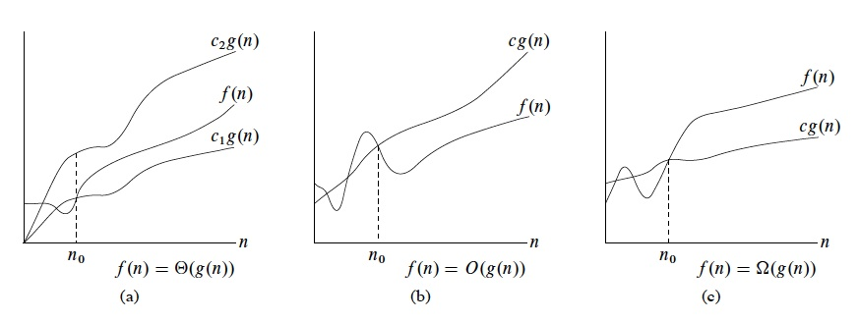
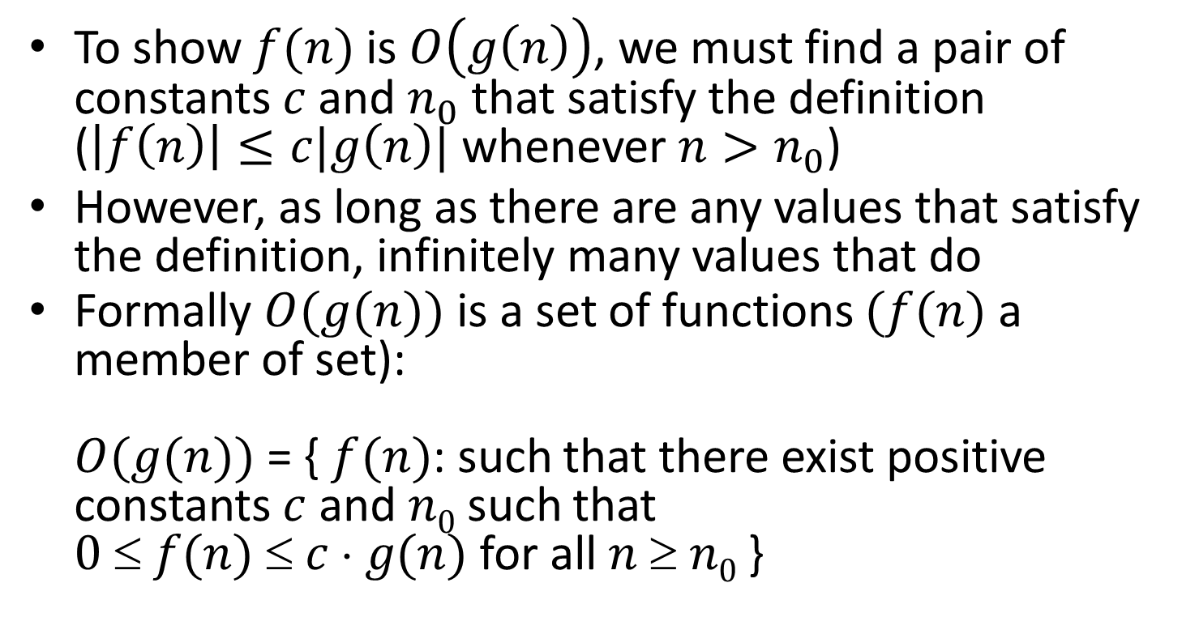
Getting Comfortable With Big-O
To show $f(n)$is $O\left(g\left(n\right)\right)$, we must find a pair of constants $c$and $n_{0}$that satisfy the definition ($\left|f\left(n\right)\right|≤c|g\left(n\right)|$ whenever $n>n_{0}$)
However, as long as there are any values that satisfy the definition, infinitely many values that do
Formally $O(g(n))$ is a set of functions $(f(n)$ a member of set): $O(g(n))$ = { $f(n)$: such that there exist positive constants $c$ and $n0$ such that $0  f(n)  c  g(n)$ for all $n  n0$ }
Corman, Leiserson, Rivest, Stein, Figure 3.1, page 45.

Slide 7
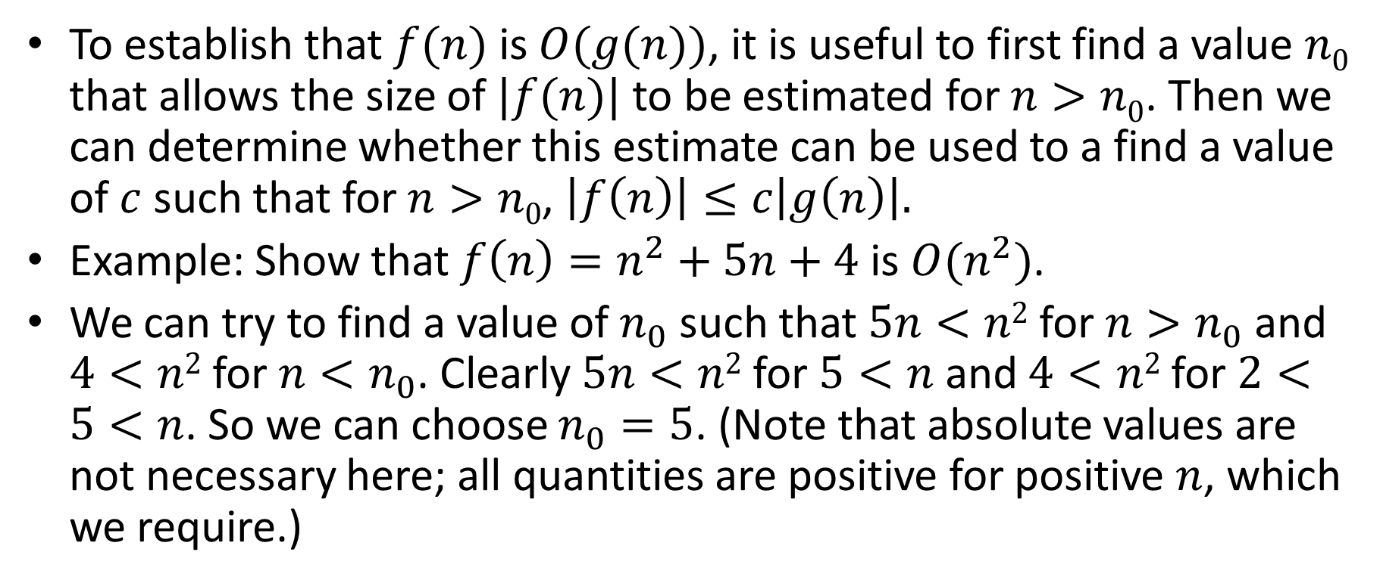
Getting Comfortable With Big-O
To establish that $f(n)$ is $O(g(n))$, it is useful to first find a value $n0$ that allows the size of $|f(n)|$ to be estimated for $n>n0$. Then we can determine whether this estimate can be used to a find a value of $c$ such that for $n>n0$, $\left|f\left(n\right)\right|≤c\left|g\left(n\right)\right|.$
Example: Show that $f\left(n\right)=n^{2}+5n+4$ is $O(n^{2})$.
We can try to find a value of $n_{0}$ such that $5n<n2$for $n>n_{0}$and $4<n2$for $n<n_{0}$. Clearly $5n<n2$for $5<n$and $4<n2$for $2<5<n$. So we can choose $n_{0}=5$. (Note that absolute values are not necessary here; all quantities are positive for positive $n$, which we require.)

Slide 8

Getting Comfortable With Big-O
Then we just need to find a value of $c$ such that $n^{2}+5n+4≤c(n^{2})$ for $n>5$.
Because $5n<n^{2}$ and $4<n^{2}$, we have $n^{2}+5n+4<n^{2}+n^{2}+n^{2}=3n^{2}$, so we can take $c=3$ and $n_{0}=5$ as witnesses to the relation $f(n)$ is $O(n^{2})$.
These are not the only witnesses. We could instead choose a different $n_{0}$: we know that $n<n^{2}$ when $n>1$ and $4<n^{2}$ when $n>2$. So we could use $n_{0}=2$. Then we have $n^{2}+5n+4<n^{2}+5n^{2}+n^{2}=7n^{2}$, giving us the pair $c=7, n_{0}=2$ as witnesses that $f(n)$ is $O(n^{2})$.

Slide 9
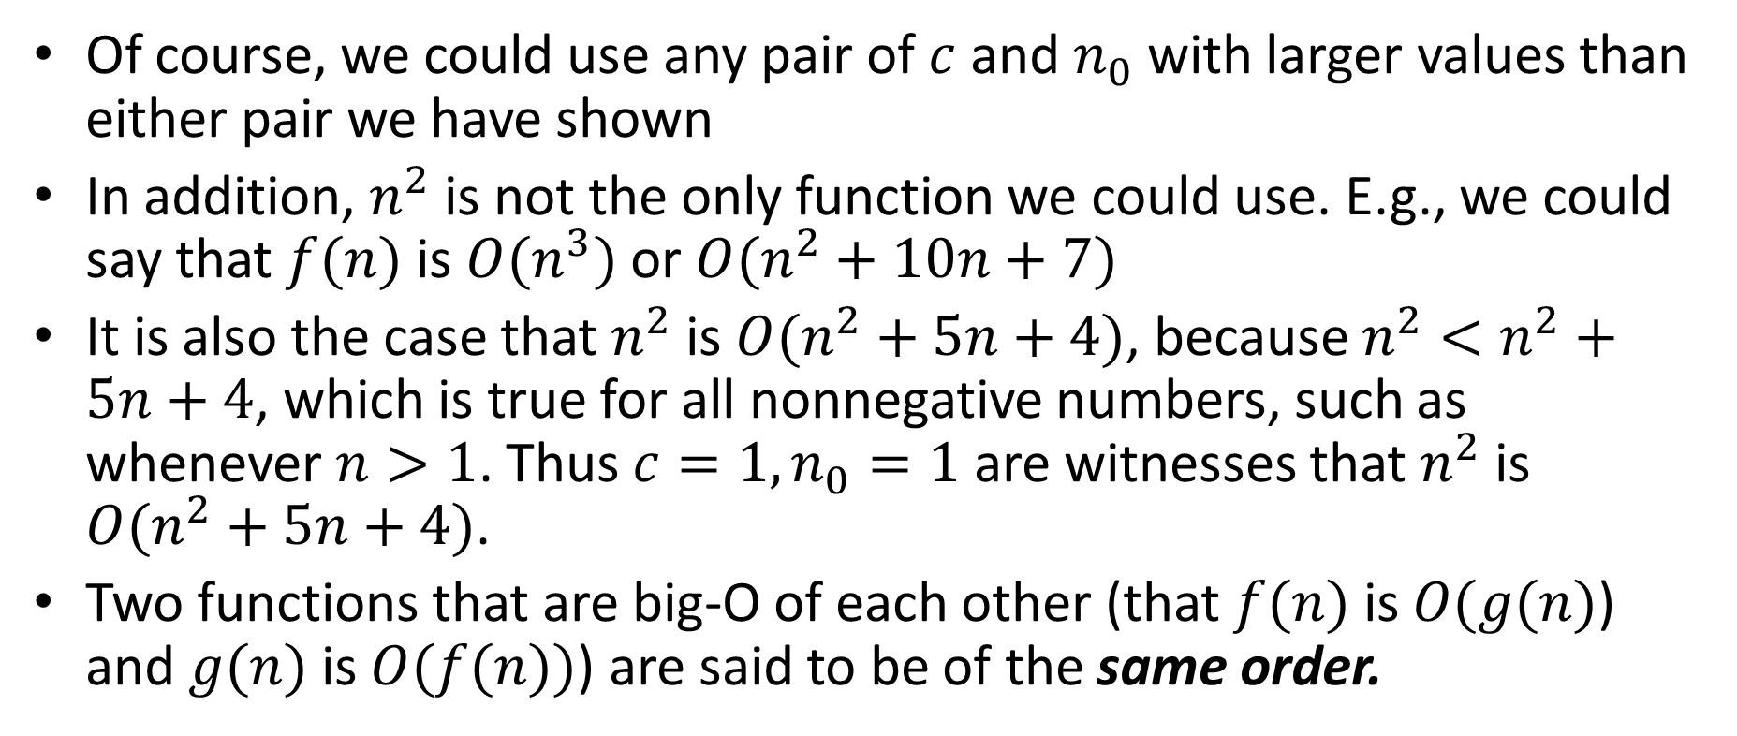
Getting Comfortable With Big-O
Of course, we could use any pair of $c$ and $n_{0}$ with larger values than either pair we have shown
In addition, $n^{2}$ is not the only function we could use. E.g., we could say that $f(n)$ is $O(n^{3})$ or $O(n^{2}+10n+7)$
It is also the case that $n^{2}$ is $O(n^{2}+5n+4)$, because $n^{2}<n^{2}+5n+4$, which is true for all nonnegative numbers, such as whenever $n>1$. Thus $c=1, n_{0}=1$ are witnesses that $n^{2}$ is $O(n^{2}+5n+4)$.
Two functions that are big-O of each other (that $f(n)$is $O(g(n)$) and $g(n)$is $O(f(n))$) are said to be of the same order.

Slide 10
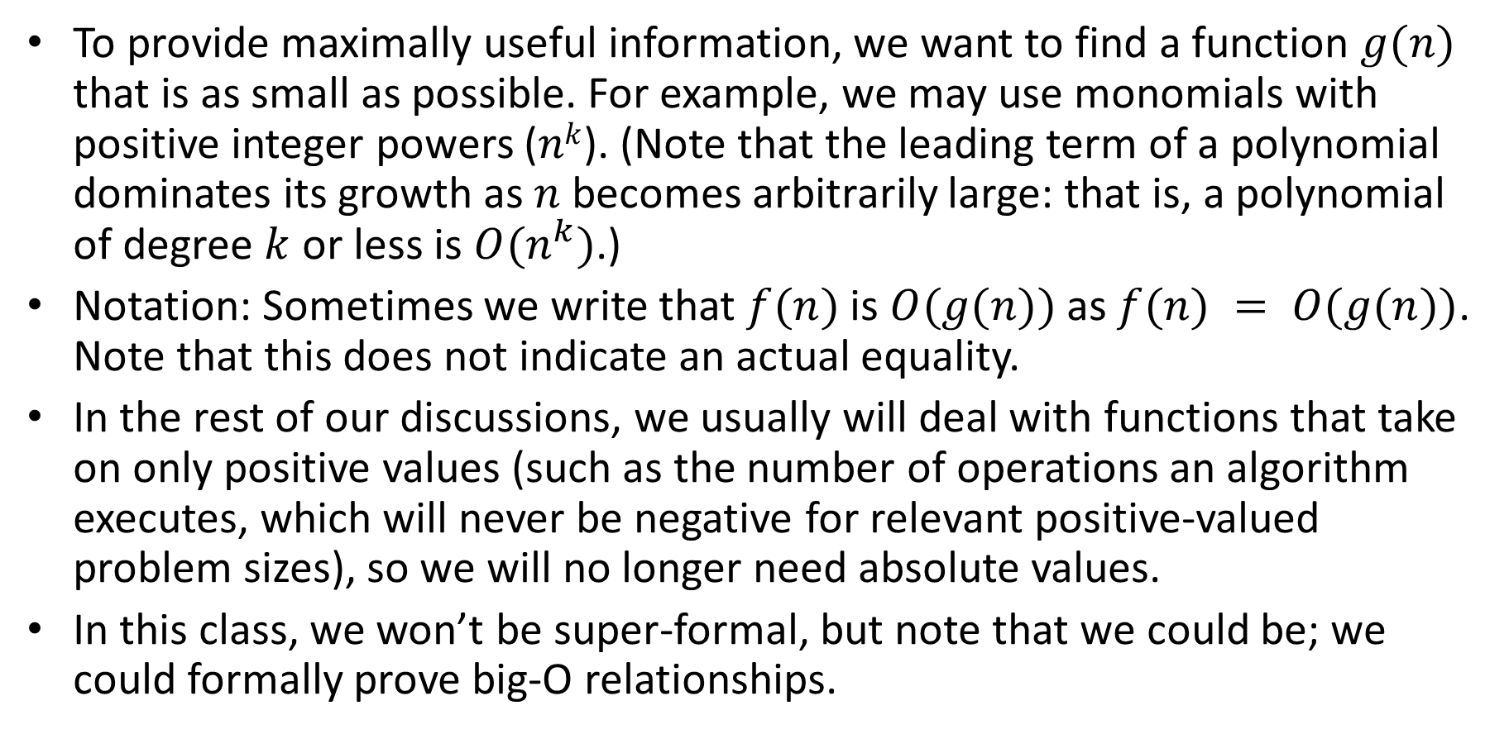
Getting Comfortable With Big-O
To provide maximally useful information, we want to find a function $g(n)$ that is as small as possible. For example, we may use monomials with positive integer powers ($nk$). (Note that the leading term of a polynomial dominates its growth as $n$ becomes arbitrarily large: that is, a polynomial of degree $k$ or less is $O(n^{k})$.)
Notation: Sometimes we write that $f(n)$is $O(g(n))$as $f(n) = O(g(n))$. Note that this does not indicate an actual equality.
In the rest of our discussions, we usually will deal with functions that take on only positive values (such as the number of operations an algorithm executes, which will never be negative for relevant positive-valued problem sizes), so we will no longer need absolute values.
In this class, we won’t be super-formal, but note that we could be; we could formally prove big-O relationships.

Slide 11
Example
Use Big-O notation to estimate the sum of the first n positive integers.
Give big-O estimates for the factorial function and for the log of the factorial function.

Slide 12
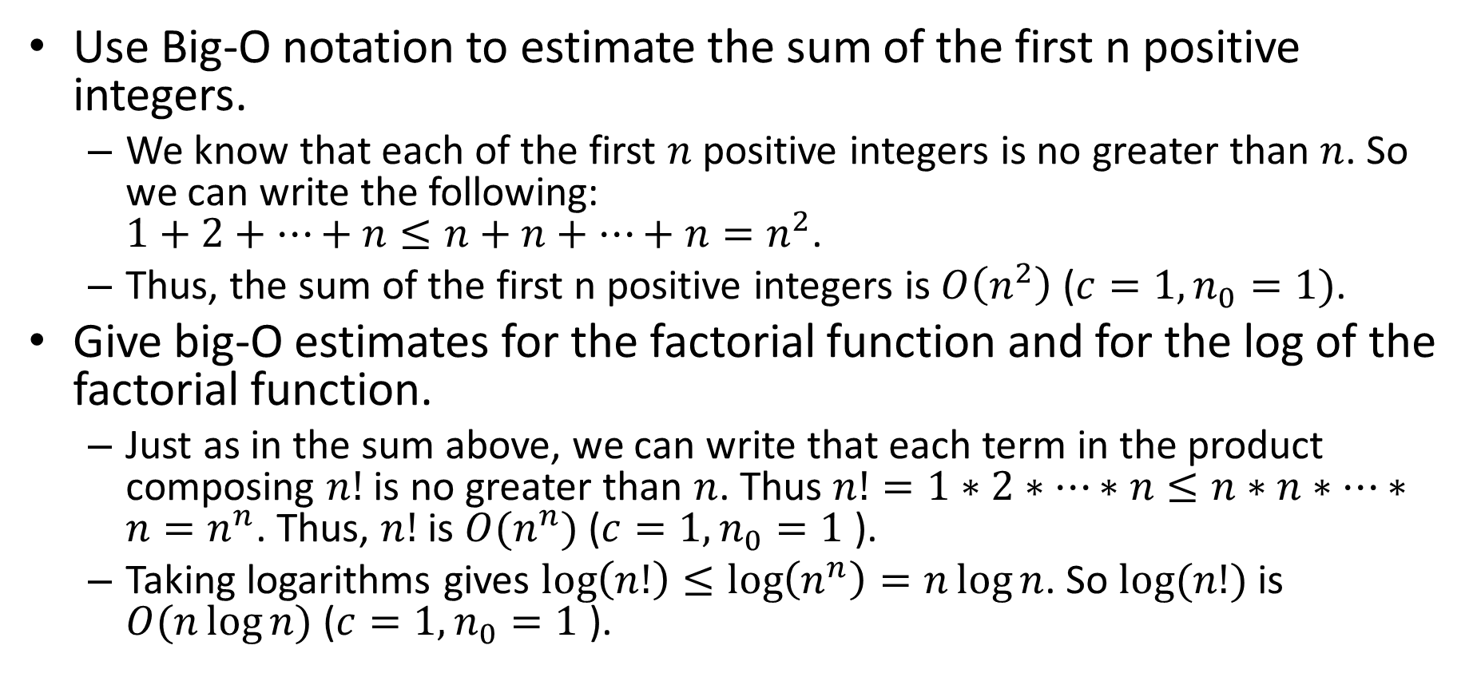
Example
Use Big-O notation to estimate the sum of the first n positive integers.
We know that each of the first $n$ positive integers is no greater than $n$. So we can write the following: $1+2+…+n≤n+n+…+n=n^{2}$.
Thus, the sum of the first n positive integers is $O\left(n^{2}\right)$ ($c=1, n_{0}=1)$.
Give big-O estimates for the factorial function and for the log of the factorial function.
Just as in the sum above, we can write that each term in the product composing $n!$ is no greater than $n$. Thus $n!=1∗2∗…∗n≤n∗n∗…∗n=n^{n}$. Thus, $n!$ is $O(n^{n})$ ($c=1,n_{0}=1$ ).
Taking logarithms gives $\log\left(n!\right)≤\log\left(n^{n}\right)=n\log{n}$. So $log(n!)$ is $O(n\log{n})$ ($c=1,n_{0}=1$ ).

Slide 14
Algorithm Complexity Part 2: Big-O Examples and Useful Functions
For use in Fall 2020 CSE6010/CX4010 only
Not for distribution

Slide 15
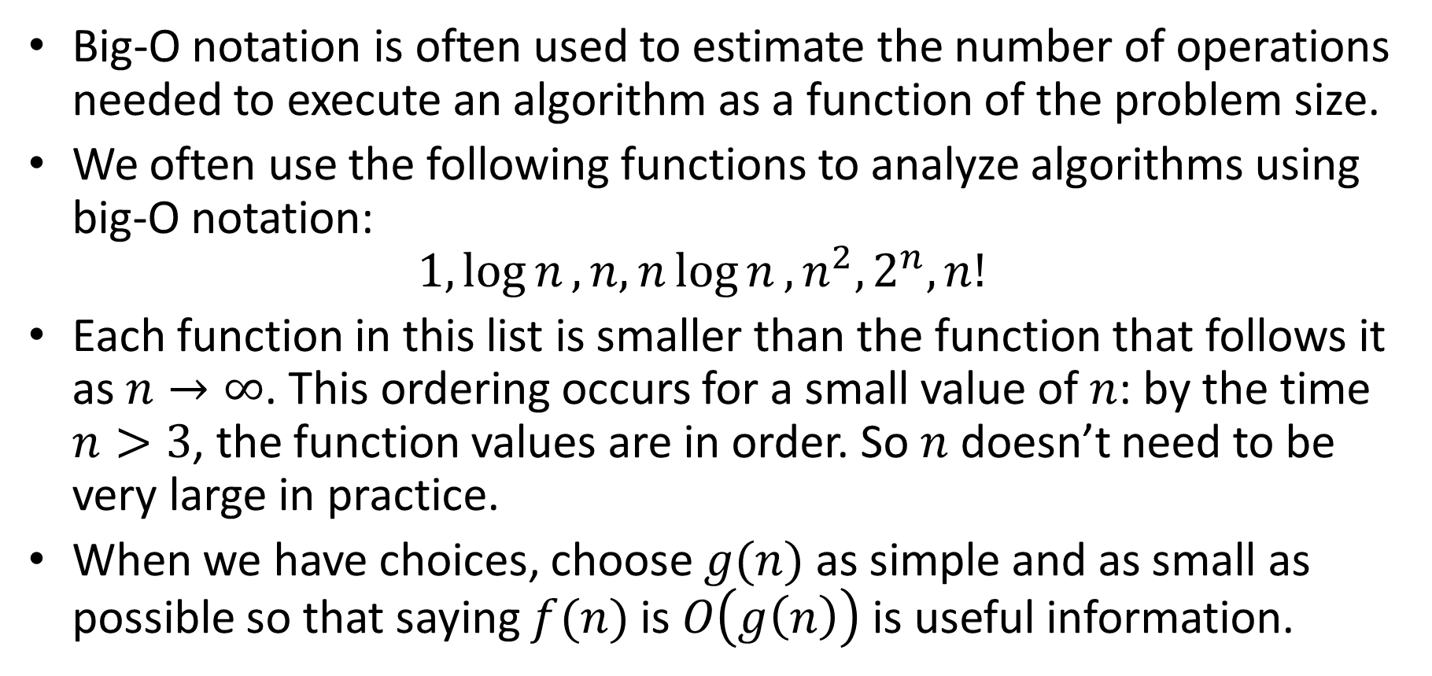
Functions Often Used in Big-O Notation
Big-O notation is often used to estimate the number of operations needed to execute an algorithm as a function of the problem size.
We often use the following functions to analyze algorithms using big-O notation: $1,\log{n}, n, n\log{n}, n^{2},2^{n}, n!$
Each function in this list is smaller than the function that follows it as $n→∞$. This ordering occurs for a small value of $n$: by the time $n>3$, the function values are in order. So $n$ doesn’t need to be very large in practice.
When we have choices, choose $g(n)$ as simple and as small as possible so that saying $f(n)$ is $O\left(g\left(n\right)\right)$ is useful information.

Slide 16
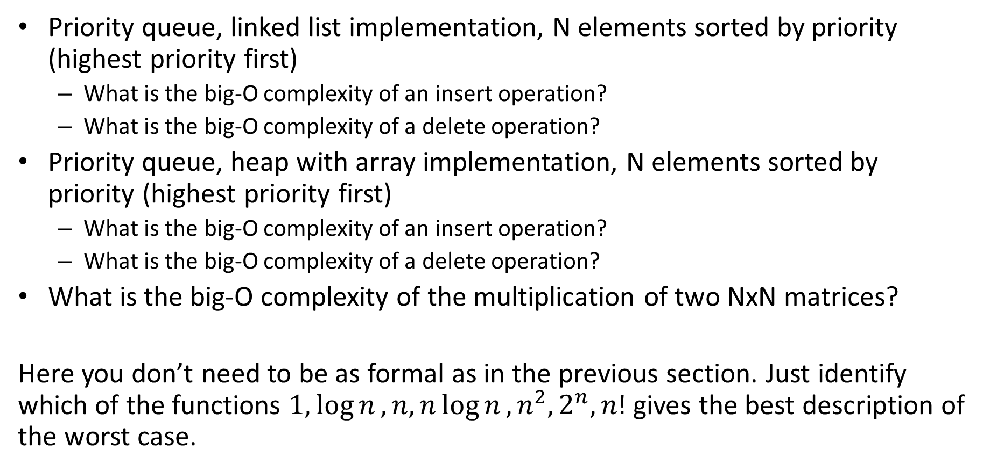
Examples
Priority queue, linked list implementation, N elements sorted by priority (highest priority first)
What is the big-O complexity of an insert operation?
What is the big-O complexity of a delete operation?
Priority queue, heap with array implementation, N elements sorted by priority (highest priority first)
What is the big-O complexity of an insert operation?
What is the big-O complexity of a delete operation?
What is the big-O complexity of the multiplication of two NxN matrices?
Here you don’t need to be as formal as in the previous section. Just identify which of the functions $1,\log{n}, n, n\log{n}, n^{2},2^{n}, n!$ gives the best description of the worst case.

Slide 17
Examples
Priority queue, linked list implementation, N elements sorted by priority (highest priority first)
What is the Big-O complexity of an insert operation? O(N); keep in mind Big-O is a worst case analysis
What is the Big-O complexity of a delete operation? O(1)
First
Priority
Priority
Priority
Priority
Data
Data
Data
Data
Next
Next
Next
Next
NULL

Slide 18
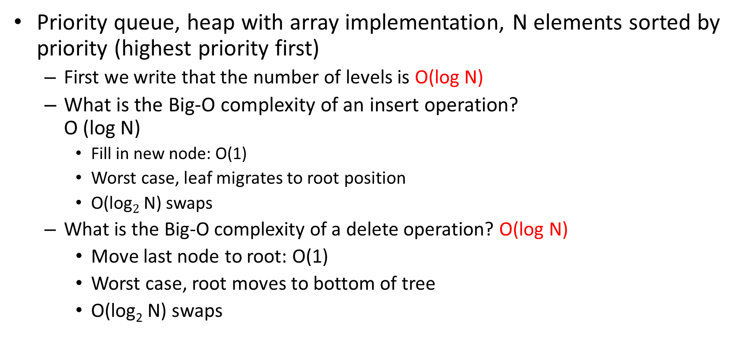
Examples
Priority queue, heap with array implementation, N elements sorted by priority (highest priority first)
First we write that the number of levels is O(log N)
What is the Big-O complexity of an insert operation? O (log N)
Fill in new node: O(1)
Worst case, leaf migrates to root position
O(log$2$ N) swaps
What is the Big-O complexity of a delete operation? O(log N)
Move last node to root: O(1)
Worst case, root moves to bottom of tree
O(log₂ N) swaps

Slide 19
Examples
What is the big-O complexity of the multiplication of two NxN matrices?
double a[N][N], b[N][N], c[N][N];
int i, j, k;
for (i=0; i<N; i++)
for (j=0; j<N; j++)
c[i][j] = 0.0;
for (i=0; i<N; i++)
for (j=0; j<N; j++)
for (k=0; k<N; k++)
c[i][j] += (a[i][k] * b[k][j]);
N² operations
N³ operations

Slide 20
Examples
Time is proportional to N² + N³
N³ term dominates as N grows to very large values
In general, the highest order term determines the performance, so we can ignore lower order terms
Run time is O(N³)

Slide 21
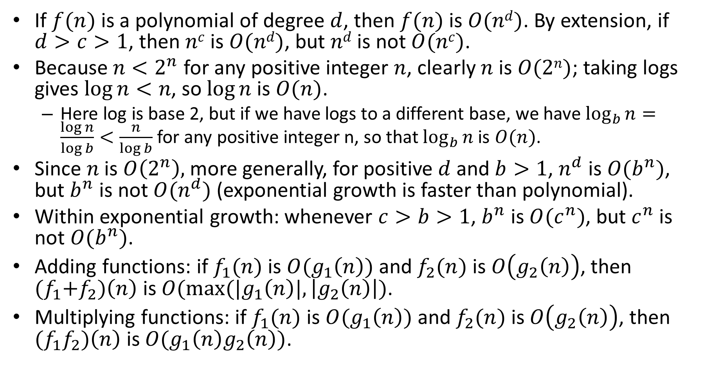
Useful Big-O Estimates
If $f(n)$ is a polynomial of degree $d$, then $f(n)$is $O(nd)$. By extension, if $d>c>1$, then $nc$is $O(nd)$, but $nd$is not $O(nc)$.
Because $n<2^{n}$ for any positive integer $n$, clearly $n$is $O(2n)$; taking logs gives $\log{n}<n$, so $log⁡n$is $O(n)$.
Here log is base 2, but if we have logs to a different base, we have $\log_{b}{n}=\frac{\log{n}}{\log{b}}<\frac{n}{\log{b}}$ for any positive integer n, so that $\log_{b}{n}$ is $O(n)$.
Since $n$ is $O\left(2^{n}\right),$ more generally, for positive $d$ and $b>1$, $n^{d}$ is $O(b^{n})$, but $b^{n}$ is not $O(n^{d})$ (exponential growth is faster than polynomial).
Within exponential growth: whenever $c>b>1$, $b^{n}$ is $O(c^{n})$, but $c^{n}$ is not $O(b^{n})$.
Adding functions: if $f_{1}(n)$ is $O(g_{1}\left(n\right))$ and $f_{2}(n)$ is $O\left(g_{2}\left(n\right)\right)$, then ${(f}_{1}+f_{2})\left(n\right)$ is $O(max⁡(|g_{1}\left(n\right)|,\left|g_{2}\left(n\right)\right|)$.
Multiplying functions: if $f_{1}(n)$ is $O(g_{1}\left(n\right))$ and $f_{2}(n)$ is $O\left(g_{2}\left(n\right)\right)$, then ${(f}_{1}f_{2})\left(n\right)$ is $O({g_{1}\left(n\right)g}_{2}\left(n\right))$.

Slide 22
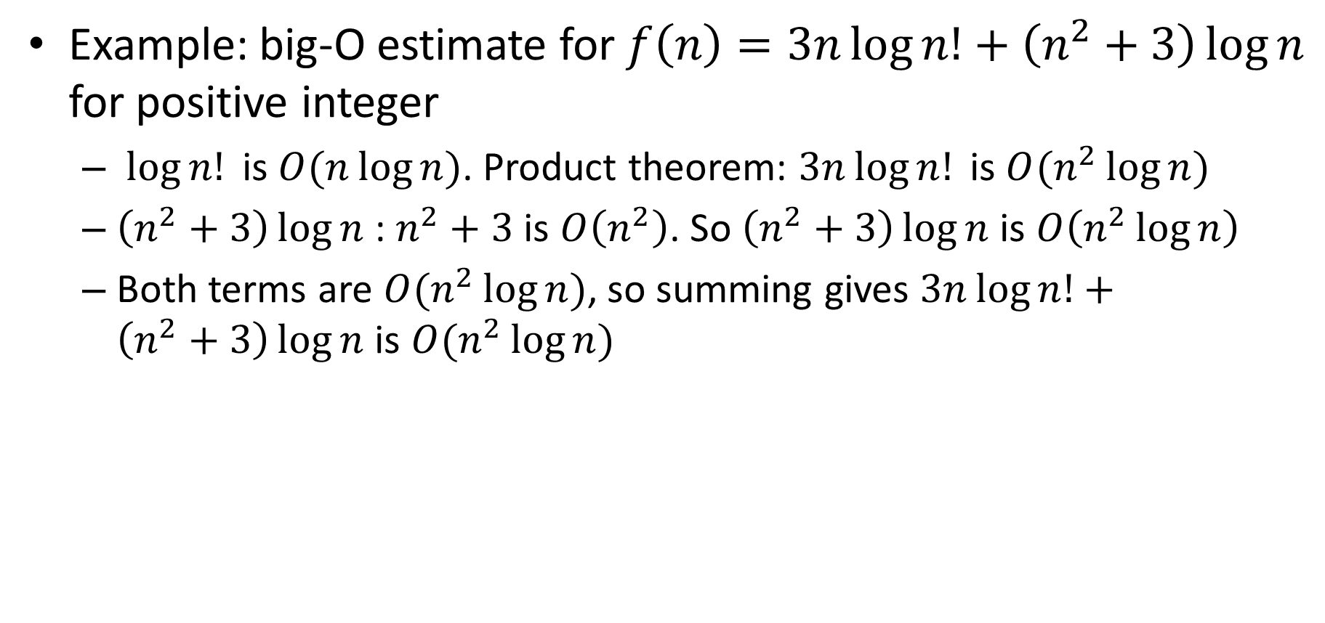
Examples of Big-O Estimates
Example: big-O estimate for $f\left(n\right)=3n\log{n!}+\left(n^{2}+3\right)\log{n}$ for positive integer
$\log{n!} \text{is} O(n\log{n})$. Product theorem: $3n\log{n!} \text{is} O(n^{2}\log{n})$
$\left(n^{2}+3\right)\log{n}$ : $n^{2}+3$ is $O\left(n^{2}\right)$. So $\left(n^{2}+3\right)\log{n}$ is $O\left(n^{2}\log{n}\right)$
Both terms are $O(n^{2}\log{n})$, so summing gives $3n\log{n!}+\left(n^{2}+3\right)\log{n}$ is $O(n^{2}\log{n})$

Slide 23
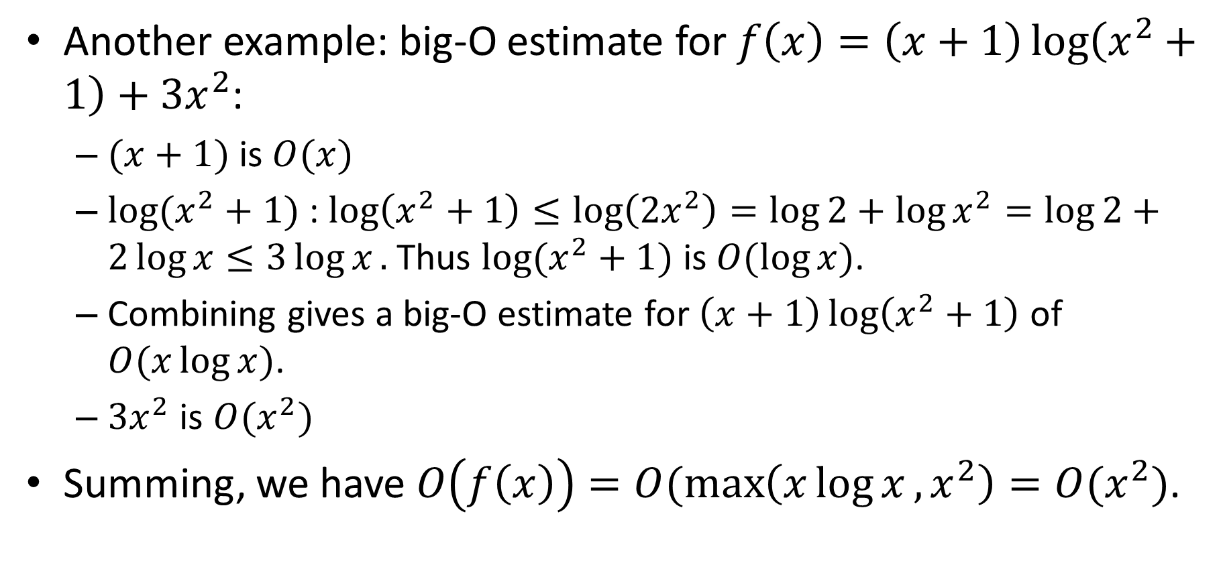
Examples of Big-O Estimates
Another example: big-O estimate for $f\left(x\right)=\left(x+1\right)\log\left(x^{2}+1\right)+3x^{2}$:
$(x+1)$is $O(x)$
$log⁡(x^{2}+1)$ : $\log\left(x^{2}+1\right)≤\log\left(2x^{2}\right)=\log{2}+\log{x^{2}}=\log{2}+2\log{x}≤3\log{x}.$ Thus $log⁡(x^{2}+1)$ is $O(\log{x})$.
Combining gives a big-O estimate for $\left(x+1\right)\log\left(x^{2}+1\right)$ of $O(x\log{x})$.
$3x^{2}$ is $O(x^{2})$
Summing, we have $O\left(f\left(x\right)\right)=O(\max\left(x\log{x},x^{2}\right)=O(x^{2})$.

Slide 24
Other Notation
Big-O
O(g(n))
Corman, Leiserson, Rivest, Stein, Figure 3.1, page 45.
(a) Θ(g(n)) (big-Theta): upper and lower bound
(b) O(g(n)) (big-O): upper bound
(c) Ω(g(n)) (big-Omega): lower bound
See Corman, Leiserson, Rivest, Stein, chpt 3 for details

Slide 26
Algorithm Complexity Part 3: Implications of Complexity
For use in Fall 2020 CSE6010/CX4010 only
Not for distribution

Slide 27
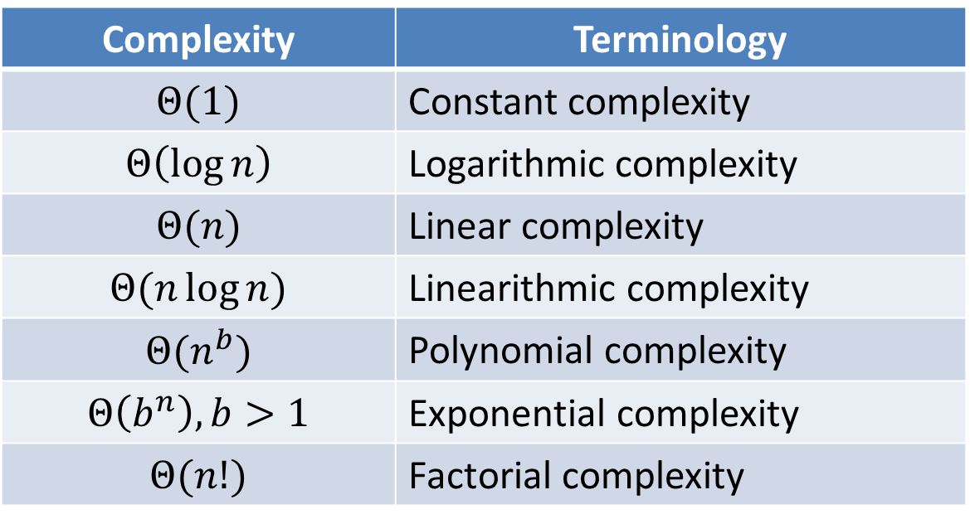

Common Complexity Terminology
Often describe the complexity of algorithms using terminology associated with the function $g(x)$ such that the algorithm is $Θ\left(g\left(x\right)\right)$.
When we are concerned mostly with worst case, big-O rather than big-Theta is often used (frequently).
Complexity | Terminology
$$Θ(1)$$ | Constant complexity
$$Θ\left(\log{n}\right)$$ | Logarithmic complexity
$$Θ(n)$$ | Linear complexity
$$Θ(n\log{n})$$ | Linearithmic complexity
$$Θ(n^{b})$$ | Polynomial complexity
$$Θ\left(b^{n}\right), b>1$$ | Exponential complexity
$$Θ(n!)$$ | Factorial complexity

Slide 28
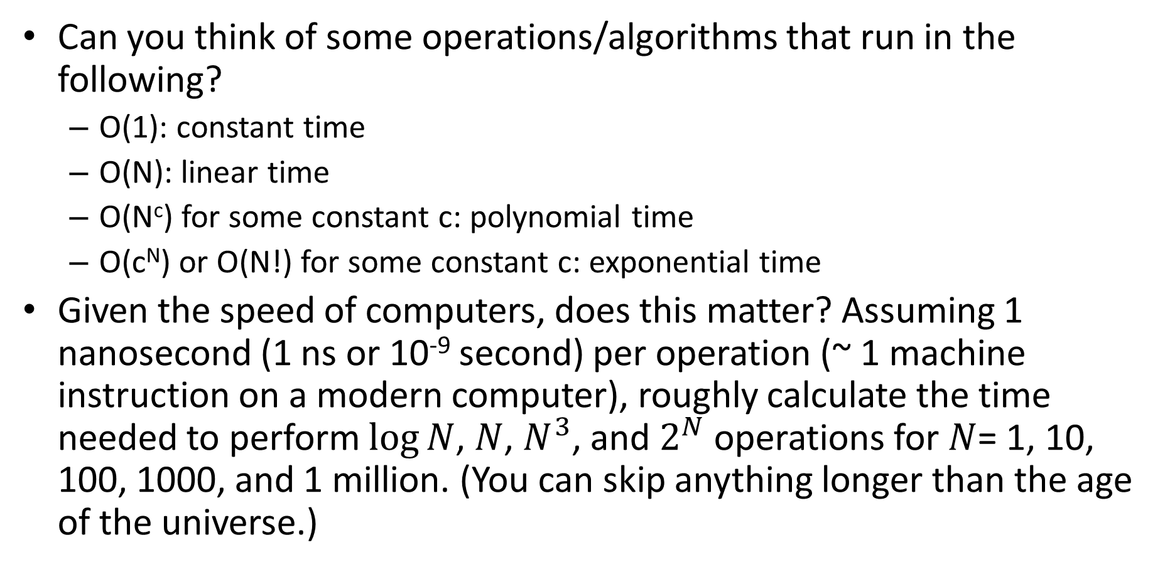
Working with Different Complexities
Can you think of some operations/algorithms that run in the following?
O(1): constant time
O(N): linear time
O(N^{c}) for some constant c: polynomial time
O(c^{N}) or O(N!) for some constant c: exponential time
Given the speed of computers, does this matter? Assuming 1 nanosecond (1 ns or 10⁻⁹ second) per operation (~ 1 machine instruction on a modern computer), roughly calculate the time needed to perform $\log{N}$, $N$, $N^{3}$, and $2^{N}$ operations for $N$= 1, 10, 100, 1000, and 1 million. (You can skip anything longer than the age of the universe.)

Slide 29
Working with Different Complexities
O(1): constant time
Examples: swap operation; a single multiply operation
O(N): linear time
Examples: dot product; insert in linked list priority queue
O(N^{c}) for some constant c: polynomial time
Example: matrix multiply
O(c^{N}) or O(N!) for some constant c: exponential time
Example: Traveling salesman problem
O(1), O(N), O(N log N) generally considered “fast”
Example: sorting can be done in O(N log N) time
Exponential time algorithms are generally only suitable for small problems.

Slide 30
Working with Different Complexities
Do differences in complexity matter?
Emphatically YES!!! (Note that the age of the universe is about 10¹⁰ years.)
N | log(N) ops | N ops | N³ ops | 2^{N} ops
1 | - | 1 ns | 1 ns | 2 ns
10 | 3 ns | 10 ns | 1 𝜇s | 1 𝜇s
100 | 7 ns | 100 ns | 1 ms | 10¹³ years
1,000 | 10 ns | 1 𝜇s | 1 sec
1,000,000 | 20 ns | 1 ms | 32 years
1 𝜇s = 10⁻⁶ seconds (one millionth of a second)

Slide 31
Algorithm Classes
Polynomial time algorithms: worst case running time is O(N^{k}) for some constant k
P class problems: a known, polynomial time algorithm exists
NP-complete class problems: no polynomial time algorithm has been discovered (yet)
AKA “hard” or “intractable” problems

Slide 32
Traveling Salesman Problem (TSP)
u
4
v
1
A minimum cost tour:
u, w, v, x, u (cost 7)
3
2
1
x
w
5
Given a set of N cities, and a certain defined cost to travel between any pair of cities, a salesman must visit each city exactly once and return to the city where the tour began
Is there a tour with cost that is at most k?
TSP is in the NP-Complete class

Slide 33
Things You Should Know About NP-Complete Problems
If a polynomial time algorithm exists for one NP-Complete problem, a polynomial time algorithm exists for all of them
No one knows if a polynomial time algorithm algorithm exists for NP-complete problems (the “P=NP” question)
Most people believe no polynomial time algorithm exists for NP-complete problems
Practical solutions to NP-complete problems typically involve finding approximate solutions (e.g., good, but not guaranteed to be optimal) or solving a special case of the general problem

Slide 34
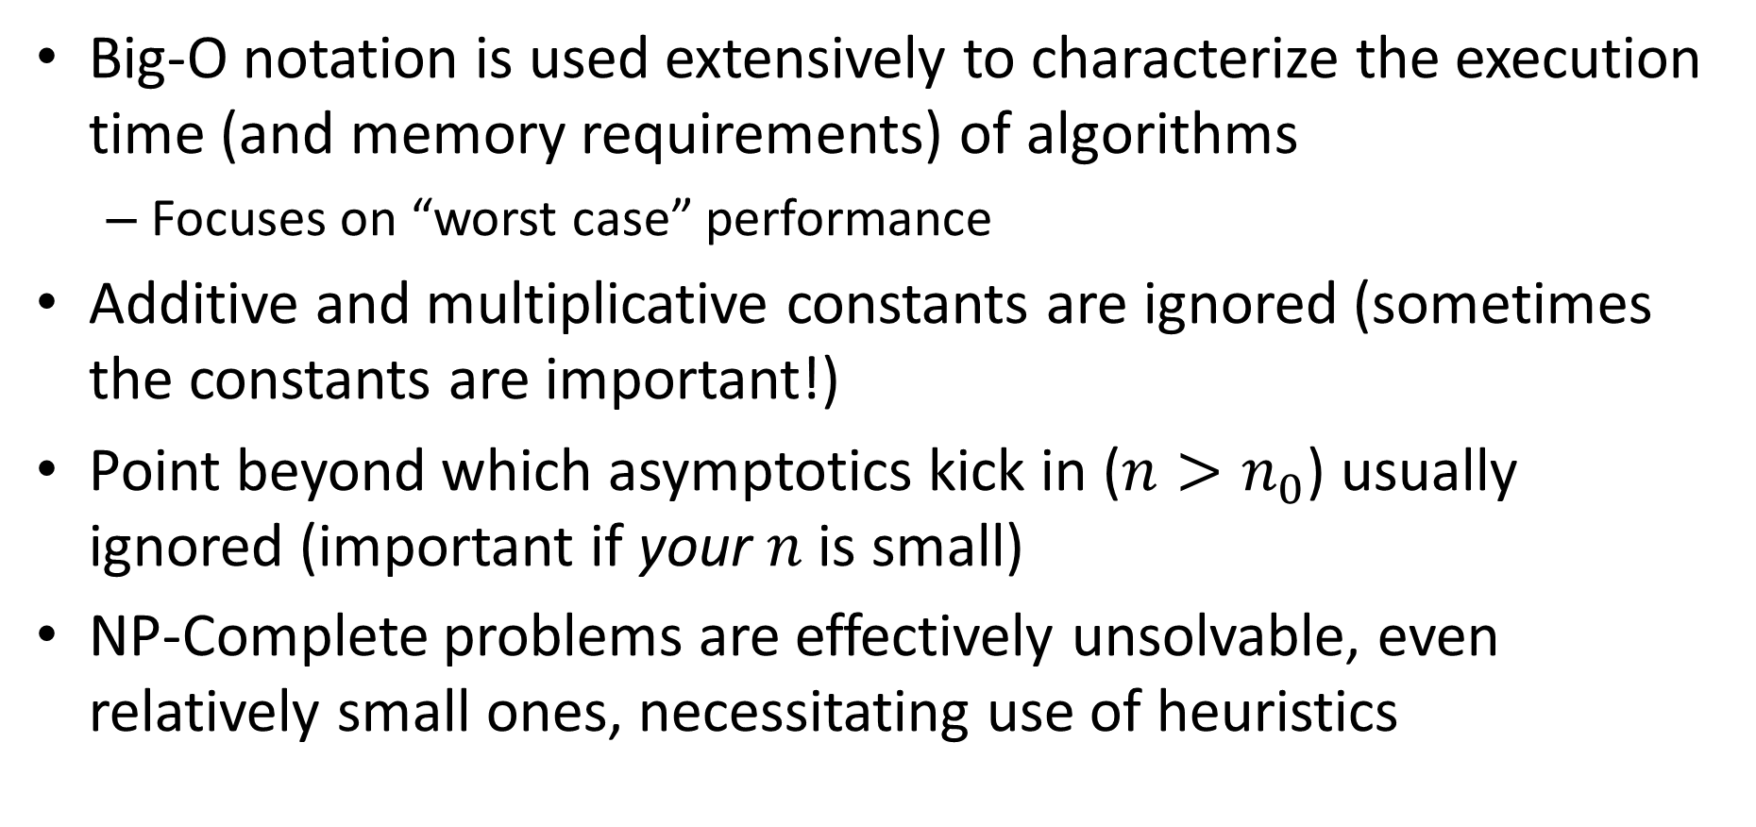
Main Points
Big-O notation is used extensively to characterize the execution time (and memory requirements) of algorithms
Focuses on “worst case” performance
Additive and multiplicative constants are ignored (sometimes the constants are important!)
Point beyond which asymptotics kick in ($n>n_{0}$) usually ignored (important if your $n$ is small)
NP-Complete problems are effectively unsolvable, even relatively small ones, necessitating use of heuristics

