Slide 1
Machine Organization: Implementation of the ISA Part 1: CPU Organization and LC-3
For use in Fall 2020 CSE6010/CX4010 only
Not for distribution

Slide 2
Levels of Abstraction in Computers
Application
(word processor, simulator, web browser, …)
☑
Algorithms
(sorting, optimization, equation solver, …)
☑
Programming Language
(C, FORTRAN, Matlab, Java, …)
☑
Operating System
(UNIX, Windows, iOS, …)
Defines interface between hardware and software
Machine Instruction Set Architecture
(Intel i86, ARM, …)
☑
Machine Organization
(Main memory, registers, adders, …)
Logic Gates
(NAND, NOR, inverter, …)
☑
Implementation of the instruction set architecture
Transistors
(CMOS, NMOS, …)
☑
Physics (Semiconductors)
(electrons, holes, …)
☑

Slide 3
Road Map
materials
electricity
transistors
circuits
logic gates
combinational logic
Memory
Sequential circuits
Central processing unit (CPU)
(microprocessors)

Slide 4
Outline
Overall Organization of CPU
Data Path
Control Unit
Overview of LC-3 Data Path Design
LC-3 Instruction Set: Data Path Examples
Arithmetic/logical
Memory
Control
Control Unit Design
Finite state machine

Slide 5
Interpreters
An interpreter is need to perform (execute) the instructions specified by the program
Machine language is interpreted by CPU hardware
Fast, efficient execution
Must use a compiler to translate high level language code to machine language code
Examples: C, C++, FORTRAN, Java, …
A program (software interpreter) could also be used to interpret (execute) the program
Slower, less efficient execution
Easier (faster) to program (no compilation needed)
Examples: Matlab, Python, Java, …

Slide 6

A View of Systems
control
signals
Action
Control
status
signals
Automobile
gas pedal, brake,
steering wheel
The data path includes functional units that process data (e.g., ALUs) together with registers and buses.
The control unit directs the memory, ALU, and I/O responses to instructions.
speedometer
fuel gauge
Computer System (CPU)
control
signals
Data
Path
Control Unit
(Finite State Machine)
status
signals

Slide 7
Von Neumann Machine Model
Central Processing Unit (CPU)
I/O
Devices
(keyboard, display, disk)
Main
Memory
Data Path
Control Unit
The CPU basically only does one thing: move bits from one place (register or memory) to another
Sometimes the bits are moved through a circuit that can perform arithmetic
Arithmetic/Logic Unit (ALU)
Here, ALU is purely combinational logic (no memory)

Slide 8
Outline
Overall Organization of CPU
Data Path
Control Unit
Overview of LC-3 Data Path Design
LC-3 Instruction Set: Data Path Examples
Arithmetic/logical
Memory
Control
Control Unit Design
Finite state machine

Slide 9
Instruction Set Architecture
The ISA specifies all information about the computer that the software needs to be aware of
Memory organization
Register set
Instruction set
Opcodes
Data types
Addressing modes
This information is available to a programmer when writing in the computer’s own machine language
We will focus on the fictional LC-3 computer
Last class we had a quick look; today we’ll take a deeper dive

Slide 10
LC-3 Memory and Registers
Address space: 2¹⁶ locations (16-bit addresses)
Addressability: 16 bits (what each memory location stores)
Normal unit of data processed in the LC-3 is 16 bits = one word, so LC-3 is word-addressable
Accessing items from memory is typically slow, leading to the need for fast temporary storage locations that can be accessed in one clock cycle
LC-3 has 8 general-purpose registers, each of which can store one word
GP registers are uniquely identifiable as R0-R7

Slide 11
Data Path: Memory Elements
CPU
16 bits
16 bits
7
FFFF
PC
6
…
5
N
Z
P
4
2¹⁶ = 65,536
3
Condition
Code (CC) register
2
0002
1
0001
0
0000
Registers
M[addr]: Main Memory
Program Counter (PC)
General purpose registers
Condition code register
Registers are also needed to hold
Address used for memory reads/writes (MAR)
Data read to/written from main memory (MDR)
Instruction now being processed (IR)
The data path consists of all the logic structures that combine to process information in the core of the computer.

Slide 12
Memory Interface
MRd
MWr
R
LMAR
LMDR
CPU
(data path)
MAR
MDR
Memory
System
address
data
Main Memory
Random Access Memory
(65,536 x 16)
MAR: Memory Address Register (16 bits) read from/write to this address
Control signal LMAR: assert to load MAR register
MDR: Memory Data Register (16 bits) information stored in that location
Control signal LMDR: assert to load MDR register
Main Memory
Control signal MRd – assert to read memory: MDR<-M[MAR]
Control signal MWr – assert to write memory: M[MAR]<-MDR
Status signal R: Ready – asserted when memory operation completed
Set up for read/ write ops

Slide 13
Multiport Register File
data (write)
RWr
Register
File
AWr
Control signals
Address
(how many bits?)
RRd2
A2
RRd1
2
1
A1
data (read)
data (read)
Used to implement 8 CPU registers in LC-3
Can simultaneously perform multiple memory operations in a single clock cycle (e.g., ADD)
Two read operations
One write operation
Can read/write the same register in a single instruction
Notes:
Implementation: straightforward extension of RAM discussed earlier; just need 3 decoders

Slide 14
Multiplexer Circuit
in0
in0
00
in1
out
in1
in0
out
01
in2
in2
in1
out
select
decoder
in3
10
in3
in2
select
11
out=in[select]
select
in3
logical
view
circuit
component
implementation
Combinational logic (no storage inside multiplexer)
Above is a 4:1 one-bit multiplexer (mux)
The circuit can be replicated for inputs with more bits

Slide 15
Multiport Register File Implementation
write
read register port 1
RRd2
DW_{i}
RRd1
Write
read register port 2
…
…
…
AWr
Write decoder
D
Q
Read 1 decoder
WE
A1
Read 2 decoder
A2
…
C = 0 open
C = 1 closed
Switch
DR1_{i}
DR2_{i}
C

Slide 17
Machine Organization: Implementation of the ISA Part 2: More on LC-3 Instruction Set
For use in Fall 2020 CSE6010/CX4010 only
Not for distribution

Slide 18
Outline
Overall Organization of CPU
Data Path
Control Unit
Overview of LC-3 Data Path Design
LC-3 Instruction Set: Data Path Examples
Arithmetic/logical
Memory
Control
Control Unit Design
Finite state machine

Slide 19
LC-3 Instruction Set
Instruction set is defined by its set of opcodes, data types, and addressing modes (determine whether the operands are located)
The choice of which instructions to include or leave out of a new ISA depends on many factors
Opcodes specify the types of operation, operands specify on what data the operation is performed
LC-3 ISA has 15 instructions, each with a unique opcode specified with the first 4 bits of an instruction
LC-3 only supports integers (no other data type)

Slide 20
Three Types of Instructions
Three types of instructions: operate (arithmetic/ logical), data movement, and control
Categorize the following LC-3 operations as best you can:
ADD
AND
BR (branch)
JMP (jump)
JSR (jump to subroutine)
LD (load)
NOT
RET (return from subroutine)
ST (store)
TRAP (system call)

Slide 21
Three Types of Instructions
Three types of instructions: operate (arithmetic/ logical), data movement, and control
Categorize the following LC-3 operations as best you can:
But wait! You may be thinking—there are not 15 of these!
There are variations for addressing modes… next topic
Operate
ADD
AND
NOT
Data Movement
LD (load)
ST (store)
Control
BR (branch)
JMP (jump)
JSR (jump to subroutine)
RET (return from subroutine)
TRAP (system call)

Slide 22
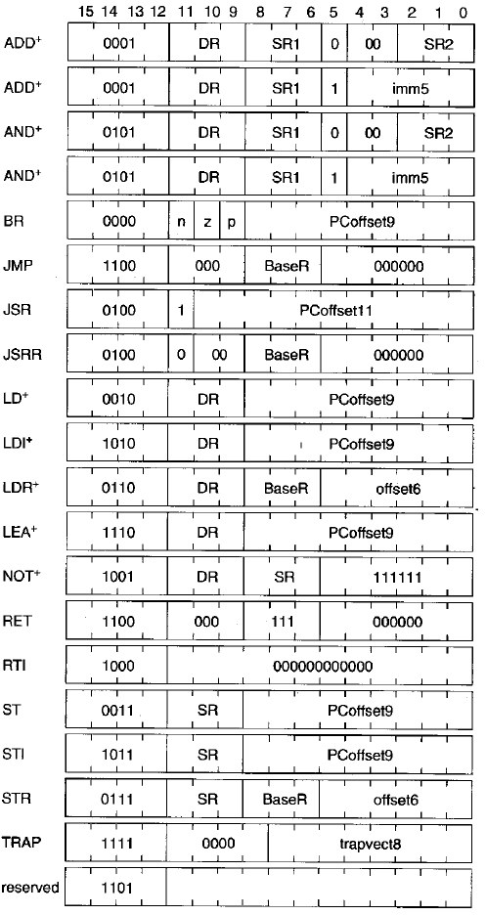
LC-3 Instructions
Load “flavors”
Store “flavors”
Load “flavors”

Slide 23
Addressing Modes
Mechanism for specifying where the operand is located, generally one of the following:
In memory
In a register
Within the instruction (literal or immediate operand)
LC-3 supports 5 addressing modes:
Immediate: operand is in the instruction
Register: operand is in a register
PC-relative: operand is located an offset from the PC
Indirect: PC-relative address is a pointer to the operand
Base + offset: operand is located an offset from address in register
Operate instructions use only immediate and register modes

Slide 24
Condition Codes
Sequence of instructions may change depending on previously generated result
LC-3 sets or clears 3 single-bit registers each time one of the GP registers is written (arithmetic/logical and load instructions): N, Z, P
The condition of that bit can be used by control instructions to change the sequence of instructions

Slide 26
Machine Organization: Implementation of the ISA Part 3: LC-3 Data Path Examples
For use in Fall 2020 CSE6010/CX4010 only
Not for distribution

Slide 27
Instructions to Be Implemented
ADD DR, S1, S2 // DR <- S1 + S2
LDR DR, BR, offset // DR <- M [BR + offset]
BRz offset // if (Z bit set)
// PC <- PC+1+offset
We will look at these in detail and look at a few others briefly
Instruction Processing
Fetch instruction to be executed: M[PC] and increment the PC
Decode instruction (check opcode)
Execute instruction
Evaluate address
Fetch operands
Perform operation (e.g., add)
Store result
Go back to step 1

Slide 28
LC-3 ADD Instruction
Notation: IR[x:y] means bits x, x-1, … y or IR register
IR[15:12] is the opcode; IR[8:6] indicates register S1
Arithmetic
ADD DR, S1, S2 // DR, S1, S2 are registers
// DR <- S1 + S2
// set N, Z, P if result negative, zero, or positive, respectively
Encoding (16 bits)
15
12
11
9
8
6
2
0
0 0 0 1
DR
S1
0 0 0
S2
opcode
(0001 indicates ADD instruction)
unused
destination
register
source register 1
source register 2

Slide 29
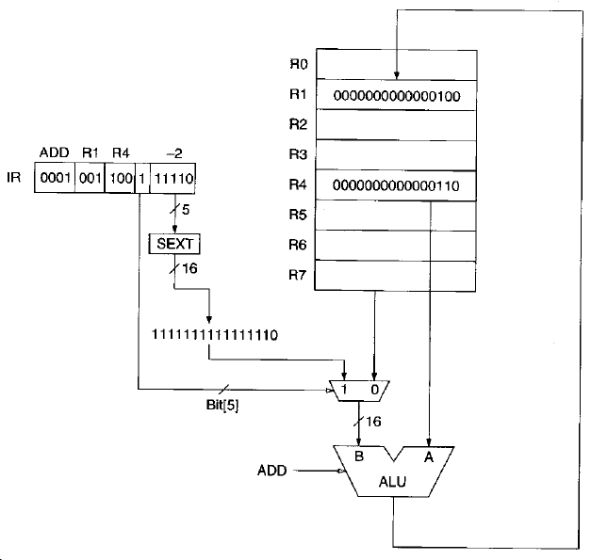
LC-3 ADD Instruction
Encoding (16 bits)
15
12
11
9
8
6
2
0
0 0 0 1
0 0 1
1 0 0
0 0 0
1 0 1
ADD R1, R4, R5
// R1 <- R4 + R5
// set N, Z, P if result negative, zero, or positive, respectively
ADD performs 2s complement addition
ADD can also specify an immediate operand instead of a second register: 0001 001 100 1 11110 will store in R1 the sum of R4 and -2

Slide 30
LC-3 Logical Instructions
See if you can determine the effects of the following LC-3 instructions.
15
12
11
9
8
6
2
0
NOT
1 0 0 1
0 1 1
1 0 1
1 1 1
1 1 1
DR
S1
Must contain all 1’s
7 | 721C
6 | 382A
5 | 0001
4 | 0004
3 | F0F0
2 | E1E1
1 | 02A3
0 | B782
15
12
11
9
8
6
2
0
AND
0 1 0 1
1 1 0
0 1 1
0 0 0
0 1 0
DR
S1
Must be 0’s
S2
Registers

Slide 31
LC-3 Logical Instructions
See if you can determine the effects of the following LC-3 instructions.
15
12
11
9
8
6
2
0
NOT
1 0 0 1
0 1 1
1 0 1
1 1 1
1 1 1
DR
S1
Must contain all 1’s
7 | 721C
6 | 382A
5 | 0001
4 | F0F0
3 | 0004
2 | E1E1
1 | 02A3
0 | B782
Store the complement of R5 in R3: FFFE
15
12
11
9
8
6
2
0
AND
0 1 0 1
1 1 0
1 0 0
0 0 0
0 1 0
DR
S1
Must be 0’s
S2
Store the bitwise AND of R4 and R2 in R6: E0E0
Registers

Slide 32
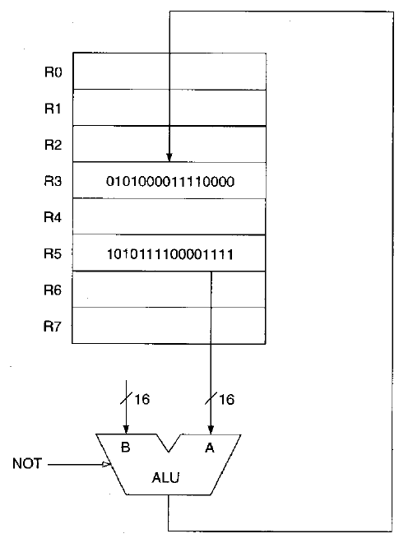
LC-3 NOT Instruction
NOT
15
12
11
9
8
6
2
0
1 0 0 1
0 1 1
1 0 1
1 1 1
1 1 1
DR
S1
Must contain all 1’s
Store the complement of R5 in R3: FFFE
Note that only one input of the two available to the ALU is used.

Slide 33
LC-3 LDR Instruction
Memory
LDR RD, RS1, offset // RD <- M [RS1 + offset]
// sign extend offset
Encoding (16 bits)
15
12
11
9
8
6
5
0
0 1 1 0
RD
RS1
offset
opcode
dest. reg.
base reg.
6 bit offset
0 1 1 0
0 0 1
1 0 1
0 0 0
0 1 0
LDR R1, R5, 2 // R1 <- M[R5 + 2]
16 bits
16 bits
7
FFFF
…
N
Z
P
6
5
0A10
0A12
0023
0
0
1
4
0A11
3
0A10
Condition
Code (CC) bits
2
…
1
0023
0
0000
Registers
Main Memory

Slide 34
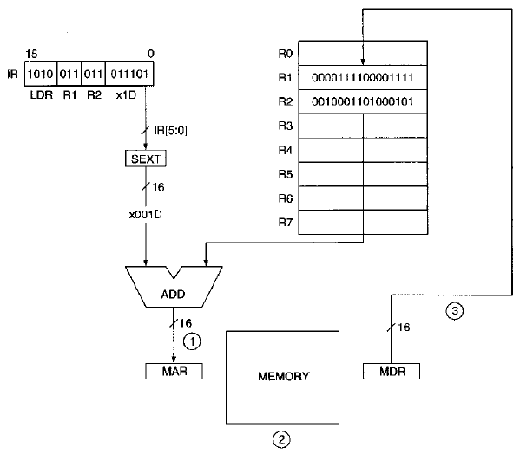
LC-3 LDR Instruction
LDR
0110
001
010
15
12
11
9
8
6
2
0
0 1 1 0
0 0 1
0 1 0
0 1 1
1 0 1
DR
S1
Load into R1 the contents of the memory location specified by the sum of R2 and 29: M[R2+29]
Here R2 contains x2345. Adding sign-extended 29 (x001D) gives x2362; this is loaded into the MAR.
M[2362] is loaded into the MDR and then into R1.
0023

Slide 35
Other LC-3 Load Instructions
There are a total of four load instructions in the LC-3 instruction set.
LDR (0110):
Base + offset: memory address is a 6-bit offset from an address in register
LD (0010):
PC-relative: memory address is located a 9-bit offset from the incremented PC
LDI (1010):
Indirect: PC-relative (9-bit offset) address is a pointer to the memory address
LEA (load effective address) (1110):
Immediate: does not access memory; loads into the specified register the address formed from the incremented PC and the 9-bit value in the instruction

Slide 36
LC-3 BRz Instruction
Control
BRz offset // if (Z bit set) PC <- PC+1+offset
// sign extend offset
// previous instruction sets Z
Encoding (16 bits)
15
12
11
9
8
0
0 0 0 0
0 1 0
offset
opcode
Test Z bit
9-bit offset
0 0 0 0
0 1 0
1 1 1
1 1 1
1 0 1
16 bits
0000
…
BRz -3
// if Z bit is set, PC <- PC-2
F110
F111
F112
BRz -3
…
FFFF
Main Memory

Slide 37
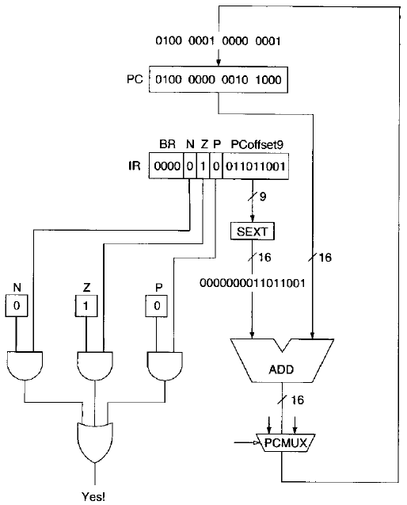
LC-3 BRz Instruction
15
12
11
9
8
0
0 0 0 0
0 1 0
0 1 1 0 1 1 0 0 1
opcode
Test Z bit
9-bit offset
BRz instruction: if Z bit is set, then load the PC with the new address.
The new address is the incremented PC + the sign-extended 9-bit offset.
Here the incremented PC is x4028.
The new address (used only if Z bit is set) is x4028 + x00D9 = x4101.

Slide 38
More on LC-3 BR
What if the test bits in the instruction were set as follows?
What if the test bits in the instruction were set as follows?
15
12
11
9
8
0
0 0 0 0
1 1 1
0 1 1 0 1 1 0 0 1
opcode
Test bits
9-bit offset
15
12
11
9
8
0
0 0 0 0
0 0 0
0 1 1 0 1 1 0 0 1
opcode
Test bits
9-bit offset

Slide 39
More on LC-3 BR
15
12
11
9
8
0
With all three bits set, the branch would be taken every time, so the instruction becomes an unconditional branch.
With none of the bits set, the branch would never be taken, so the instruction becomes a no-op.
0 0 0 0
1 1 1
0 1 1 0 1 1 0 0 1
opcode
Test bits
9-bit offset
15
12
11
9
8
0
0 0 0 0
0 0 0
0 1 1 0 1 1 0 0 1
opcode
Test bits
9-bit offset

Slide 41
Machine Organization: Implementation of the ISA Part 4: Control Unit Design
For use in Fall 2020 CSE6010/CX4010 only
Not for distribution

Slide 42
Outline
Overall Organization of CPU
Data Path
Control Unit
Overview of LC-3 Data Path Design
LC-3 Instruction Set: Data Path Examples
Arithmetic/logical
Memory
Control
Control Unit Design
Finite state machine

Slide 43
Partial LC-3 Data Path (ADD, LDR, BRz instructions)
16 bits
1 bit
KEY
Multiplexer
LPC
LIR
MRF
IR[11:9]
IR
PC
IR[8:0]
(sign ext.)
IR[5:0]
(sign ext.)
RWr
Register
File
“add”
RRd2
IR[8:6]
RRd1
2
1
MPC
1
IR[2:0]
MALU
MMAR
LMAR
ALUop
MDR
MAR
MRd
MWr
R
N
Z
P
LCC
LMDR
Main Memory (RAM)

Slide 44
LC-3 Control Unit (ADD, LDR, BRz Instructions)
R=0
MAR <- PC
PC <- PC+1
MDR<-M[MAR]
R=1
IR<-MDR
IR[15:12]=BRz
IR[15:12]=ADD
IR[15:12]=LDR
RD<-RS1+RS2
CC<-Sign
MAR<-RS1+IR[5:0]
Z=1
Z=0
R=0
MDR<-M[MAR]
PC<-PC+IR[8:0]
R=1
RD <- MDR
CC<-Sign

Slide 45
Control and Status Signals
Control Signals
(FSM outputs)
Control Signals (cont.)
register
file
main
memory
MRd: read memory
MWr: write memory
LPC: load PC
LIR: load IR
LMAR: load MAR
LMDR: load MDR
MPC: PM mux
MMAR: MAR mux
MRF: register file mux
MALU: ALU mux
ALUop: ALU operation
LCC: load condition codes
RRd1: read RF port 1
RRd2: read RF port 2
RWr: write RF
load
register
Status Signals (FSM inputs)
R: Memory operation completed
IR[15:12]: opcode
N: N bit of condition code
Z: Z bit of condition code
P: P bit of condition code
mux
control
misc.

Slide 46
LC-3 Control Unit (ADD, LDR, BRz Instructions)
R=0
MMAR=PC; LMAR; MPC=1; LPC
MRd; LMDR
R=1
LIR
IR[15:12]=BRz
IR[15:12]=ADD
IR[15:12]=LDR
RRd1; RRd2; MALU=RF; ALUOp=add; LCC; MRF=ALU; RWr;
RRd1; MALU=IR ALUOp=add; MMAR=ALU; LMAR
Z=1
Z=0
R=0
MRd; LMDR
MPC=IR; LPC
R=1
MRF=MDR; RWr; LCC

Slide 47
Notes
The data path and control unit shown so far only represent the realization of three machine instructions; one must continue design process for the full instruction set
It is convenient to define a “bus” in the data path to carry signals among multiple sources and destinations of data
Only one source device can put data on bus at one time!
source
devices
…
destination
devices
…
bus

Slide 48
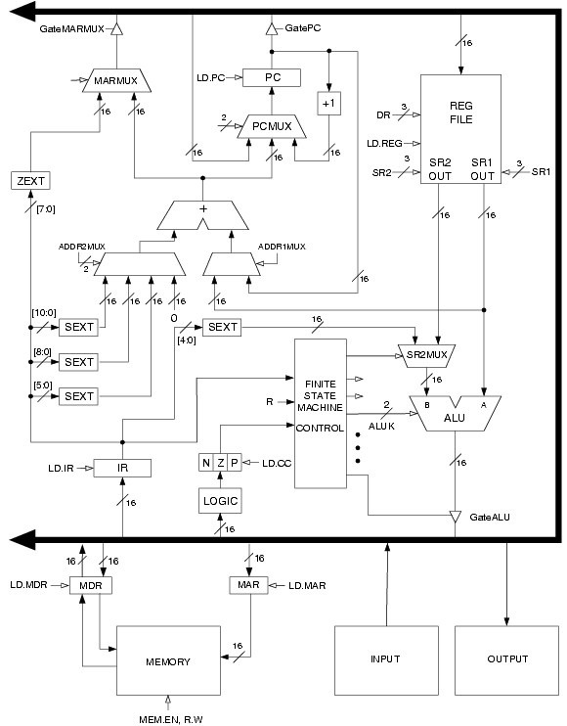
LC-3 Data Path

Slide 49
Summary: CPU Design Process
CPU = Data Path + Control Unit
Data path design: determine what components you need
Memory visible to machine code programmer/compiler (PC, registers, condition codes)
Memory and memory interface (MAR, MDR)
Instruction Register (IR)
ALU(s)
Control Unit: design finite state machine
Implement instruction processing cycle: Instruction Fetch, decode, operand fetch, execute, store result
Determines interconnection among the components in the data path design

