Slide 1
Vancouver neighborhood
Capstone Project
Winnie CHAN

Slide 2
Data source
Neighborhood data with names and latitude/longitude
Four Square API

Slide 3
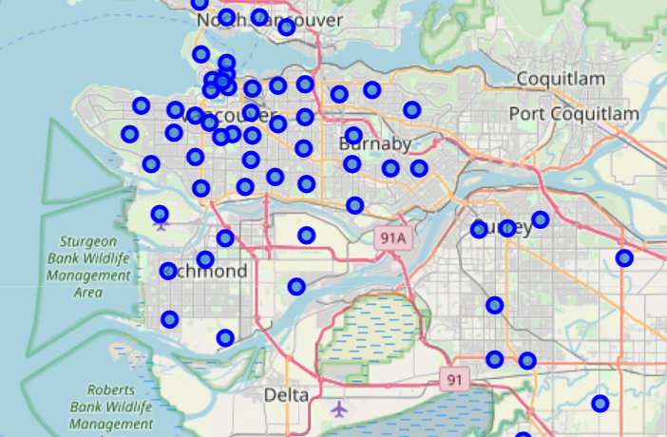
Preliminary Map view

Slide 4
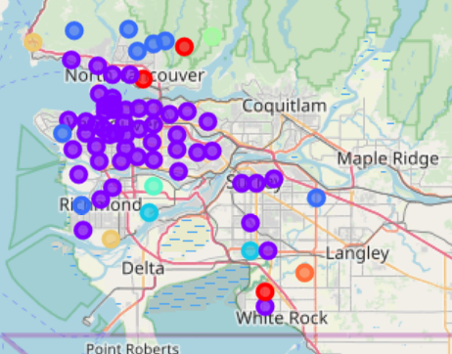
Cluster view

Slide 5
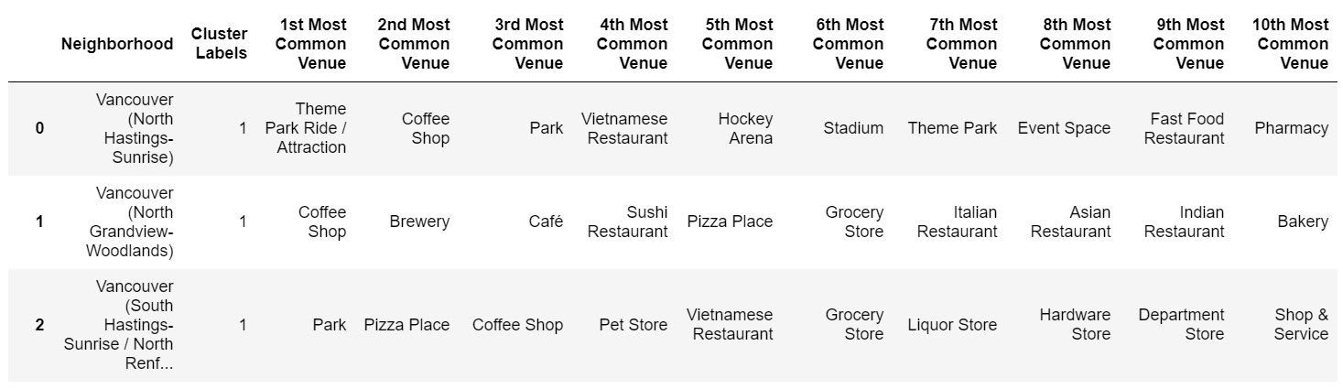
CLUSTER 1

Slide 6
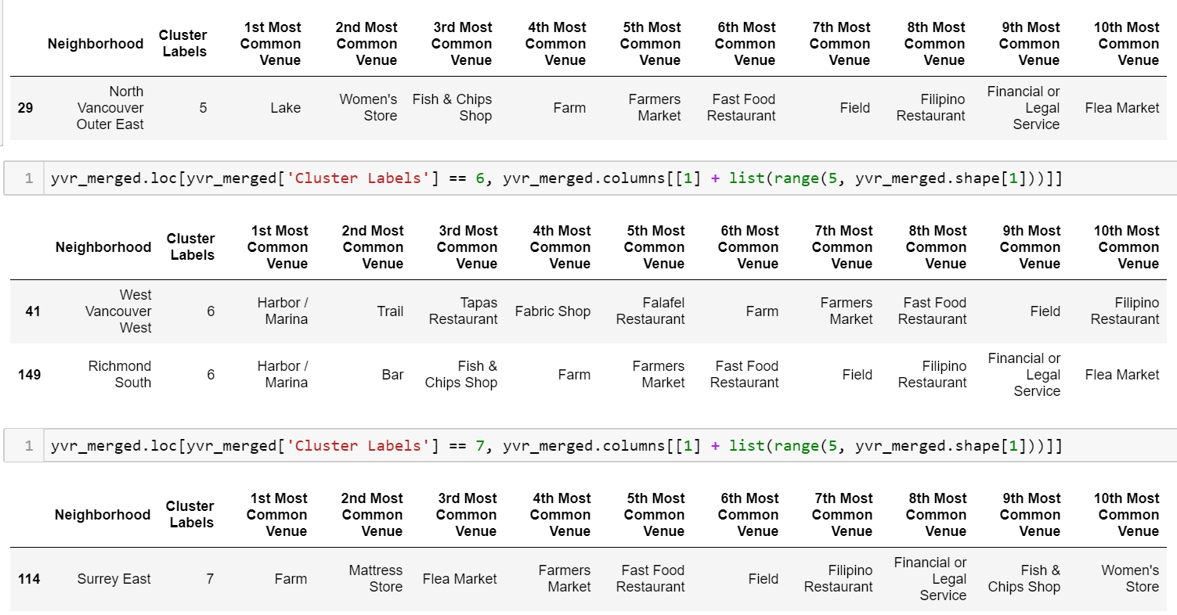
CLUSTER 5-7

