Slide 1


Slide 2
Problem Statement
Cancer - leading cause of non accidental deaths in children ages 5-14
three-quarters of child survivors suffer from psychological disorders
Childhood cancer accounts for ≤ 3% of cancer funding in Canada today.
Reduce the psychological effects of cancer on children ages 9-14 years.
“Because when a child has cancer there is crisis for the whole family - cancer.org”
Sources: cancer.org , kidscancercare.ab.ca

Slide 3
https://invis.io/8X8MYJSWG

Slide 4
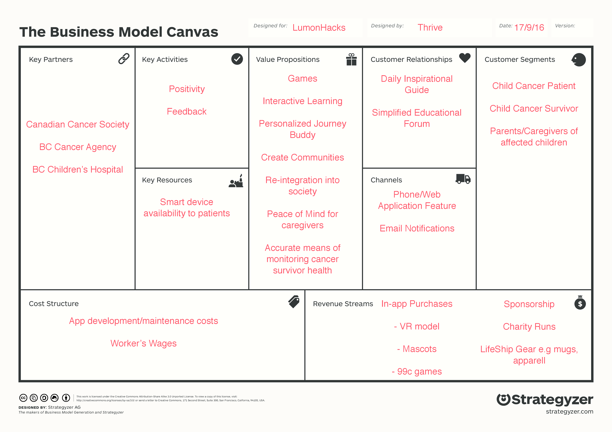
Business Model

Slide 5
Implementation Timeline
 | 0-6 months | 6-12 months | 1-2 years | 3+ years
App Development | Develop the initial app | Start expansion packs and VR model | Diversify to include a global community, more apparel | Integrate IoT, more health monitoring
Audience Expansion | target local community for beta testing | Launch and expand users as much as possible (target 100,000) | Focus on going fully global | Making it available in every children's hospital
Support and Sponsorship Expansion | Working with research centres to gather support, ethics approval, monetary support and government funds | start profit making and building a global community, | Become self sufficient, Beta users around the world | Continuous feedback and maintaining relationship

Slide 6
Initial Cost
App Development | Consulting Specialist | Mascot Modeling
One year on App Store $100 | collaboration with institutions as a way of sponsorships | $20 setup fee
6 months of initial Development ~$34,560 |  | $12/piece
 |  | Will later reduce through mass production
Total cost for the first six months, targeting 20 beta users: |  | $34,920

Slide 7
Monetization
In-app purchases: purchase the VR model
$30 for permanent access
Purchase a different outfit for your mascot
$0.70 cents for the software model
$20 for the physical model
Purchase expansion packs with more games
$20/pack
Purchase a bigger mascot
up to $300 for lifesize one
After 100,000 user charge download fee
90 cents/download
Collaboration with on-going research groups with approved fundings
*for 10,000 users assuming 10% of user would use each purchasing option once except the lifesize mascot.
Revenue: $71,600

Slide 8
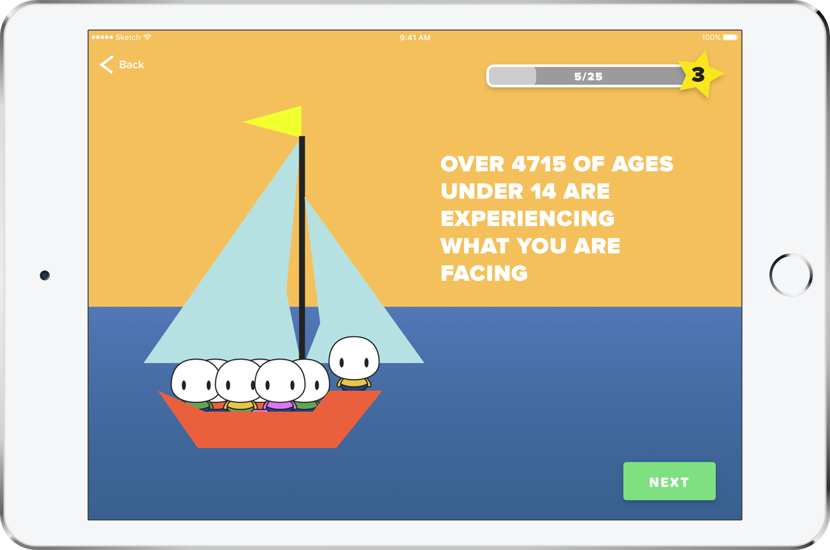
Imagine...
Notes:
Imagine a global community of youths whose only view of cancer is not a deadly monster, but a process that they can courageously go through with knowledge and FLOURISH through this journey

Slide 9
Appendix: Risk Management
Issues | Possible solution.
Relying on the application | Including the physician in the flourish experience.
Children getting socially awkward from depending on the app. | Including necessary physical activity while playing games.
Cyberbullying | Moderating the communication platform.
Users unable to troubleshoot any problems they may have. | Tech support will be available through email and documentation.
Not attracting enough early users. | Partnerships with hospitals will increase early user base to gain traction for future users.

