Slide 1
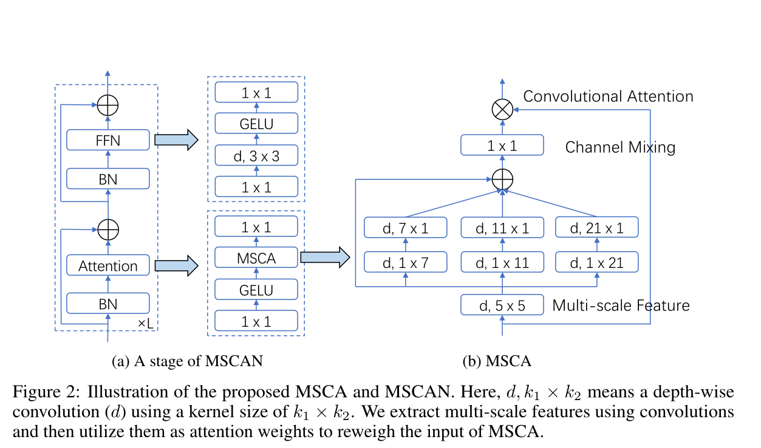
multi-scale convolutional attention (MSCA) module.
单击输入您的封面副标题

