Slide 1
2018~2019 AI Quiz

Slide 2
Question 1

Slide 3
m: the row number of the graph
n: the column number of the graph
bgColor: the background color
graph[m][n]: a matrix contains each cell’s color
flag[m][n]: a matrix records block’s ID, if ID = 0, the color of the cell is the same with the background color
Input: graph[m][n]
Output: the dirty block number numDirty
//Initialization
Set all elements in flag[m][n] to 0
Set numDirty = 0
for i = 1 -> m do
for j = 1 -> n do
if graph[i][j] != bgColor and flag ==0 then
numDirty++
BFS(i,j)
end
end
end
return numDirty
BFS(i,j)
flag[i][j] = 1
for k = i-1 -> i+1 do
for l = j-1 ->j+1 do
if [k,l] is in graph’s boundary and is not [i,j] then
if graph[i][j] != bgColor and flag ==0 then
BFS(k,l)
end
end
end
end
end

Slide 4
Question 2
(6,2)
E
(7,1)
(2,1)
B
G
(0,0)
(6,0)
Target
A
F
Start
(2,-1)
(3,-1)
C
D
H
(7,-1)

Slide 5
Initial
Priority Queue: A(7.071)
Explored Set: {}
Start
A
Step1
Priority Queue: B(2.236+5),C(2.236+5.383),F(6+1.414)
Explored Set: {A(7.071)}
B
C
F
(6,2)
E
D
H
Step2
Priority Queue: F(6+1.414), C(2.236+5.383), E(6.359+1.414)
Explored Set: {A(7.071), B(2.236+5)}
Step3
Priority Queue: C(2.236+5.383), E(6.359+1.414),D(9.162+4.472),H(7.414+2)
Explored Set: {A(7.071), B(2.236+5), F(6+1.414)}

Slide 6
Start
Step4
Priority Queue: D(3.236+4.472),E(6.359+1.414),D(9.162+4.472),H(7.414+2)
Explored Set: {A(7.071), B(2.236+5), F(6+1.414) C(2.236+5.383)}
A
B
C
F
Step5
Priority Queue: E(6.359+1.414),H(7.414+2)
Explored Set: {A(7.071), B(2.236+5), F(6+1.414) C(2.236+5.383), D(3.236+4.472)}
E
D
H
G
Target
Step6
Priority Queue: G(7.773),H(7.414+2)
Explored Set: {A(7.071), B(2.236+5), F(6+1.414) C(2.236+5.383), D(3.236+4.472), E(6.359+1.414)}

Slide 7
Question 3
A
B1
B2
C1
C2
C3
C4
21
17
18
23
21
20
23
24
25
26
27
28

Slide 8
A
(-∞,+∞)
B1
B2
(-∞,+∞)
C1
C2
C3
C4
(21,+∞)
21
17
18
23
21
20
23
24
25
26
27
28

Slide 9
A
(-∞,+∞)
B1
B2
(-∞,+∞)
(-∞,21)
C1
C2
(-∞,21)
C3
C4
(21,+∞)
21
17
18
23
21
20
23
24
25
26
27
28

Slide 10
A
(-∞,+∞)
B1
B2
(-∞,+∞)
(-∞,21)
C1
C2
(23,21)
C3
C4
(21,+∞)
21
17
18
23
21
20
23
24
25
26
27
28

Slide 11
A
(-∞,+∞)
B1
B2
(-∞,+∞)
(-∞,21)
return 23
C1
C2
(23,21)
C3
C4
(21,+∞)
21
17
18
23
21
20
23
24
25
26
27
28

Slide 12
A
(-∞,+∞)
(21,+∞)
return 21
B1
B2
(-∞,+∞)
(-∞,21)
C1
C2
(23,21)
C3
C4
(21,+∞)
21
17
18
23
21
20
23
24
25
26
27
28

Slide 13
A
(-∞,+∞)
(21,+∞)
B1
B2
(-∞,+∞)
(21,+∞)
(-∞,21)
(21,+∞)
C1
C2
(23,21)
C3
C4
(21,+∞)
21
17
18
23
21
20
23
24
25
26
27
28

Slide 14
A
(-∞,+∞)
(21,+∞)
B1
B2
(-∞,+∞)
(21,+∞)
(-∞,21)
(25,+∞)
(21,25)
C1
C2
(23,21)
C3
return 25
C4
(21,+∞)
21
17
18
23
21
20
23
24
25
26
27
28

Slide 15
A
(-∞,+∞)
(21,+∞)
B1
B2
(-∞,+∞)
(21,+∞)
(-∞,21)
(25,+∞)
(21,25)
C1
C2
(23,21)
C3
C4
(21,+∞)
(21,25)
(26,25)
21
17
18
23
21
20
23
24
25
26
27
28

Slide 16
A
(-∞,+∞)
Choose B2
(25,+∞)
(21,+∞)
return 25
B1
B2
(-∞,+∞)
(21,+∞)
(-∞,21)
(25,+∞)
(21,25)
return 26
C1
C2
(23,21)
C3
C4
(21,+∞)
(21,25)
(26,25)
21
17
18
23
21
20
23
24
25
26
27
28

Slide 17
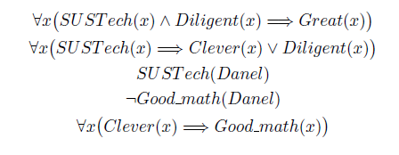
Question 4

Slide 18
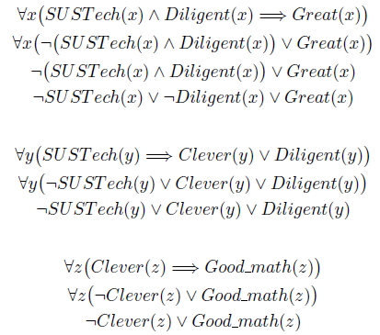
Question 4

Slide 19
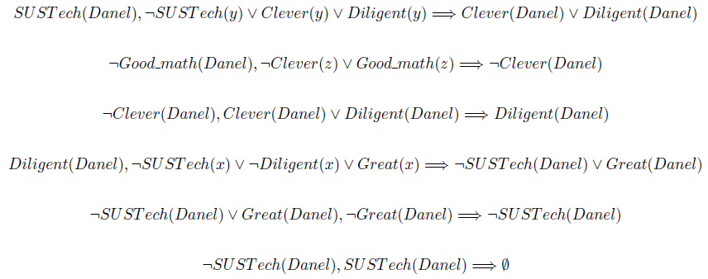
Question 5

