Slide 1



Program Synthesis Using Conflict-Driven Learning
In PLDI’18
Authors: Yu Feng, Ruben Martins, Osbert Bastani, Isil Dillig
Chen Shaoyuan
Jun 16, 2020

Slide 2
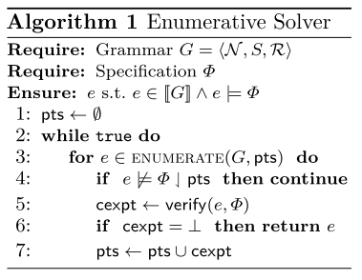
Review: SyGuS & Enumerative Search
The enumerative search algorithm is a kind of CounterExample-Guided Inductive Search (CEGIS).

Slide 3
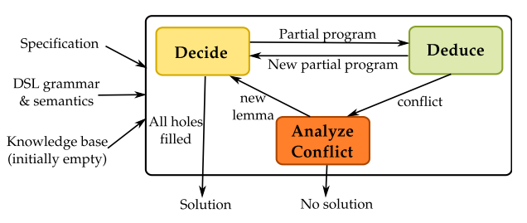
Conflict-Driven Synthesis
Conflict-driven: learn from past mistakes

Slide 4
Conflict-Driven Synthesis (Cont’d)
Decide:
Selects which hole of the current partial program to fill and determines how to fill it using the constructs in the DSL.
Deduce:
Makes inferences based to semantics of DSL and the knowledge base, which keeps track of useful lemmas during the synthesis.
Analyze Conflict:
When the deduce component detects a conflict, it identifies the root cause and add new learned lemmas to the knowledge base.
The algorithm backtracks after the conflict analyzation completed.

Slide 5

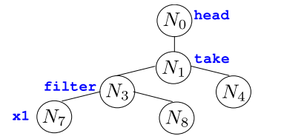
Partial Program
Definition of a partial program:
(CFG) a sentential form (token sequence with non-terminals)
(AST) an abstract syntax tree with unexpanded nodes
(Program) a program template with unfilled holes
unexpanded nodes (holes)

Slide 6
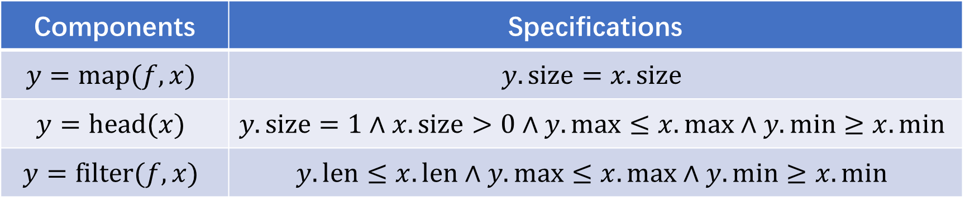
Component and Component Specification
A component is a simply production rule in CFG.
The components are under-specified, often by constraining some attributes of non-terminals.
For example, in List Operation CFG, we can choose the minimum, maximum, size, etc., as the list attributes:
Components | Specifications
$$y=map(f,x)$$ | $$y.size=x.size$$
$$y=head(x)$$ | $$y.size=1∧x.size>0∧y.max≤x.max∧y.min≥x.min$$
$$y=filter(f,x)$$ | $$y.len≤x.len∧y.max≤x.max∧y.min≥x.min$$

Slide 7
Pruning the Search Space
The under-specifications of the components can be used to rule out some partial programs.
Note in the original enumerative search, validation only performed when the program is complete. However, a partial programs represent exponentially many complete programs, hence pruning may significantly speed up the search.
For example, consider the following list program synthesis task, which sums up the 2 maximum elements
Input: x=[49,62,82,54,76]
Output: y=158

Slide 8
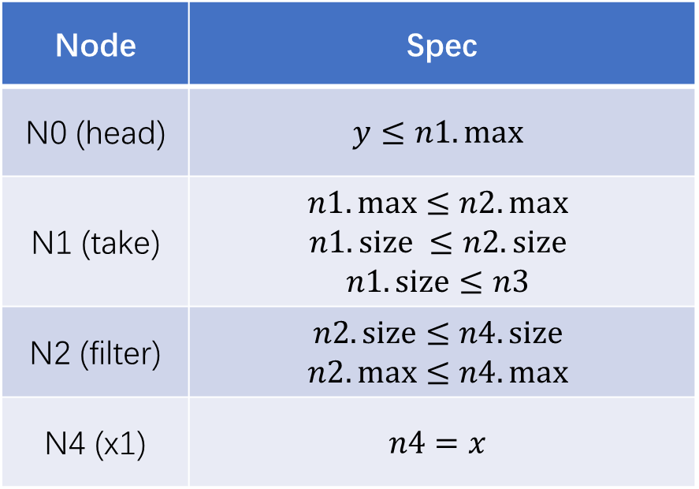
Pruning the Search Space (Cont’d)
Input: x=[49,62,82,54,76]
Output: y=158
Node | Spec
N0 (head) | $$y≤n1.max$$
N1 (take) | $$n1.max≤n2.max$$ $$n1.size ≤n2. size$$ $$n1.size≤n3$$
N2 (filter) | $$n2.size≤n4.size$$ $$n2.max≤n4.max$$
N4 (x1) | $$n4=x$$
N0
head
Integer
List
N1
take
Function
filter
N2
N3
?
x1
N4
N5
?
UNSAT!

Slide 9
Learning from Mistakes
Input: x=[49,62,82,54,76]
Output: y=158
N0
head
sort,
reverse,
filter
Integer
Two components X, X’ are equivalent modulo conflict at node N, if replacing X with X’ leads to the same conflict.
How to detect EMCs?
N1
take
List
filter
N2
N3
?
Function
x1
N4
N5
?
$$take=_{N1}sort=_{N1}reverse=_{N1}filter$$

Slide 10
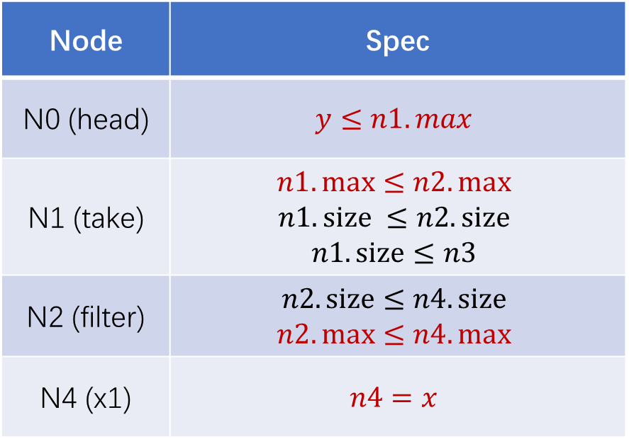
Learning from Mistakes (Cont’d)
Input: x=[49,62,82,54,76]
Output: y=158
N0
head
Integer
Node | Spec
N0 (head) | $$y≤n1.max$$
N1 (take) | $$n1.max≤n2.max$$ $$n1.size ≤n2. size$$ $$n1.size≤n3$$
N2 (filter) | $$n2.size≤n4.size$$ $$n2.max≤n4.max$$
N4 (x1) | $$n4=x$$
N1
take
List
filter
N2
N3
?
Function
x1
N4
N5
?
Understanding the root cause of mistakes.
unsat core: minimal unsat subset of clauses

Slide 11

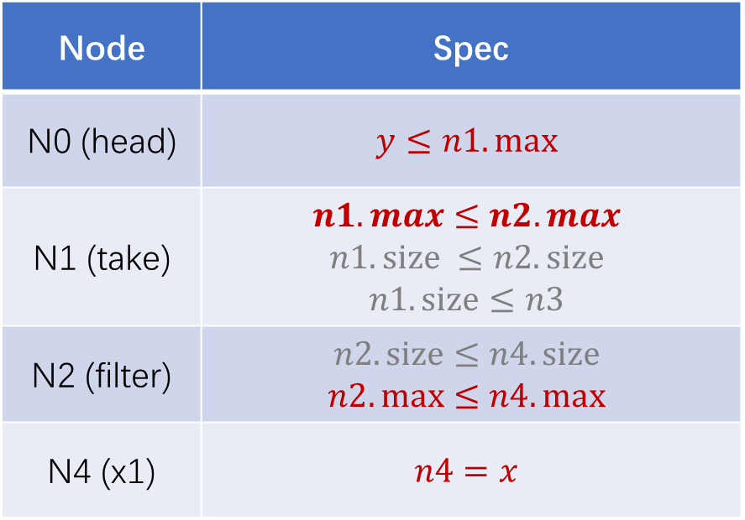
Learning from Mistakes (Cont’d)
Using learning from mistakes, we can prune exponentially many partial programs at one time!
Input: x=[49,62,82,54,76]
Output: y=158
Node | Spec
N0 (head) | $$y≤n1.max$$
N1 (take) | $$n1.max≤n2.max$$ $$n1.size ≤n2. size$$ $$n1.size≤n3$$
N2 (filter) | $$n2.size≤n4.size$$ $$n2.max≤n4.max$$
N4 (x1) | $$n4=x$$
N0
head
SAT
$$Φ( )$$
💣
？
Integer
💣
N1
take
？
？
List
filter
N2
N3
?
Function
x1
N4
N5
?

Slide 12
Research Thoughts
SAT Solver
Before 2000: SAT solving was considered intractable!
Since 2000: Conflict-Driven Clause Learning SAT solvers enable us to solve SAT problems with millions of variables, which completely revolutionized the field!
Program Synthesis:
This is the first step towards learning from mistakes.
Can learning push the boundaries of program synthesis?

Slide 13
Q & A

