Slide 1

Augmented Reality Game: Older Adults Companion
Chong Wei Xin
Project Supervisor: Dr Lee Yun Li

Slide 2
Introduction
Objective of the project:
Develop an AR mobile game for aimed at older adults.
Name of mobile game: "Health Friend"
A virtual pet raising game with AR features accompanied by two puzzle minigames.
Problem:
Older adults experience cognitive decline and social isolation

Slide 3
Introduction
Aim of the mobile game
Provide an enjoyable experience that encourages older adults to regularly engage with cognitive training.
01
Enhance cognitive abilities of older adults, including memory, attention, and problem-solving.
02
Provide companionship towards older adults and reduce loneliness.
03

Slide 4
Literature Review
Type of games that are beneficial and suitable to older adults:
Puzzle games
Increase cognitive performance
Virtual pet games
Sense of companionship
Reduce stress

Slide 5
Literature Review
Like
Single player games
Casual content
Simple and easy controls
Augmented reality
Dislike
Violent Content
Intense Interaction
Complicated controls
Audiovisual cues
What kind of video game content do older adults like and dislike?

Slide 6
Literature Review
How the beneficial genres can incorporate preferred elements:
Puzzle games
Non-violent content
Casual
Simple and easy controls
Virtual pet games
Non-violent content
Casual
Simple and easy controls
Augmented Reality

Slide 7
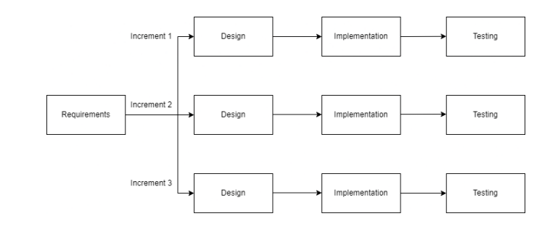
Methodology
App is developed using Incremental Model

Slide 8
Methodology
Design
Create wireframe of app UI using Figma
Implementation
Coding app and their functionalities using Unity and C# scripts
Testing
Test app according to criterias
An increment consists of:

Slide 9
Work Done
Compile app into APK file and carry out user acceptance testing
Requirements
Survey
Literature Review
Increment 1
Virtual pet section
Increment 2
Minigames section: Sudoku game and Memory game
Increment 3
Extra features and completion of app

Slide 10
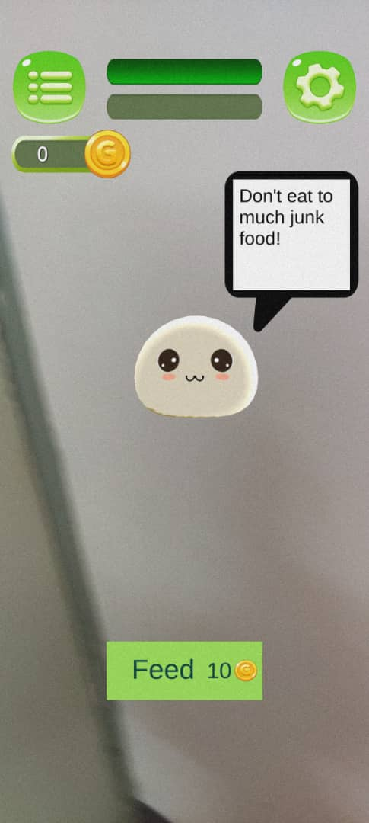
Work Done
Increment 1: Virtual Pet Section

Slide 11
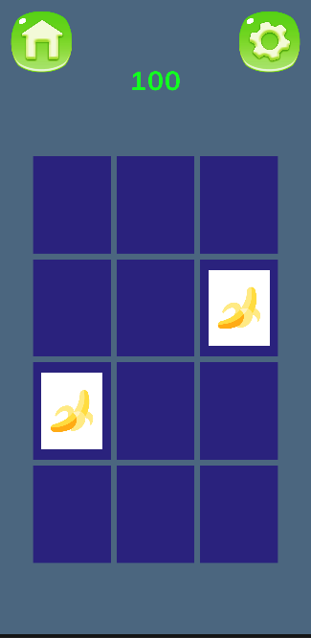
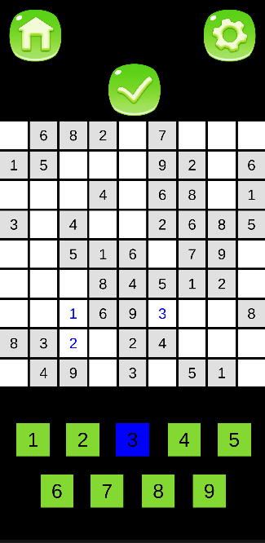
Work Done
Increment 2: Minigames section
Memory Game
Sudoku Game

Slide 12
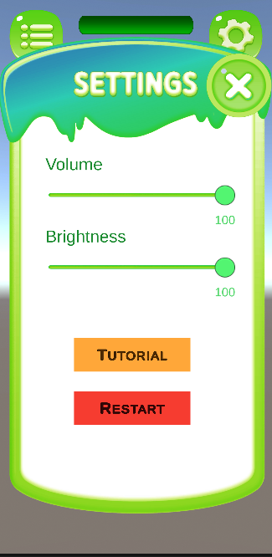
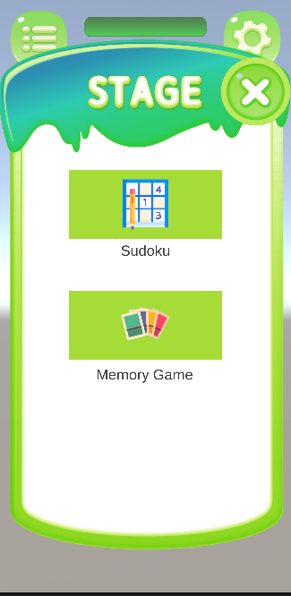

Work Done
Increment 3: Extra features and completion of app
App installed onto a phone
Settings Menu
Minigames Menu

Slide 13

Results and Discussion
Survey
Rate different aspects of the game on a scale of 1 to 5, from “strongly disagree” to “strongly agree"
Includes 3 questions which contains a choice, the reasoning, and optional feedback.
Purpose: evaluate suitability of the app to older adults
10 Participants
40 – 60 age range

Slide 14
Results and Discussion
Enjoyment of Mobile Game
Mixed responses but mostly neutral or positive
Ease of Understanding
Majority found it easy to understand
App Navigation
Most did not find it difficult to navigate
Improve on this aspect through feedback

Slide 15
Results and Discussion
Mostly neutral towards health advice speech bubble
Adaptation to Older Adults
Room for further improvement
Sound Effect and Visuals
Sound – should add background music
Pet was mostly liked
Visuals – clear and organized
Virtual Pet
Need more interactivity and customization

Slide 16
Results and Discussion
Augmented Reality (AR) Features
Can be considered an attractive element
Minigames for cognitive training
More variety of minigames should be included
Overall Benefit
Mixed responses but no disagreements

Slide 17
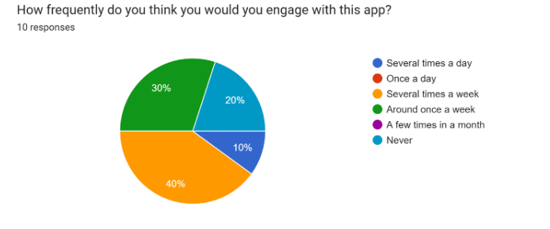
Results and Discussion
Reasons for engagement:
relaxation, passing time
Reasons for lower engagement:
lack of engaging elements such as flashy animations and responsive pet

Slide 18
Results and Discussion
More interactive tutorials
Add background music
Customization options for pets
Both virtual pet raising game and puzzle minigams should have faster pace
Additional feedback given:

Slide 19
Conclusion and Future Work
Conclusion
Mobile game developed has potential for cognitive training and enjoyment, need further enhancements to fully accomplish the aims
Future Work
Incorporate feedback into future enhancement and improvement
Carry out further research into content that will appeal to older adults
Conduct larger-scale user acceptance testing

Slide 20

Thank You

Slide 21
References
M. M. Botvinick, T. S. Braver, D. M. Barch, C. S. Carter, and J. D. Cohen, “Conflict monitoring and cognitive control.,” Psychological Review, vol. 108, no. 3, pp. 624–652, 2001. [6] J. van Muijden, G. P. Band, and B. Hommel, “Online games training aging brains: Limited transfer to cognitive control functions,” Frontiers in Human Neuroscience, vol. 6, 2012.
H. Brooker, K. A. Wesnes, C. Ballard, A. Hampshire, D. Aarsland, Z. Khan, R. Stenton, M. Megalogeni, and A. Corbett, “The relationship between the frequency of number-puzzle use and baseline cognitive function in a large online sample of adults aged 50 and over,” International Journal of Geriatric Psychiatry, vol. 34, no. 7, pp. 932–940, 2019.
] L. E. Nacke, A. Nacke, and C. A. Lindley, “Brain training for Silver Gamers: Effects of age and game form on effectiveness, efficiency, self-assessment, and gameplay experience,” CyberPsychology & Behavior, vol. 12, no. 5, pp. 493–499, 2009.

Slide 22
References
K. A. Blocker, T. J. Wright, and W. R. Boot, “Gaming preferences of aging generations,” Gerontechnology, vol. 12, no. 3, 2014.
A. Chesham, P. Wyss, R. M. Müri, U. P. Mosimann, and T. Nef, “What older people like to play: Genre preferences and acceptance of casual games,” JMIR Serious Games, vol. 5, no. 2, 2017.
S. Gabriel, “Pokémon Go-How Religious Can an Augmented Reality Hunt Be?,” Online-Heidelberg Journal of Religions on the Internet 12, pp. 18-31, 2017.

