Slide 1

Effects of Language Type and Response Position
on Associative Stability
汇报人：王鑫 博士研究生
指导教师：张萍 教授
单位：苏州大学外国语学院

Slide 2
研究背景
核心构念
研究空白
研究问题
研究设计
结果与讨论
被试信息
实验材料
数据采集
数据分析
研究结果
初步讨论
研究启示
不足之处
现有研究

Slide 3
核心构念
词汇联想（Word Association）
  词汇产出知识测量（Meara & Fitzpatrick 2000）
  词汇（语言）能力发展（Kruse et al. 1987; Zareva 2007）
  心理词汇组织方式（Jiang & Zhang 2021; 张萍 2010; 张珊珊 2006）
Notes:
西方

Slide 4
核心构念
联想稳定性（Associative Stability）
  方法论视角（Gekoski & Riegel 1966; Meara 1982; 2009）
  词汇表征视角（de Bot & Lowie 2010）
  词汇网络视角（本研究）
    Lexical network perspective (Meara 2009)
    Ontogenesis model of L2 lexical representation (Bordag et al. 2022)
    Multiplex lexical network (Stella et al. 2017)
Notes:
西方

Slide 5
现有研究
一语研究
  英语母语者联想稳定性（Brotsky & Linton 1967; Fitzpatrick et al. 2015; Gekoski & Riegel 1966）
二语研究
  英语学习者联想稳定性（Fitzpatrick & Clenton 2010; Fitzpatrick & Meara 2004)
双语研究
  阿拉伯语英语双语联想稳定性（Dalrymple-Alford & Aamiry 1970)
  荷兰语英语双语联想稳定性（Van Hell & De Groot 1998）
Notes:
西方

Slide 6
研究空白
一语和二语各自的联想稳定性证据并不充分
未考察一语和二语联想稳定性的个体内部一致程度
  (Fitzpatrick 2009)
未探讨反应位置和语言类型对联想稳定性的共同影响
  (De Deyne & Storms 2008; Lam & Sheng 2020)
Notes:
西方

Slide 7
研究问题
Are there any differences between L1 and L2 associative stability?
Are there any correlations between L1 and L2 associative stability?
Are there any response position effects on L1 and L2 associative stability?
Notes:
西方

Slide 8
被试信息
40 Chinese university students
  Mean age: 19.73 years
  Mean length of L2 learning: 12.10 years
  L2 proficiency: CET-4
  Major: English, English education
Notes:
西方

Slide 9
实验材料
30 high-frequency English words (张萍 2010)
Degree of concreteness | Word class | Examples of English cue words | Examples of Chinese cue words
concrete | noun | kitchen, dog | 厨房，狗
 | verb | smile, climb | 微笑，攀爬
 | adjective | hot, soft | 热的，柔软的
abstract | noun | peace, value | 和平，价值
 | verb | suppose, prefer | 假设，偏向
 | adjective | proper, essential | 适当的，必需的
Notes:
西方

Slide 10
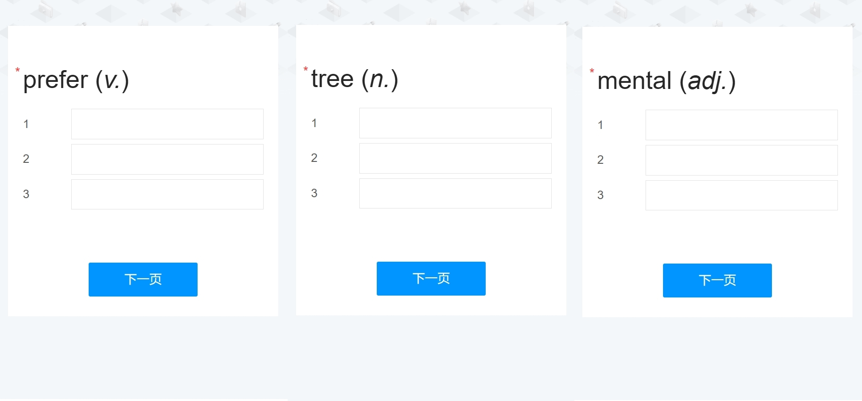
数据采集
Web-based continuous word association task
  1 cue word – 3 response words
  Two test sessions spaced two weeks apart
  Instructions, time of administration, order of cue words kept constant
Notes:
西方

Slide 11
数据分析
13927 valid responses, 113 blank responses
Data treatment:
  Plural → singular
  Spelling correction
  Derivations and multi-word responses retained
Statistical analysis: repetition rate
  Independent-sample t-test
  Pearson correlation test
  Welch’s ANOVA, two-way ANOVA
Notes:
西方

Slide 12
研究结果
1. Are there any differences between L1 and L2 associative stability?
Yes.
 | Chinese |  | English |  | Independent t-test results
 | % | SD | % | SD
By-participant | 31.74 | 10.46 | 39.09 | 10.86 | RR _{E} > RR _{C}**
By-item | 62.68 | 6.76 | 68.55 | 5.37 | RR _{E} > RR _{C}***
Notes:
西方

Slide 13
研究结果
2. Are there any correlations between L1 and L2 associative stability?
Partially.
By-participant: Yes
  r = 0.636, p < 0.001, 95% CI [0.400, 0.792]
By-cue: No
  r = 0.1547, p = 0.414, 95% CI [−0.2177, 0.4878]
Notes:
西方

Slide 14
研究结果
3. Are there any response position effects on L1 and L2 associative stability?
Yes.
By-participant
  Response position: p < 0.001, η2 = 0.663
  Language type: p = 0.156, η2 = 0.002.
  Response position × Language type: p = 0.621, η2 = 0.0014
By-cue
  Response position: p < 0.001, η² = 0.625
  Language type: p = 0.412, η² = 0.004
  Response position × Language type: p = 0.442, η² = 0.009
Notes:
西方

Slide 15
初步讨论
Differences between L1 and L2 WA behavior
  Consistent with Fitzpatrick & Izura (2011), Henriksen (2008), Zareva (2007)
  Inconsistent with Dalrymple-Alford & Aamiry (1970), Van Hell & De Groot (1998)
Consistency between L1 and L2 WA behavior within individuals
  Consistent with Fitzpatrick (2007, 2009), Higginbotham (2010)
WA behavior across response positions
  Consistent with De Deyne & Storms (2008a, 2008b), Lam & Sheng (2020), Sheng et al. (2006)
Notes:
西方

Slide 16
研究启示
Link stability to the organization of lexical network
Understand L2 lexical behavior through the lens of L1 lexicon
Explore less common associative connections through continuous WA task
Notes:
西方

Slide 17
不足之处
A two-week interval
Associative stability of low-frequency words
Connection between stability research and category-based WA research
Notes:
西方

Slide 18
Selected references
Fitzpatrick, T., Playfoot, D., Wray, A., & Wright, M. J. (2015). Establishing the reliability of word association data for investigating individual and group differences. Applied Linguistics, 36(1), 23-50.
Jiang, N., & Zhang, J. (2021). Form prominence in the L2 lexicon: Further evidence from word association. Second language research, 37(1), 69-90.
Kruse, H., Pankhurst, J., & Smith, M. S. (1987). A multiple word association probe in second language acquisition research. Studies in Second Language Acquisition, 9(2), 141-154.
Meara, P. (2009). Connected Words: Word associations and second language vocabulary acquisition. John Benjamins Publishing Company.
Van Hell, J. G., & De Groot, A. M. (1998). Conceptual representation in bilingual memory: Effects of concreteness and cognate status in word association. Bilingualism: Language and Cognition, 1(3), 193-211.
张萍. (2010). 中国英语学习者心理词库联想模式对比研究. 《外语教学与研究》, 42(01), 9-16+80.
Notes:
西方

Slide 19


