Slide 1
Path Recommending System
GROUP 6
Prof. Antonio Miranda
Teaching assistant: Abraham Gale
Team members: Tianfang Zhang(tz203), Xu Liu(xl558), Xinghao Wang(xw354)

Slide 2
Contents
PART ONE: Goal
PART TWO: Project Description
PART THREE: Genetic Algorithm
PART FOUR: Graphical User Interface PART FIVE: Future Work

Slide 3
Goal
Introduce the achievement of a path recommending system.
The system is a handy tool for every user who wants to find a path with minimal length. The problem is actually a TSP(Traveling Salesman Problem).
In this system, we use approximation method-Genetic Algorithm to solve it.

Slide 4
Project Description
The type of this project is implementation of an algorithm not covered in class.
This system uses genetic algorithms to find an optimal path. Path planning plays an important part in our daily life, especially for people who are planning trips and want to find a path with minimal length, therefore developing a path recommending system helps a lot and is extremely useful.

Slide 5
Project Description
Using genetic algorithms, we can provide a path for users as well as possible. Each one in our group is proficient in data structures and algorithms, so it is feasible for us to complete it within a semester.
By using approximation method, we may not be able to get an optimal path, but its efficiency is excellent. This is the novel part of this system.
The project has four stages: Gathering, Design, Infrastructure
Implementation, and User Interface.

Slide 6
Project Description
The data are 48 capitals of the US (Padberg/Rinaldi). The corresponding cities are as shown in the table below.
Sequence Number | City | Sequence Number | City | Sequence Number | City | Sequence Number | City
1 | AL | 13 | IA | 25 | NE | 37 | RI
2 | AZ | 14 | KS | 26 | NV | 38 | SC
3 | AR | 15 | KY | 27 | NH | 39 | SD
4 | CA | 16 | LA | 28 | NJ | 40 | TN
5 | CO | 17 | ME | 29 | NM | 41 | TX
6 | CT | 18 | MD | 30 | NY | 42 | UT
7 | DE | 19 | MA | 31 | NC | 43 | VT
8 | FL | 20 | MI | 32 | ND | 44 | VA
9 | GA | 21 | MN | 33 | OH | 45 | WA
10 | ID | 22 | MS | 34 | OK | 46 | WV
11 | IL | 23 | MO | 35 | OR | 47 | WI
12 | IN | 24 | MT | 36 | PA | 48 | WY

Slide 7
Genetic Algorithm
General Steps
Generate an initial population of N solution (routes).
Rank each solution according to its fitness (inversely proportional to the length of the route).
Select solutions for recombination, with frequency determined by its fitness.
Generate N children solutions recombining the selected parents.
With some probability, introduce mutations into each child.
Of the 2N solutions (parents + children), select the best N.
Repeat the steps above.

Slide 8
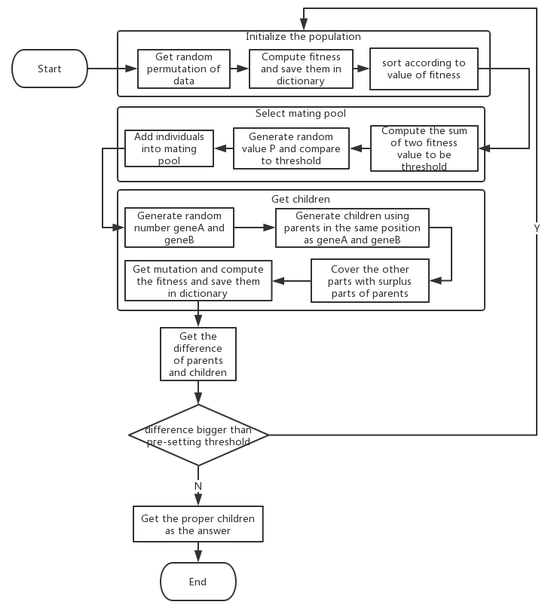
Flow Diagram

Slide 9
Genetic Algorithm
Initialization of the First Generation
Once we get the input including start point and stops, we can generate the first generation by randomly shuffle the stops.
Therefore, the N solutions generated are just the permutation of stops.

Slide 10
Genetic Algorithm
Fitness Computation
Given a solution, how to measure its fitness?
Actually, it is simple because we can just compute the sum of distance between every two adjacent stops. However, for the solution is a permutation of the stops, it doesn’t include the start and end point. So, we need to add the two distances, outgoing and incoming edge from start point.
Finally, return the inverse of sum as the fitness of the solution.

Slide 11
Genetic Algorithm
Breeding Parents Selection
To ensure high quality of genes to pass and at the same time keep the genetic diversity, we choose two parents in the population at one time with frequency according to its fitness.
In other words, the higher fitness it has, the more chance the solution be chosen.

Slide 12
Genetic Algorithm
Recombination of Genes
First, we randomly pick a continuous part of genes to crossover.
Parent1
3 | 6 | 2 | 9 | 1 | 5 | 7 | 4 | 8
Parent2
1 | 5 | 3 | 8 | 7 | 6 | 4 | 2 | 9

Slide 13
Genetic Algorithm
Recombination of Genes
Then, we swap the two parts and fill in the rest part with those genes that not in the swapped part in the original order.
Child1
3 | 2 | 9 | 8 | 7 | 6 | 4 | 1 | 5
Child2
3 | 8 | 6 | 9 | 1 | 5 | 7 | 4 | 2

Slide 14
Genetic Algorithm
Recombination of Genes
Finally, we move the selected parts into the head of genes and two childs are generated.
Child1
8 | 7 | 6 | 4 | 3 | 2 | 9 | 1 | 5
Child2
9 | 1 | 5 | 7 | 3 | 8 | 6 | 4 | 2

Slide 15
Genetic Algorithm
Mutation
In order to get chance to jump out of the local optimum, we introduce mutation with some probability while generating the child. Randomly choose two genes and swap them.
Child
8 | 7 | 6 | 4 | 3 | 2 | 9 | 1 | 5
Mutation happens
Child ’
8 | 7 | 9 | 4 | 3 | 2 | 6 | 1 | 5

Slide 16
Genetic Algorithm
Termination Conditions
One way we use is to compute the difference of two generations (parents and children) in every iteration. If the difference is sufficiently small, we stop the loop.
The other way we use is to set a specific number of iterations, so the program stops after fixed iterations.

Slide 17

Graphical User Interface
Login window
All the user IDs and passwords are stored in the info.txt in the root directory.

Slide 18

Graphical User Interface
Main window
In the main page, we can:
look up the map
input the start point and stops to find the route
Look up the optimal route.

Slide 19
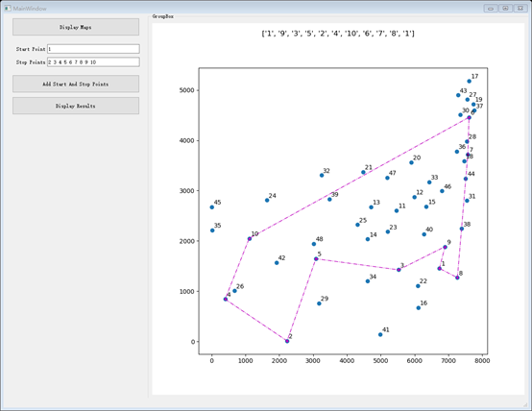
Graphical User Interface
Result
After we set the start point 1 and stops 2, 3 , 4, 5, 6, 7, 8, 9, 10, the optimal route is as shown in the graph.
And the route is print as a list above the graph.

Slide 20
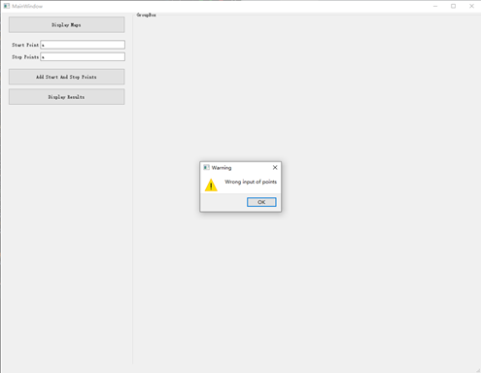

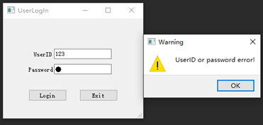
Graphical User Interface
Stability

Slide 21
Future Work
Apply the Genetic Algorithm to more complicated datasets.
Improve efficiency of the Genetic Algorithm by exploring new crossover approaches.
Apply different mutation rate and find one that has the best performance.
Add a module that user can input not only the start point and stops, but also the end point, so the user is able to find a short path from start to end through the stops.

Slide 22
Reference
[1] Koza J R. Genetic programming[J]. 1997.
[2] Potvin, Jean-Yves. "Genetic algorithms for the traveling salesman problem." Annals of Operations Research 63.3 (1996): 337-370.
Data Set Resource:
http://elib.zib.de/pub/mp-testdata/tsp/tsplib/tsp/att48.tsp

Slide 23
Thanks!

