Slide 1
pythia.readString("SoftQCD:nonDiffractive = on");
// Color reconnection tune (CR) mode2
pythia.readString("Tune:pp 14");
pythia.readString("Tune:ee 7");
pythia.readString("MultipartonInteractions:ecmPow=0.215");
pythia.readString("MultipartonInteractions:expPow=1.85");
pythia.readString("StringPT:sigma =0.335");
pythia.readString("StringZ:aLund =0.36");
pythia.readString("StringZ:bLund =0.56");
pythia.readString("StringFlav:probQQtoQ =0.078");
pythia.readString("StringFlav:ProbStoUD =0.2");
pythia.readString("StringFlav:probQQ1toQQ0join = 0.0275,0.0275,0.0275,0.0275");
pythia.readString("MultiPartonInteractions:pT0Ref =2.15");
pythia.readString("BeamRemnants:remnantMode =1");
pythia.readString("BeamRemnants:saturation= 5");
pythia.readString("ColourReconnection:mode = 1");
pythia.readString("ColourReconnection:allowDoubleJunRem =off");
pythia.readString("ColourReconnection:m0=0.3");
pythia.readString("ColourReconnection:allowJunctions =on");
pythia.readString("ColourReconnection:junctionCorrection=1.2");
pythia.readString("ColourReconnection:timeDilationMode=2");
pythia.readString("ColourReconnection:timeDilationPar=0.18");
Rui’s pythia root file is no available anymore;
We need to redo the pythia simulation to estimate the prompt ratio.
all codes are at:
https://github.com/wxie2013/LambdaC-PYTHIA8-simulation.git
PYTHIA8302.
Color reconnection mode 2
1b events generated
Inclusive Lc
B→Lc
Inclusive B-hadrons

Slide 2
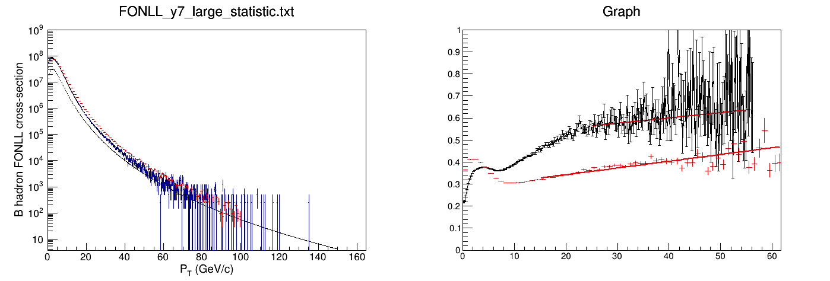
Inclusive B-hadron and Weight comparison with Rui’s results
Black: FONLL
Blue: PY(incl. b-hadron Rui)
Red: PY(incl. b-hadron new)
Black: Rui’s result
Red: new result
FONLL/PYYHIA (incl. B-hadron)
Unit: pb
pT(GeV/c)
The new PYTHIA B-hadron cross section is a bit higher than Rui’s result.
Tunning or different version of pythia

Slide 3
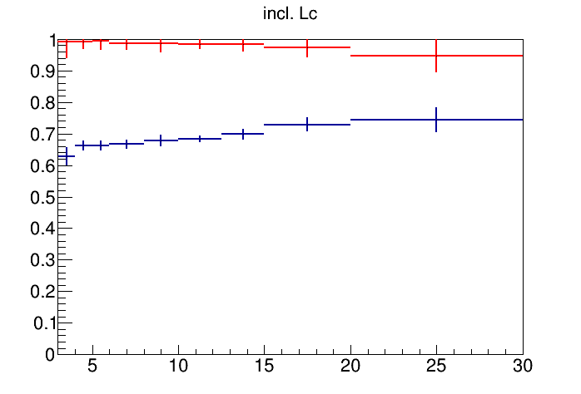
The prompt ratio are roughly consistent with Rui’s results.
The small difference could be from
Pythia tuning
Pythia version
pT | PYTHIA | FONLL
3-4 | 0.62 | 0.991
4-5 | 0.66 | 0.993
5-6 | 0.66 | 0.993
6-8 | 0.67 | 0.987
8-10 | 0.68 | 0.988
10-12.5 | 0.684 | 0.984
12.5-15 | 0.70 | 0.985
15-20 | 0.73 | 0.973
20-30 | 0.75 | 0.947

Slide 4
|y|<2 for pythia; FONLL |y|<7. Inconsistent
My bug: FONLL spectra did not divide 1/lum/2 and bin width

