Slide 1
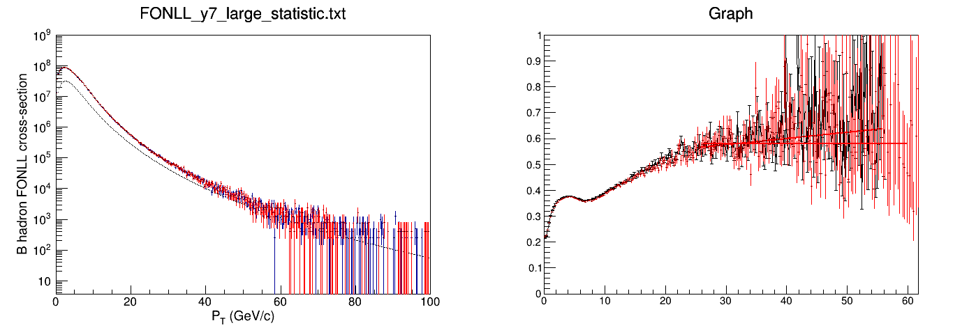
Inclusive B-hadron and Weight comparison with Rui’s results
Black: FONLL
Blue: PY(incl. b-hadron Rui)
Red: PY(incl. b-hadron new)
Black: Rui’s result
Red: new result
FONLL/PYYHIA (incl. B-hadron)
Unit: pb
pT(GeV/c)
pythia8302:
Pythia8 tune: CUETP8M1
HardQCD_ON
decay with EvtGen
reproduce Rui’s weight result
Mistake in last presentation:
Did not remove B-hadrons decaying into B-hadrons.

Slide 2
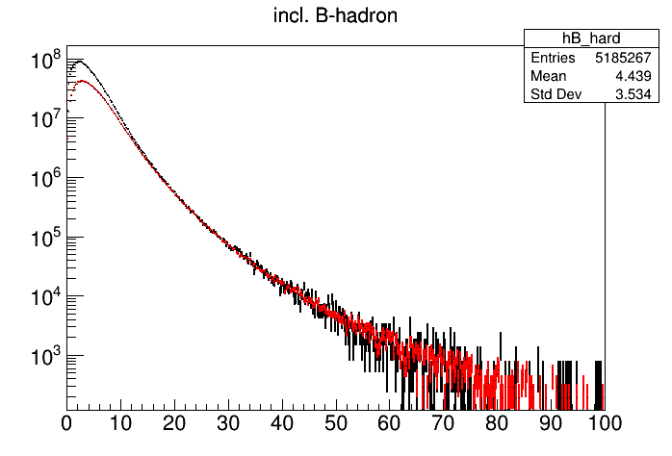
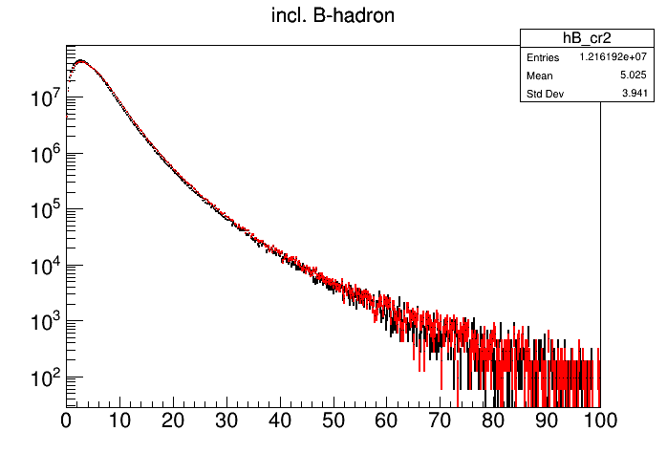
Hard_QCD_ON ----- soft_nondiff_ON ----- PYTHIA tunes
Black: HardQCD ON
Red: softQCD_nondiff_ON
Pythia tune: CUETP8M1
Black: Color Reconnection mode2
Red: CMS CUEPT8M1
SoftQCD_nonDiffractive_ON
pT(GeV/c)
pT(GeV/c)
pT>15 GeV/c, no difference between
SoftQCD_nonDiffractive_ON and
HardQCD_ON
pT<15 GeV/c need to use SoftQCD_nonDiffractive_ON
Communication with pythia author
Small difference between
CMS CUEPT8M1 and
Color Reconnection mode2

Slide 3
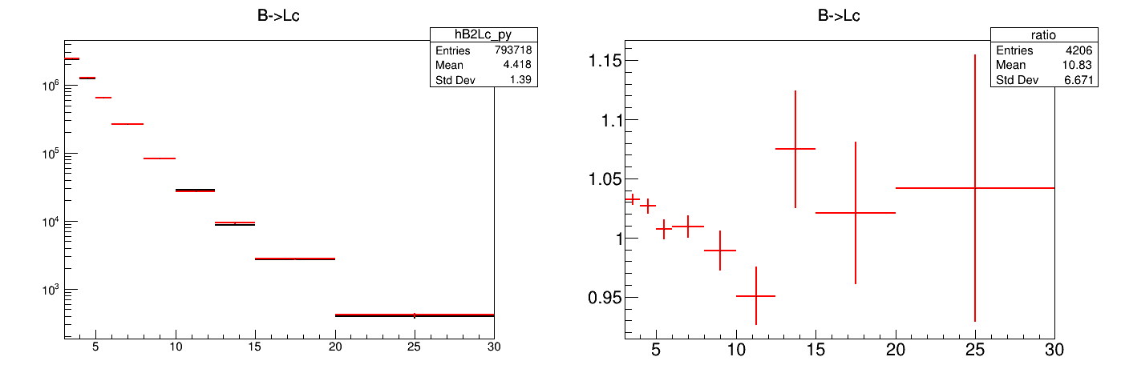
B→Lc With and Without Using EvtGen
B→Lc cross section
red: evtgen decay
black: pythia decay
EvtGen/pythia
pT(GeV/c)
pT(GeV/c)
Effect of decay kinematic ~ 5%.
Final result use EvtGen

Slide 4
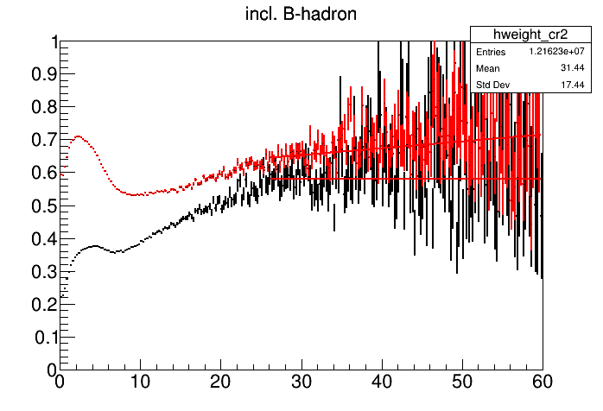
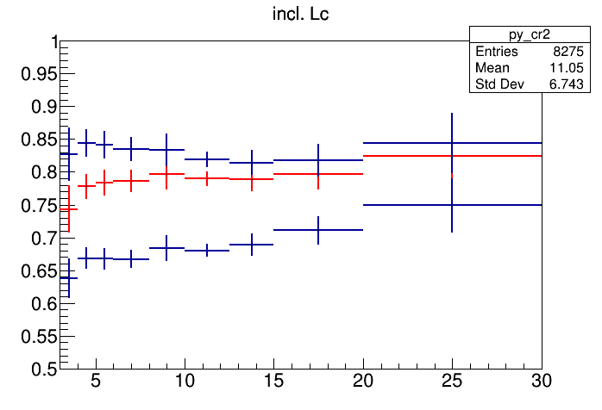
Lc prompt ratio with old and new weight
Red: weight w/ softQCD_nodiff_on
Black: weight w/hardQCD_ON
Red: weight w/ softQCD_nodiff_on
Black: weight w/hardQCD_ON
Inclusive Lc is from CR2 tune with softQCD_nondiff_ON
It describe the data
In the last presentation, FONLL cross section for B→Lc missed the 2*lum (0.04 pb^-1) and bin width normalization
Rui probably made the same mistake leading to high prompt ratio in FONLL

Slide 5
Final results of Lc prompt ratio from PYTHIA
Using weight from softQCD_nondiff_ON.
pT | PYTHIA | FONLL
3-4 | 0.64 | 0.74
4-5 | 0.67 | 0.78
5-6 | 0.67 | 0.78
6-8 | 0.67 | 0.79
8-10 | 0.68 | 0.80
10-12.5 | 0.68 | 0.79
12.5-15 | 0.69 | 0.79
15-20 | 0.71 | 0.80
20-30 | 0.75 | 0.82
Red: weight w/ softQCD_nodiff_on
Black: weight w/hardQCD_ON

Slide 6
backup

Slide 7
pythia.readString("SoftQCD:nonDiffractive = on");
// Color reconnection tune (CR) mode2
pythia.readString("Tune:pp 14");
pythia.readString("Tune:ee 7");
pythia.readString("MultipartonInteractions:ecmPow=0.215");
pythia.readString("MultipartonInteractions:expPow=1.85");
pythia.readString("StringPT:sigma =0.335");
pythia.readString("StringZ:aLund =0.36");
pythia.readString("StringZ:bLund =0.56");
pythia.readString("StringFlav:probQQtoQ =0.078");
pythia.readString("StringFlav:ProbStoUD =0.2");
pythia.readString("StringFlav:probQQ1toQQ0join = 0.0275,0.0275,0.0275,0.0275");
pythia.readString("MultiPartonInteractions:pT0Ref =2.15");
pythia.readString("BeamRemnants:remnantMode =1");
pythia.readString("BeamRemnants:saturation= 5");
pythia.readString("ColourReconnection:mode = 1");
pythia.readString("ColourReconnection:allowDoubleJunRem =off");
pythia.readString("ColourReconnection:m0=0.3");
pythia.readString("ColourReconnection:allowJunctions =on");
pythia.readString("ColourReconnection:junctionCorrection=1.2");
pythia.readString("ColourReconnection:timeDilationMode=2");
pythia.readString("ColourReconnection:timeDilationPar=0.18");
Rui’s pythia root file is no available anymore;
We need to redo the pythia simulation to estimate the prompt ratio.
all codes are at:
https://github.com/wxie2013/LambdaC-PYTHIA8-simulation.git
PYTHIA8302.

