Slide 1
BT2102
Assignment 1
Group 35
Student Names: | NUS ID:
Yang Haoying | A0238149X
Zhang Zishuo | A0239837M
Lee Shan Shan | A0241238L
Lim Wei Xuan | A0233827B

Slide 2
Final Entities and Attributes(1/2)
Member
Book
accessionNumber
numOfReservations
memberID
fineAmount
Title
returnDate
fName
email
ISBN
dueDate
lName
phone
publisherName
borrowDate
faculty
Publication Year
memberID

Slide 3
Final Entities and Attributes(2/2)
Publisher
Author
FinePayment
publisherName
authorName
memberID
paidAmount
paymentDate
BookHasAuthor
BookHasReservation
accessionNumber
reserveDate
accessionNumber
authorName
memberID

Slide 4
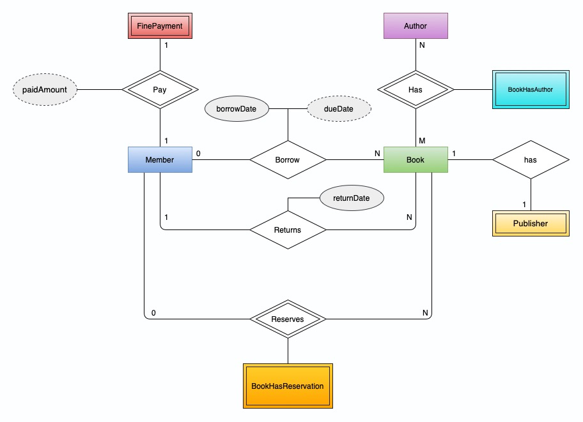
The Final Conceptual Data Model

Slide 5
The Final Logical Schema
Member(memberID, fName, lName, phone, faculty, email, fineAmount)
Book(accessionNumber, title, ISBN, publicationYear, borrowDate, dueDate, returnDate, numOfReservations, memberID, publisherName)
Author(authorName)
Publisher(publisherName)
BookHasAuthor(authorName, accessionNumber)
BookHasReservation(reserveDate, memberID, accessionNumber)

Slide 6
The Final Logical Data Model
Member(memberID, fName, lName, phone, faculty, email, fineAmount) Primary Key memberID | Publisher(publisherName) Primary Key publisherName
Book(accessionNumber, title, ISBN, publicationYear, publisherName, memberID, borrowDate,dueDate,returnDate, numOfReservations) Primary Key accessionNumber Foreign Key publisherName references Publisher(publisherName) Foreign Key memberID references Member(memberID) | BookHasAuthor(accessionNumber, authorName) Primary Key (accessionNumber, authorName) Foreign Key authorName references Author(authorName) Foreign Key accessionNumber references Book(accessionNumber)
FinePayment(memberID, paidAmount, paymentDate) Primary Key (memberID, paymentDate) Foreign Key memberID references Member(memberID) | BookHasReservation(accessionNumber, memberID, reserveDate) Primary Key (accessionNumber, memberID) Foreign Key accessionNumber references Book(accessionNumber) Foreign Key memberID references Member(memberID)
Author(authorName) Primary Key authorName

