Slide 1
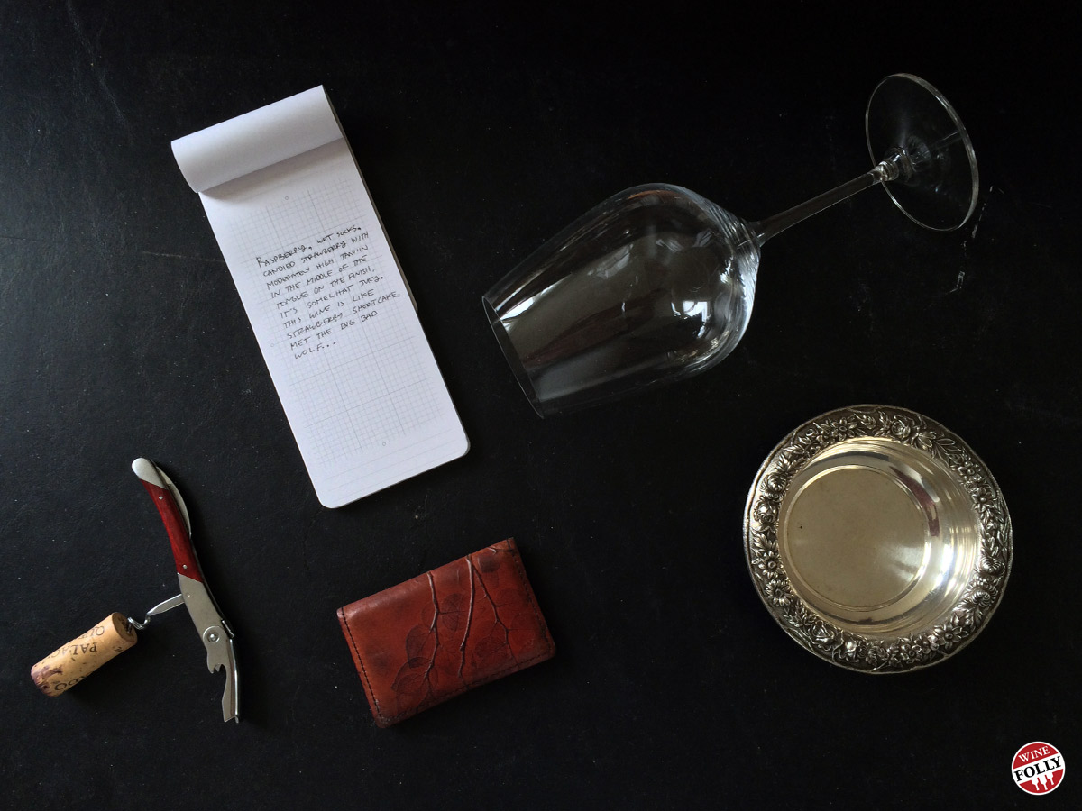
In Vino Veritas
GA Data Science Final Project
3/7/2016
Wen Lu

Slide 2
How to discern wine quality? By description: Balance, Length, Depth, Complexity, Finish By measurements: Physiochemical characters Wine making is considered an art. - Is there a formula for a quality wine? - What basic properties are the formula for a good wine? - Do white wine and red wine share the same formula? - Are there any characters that distinguish white wine and red wine?

Slide 3
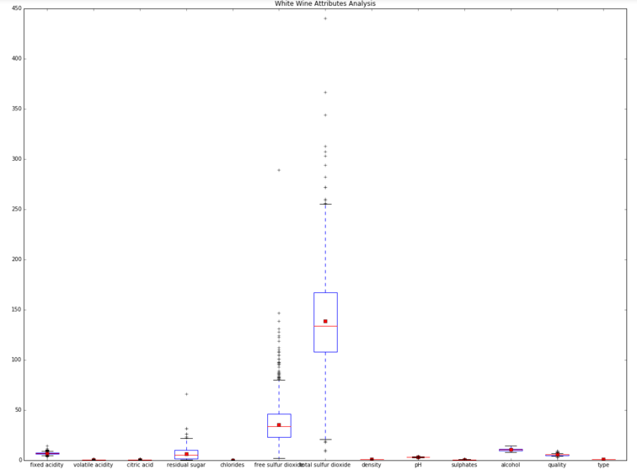
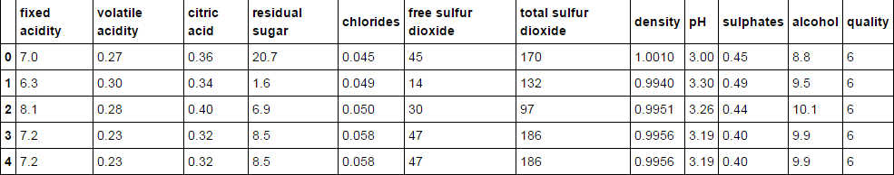
Data Source: UCI Machine Learning Repository Wine Quality Data Set http://mlr.cs.umass.edu/ml/datasets/Wine+Quality Two datasets: White Wine & Red Wine - 12 attributes - no missing values - sample size >1k (1599 vs 4898) - some noises - different measurement units - some features correlated

Slide 4
Framework
EDA
- Feature distribution graph (to be done)
- Standardization
- Benchmark (Dummy Classifier)
Supervised Learning
- Logistic Regression
- Lasso
- Random Forest (importance score)
- SVM
Unsupervised Learning
- [Concatenate datasets]
- PCA
- K-means Clustering
- Visualization
Challenges
- Perform on 3 datasets
- How to determine good white wine formula and good red wine formula are drastically different or not?

