Slide 1



Cloud Native Applications
Polyglot Persistence with Spring Data REST
Notes:
Resting slide on screen before you begin presenting.

Slide 2
Workshop Agenda
Spring Data
Spring Data REST
Polyglot Persistence

Slide 3
Workshop Agenda
Spring Data
Spring Data REST
Polyglot Persistence

Slide 4
What Types of Data Stores?
Spring Data
JPA
MongoDB
Redis
Solr
GemFire
KeyValue
Community
Aerospike
Cassandra
Couchbase
DynamoDB
ElasticSearch
Neo4J

Slide 5
Import the Required Dependency
Add the JPA starter to the pom.xml
<dependency>
<groupId>org.springframework.boot</groupId>
<artifactId>spring-boot-starter-data-jpa</artifactId>
</dependency>

Slide 6
Repositories
Tired of creating / maintaining boilerplate code
Use Spring Repositories
CRUD support added with no implementation required
public interface CrudRepository<T, ID extends Serializable> extends Repository<T, ID> {
// Saves the given entity
<S extends T> S save(S entity);
// returns the entity identified by the given id
T findOne(ID primaryKey);
// returns all entities
Iterable<T> findAll();
// deletes the given entity
void delete(T entity);
// .. more functionality omitted.
}

Slide 7
Add Required Methods as Needed
public interface PersonRepository extends JpaRepository<User, Long> {
List<Person> findByEmailAddressAndLastName
(EmailAddress emailAddress, String lastname);
// enables the distinct flag for the query
List<Person> findDistinctPeopleByLastnameorFirstname
(String lastname, String firstname);
List<Person> findPeopleDistinctByLastnamefOrFirstname
(String lastname, String firstname);
// enabling ignoring case for individual property
List<Person> findByLastnameIgnoreCase(String lastname);
}

Slide 8
@Query as an Alternative to Keywords
A JPA based repository using the @Query Annotation
public interface UserRepository extends JpaRepository<User, Long> {
@Query(“select u from User u where u.emailAddress = ?1)
User findByEmailAddress(String emailAddress);
}

Slide 9
Workshop Agenda
Spring Data
Spring Data REST
Polyglot Persistence

Slide 10
Spring Data REST
Goal is to provide a solid foundation on which to expose CRUD repositories to your repository manage entities using plain HTTP REST semantics

Slide 11
Import the Required Dependency
Add the Spring Data REST starter to the pom.xml
<dependency>
<groupId>org.springframework.boot</groupId>
<artifactId>spring-boot-starter-data-rest</artifactId>
</dependency>

Slide 12
Exporting the Repository
public interface OrderRepository extends CrudRepository<Order, Long> {
List<Order> findByDate(@Param(“date”) Date date);
}
For this repository, Spring Data REST exposes a resource collection at “/orders”
The path is derived from the uncapitalized, pluralized, simple class name of the domain class being managed
It also exposes an item resource for each of these items managed by the repository under the URI template /orders/{id}
Custom queries are exported to /search, e.g. /search/findByDate

Slide 13
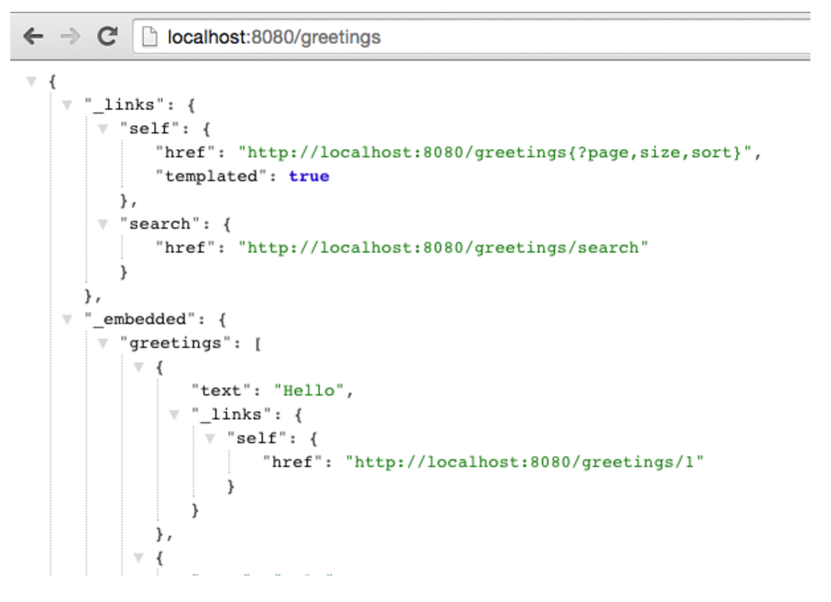
RESTful API

Slide 14
Workshop Agenda
Spring Data
Spring Data REST
Polyglot Persistence

Slide 15
Other Repositories - Cassandra NoSQL
@Repository
public interface BookRepository extends CassandraRepository<Book> {
…
}

Slide 16
Other Repositories - Redis
@Repository
public interface BookRepository {
void saveBook(Book book);
…
}
Redis does not support a “standard” query interface therefore the implementers of Spring Data Redis decided that “the interactions with Redis are quite unique to the use case so we didn't see that much functional overlap to motivate a generic implementation that does more than just ‘save’ and ‘load’”

Slide 17

Lab

