Slide 1
Lisa Brooks’
“Our Beloved Kin”
By Ryan Xu

Slide 2
Summary
In an excerpt from Lisa Brooks’ “Our Beloved Kin,” Brooks describes Mary Rowlandson’s attempts to portray Weetamoo as weak and a servant because of Puritan beliefs of women’s place in society.
Brooks notes how Rowlandson does not recognize Weetamoo’s high status in the Wampanoag society but instead portrays her as “imagined royalty” (Brooks 1)
Rowlandson also highlights the inferiority of Weetamoo to English women and describes Weetamoo as unsuccessfully attempting to emulate Puritan women.
Additionally, Brooks shows how Rowlandson misrepresents Weetamoo’s role to craft wampum belts, portraying it as work and decoration, when instead it is important in tribal alliances and is a symbol of leadership.
Rowlandson spends time to portray Weetamoo as arrogant and out of her place, unlike her depictions of Wampanoag men as kind and respectful.
Brooks shows how Rowlandson’s depiction of Weetamoo reveals her traditional Puritan beliefs and her difficulty with accepting Weetamoo’s powerful place in society.

Slide 3
Summary
Brooks also reveals Weetamoo’s difficulty to accept Rowlandson’s Puritian beliefs and behavior, and shows both of the women’s frustration with the other’s culture and place in society.
Brooks describes Weetamoo’s criticism of Rowlandson’s “weak and selfish behavior” (2).
In Wampanoag community, women are expected to be strong and care for themselves, unlike how in Puritan communities, Rowlandson was often well took care of by her father and husband.
Brooks depicts Rowlandson’s difficulty to travel uphill while carrying a heavy load as a burden for Weetamoo and the Wampanoag community.
Brooks suggests that Rowlandson and other Puritan women were held back by their traditional beliefs and ideas about women in society from work that would otherwise help them physically and emotionally.

Slide 4
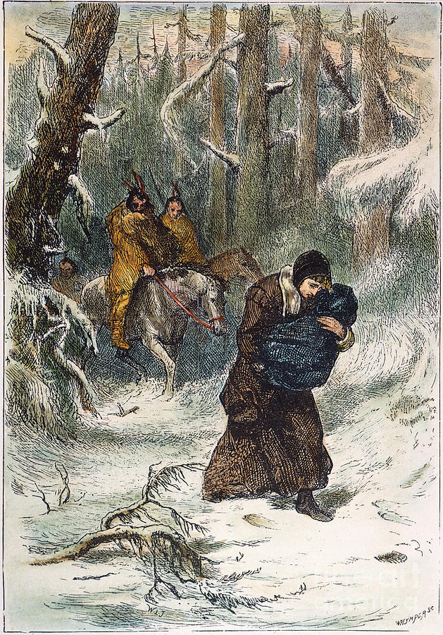
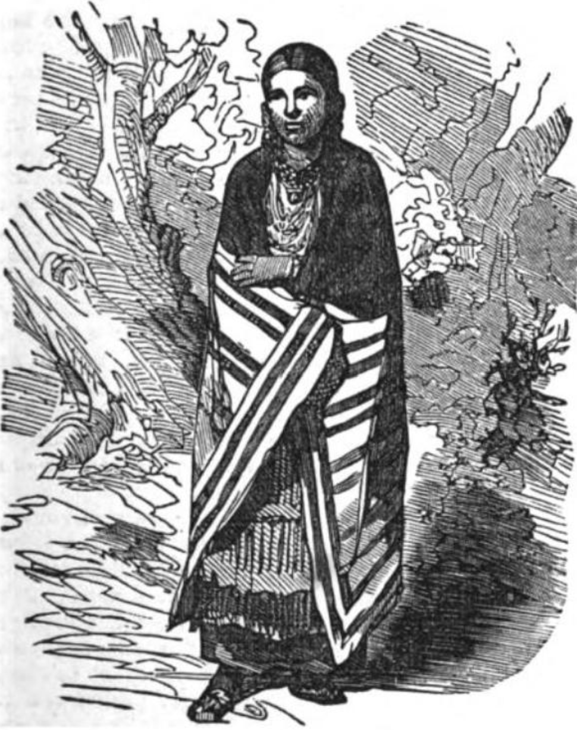
Comparison
Mary Rowlandson was the wife of a Puritan minister living in Lancaster, MA, who was kidnapped and held for ransom by Indians in King Philip's War. She was later released and wrote a narrative about her experiences.
Weetamoo was the wife of the Indian who bought Rowlandson after she was kidnapped. She was the sachem (leader) of Pocasset tribe and an ally and sister-in-law of King Philip.

Slide 5
Reading
The idea of Rowlandson misrepresenting Weetamoo’s place in Wampanoag society is shown several times in the Nineteenth and Twentieth Removes from this week’s reading.
“A severe and proud dame she was, bestowing every day in dressing herself neat as much time as any of the gentry of the land,going with necklaces, with jewels in her ears, and bracelets upon her hands” (Rowlandson 148)
  connects to Brooks’ description of Weetamoo as an arrogant upstart queen who tries but is unable to become like an English woman
“When [Weetamoo] had dressed herself, her work was to make girdles of wampum and beads” (148)
  Rowlandson deemphasizes the importance of Weetamoo’s task and instead portrays it as servant work (which is at odds at her makeup and jewelry)

Slide 6
My ideas
I think Brooks’ reasoning on why Rowlandson could have misrepresented Weetamoo’s status makes sense. Her Puritan beliefs seem to be the main cause:
Brooks’ examples of Rowlandson’s disdain at Weetamoo’s jewelry and accessories supports the idea that Weetamoo is attempting, through decorations, to become royal.
I also agree that Rowlandson seems to be negative towards Weetamoo because she has the power in society that Puritan women never had and do not want, so she represents the opposite of an obedient and meek woman.
By highlighting the differences in how women live in the Puritan and Wampanoag communities, it makes sense that Rowlandson would be resentful with Weetamoo because she must perform of the physical labor she must perform.
However, it might also be nice to see if we could receive insight on if Increase Mather played a role in Weetamoo’s description because of the influence he had in publishing Rowlandson’s narrative (as described in the introduction to Mary Rowlandson in the Norton Anthology).

Slide 7
Discussion questions
Here are some discussion questions to consider:
What is the effect of Rowlandson’s representation of Weetamoo on the mostly European and Christian audience?
Was it Rowlandson’s Puritan beliefs that contributed to Rowlandson negative depictions of Weetamoo? How much did Rowlandson's traditional beliefs affect her ideas on Weetamoo?
Is it only Rowlandson’s religious beliefs that contribute to her portryal of Weetamoo? Could Rowlandson be resentful or jealous of her status or is she angry that she possesses power in the first place? (or maybe something else?)

Slide 8
Thank you!

