Slide 1
Haptic Augmentation for Visualization
Richard Carley

Slide 2
Reasoning and objectives
Reasoning:
Double coding of visual data
Discerning differences not visually apparent
Prior work has shown success in applying haptic or tactile models to augment visual learning methods in academic settings.[1][2]
Bi-variate representation
Raster Data: Roughness
Vector Data: Bivariate
Aid in identifying colors for people with color blindness
Objectives:
Rumble based on an intensity value
Rumble based on roughness(or like minded value)
Rumble Pulse Pattern where:
Value = max rumble value
Frequency of pulse ~= level of roughness( long pulse time means smoother area.)
Implement 1-2 for vector and raster data, and 3 for raster data
Implement discrete codes for Hue(Work in progress)

Slide 3
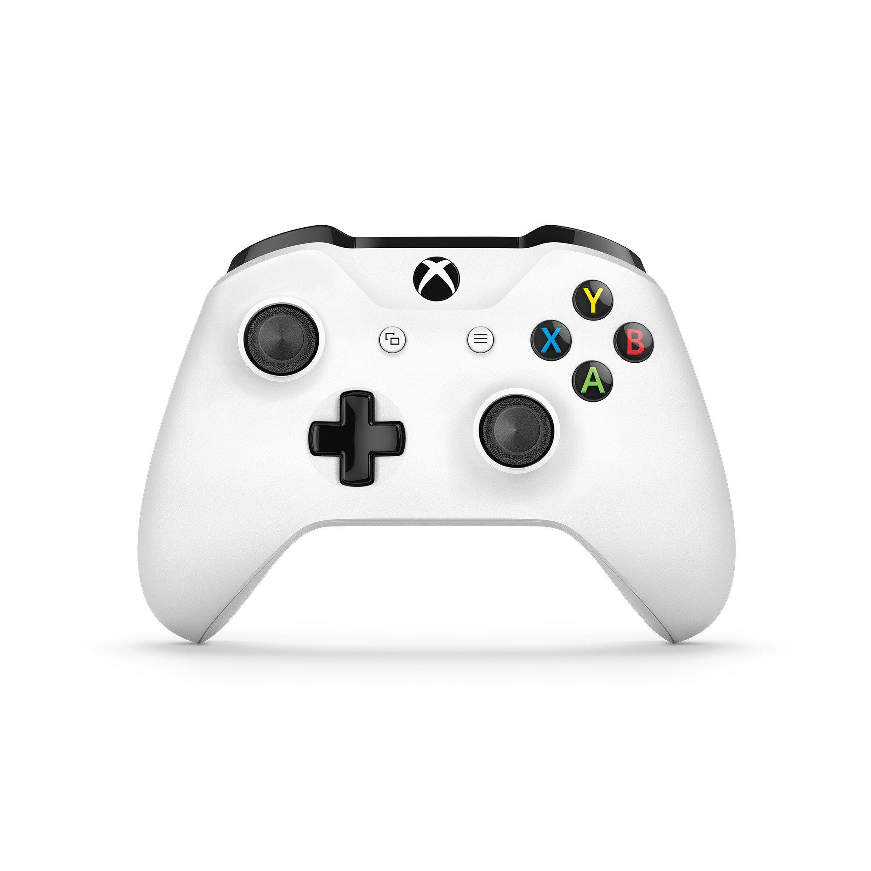
Haptic Device
Xbox One Controller
Native Windows/Unity support
Plentiful and relatively cheap
2 different types of motors
Low Frequency(left)
High Frequency (right)

Slide 4
Software
Unity
Accessible
Native controller support
Flexible enough
Create Virtual Cursor
Used for selection and reading of pixels or vector data.
Data are normalized when appropriate and used to set the rumble intensity

Slide 5
Data
Raster
Image of Digital Elevation Model (DEM): https://gis.arkansas.gov/product/dem-1m-2018/
Image of Apples:https://www.nutritionletter.tufts.edu/ask-experts/green-apples-vs-red-apples/
Original photo by and (c)2007 NaJina McEnany. Photo prepared by User:Ram-Man.
Vector
Census 2019 median household income census bureau
Federal funds per person per state (https://www.usatoday.com/story/money/economy/2019/03/20/how-much-federal-funding-each-state-receives-government/39202299/)
State data poorly traced and created by me.

Slide 6
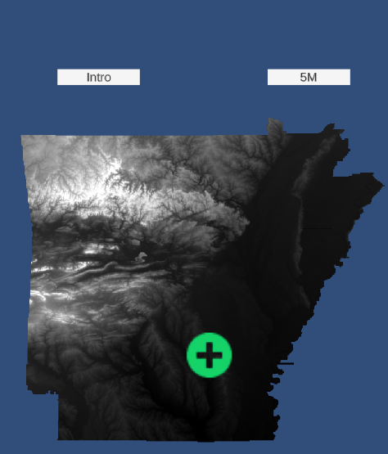
Raster: Black and White
Low Frequency: Roughness
High Frequency: Intensity
Both
Pulse
Digital Elevation Model(DEM)
intensity/luminance = height
often 0-255 grayscale
Intensity is average in a 3x3 window
Roughness = Topographic Roughness Index: 3x3

Slide 7
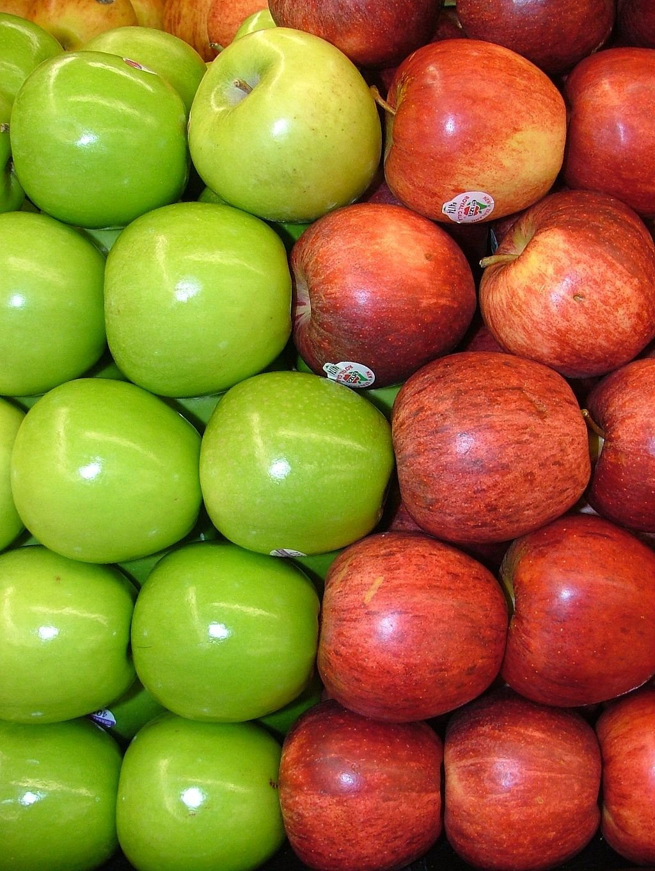
Raster: Color
Hue: as categorical
Unity’s RGBToHSV function
2 colors at the moment: green/red
Encoded with 3 pulses of
Green = high frequency motor
Red = low frequency motor
Not all images worked well
Categorical representation with vibration is difficult, not efficient

Slide 8
Color Issues
Not all images seemed to work output the correct hue.
Unsure if this is a calibration issue or if it is because I am not taking saturation or value into account.
Possibly to do with reflection

Slide 9
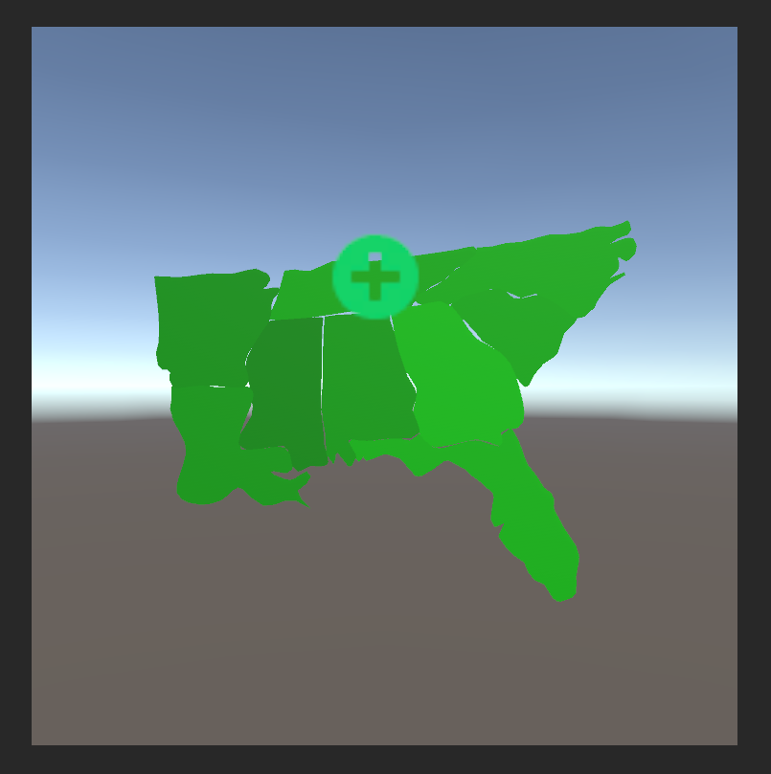
Vector: Choropleth map
Low Frequency: - Federal Funds per person
High Frequency: Median Income
Both
Choropleth map Southern US states
The brighter the green the higher the income
Max normalized by Virginia’s numbers
Colors kept deliberately close together
Stored as a CSV in a game folder

Slide 10
Personal Observations
Low + High frequency can be combined to represent 2 variables well
Pulse works as well, but seems to be perceptually slower
Can hear changes in high frequency vibration better than low
Can hear changes in high frequency better than I feel them sometimes
Modifiable Area Unit Problem: especially with raster data.
How big do you set your window?
Seems to work better in a comparison context
Notes:
Focus on highlighted points
Use of a sigmoid function to possible exagerate intensity
Encode more colors for Hue
Add saturation and value as rumble intensity to hue encodings?
Color Blindness type-specific encodings(ignore blue for red green colorblindness.

Slide 11
Future Work
User studies/surveys.
“Higher resolution” haptics
Use rumble with already bivariate maps (trivariate, quartavariate)
Or true color + infrared/ultraviolet rumble
Could rumble based on thresholds
Encode more colors for Hue
Add saturation and value as rumble intensity to hue encodings?
Attempt encoding hue as a continuous representation?
Sampling functionality(for representations)
Alternate ways of encoding color data
Assign encodings to high/middle/low for both high/low frequency motors
9 potential representations.
Can’t represent saturation or value.

Slide 12
Questions

Slide 13
References:
[1] G. Liu, C. Zhang and X. Sun, "Tri-Modal Tactile Display and Its Application Into Tactile Perception of Visualized Surfaces," in IEEE Transactions on Haptics, vol. 13, no. 4, pp. 733-744, Oct.-Dec. 2020, doi: 10.1109/TOH.2020.2979182.
[2] Clark, D., & Jorde, D. (2004). Helping students revise disruptive experientially supported ideas about thermodynamics: Computer visualizations and tactile models. Journal of Research in Science Teaching: The Official Journal of the National Association for Research in Science Teaching, 41(1), 1-23.
Unity Tutorials
https://www.youtube.com/watch?v=_yf5vzZ2sYE: Raycast selection
https://www.youtube.com/watch?v=Y3WNwl1ObC8 :Cursor
https://www.youtube.com/watch?v=11GUuaeT0w4&list=PLhPNOL0P0EY1v3-KIn73kYlKHpnVzR7iC :Reading Pixel Data
Other
https://stackoverflow.com/questions/41505049/interactive-2d-map-in-unity

Slide 14
Raster: Color Encodings
Red: 331°-10°
0-0-0
Orange 11°- 40°
0-0-1
Yellow: 40°-70°
0-1-0
Green: 71°-150°
0-1-1
Cyan: 151°-210°
1-0-0
Blue: 211°-260°
1-0-1
Magenta: 260° - 330°
1-1-0

Slide 15
Code

