Slide 1
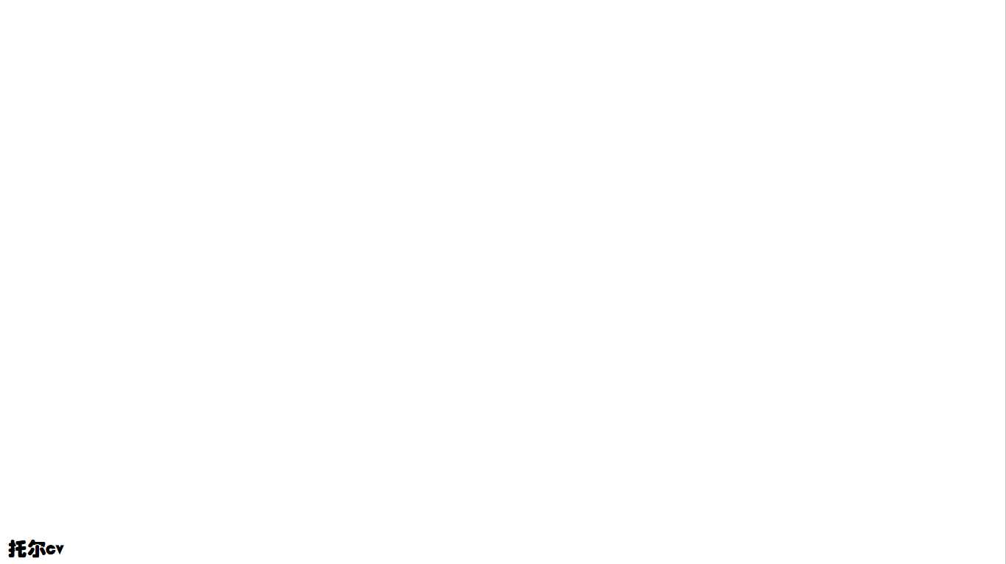
注意力机制

Slide 2
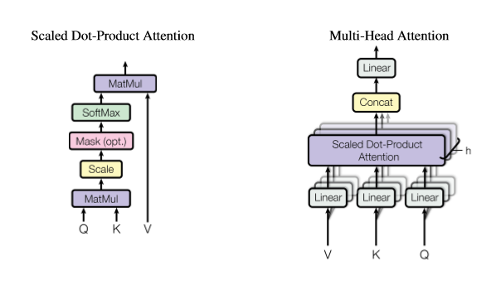
Scaled Dot-Product Attention/Multi-Head Attention
(多头注意力)
https://proceedings.neurips.cc/paper/2017/file/3f5ee243547dee91fbd053c1c4a845aa-Paper.pdf
Original image
Scaled Dot-Product Attention
Multi-Head Attention
MatMul
Linear
SoftMax
Concat
Mask (opt.)
Scaled Dot-Product
Attention
Scale
Linear
Linear
Linear
MatMul
Q
K
V
V
K
Q

Slide 3
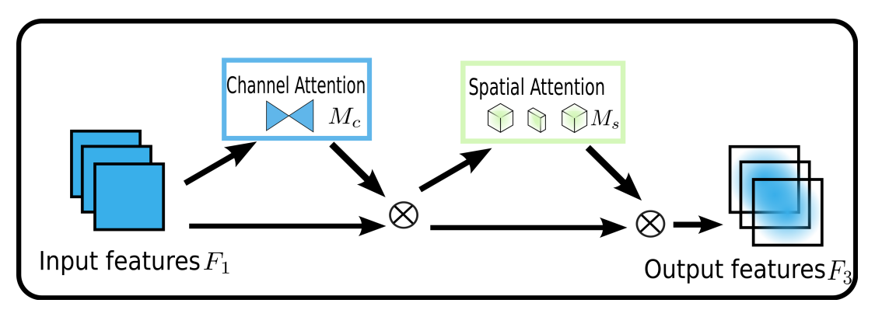

GAM
https://ar5iv.labs.arxiv.org/html/2112.05561
Original image
Channel Attention
Spatial Attention
M_{c}
M_{s}
Input features F₁
Output features F₃

Slide 4
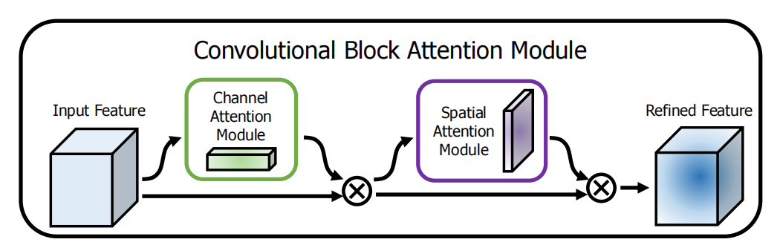
CBAM
https://arxiv.org/abs/1807.06521
Original image
Convolutional Block Attention Module
Input Feature
Channel
Attention Module
Refined Feature
Spatial
Attention Module

Slide 5
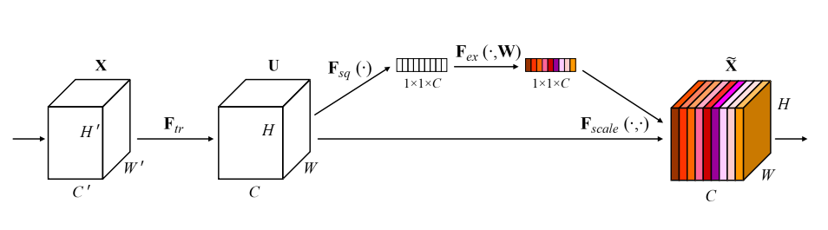
Squeeze-and-Excitation block
SE 注意力机制
https://arxiv.org/abs/1709.01507
Original image
1×1×C
1×1×C
’
’
’

Slide 6
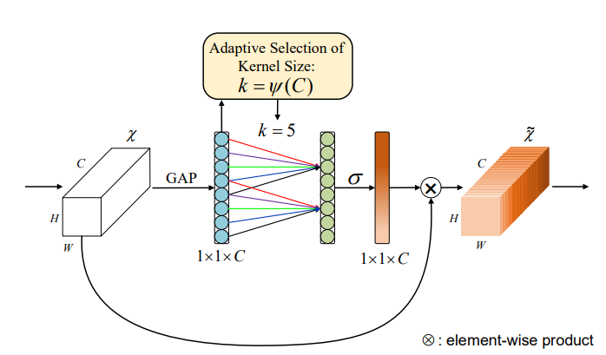
efficient channel attention module ECA 注意力机制
https://arxiv.org/pdf/1910.03151
Original image
Adaptive Seletion of
Kernel Size:
k = ψ (C)
χ
k = 5
~
χ
C
σ
C
GAP
H
H
W
1×1×C
1×1×C
W
: element-wise product

Slide 7
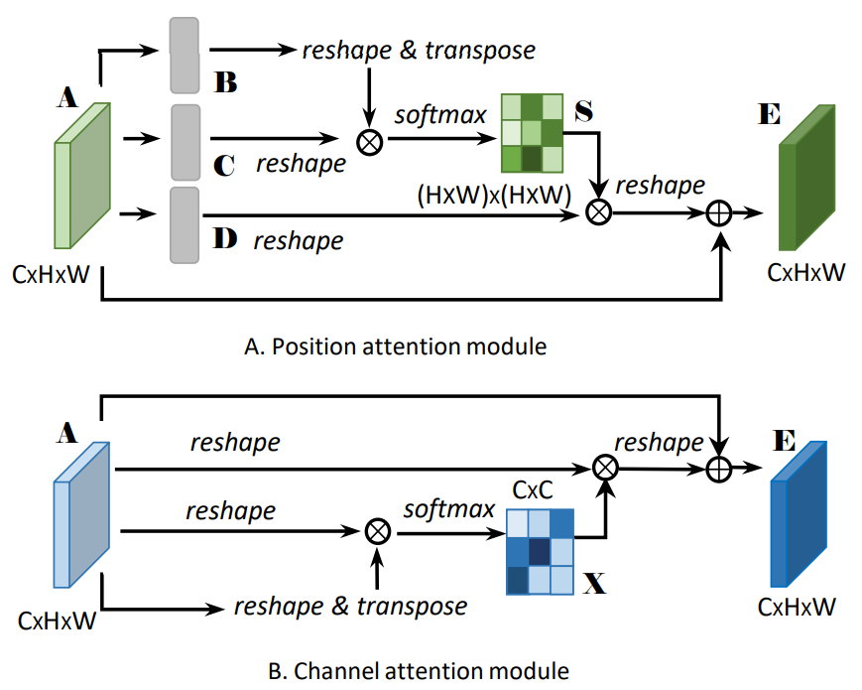
Position Attention Module、Channel Attention Module
通道注意力(CAM)、空间注意力(PAM)
https://arxiv.org/pdf/1809.02983
Original image
reshape & transpose
A
B
E
softmax
S
C
reshape
(HxW)x(HxW)
reshape
D
reshape
CxHxW
CxHxW
A
E
reshape
reshape
CxC
reshape
softmax
X
CxHxW
reshape & transpose
CxHxW

Slide 8
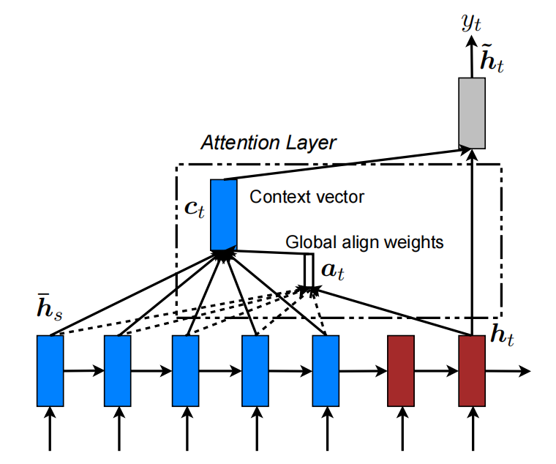
Global attentional model硬注意力机制
https://arxiv.org/pdf/1508.04025
Original image
_{𝓨}
t
~
𝓱
t
Attention Layer
c
Context vector
t
Global align weights
a
t
¯
𝓱
s
𝓱
t

Slide 9
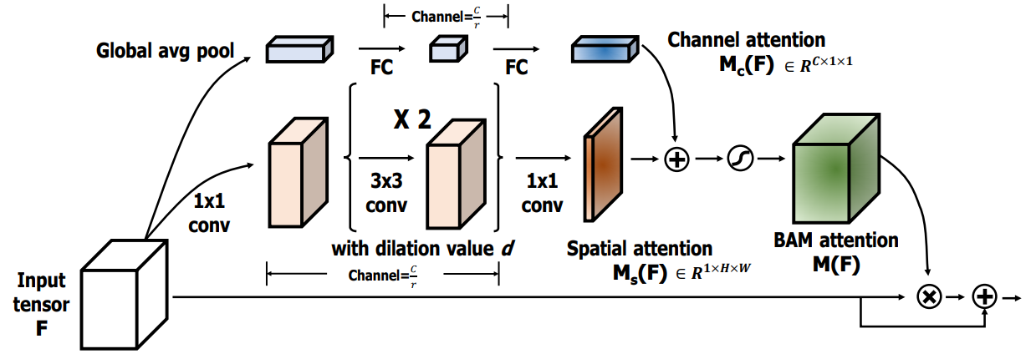
Bottleneck Attention Module (BAM)
瓶颈注意力机制
https://arxiv.org/pdf/1807.06514
Original image
Channel=
Channel attention
Global avg pool
M_{C}(F) ∈ R^{C×1×1}
FC
FC
×2
1×1
conv
3×3
conv
1×1
conv
with dilation value d
Spatial attention
BAM attention
Input
tensor
F
Channel=
M_{S}(F) ∈ R^{1×H×W}
M(F)

Slide 10
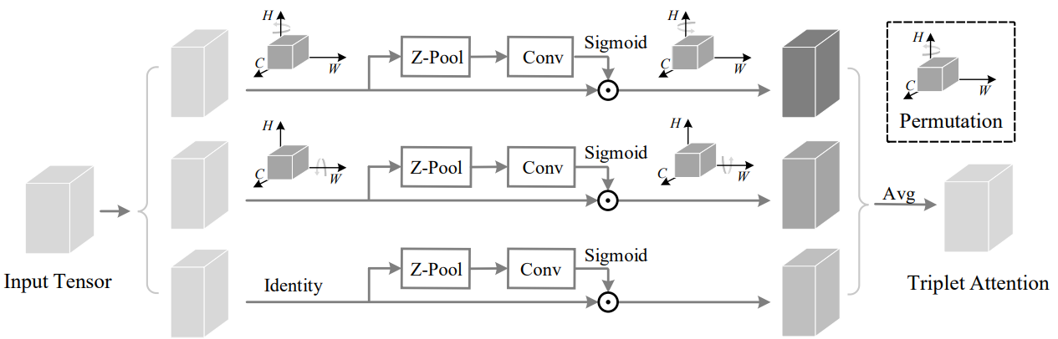
TripletAttention
https://arxiv.org/pdf/2010.03045
Original image
H
H
Sigmoid
H
C
W
Z-Pool
Conv
C
W
=
C
W
H
H
Permutation
Sigmoid
C
W
Z-Pool
Conv
C
W
Avg
Sigmoid
Input Tensor
Identity
Z-Pool
Conv
Triplet Attention
=

Slide 11
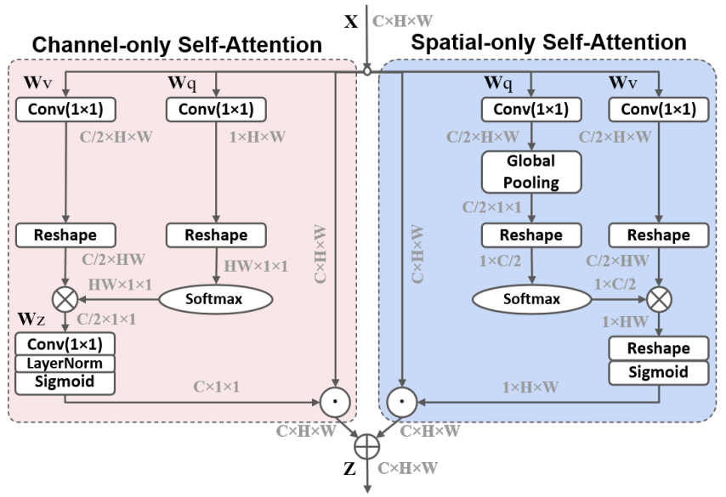
Polarized Self-Attention
极化自注意力
Original image
https://arxiv.org/pdf/2107.00782v2
X
C×H×W
Channel-only Self-Attention
Spatial-only Self-Attention
Wv
Wq
Wq
Wv
Conv(1×1)
Conv(1×1)
Conv(1×1)
Conv(1×1)
C/2×H×W
1×H×W
C/2×H×W
C/2×H×W
Global
Pooling
C/2×1×1
Reshape
Reshape
Reshape
Conv(1×1)
C/2×HW
HW×1×1
C×H×W
C×H×W
1×C/2
C/2×HW
1×C/2
Softmax
Softmax
Wz
C/2×1×1
Conv(1×1)
Reshape
LayerNorm
Sigmoid
Sigmoid
C×1×1
1×H×W
C×H×W
C×H×W
Z
C×H×W

Slide 12
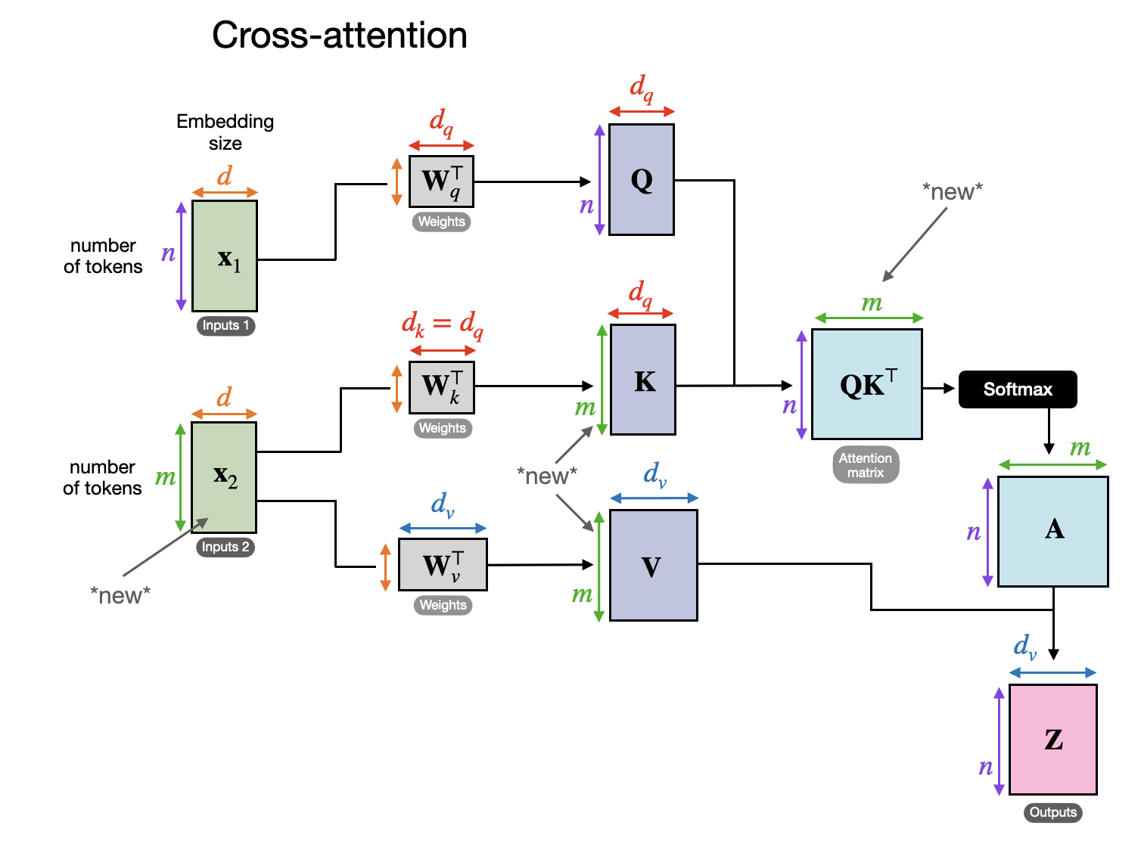
Cross Attention Module
交叉注意力
https://magazine.sebastianraschka.com/p/understanding-multimodal-llms
Original image
Embedding
size
d_{q}
d_{q}
d
_{T}
Q
W_{q}
Weights
n
number
of tokens
n
x₁
d_{q}
m
Inputs2
d_{k}=d_{q}
_{T}
K
_{T}
d
W_{k}
m
n
QK
Softmax
number
of tokens
Weights
m
m
x₂
d_{v}
Attention
matrix
d_{v}
n
A
Inputs2
_{T}
W_{v}
V
Weights
m
d_{v}
n
Z
Outputs

Slide 13
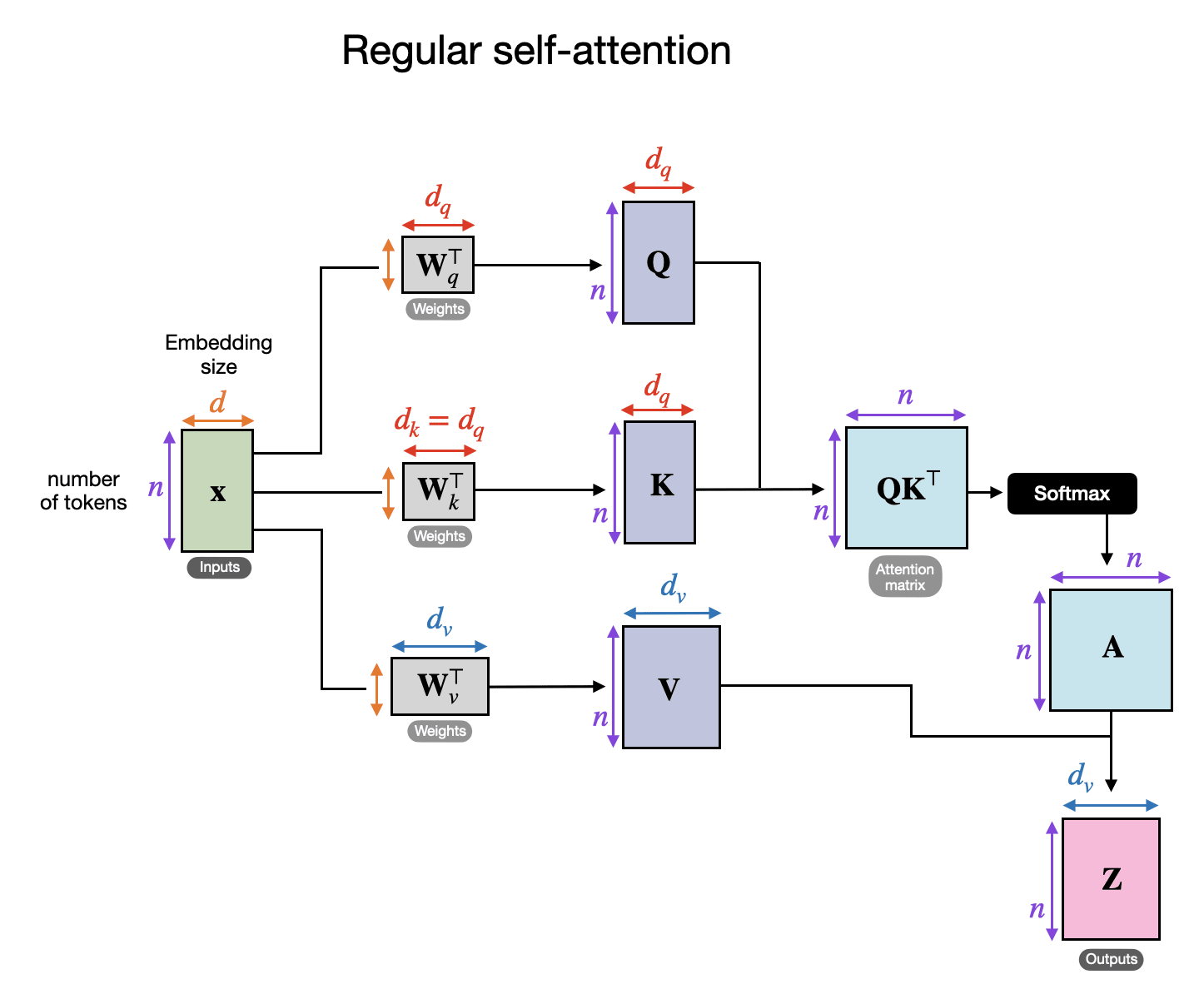
Self Attention Module
自注意力
https://magazine.sebastianraschka.com/p/understanding-multimodal-llms
Original image
d_{q}
d_{q}
_{T}
Q
W_{q}
Weights
n
Embedding
size
d
d_{q}
n
d_{k}=d_{q}
number
of tokens
_{T}
K
_{T}
n
x
W_{k}
n
n
QK
Softmax
Weights
n
Inputs2
d_{v}
Attention
matrix
d_{v}
n
A
_{T}
W_{v}
V
Weights
n
d_{v}
n
Z
Outputs

Slide 14
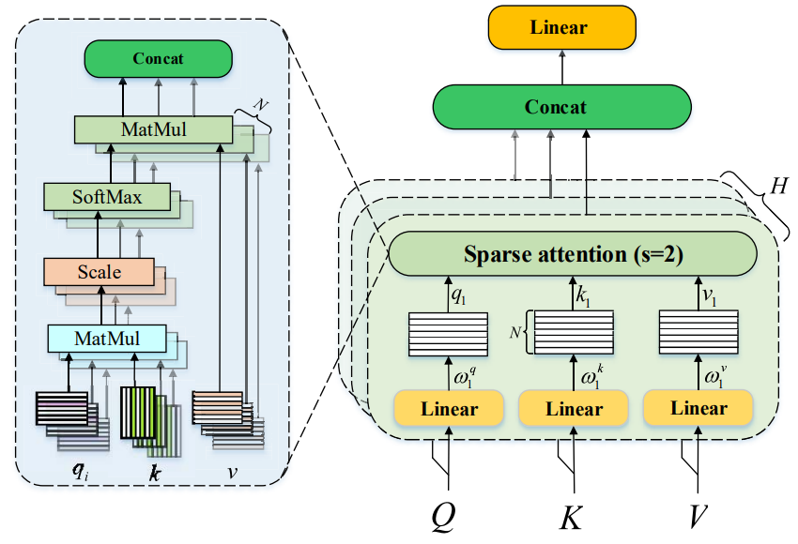
稀疏注意力机制
Wang J, Shao H, Peng Y, et al. PSparseFormer: Enhancing fault feature extraction based on parallel sparse self-attention and multiscale broadcast feed-forward block[J]. IEEE Internet of Things Journal, 2024, 11(13): 22982-22991.
Original image
Linear
Concat
N
Concat
MatMul
SoftMax
H
Sparse attention (s=2)
Scale
q₁
k₁
v₁
MatMul
N
ω₁
^{q}
ω₁
^{k}
ω₁
^{v}
Linear
Linear
Linear
q_{i}
k
v
Q
K
V

