Slide 1
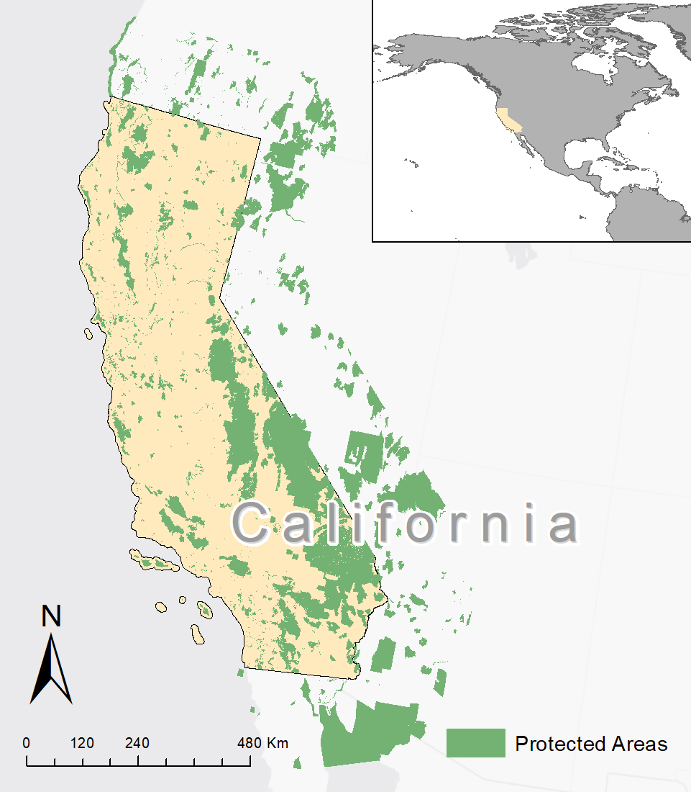
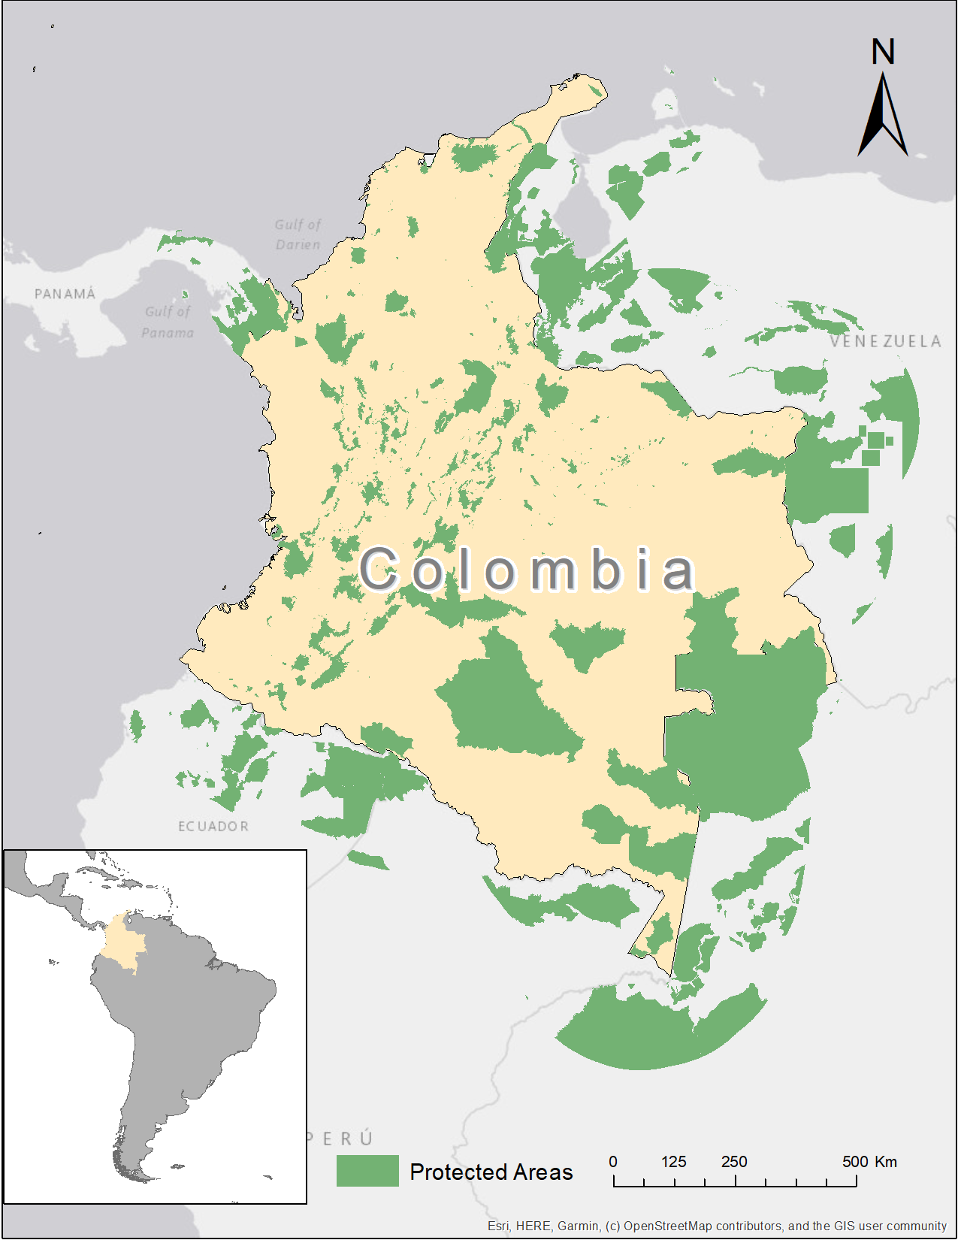
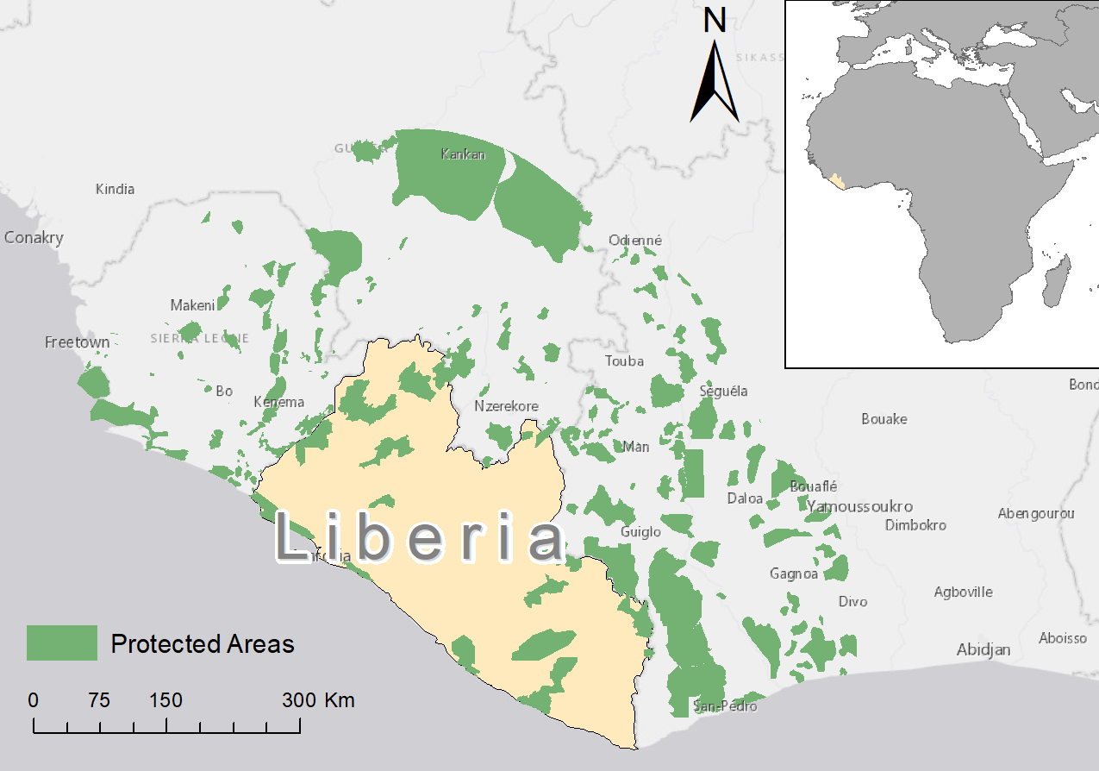
(a)
(b)
(c)
Figure 1: Protected areas of the study regions and transboundary PAs (i.e., within 230 km) for a) California, b) Colombia, and c) Liberia.

Slide 2
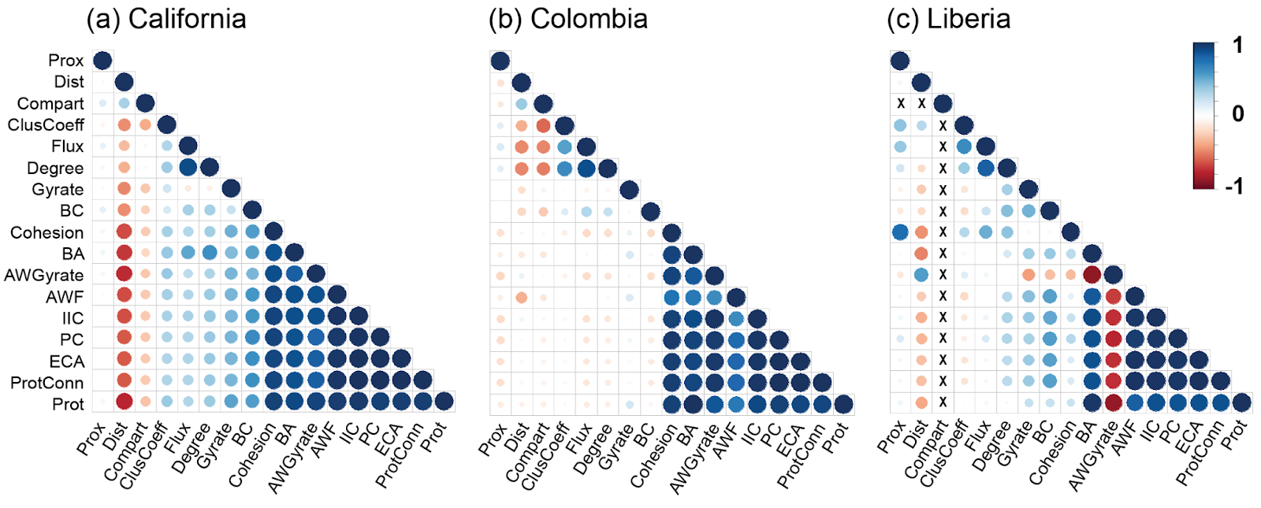
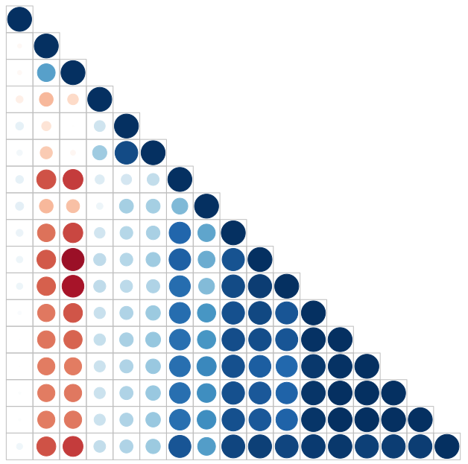
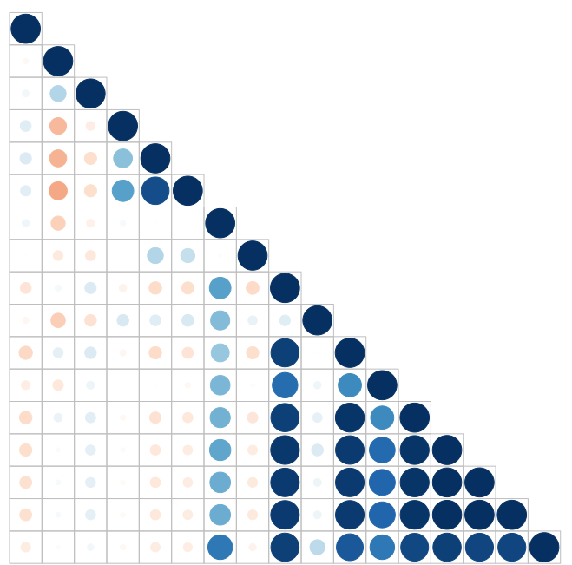
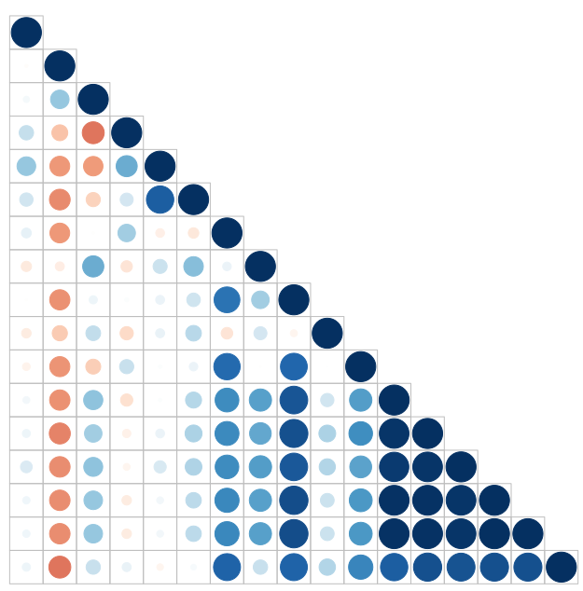
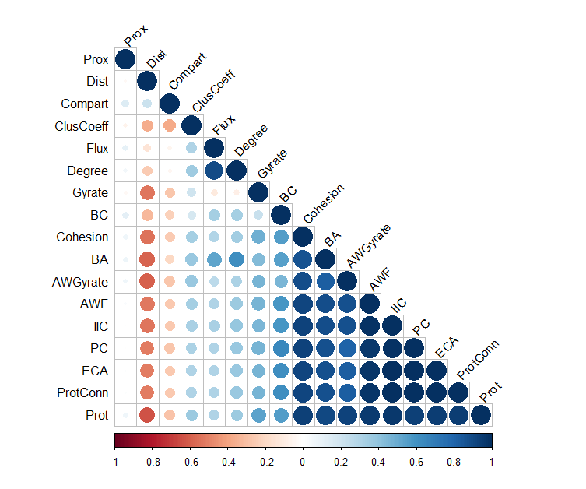
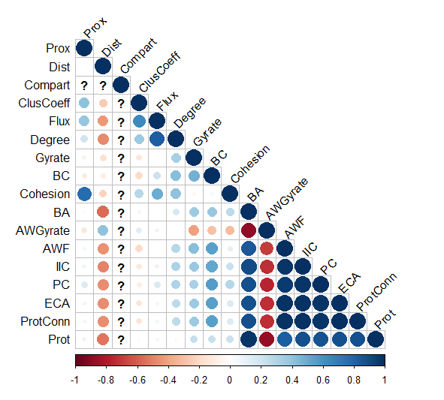
Version: 07/22, 2023

Slide 3
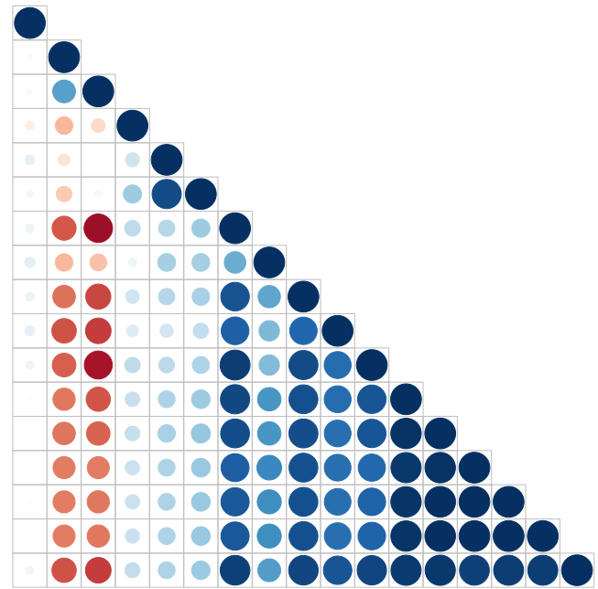
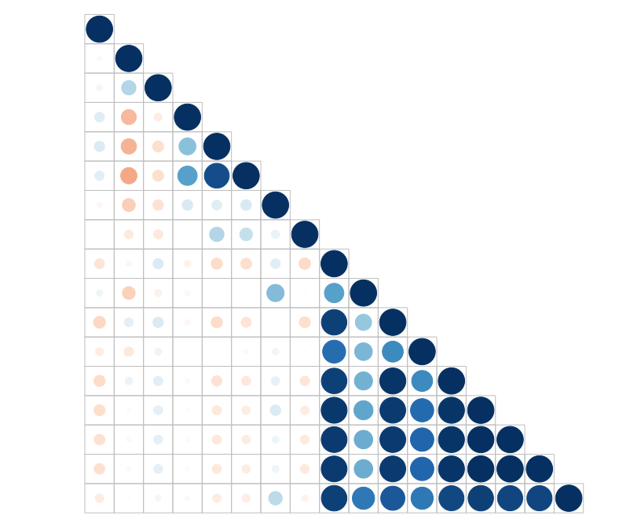
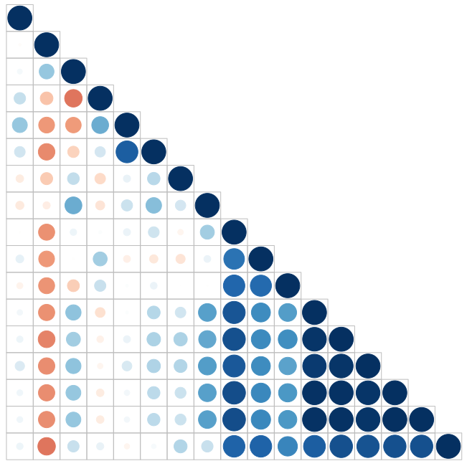
Version: 07/24, 2023 → 09/08, 2023 → 09/11, 2023
Prox
Dist
Compart
ClusCoeff
Flux
Degree
BA
BC
Cohesion
Gyrate
AWGyrate
AWF
IIC
PC
ECA
ProtConn
PctArea
Flux
Flux
ECA
Flux
ECA
Degree
ECA
Degree
PC
Degree
PC
AWGyrate
PC
AWGyrate
AWGyrate
Cohesion
PctArea
Prox
Cohesion
AWF
PctArea
Prox
Cohesion
AWF
PctArea
Prox
BC
AWF
Dist
BC
IIC
Dist
BC
IIC
Gyrate
Gyrate
Dist
IIC
BA
BA
Gyrate
Compart
BA
Compart
Compart
ClusCoeff
ProtConn
ClusCoeff
ProtConn
ClusCoeff
ProtConn

Slide 4
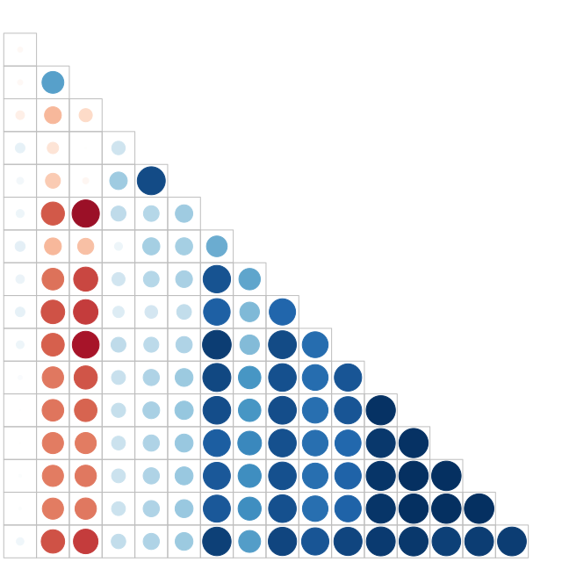
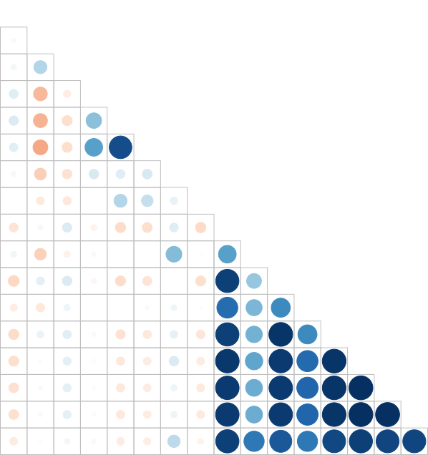
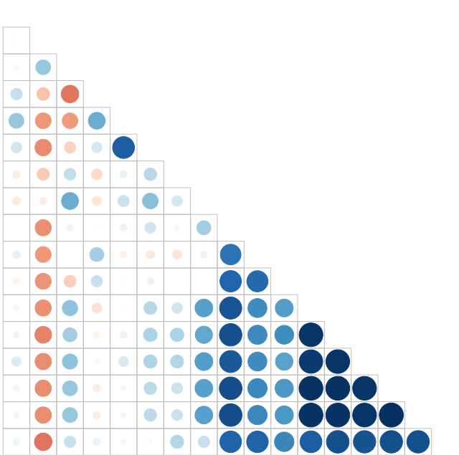
Version: 11/07, 2023
Dist
Compart
ClusCoeff
Flux
Degree
BA
BC
Cohesion
Gyrate
AWGyrate
AWF
IIC
PC
ECA
ProtConn
PctArea
Flux
Flux
ECA
Flux
ECA
Degree
ECA
Degree
PC
Degree
PC
AWGyrate
PC
AWGyrate
AWGyrate
Cohesion
Prox
Cohesion
AWF
Prox
Cohesion
AWF
Prox
BC
AWF
Dist
BC
IIC
Dist
BC
IIC
Gyrate
Gyrate
Dist
IIC
BA
BA
Gyrate
Compart
BA
Compart
Compart
ClusCoeff
ProtConn
ClusCoeff
ProtConn
ClusCoeff
ProtConn

Slide 5
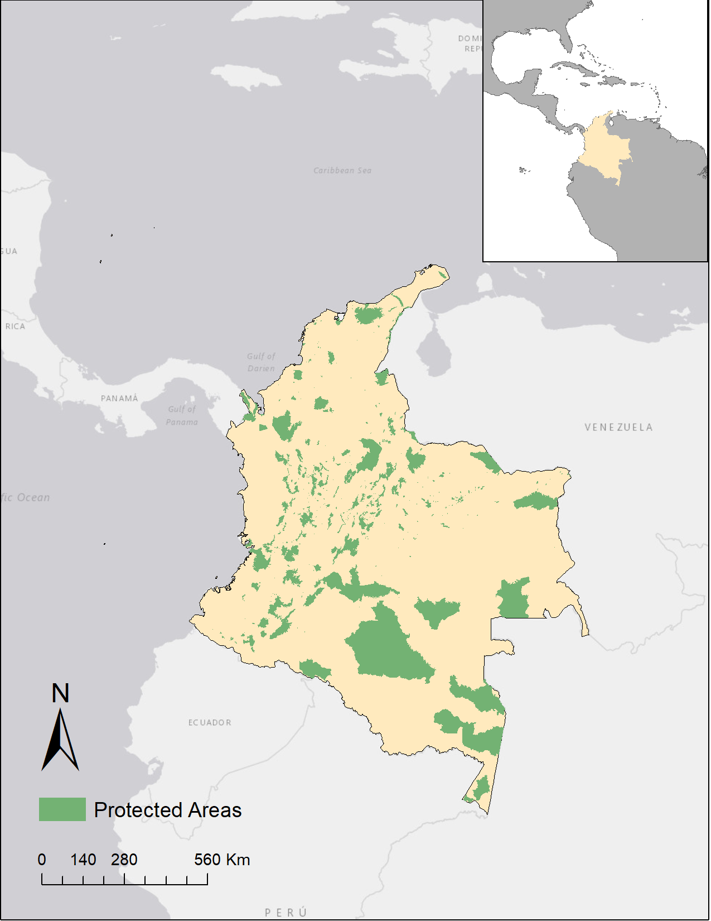
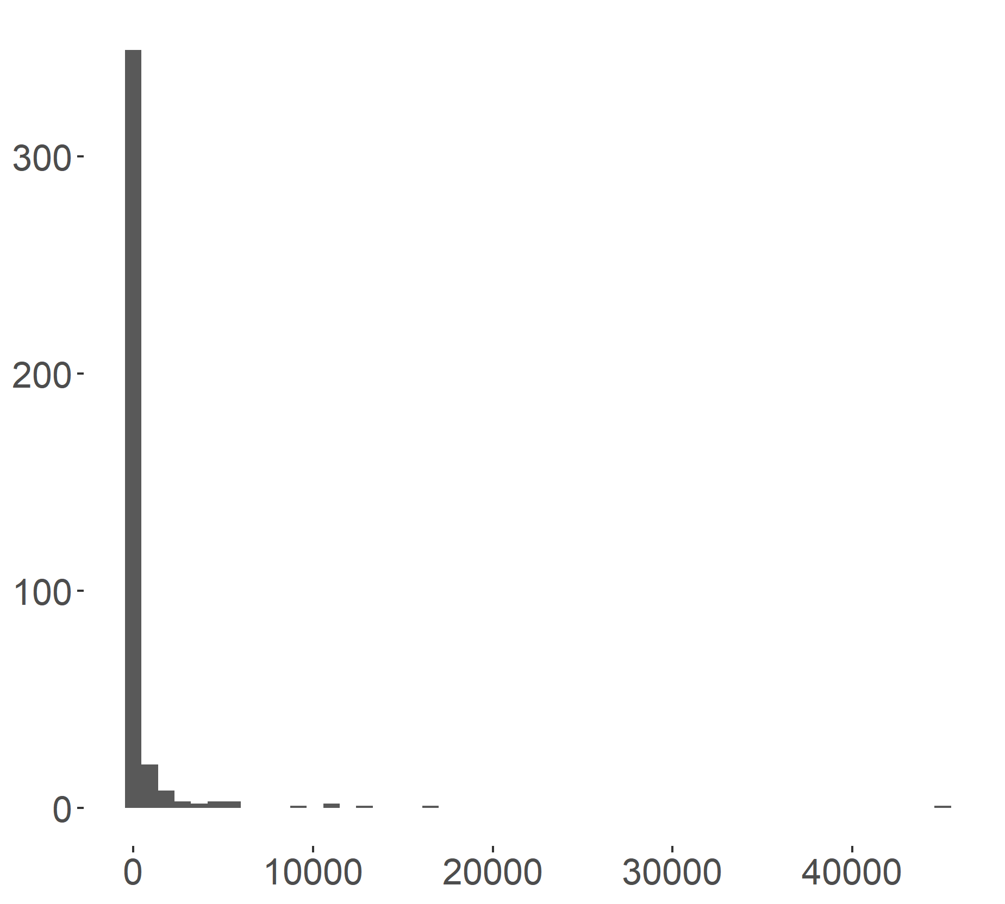
Count
PA Area (km²)

Slide 6
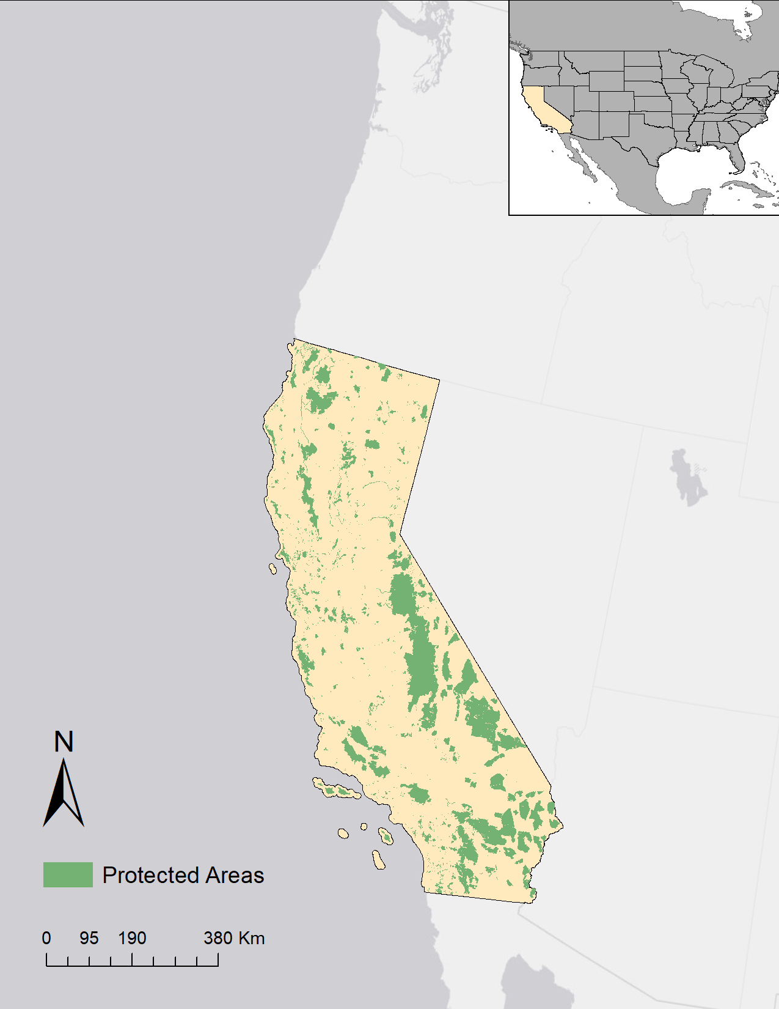
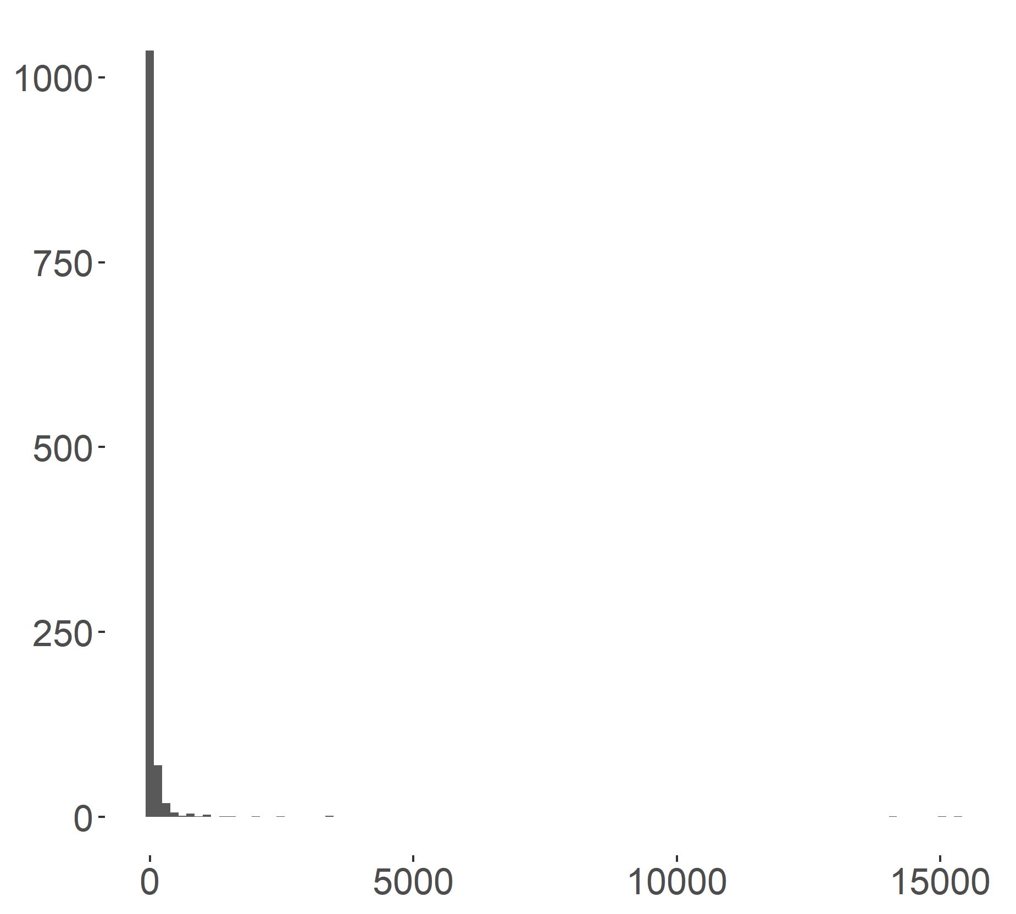
Count
PA Area (km²)

Slide 7
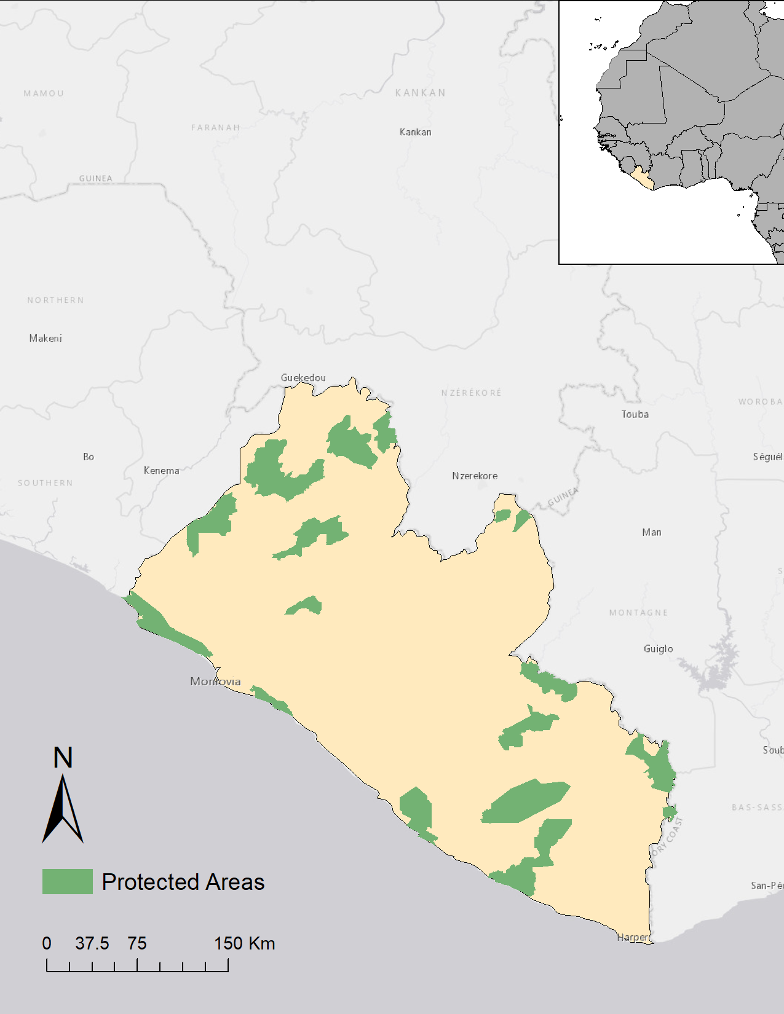
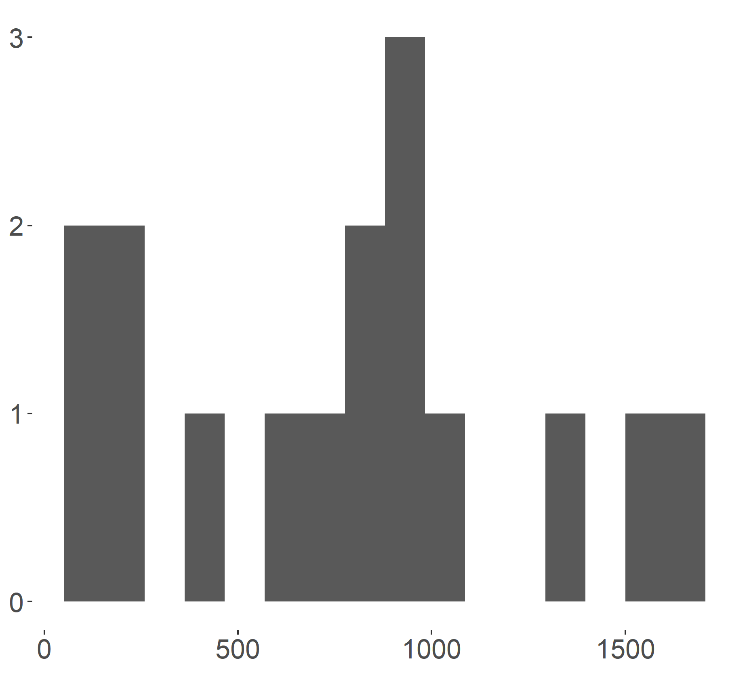
Count
PA Area (km²)

