Slide 1
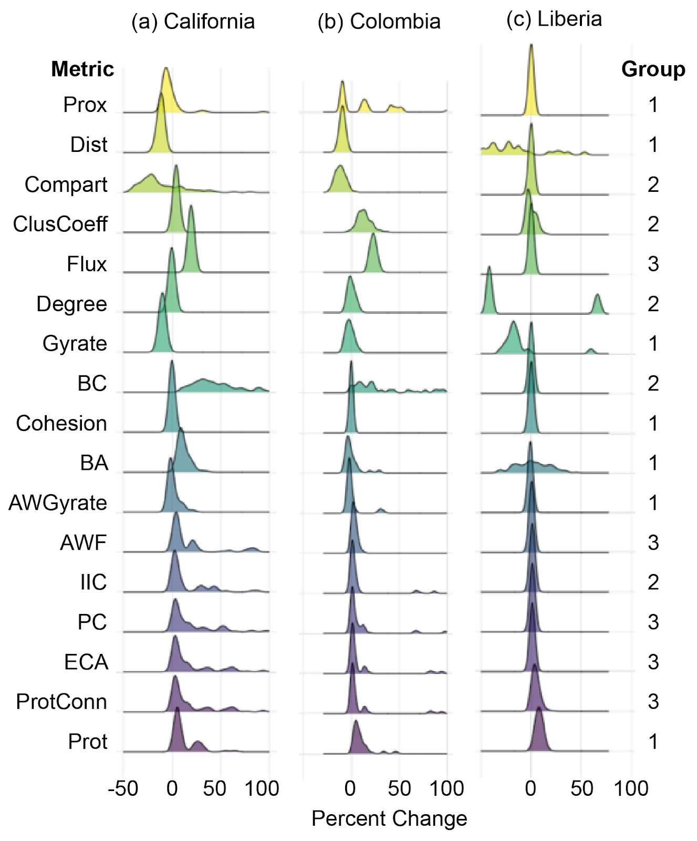
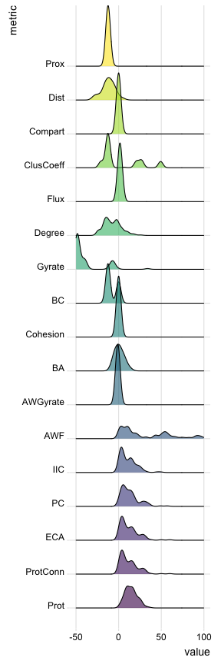
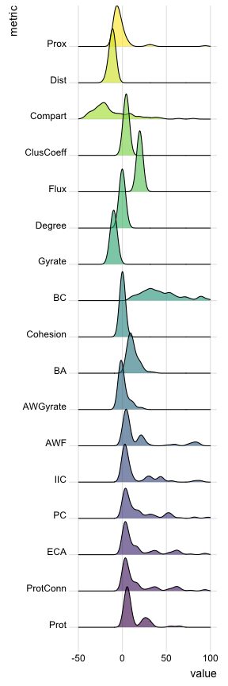
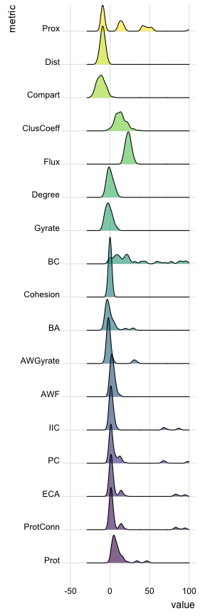
Version: 02/2023
Type
Notes:
Version Feb, 2023

Slide 2
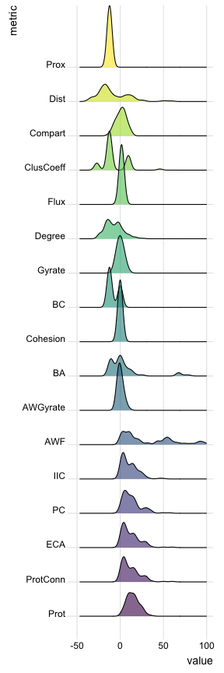
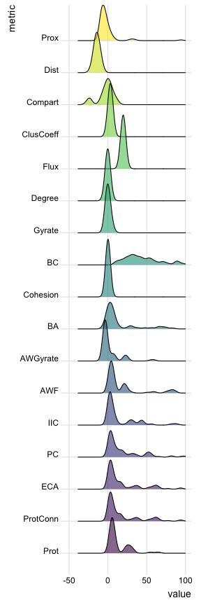
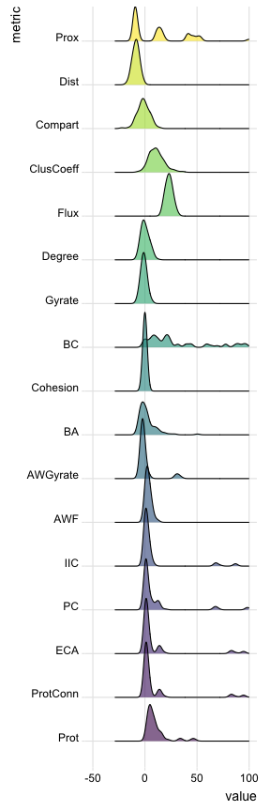
Version: 07/22/2023
Type
Notes:
Version July 22, 2023
Changed BA, ClusCoeff, Compart, Gyrate, AWGyrate, Cohesion
Version July 19, 2023
Changed code on dist

Slide 3
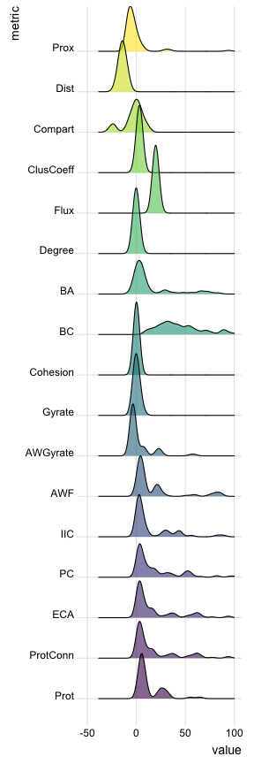
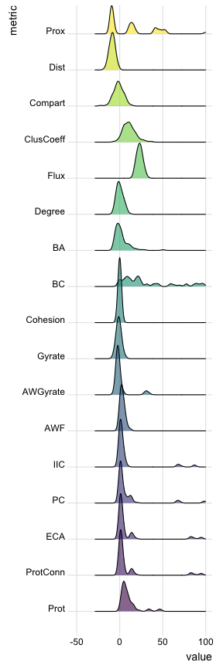
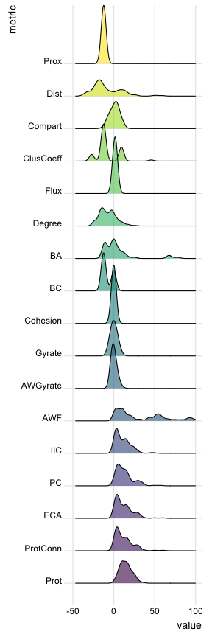
Version: 07/24/2023
Type
Notes:
Version July 22, 2023
Changed BA, ClusCoeff, Compart, Gyrate, AWGyrate, Cohesion
Version July 19, 2023
Changed code on dist

Slide 4
Version: 09/11/2023
Type
Prox
Dist
Compart
ClusCoeff
Flux
Degree
BA
BC
Cohesion
Gyration
AWGyrate
AWF
IIC
PC
ECA
ProtConn
PctArea
Notes:
Version July 22, 2023
Changed BA, ClusCoeff, Compart, Gyrate, AWGyrate, Cohesion
Version July 19, 2023
Changed code on dist

Slide 5
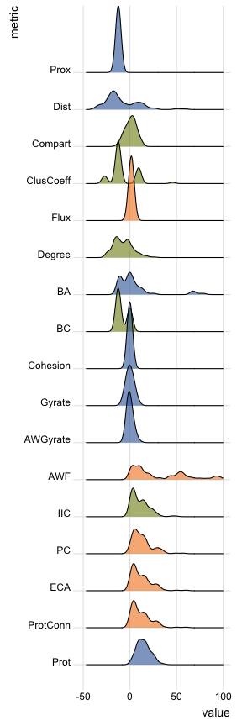
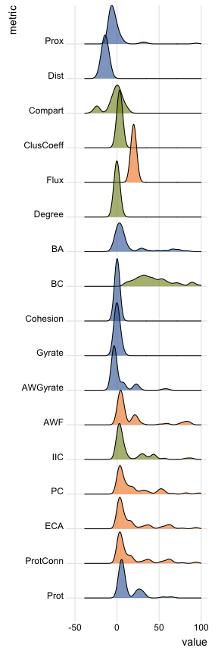
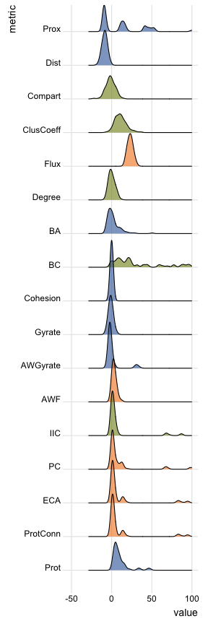
Version: 11/06/2023
Type
Prox
Dist
Compart
ClusCoeff
Flux
Degree
BA
BC
Cohesion
Gyration
AWGyrate
AWF
IIC
PC
ECA
ProtConn
PctArea
Notes:
Version July 22, 2023
Changed BA, ClusCoeff, Compart, Gyrate, AWGyrate, Cohesion
Version July 19, 2023
Changed code on dist

Slide 6
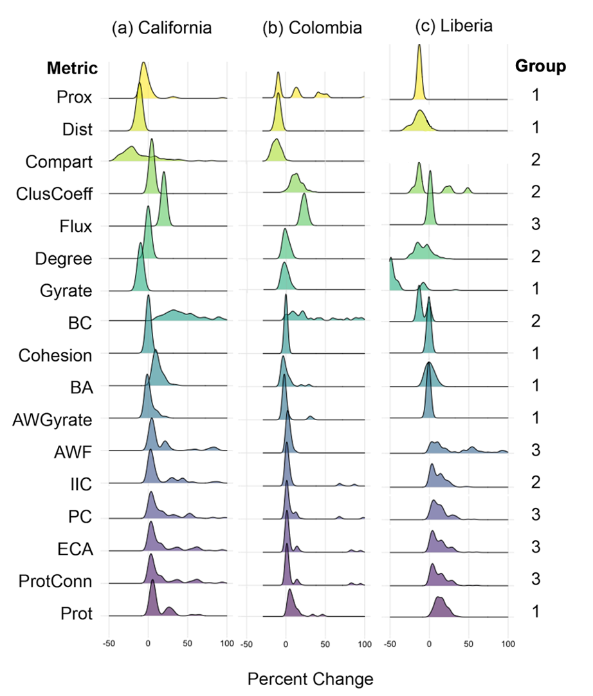
Notes:
Version Feb 2023

Slide 7
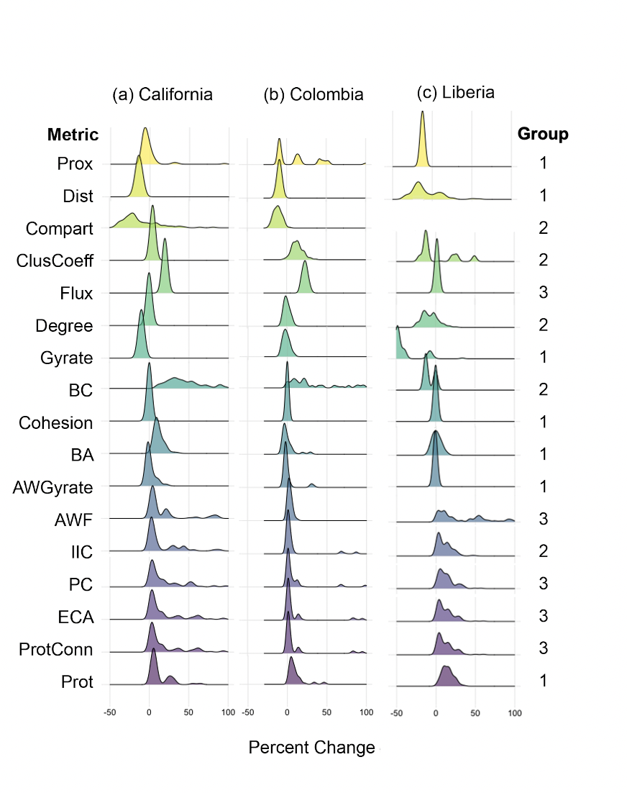
Notes:
Version Jul 19

