Slide 1
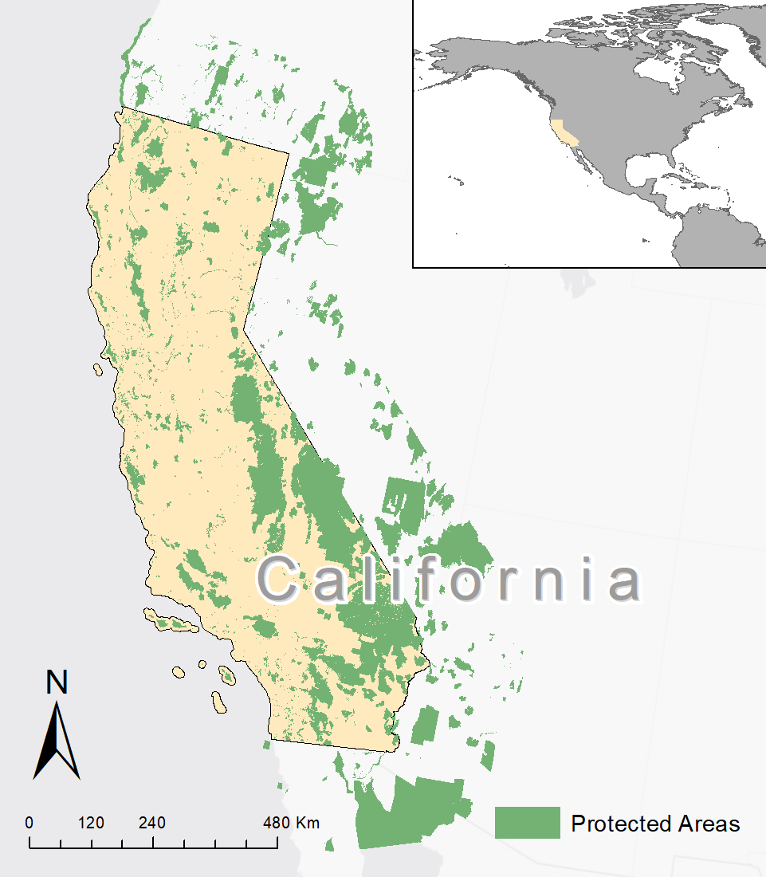
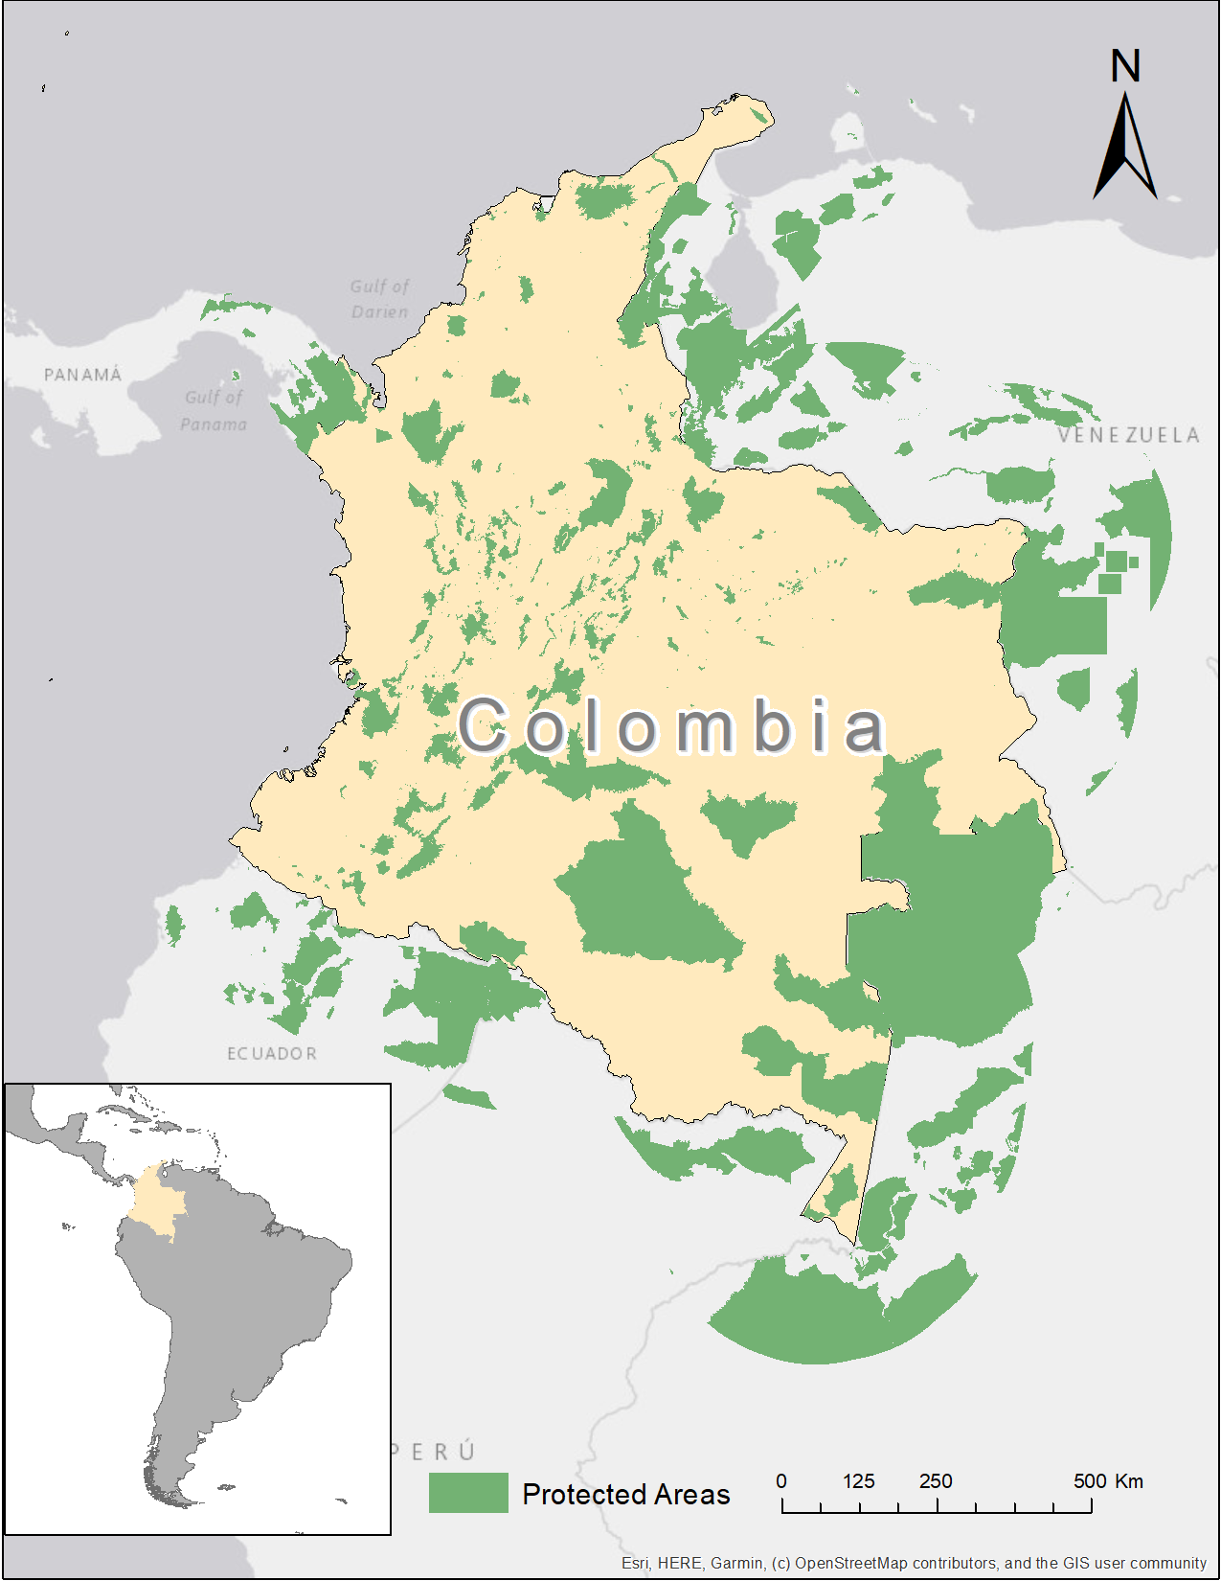
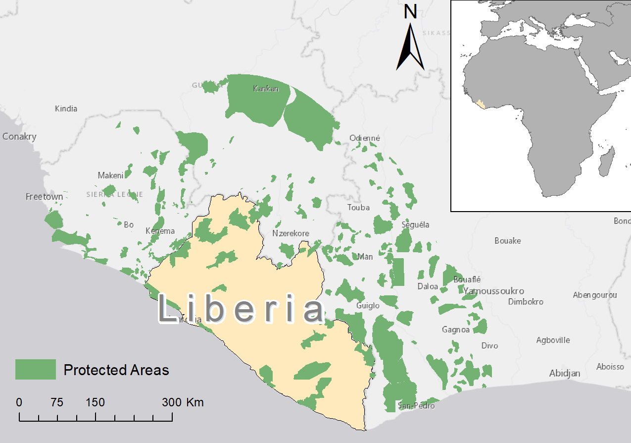
(a)
(b)
(c)
Figure 1: Protected areas of the study regions and transboundary PAs (i.e., within 230 km) for a) California, b) Colombia, and c) Liberia.

Slide 2
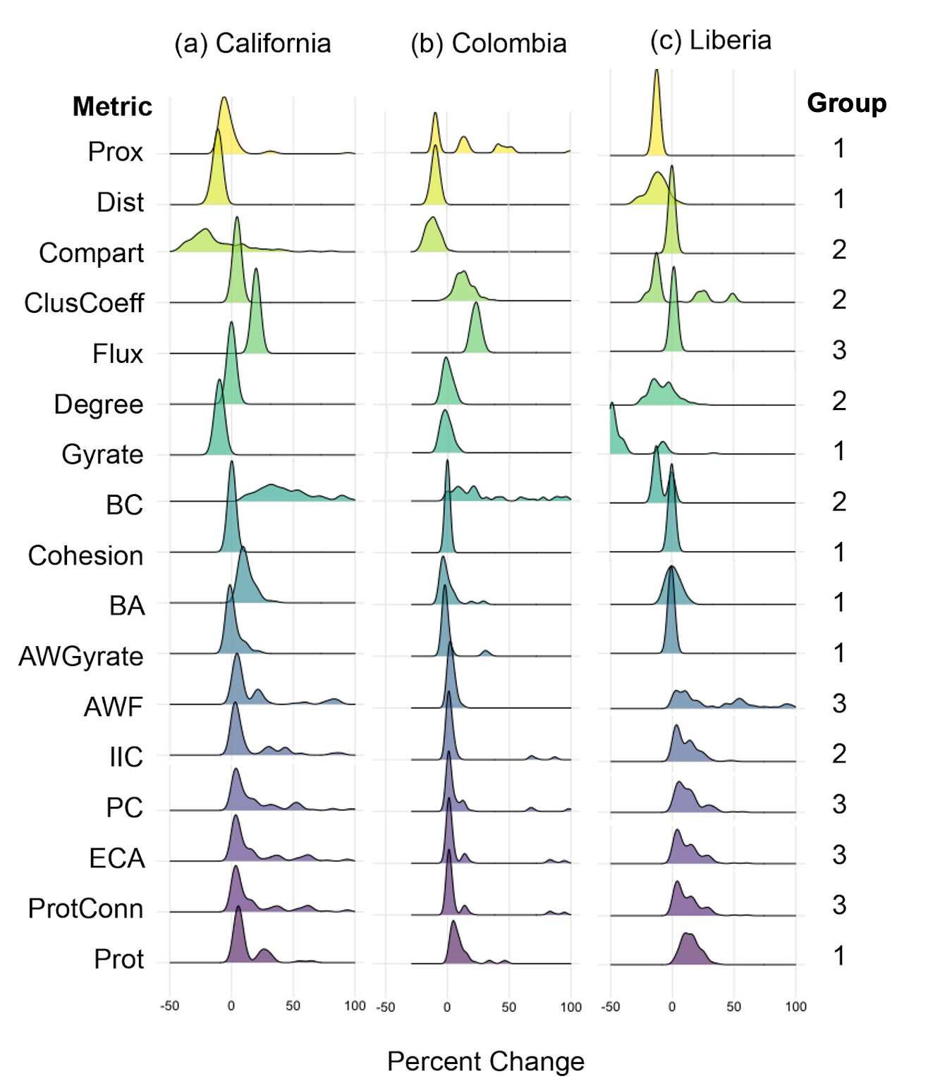

Slide 3
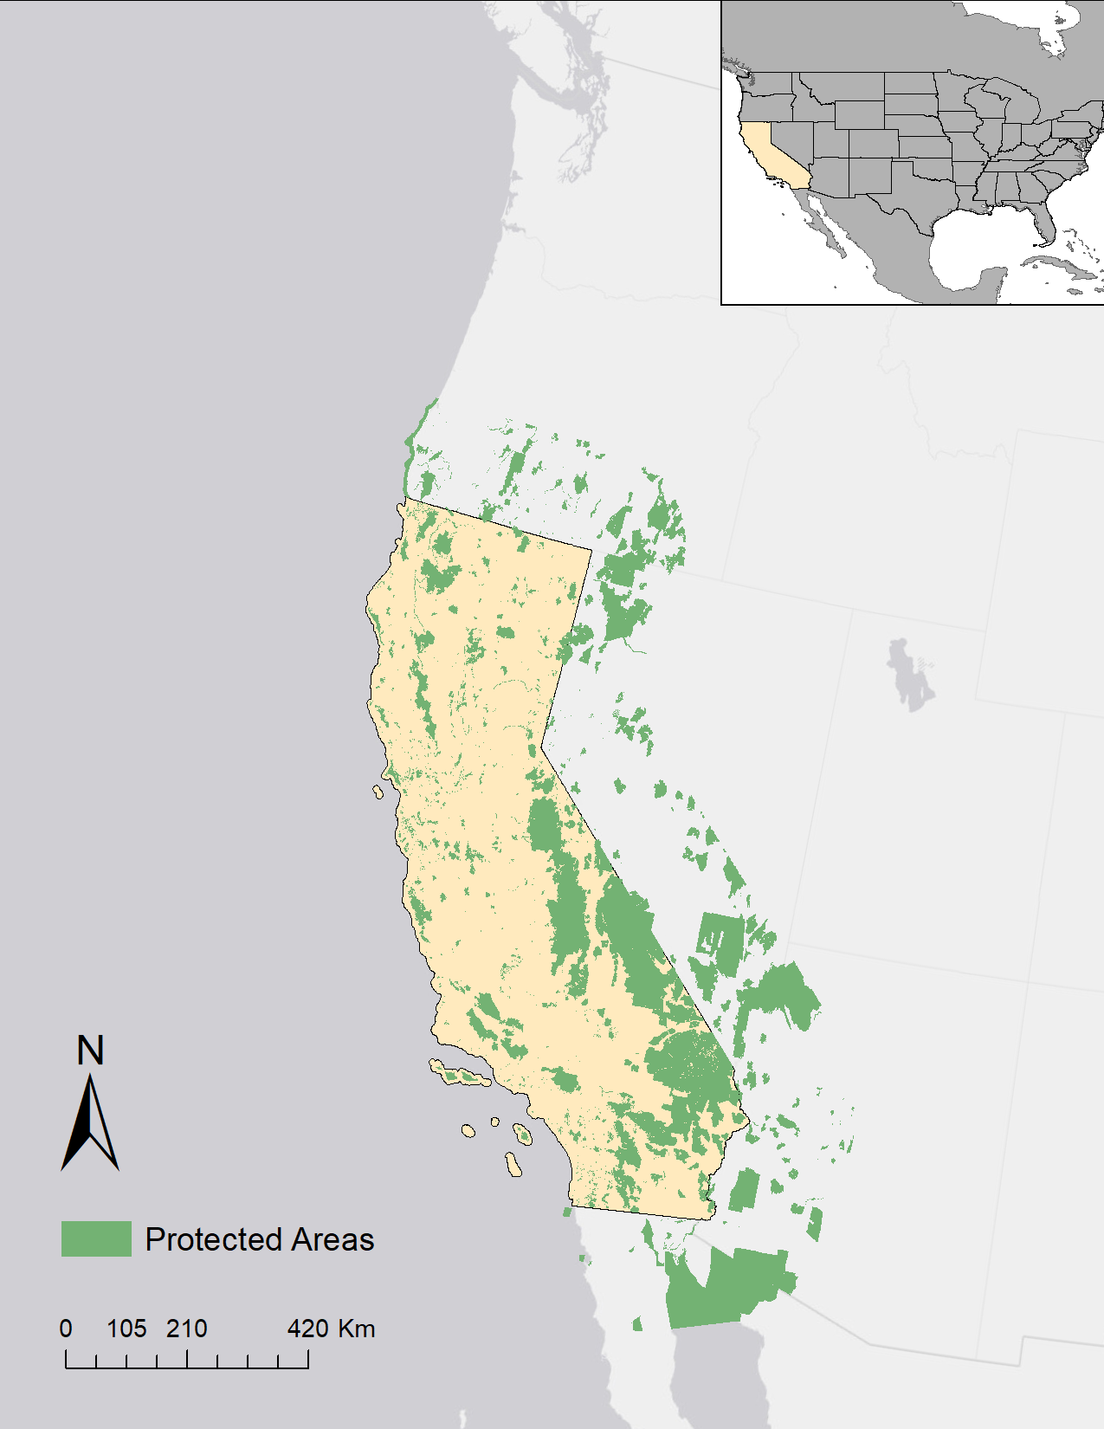
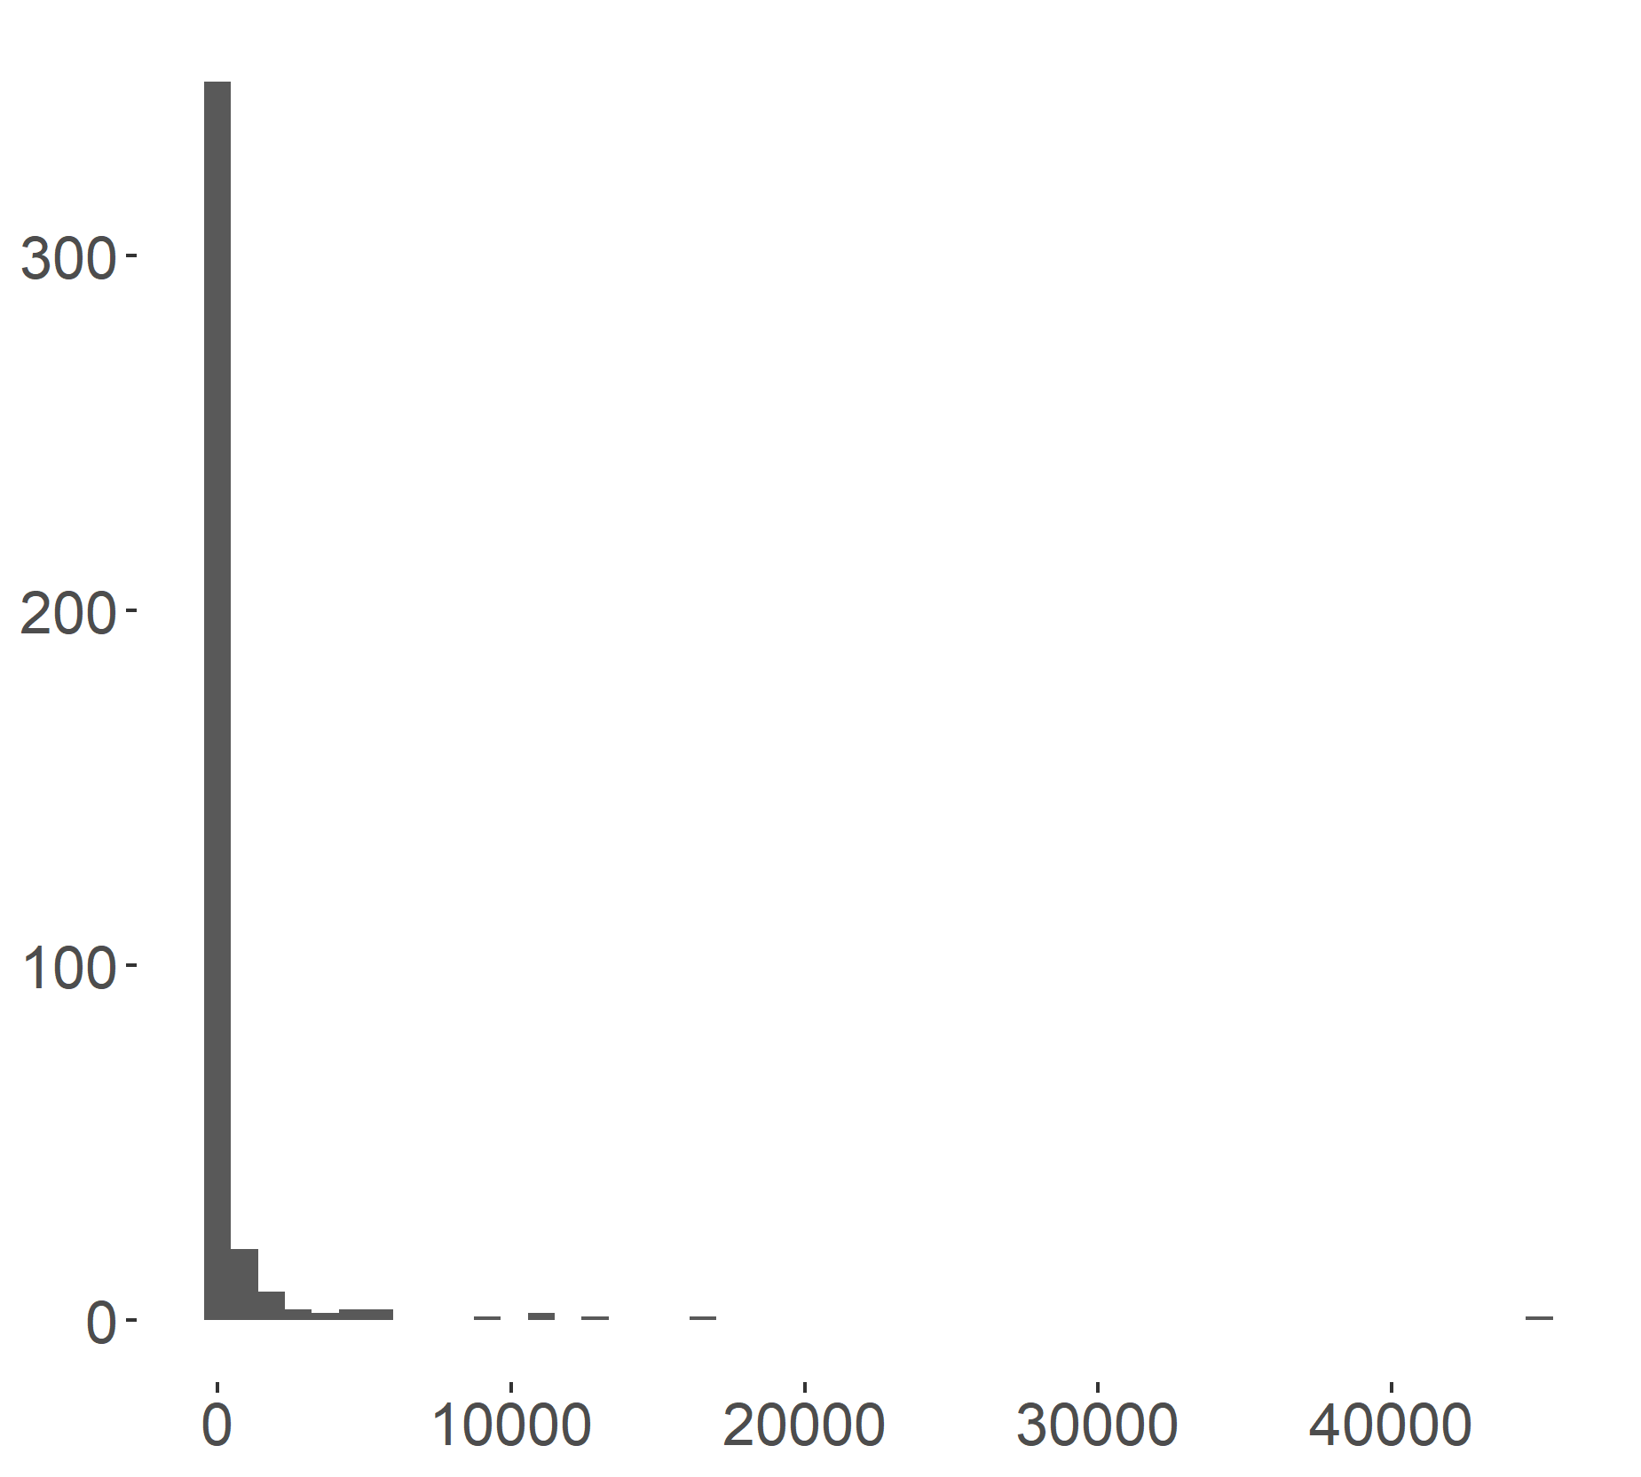
Count
PA Area (km2)

Slide 4
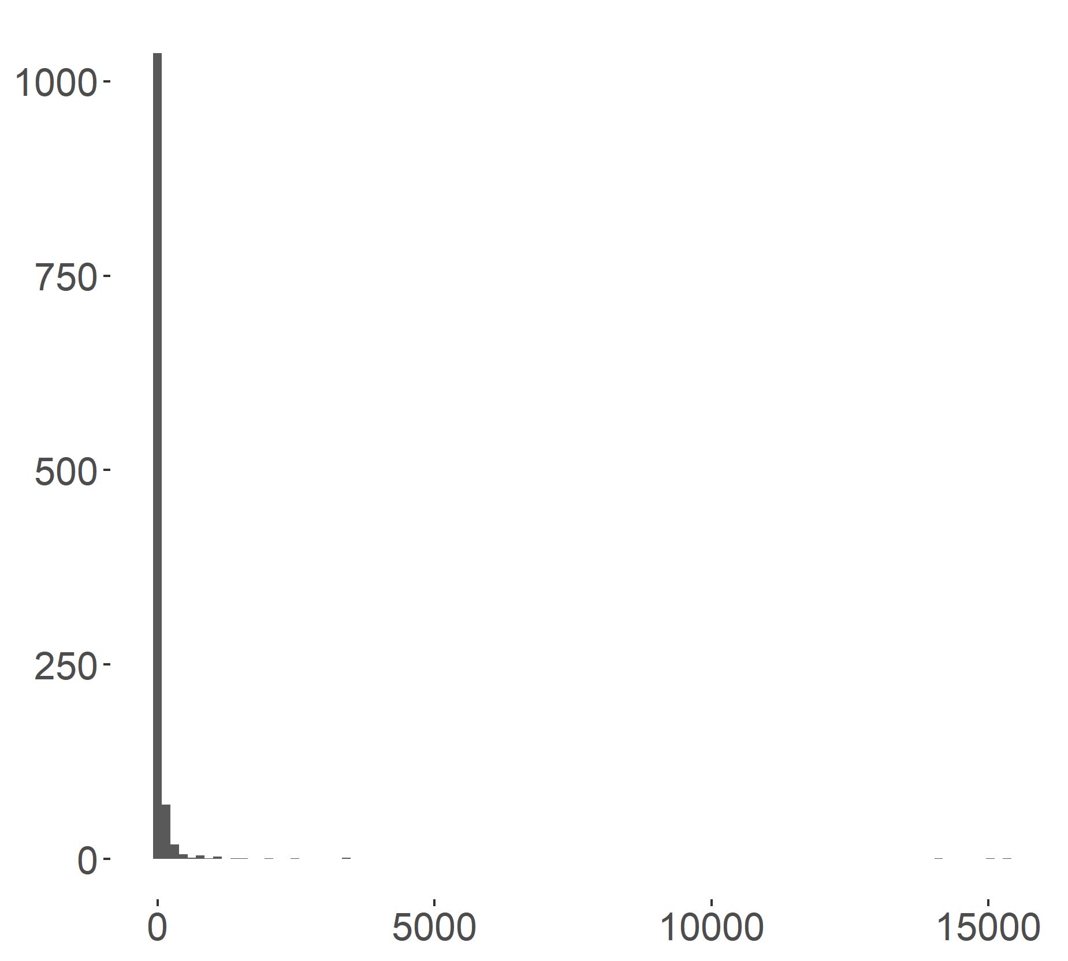
Count
PA Area (km2)

Slide 5
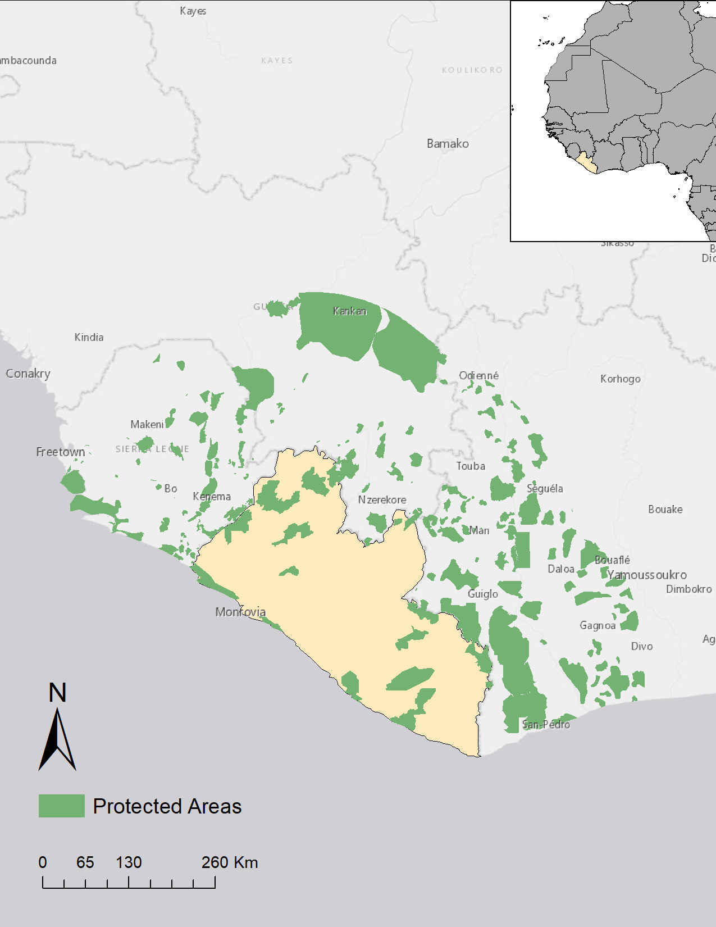
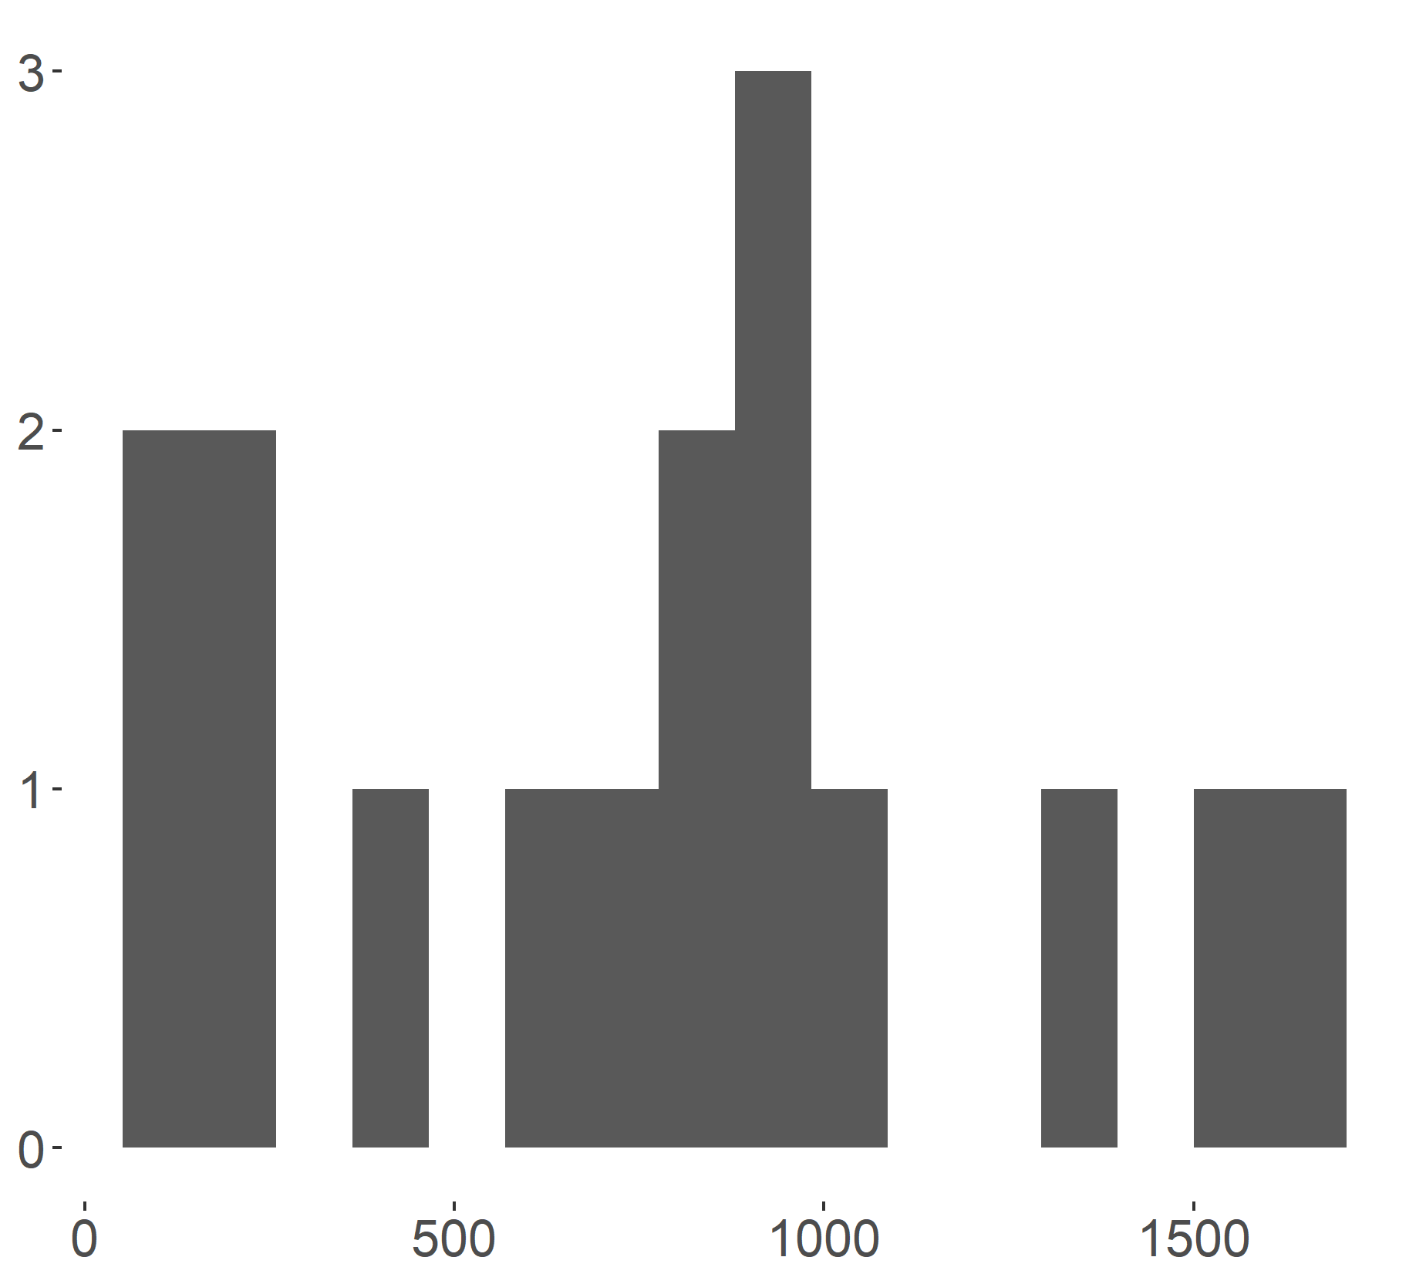
Count
PA Area (km2)

Slide 6
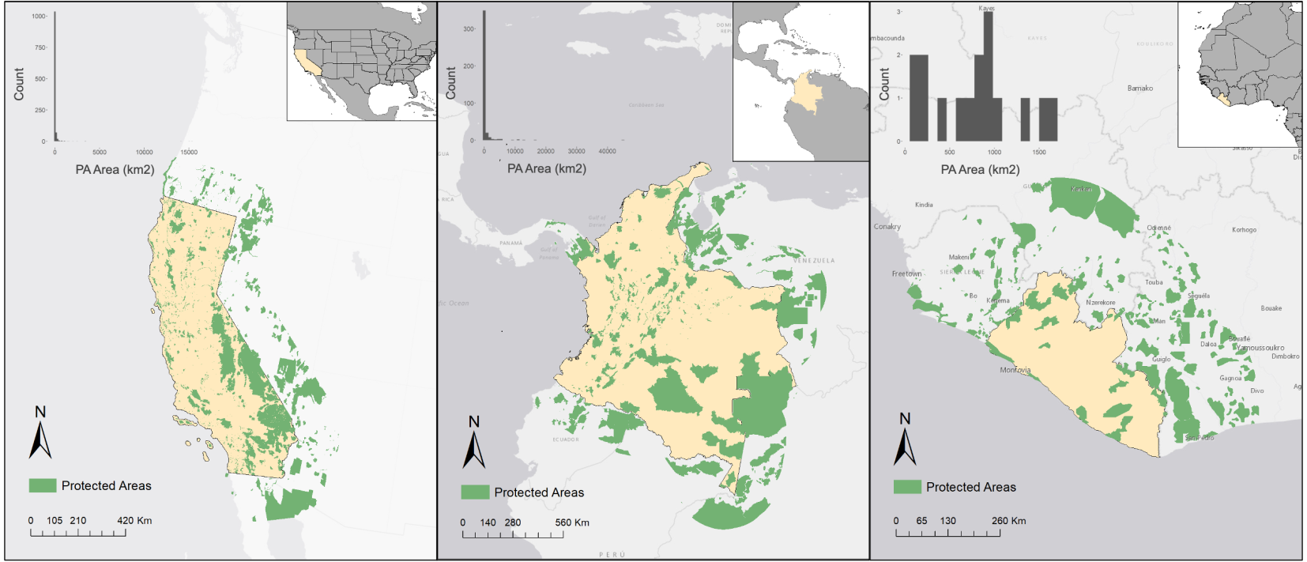
(a) California
(b) Colombia
(c) Liberia

