Slide 1
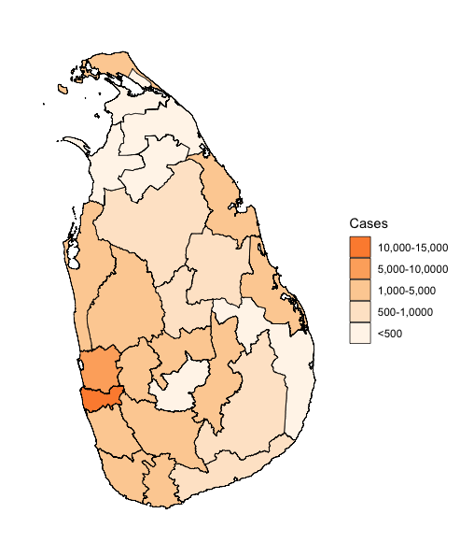
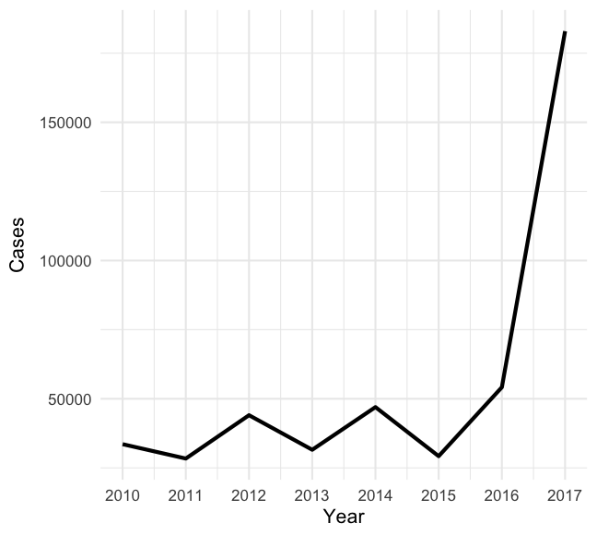
Monthly dengue case data by district in Sri Lanka from 2010-2017 (Sourced from: Epidemiology Unit, Ministry of Health)
Average number of yearly reported dengue cases by district between 2010-2017
Annual number of reported dengue cases in Sri Lanka from 2010-2017

Slide 2
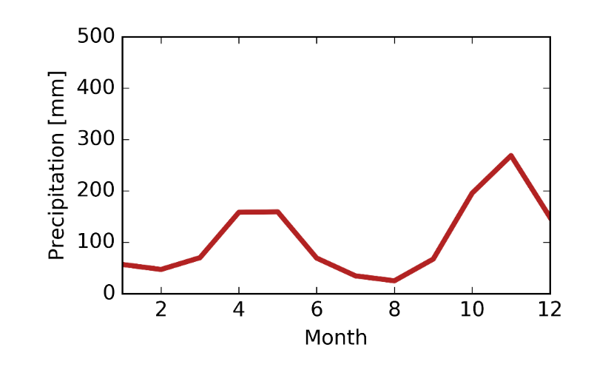
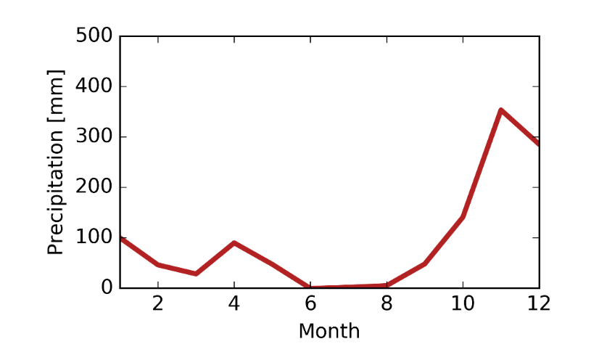
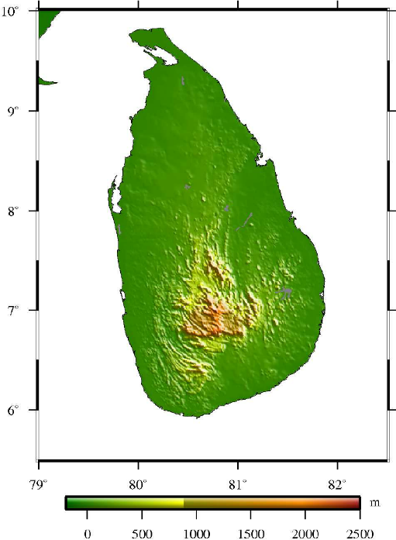
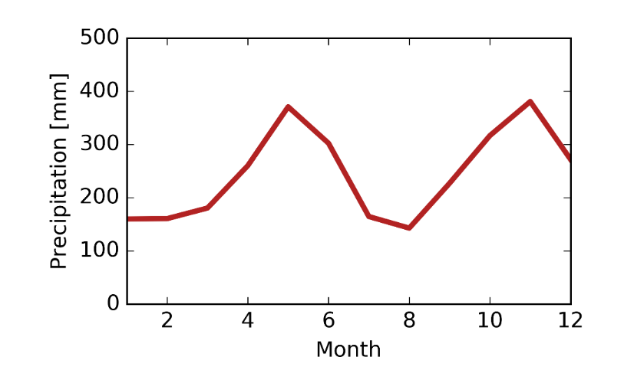
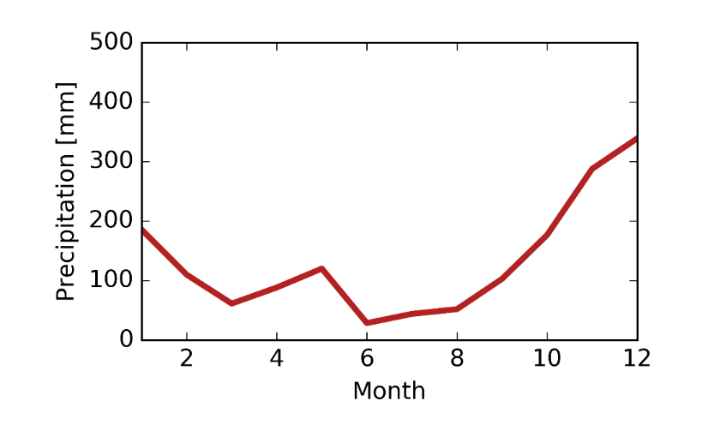
Precipitation seasonality
Elevation
Abeyratne, et al 2009

Slide 3
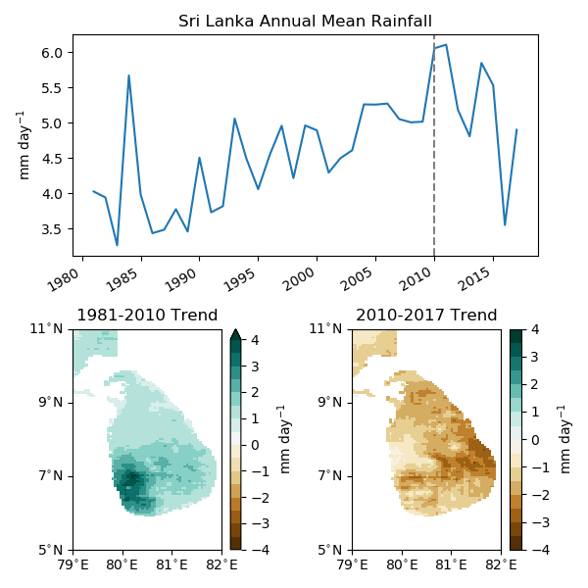
Sri Lanka Annual Mean Rainfall 1981-2017
Data Source: CHIRPS

Slide 4
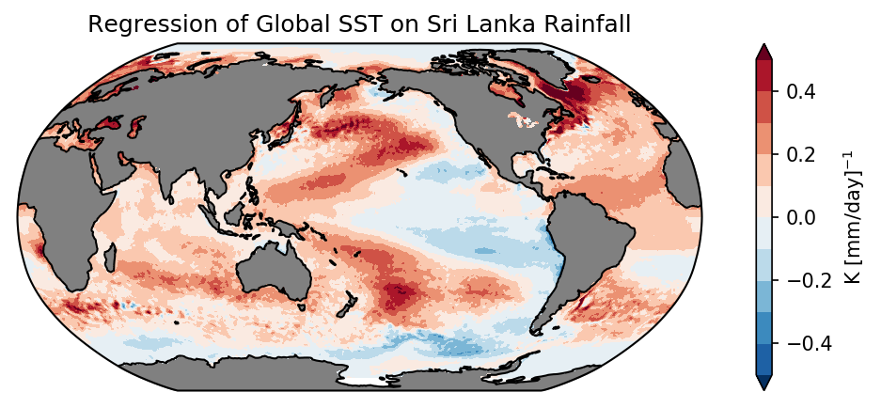
Sri Lanka Rainall and Global Sea Surface Temperature
Data Source: CHIRPS, OISST

