Slide 1

Python Installing and Basics
Wenchang Yang
Department of Geosciences
Princeton University
Junior Colloquium
2019-09-30

Slide 2
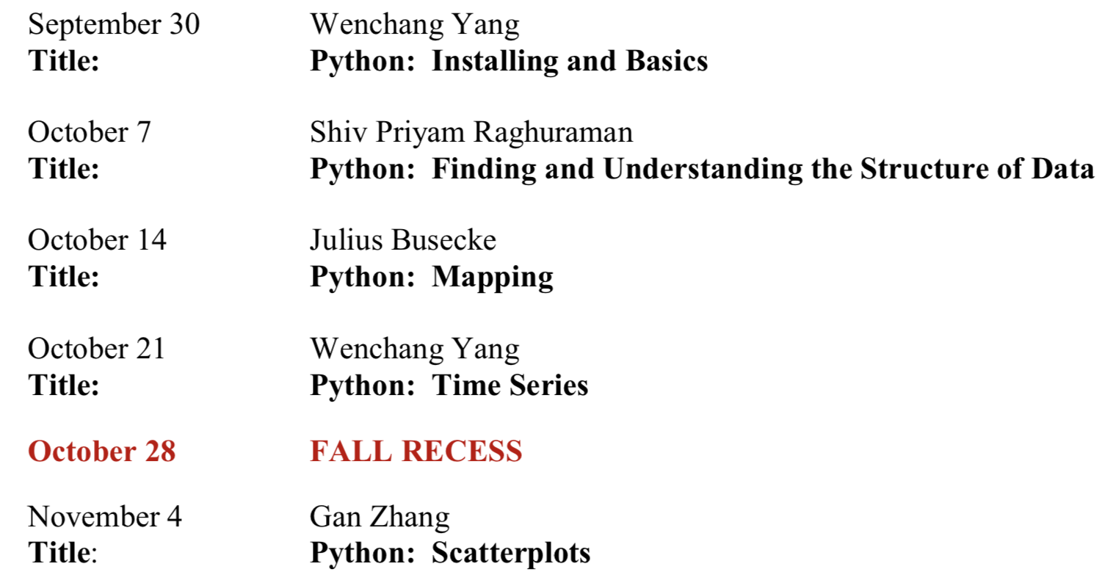
Python Series

Slide 3
Today’s Plan
A very short introduction
Python Installing
Python Basics

Slide 4
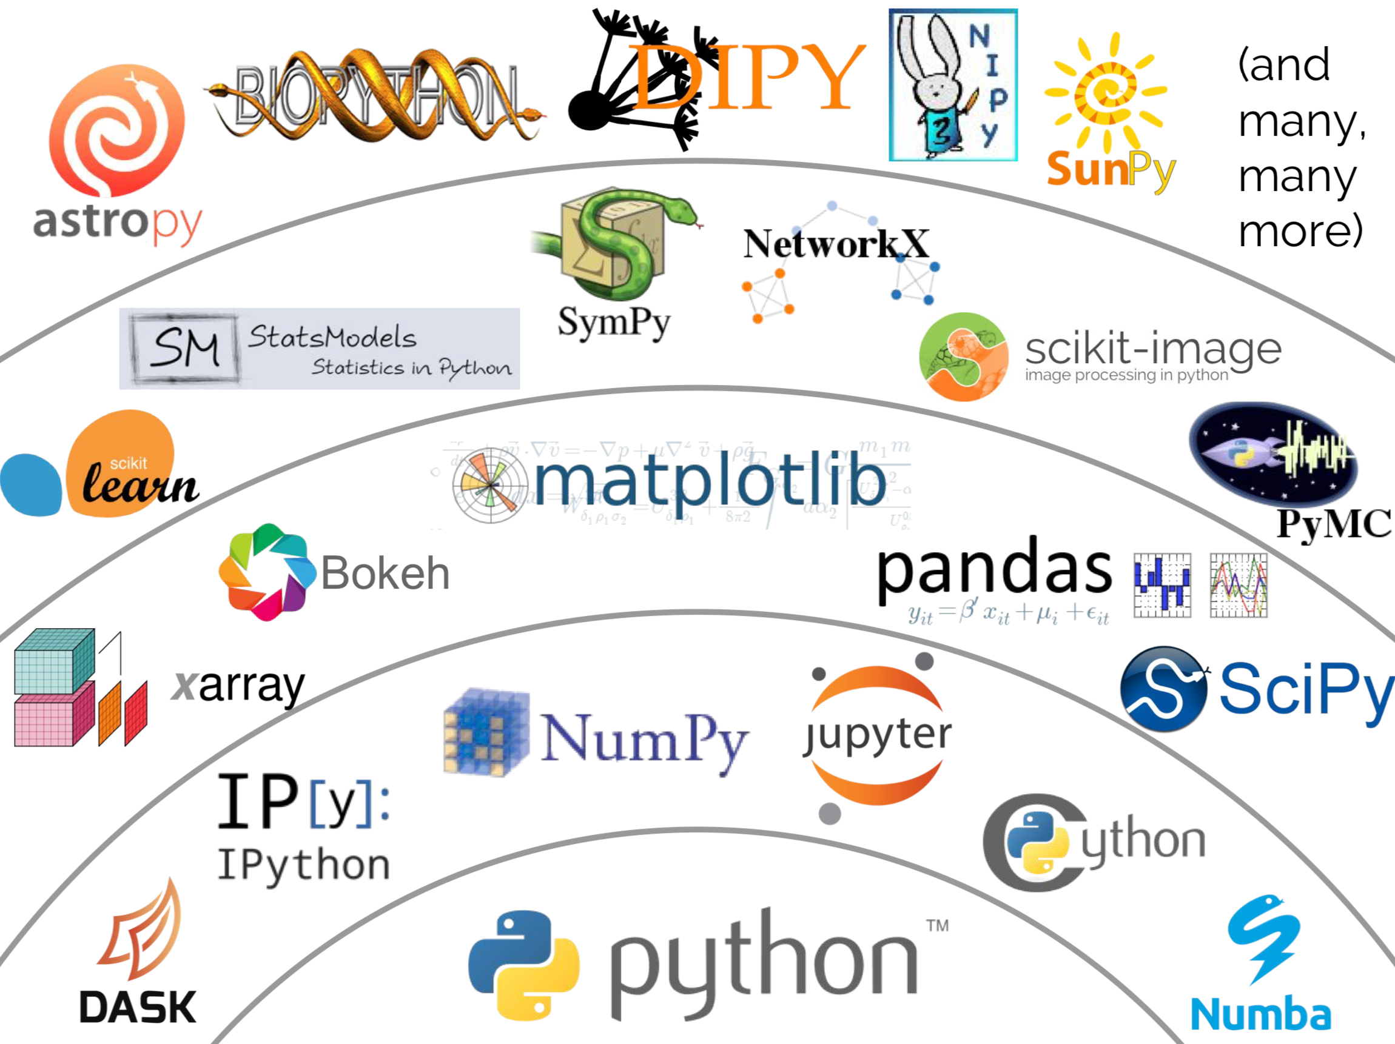
Why Python?
Powerful.
Rich libraries.
Healthy ecosystem.
Free and open source.
Easy to use.
The dominant language in AI/Machine Learning/Big Data.
Graph Credit: Jake vanderPlas, "The Unexpected Effectiveness of Python in Sciene", PyCon 2017

Slide 5
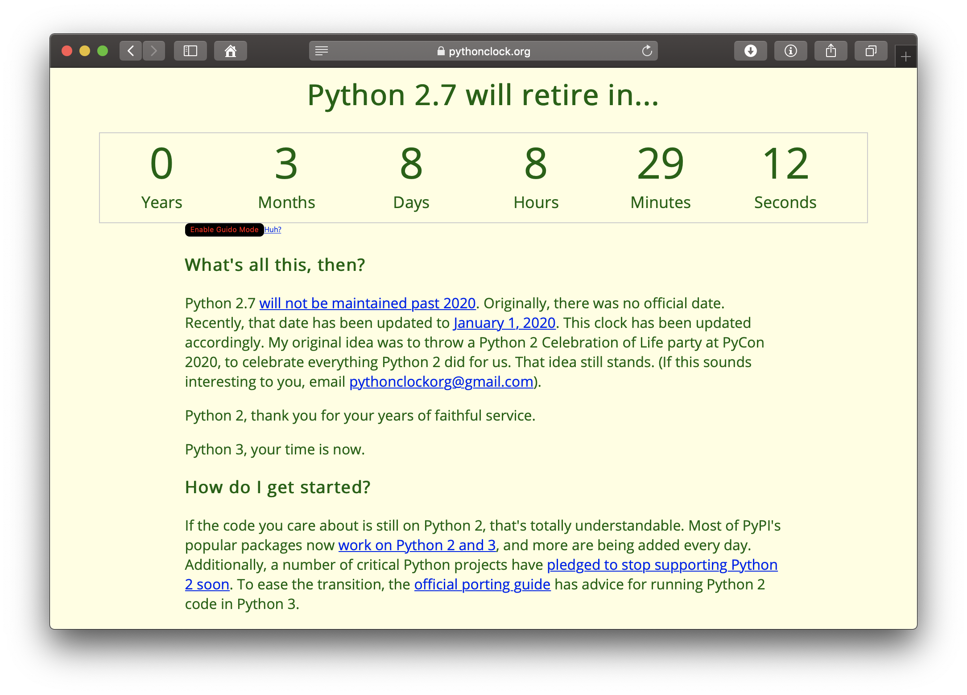
Python 2 vs. Python 3
Python 2.x is legacy and will retire on Jan 1, 2020
Python 3.x is the present and future of the language
Please use Python 3.x

Slide 6
Installing and Basics
Python Install Instruction:
https://github.com/wy2136/learnPython/blob/master/install_python.md
Python Basics:
https://github.com/wy2136/learnPython

