Slide 1
Vector Quantization
Wyatt Clark

Slide 2
Methods – Data representation
A signal is represented as a Short Term Fourier Transform
Given a
l length signal
N length window size
H length shift

Slide 3
Methods-Data representation
A STFT is a MxN matrix of complex numbers
M = (l-N)/H
M is the number of fourier transforms taken
N = Window size
These numbers can be decomposed into their respective parts
Phase
Energy

Slide 4
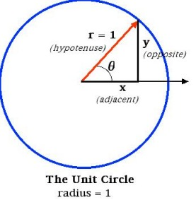
Clustering
Energies of the signal can be extracted from the complex numbers
In matlab this is done using the “angle” argument

Slide 5
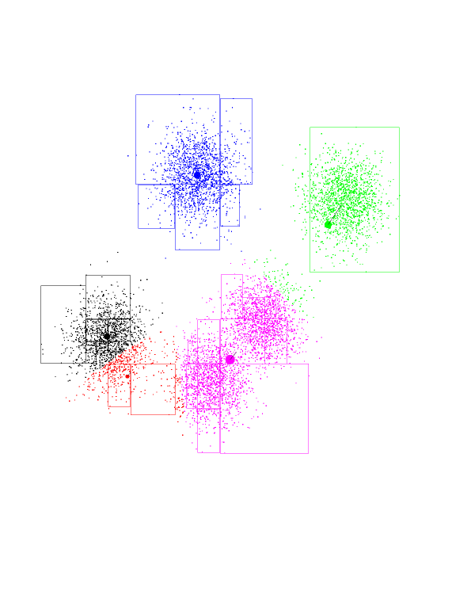
Methods - Clustering
Create k clusters of vectors
Each cluster is represented by a Centroid
C = { c₁,c₂,…..c_{k}}

Slide 6
Methods - Encoding
Encode a signal s as m length vector
q = {q₁, q₂, …q_{m}}
q_{i} = index of centroid that n length vector i is closest to
Distance measure can be calculated a number of ways
_{City block}
_{Euclidean}
_{Mahalanobis}

Slide 7
Encoding
Signals can now be encoded as:
a M < l length vector of centroid id’s
A set of K, N length centroids
If M+(KxN) < l, then this provides an efficient method of encoding a signal
IF it can be recreated without sufficient loss

Slide 8
Problems
By only encoding the angle of the complex number, you still have a l length vector of phases
Clustering phase vectors is problematic
Concatenating Phase and Energy Vectors Does not help
Might have to try a large cluster size
Might not be able to cluster phase vectors

