Slide 1
Smart Grid Vulnerability Analysis Methods
Nyffeler, Lehman, Ward

Slide 2

Consider, if you Will…
Power interruptions can cripple…
Payment processors
Students submitting homework at the last minute
Sewage pumps
Medical equipment
Significant portions of infrastructure for extended periods
Cellular networks (911 calls)

Slide 3

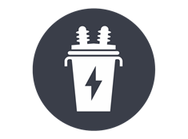
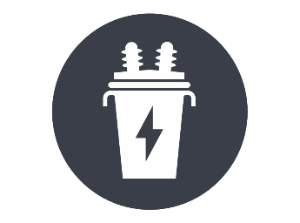



Definitions
A smart grid is a computerized power grid.
In the event of a malfunctioning unit (generator or transformer), power can be automatically redirected from elsewhere.
Transformer
Generator
Consumer
Notes:
Power Plant: https://www.kissclipart.com/factory-clipart-car-citron-factory-vvucrf/
Transformer: https://www.vippng.com/preview/ihxJJRR_distribution-transformer-electrical-steel-electrical-transformer-transformer-icon/
PFW: https://pfw.photoshelter.com/galleries/invited_galleries/C0000FUIbLB60jMk/C0000li9qCfTuVD0/C0000pVy0Bv0b1tw/C00005m_PfwyMB3w/C0000QADZPeyIyt8/G0000Kl4b_HiQrB0/Full-Color

Slide 4


Definitions
A smart grid is a computerized power grid.
In the event of a malfunctioning unit (generator or transformer), power can be automatically redirected from elsewhere.
Transformer
Generator
Consumer

Slide 7
Background Information
Smart grids can be vulnerable to attacks.
If key points are forced offline, the failures can “cascade.”
Cascade happens when the remaining infrastructure fails to meet the burden being placed on it and components begin to fail.

Slide 8

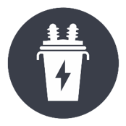


Cascade: an Example
Observe how the marked transformer fails in this scenario:
Transformer
8
Max
Load 1
3
1
Generator
Total
1
1

Slide 9
Cascade: an Example
A failure elsewhere cause power to be redirected to the transformer
Transformer
8
Max
Load 1
+ 1
3
1
Generator
Total
1
1

Slide 10
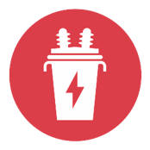
Cascade: an Example
The redirection overloads the transformer
Transformer
8
Max
Load 1
+ 1
2
3
1
Generator
Total
1
1

Slide 11
Cascade: an Example
The overloaded transformer fails, causing a domino effect that cascades
Transformer
8
Max
3
1
Generator
Total
1
1

Slide 12
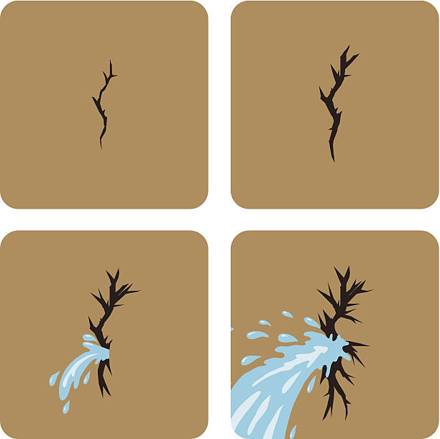
Research Question
How can we determine the cascading failure point of a system?
Notes:
Crack: https://www.istockphoto.com/jp/ベクター/クラックにダム-gm486894653-38938542

Slide 13
Research Problem
What is our problem?
We need to find out what the most vulnerable points in the grid are, so that we can protect it from potential attacks.

Slide 14


What Can We Do?
Think like the attacker.
Notes:
Hacker type: https://picsart.com/i/sticker-304848469029211
Thought Bubble: http://www.clker.com/cliparts/r/K/T/F/J/l/cartoon-thought-bubble-md.png

Slide 15
What Can We Do?
Attackers have finite resources
Everything they do has a cost
Systems that can harden locations from attacks frequently have large costs
Thus, not every location will have the same level of protection
Some may have no protection at all
The level of protection afforded to a location is frequently proportional to the attractiveness of disabling that location
Notes:
Minnow and whale for importance? (use animation/pictures)

Slide 16
System Model: What’s Important?
With how attackers think in mind, a system model was developed.
How can our system be simplified while staying applicable to the real world?

Slide 17


Factors
What aspects of the Smart Grid system should we worry about?
Notes:
Red Question Mark: https://clipartix.com/questions-clipart-image-29220/
Black Pair: https://veritasdomain.files.wordpress.com/2016/02/question-mark-blackandwhite.png

Slide 18

System Model
Our system consists of Suppliers, Transformers, and power lines.
Transformers:
Weight (W)
Capacity
Cost (C)
Notes:
Weight: value of customer,
MAIN IDEA: Minimize resources while maximizing cost

Slide 19



Weight
Not all attack points are as “valuable”
For example, individual houses are not as important as hospitals.
Supports one family
Supports entire communities
Notes:
Weight: http://www.clker.com/clipart-weight.html
Hospital: http://cliparts.co/clipart/2332315

Slide 20

Capacity
There is a limit to the amount of electricity that a transformer can handle.
Parts can only be made to work so hard before they fail.
Notes:
Cup: https://fineartamerica.com/featured/1-water-overflowing-cup-zing-images.html

Slide 21

Cost
Attacking a transformer requires spending resources
Attackers have a finite resource budget to work with
Notes:
Money pile: https://pixabay.com/vectors/cash-finance-financial-green-ideas-1296584/

Slide 22
Image Sources
https://www.kissclipart.com/factory-clipart-car-citron-factory-vvucrf/
https://www.vippng.com/preview/ihxJJRR_distribution-transformer-electrical-steel-electrical-transformer-transformer-icon/
https://pfw.photoshelter.com/galleries/invited_galleries/C0000FUIbLB60jMk/C0000li9qCfTuVD0/C0000pVy0Bv0b1tw/C00005m_PfwyMB3w/C0000QADZPeyIyt8/G0000Kl4b_HiQrB0/Full-Color
http://www.clker.com/clipart-weight.html
https://fineartamerica.com/featured/1-water-overflowing-cup-zing-images.html
https://pixabay.com/vectors/cash-finance-financial-green-ideas-1296584/
https://veritasdomain.files.wordpress.com/2016/02/question-mark-blackandwhite.png
https://clipartix.com/questions-clipart-image-29220/
http://www.clker.com/clipart-orange-house-2.html
http://cliparts.co/clipart/2332315
https://picsart.com/i/sticker-304848469029211
http://www.clker.com/cliparts/r/K/T/F/J/l/cartoon-thought-bubble-md.png
https://www.istockphoto.com/jp/ベクター/クラックにダム-gm486894653-38938542

