Slide 1
Final Presentation Team 07
Wyatt Ward, Mitchell Lehman, Andrew Nyffeler
Tu N. Nguyen, Advisor
Purdue Fort Wayne CS Dep't, Sponsor
w

Slide 2
Introduction
Our Team
Wyatt Ward, Project Leader
Andrew Nyffeler
Mitchell Lehman
Sponsored by Purdue Fort Wayne Computer Science Department
Advisor: Tu N. Nguyen
Goals
Find what vulnerabilities exist within smart grid systems
a

Slide 3
Goals
Find what vulnerabilities exist within smart grid systems
Primary stakeholders: The Purdue Fort Wayne Computer Science Department

Slide 4
Project Schedule
Most work happened at meetings of all team members, and most plans were made then. Meetings were twice a week.
This system worked well until physical classes were cancelled. After that, efforts were made to meet frequently as possible via remote software, e.g. Zoom.

Slide 5
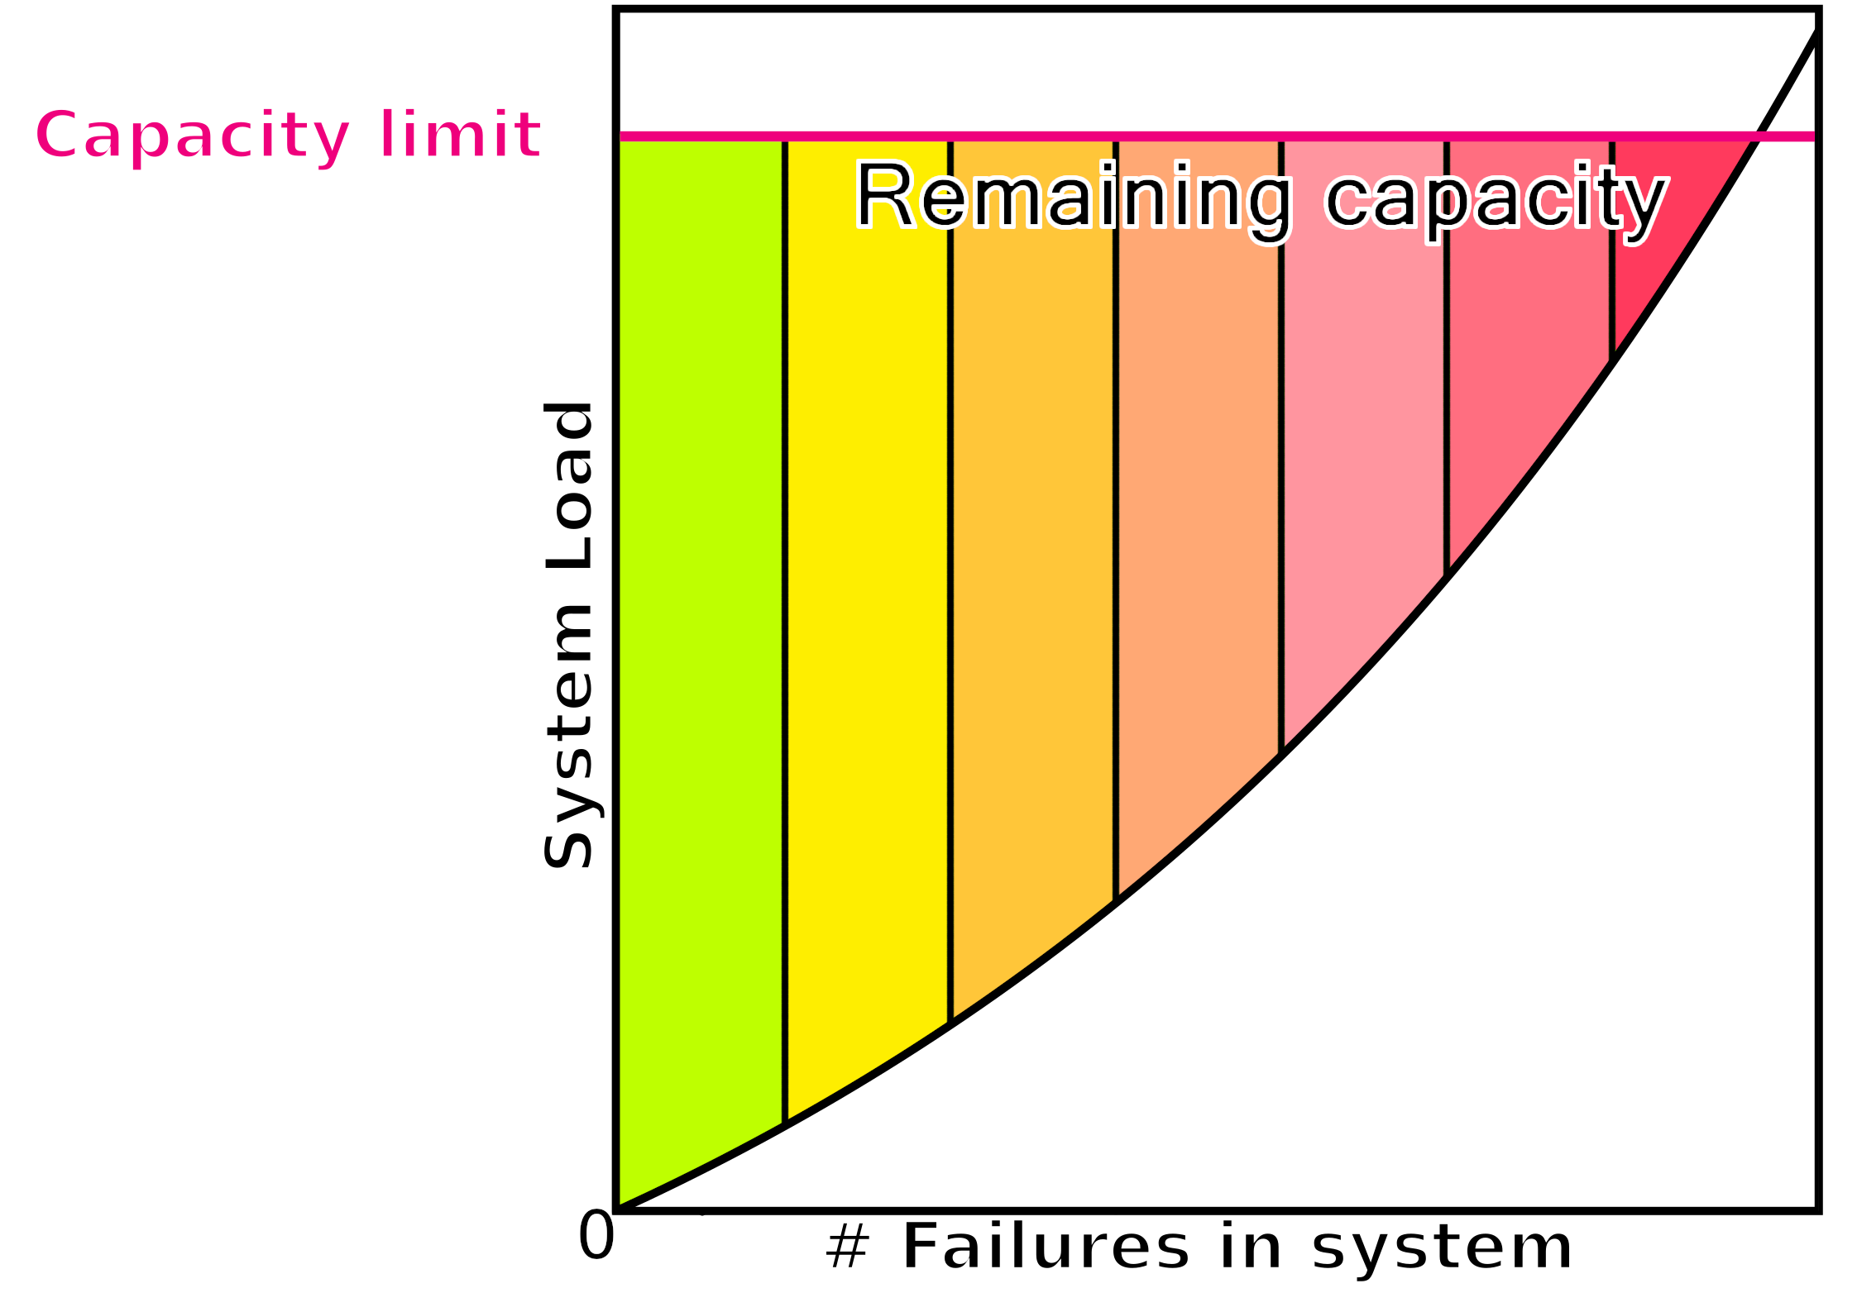

System Overview
The objective of the research project is designing a system model that can be used to test smart grid systems under a large number of differing circumstances.

Slide 6





Demonstration
13/16
1/2
1/2
1/2
W=2
1/2
W=2
C=4
W=4
C=5
4/5
2/3
2/2
1/2
1/2
2/4
1/2
W=2
C=1
W=1
C=1
$$M_{x}=\frac{W_{x}}{C_{x}}$$
2/4
2/2
W=2
C=4
w

Slide 7


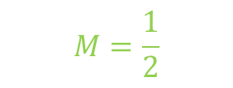
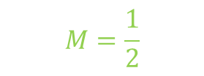

Demonstration
13/16
1/2
1/2
1/2
W=2
$$M=\frac{1}{2}$$
1/2
W=2
C=4
W=4
C=5
4/5
2/3
$$M=\frac{4}{5}$$
2/2
1/2
1/2
2/4
1/2
W=2
C=1
W=1
C=1
$$M=\frac{1}{2}$$
$$M=\frac{2}{1}$$
$$M_{x}=\frac{W_{x}}{C_{x}}$$
$$M=\frac{1}{1}$$
2/4
2/2
W=2
C=4
w

Slide 8

Demonstration
15/16
2/2
2/2
1/2
W=2
2/2
W=2
W=4
(2+2)
5/5
4/3
2/2
1/2
3/2
2/4
1/2
W=1
W=2
$$M=\frac{2}{1}$$
$$M_{x}=\frac{W_{x}}{C_{x}}$$
4/4
2/2
W=1
w

Slide 9

Demonstration
4/16
2/2
0/2
0/2
W=2
0/2
W=2
W=4
(2+2)
4/5
4/3
2/2
2/2
3/2
2/4
0/2
W=1
W=2
$$M_{x}=\frac{W_{x}}{C_{x}}$$
0/4
2/2
W=1
w

Slide 10
Demonstration
4/16
2/2
0/2
0/2
W=2
0/2
W=2
W=4
(2+2)
4/5
4/3
2/2
2/2
3/2
2/4
0/2
W=1
W=2
$$M_{x}=\frac{W_{x}}{C_{x}}$$
0/4
2/2
W=1
w

Slide 11
Demonstration
4/16
2/2
0/2
0/2
W=2
0/2
W=2
W=4
(2+2)
4/5
4/3
2/2
2/2
3/2
2/4
0/2
W=1
W=2
$$M_{x}=\frac{W_{x}}{C_{x}}$$
0/4
2/2
W=1
w

Slide 12
Project Schedule/Distribution
Hours Worked:
Nearly 350 hours in joint meetings over the course of both semesters
The COVID-19 pandemic made tracking difficult in semester 2, many hours went unlogged due to only one member having the spreadsheet at first.

Slide 13
Other Remarks
Positive Outcomes:
Got more experience working together as a group towards a common goal
Gained insight into the world of computer science academia while doing research
Learned how to work with more freedom and more broad guidance

Slide 14
Other Remarks
Difficulties Faced:
Staying on track, especially in the beginning when our plan was not as well thought out as it was later
Meeting regularly and routine communication became much more difficult when we could no longer meet physically

Slide 15
Other Remarks
What could we have done differently?
Spend more time doing work individually
Allocate the project more efficiently between group members
Choose a project with more concrete goals from the beginning

