Slide 1
Smart Grid Vulnerability Analysis Methods
Wyatt Ward, Mitchell Lehman, Andrew Nyffeler,
Tu N. Nguyen, Advisor
Purdue Fort Wayne CS Dep't, Sponsor
w

Slide 2
Introduction
Our Team
Wyatt Ward, Project Leader
Andrew Nyffeler
Mitchell Lehman
a

Slide 3
Goals
Find what vulnerabilities exist within smart grid systems
Primary stakeholders: The Purdue Fort Wayne Computer Science Department

Slide 4
Project Schedule
Our group primarily focused on meeting twice a week to discuss what we currently had done, what we were going to do, and what we needed to do later.
This system worked well until physical classes were cancelled. After that, we did our best to meet as often as possible remotely via software such as Zoom.

Slide 5
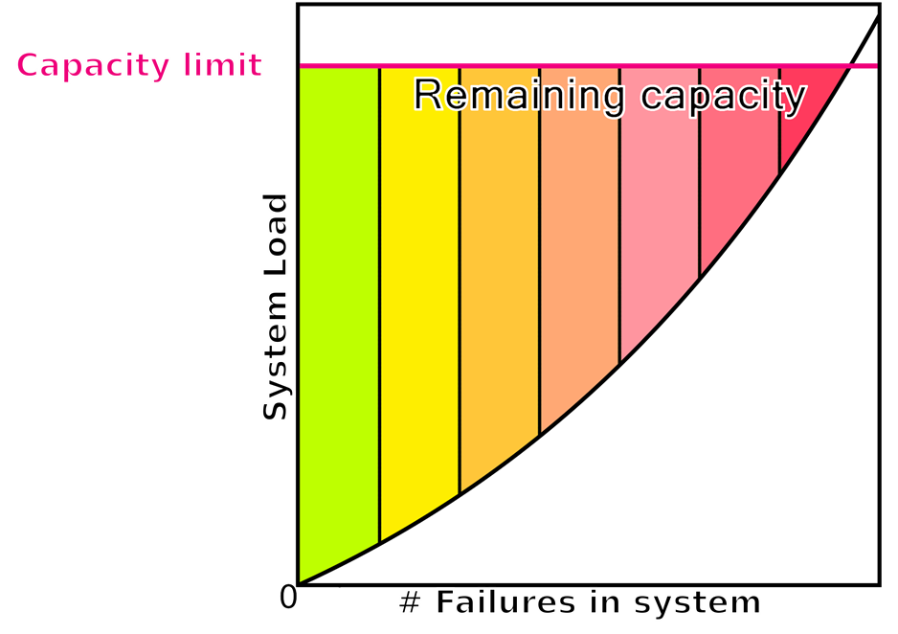

System Overview
Our final product was the creation of a system model that can be used to create and test smart grid systems under a large number of differing circumstances

Slide 6
Looking Back
Hours Worked:
Our group managed to put in nearly 350 hours over the course of both semesters

Slide 7
Looking Back
Positive Outcomes:
Got more experience working together as a group towards a common goal
Gained insight into the world of computer science academia while doing research
Learned how to work with more freedom and more broad guidance

Slide 8
Looking Back
Difficulties Faced:
Staying on track, especially in the beginning when our plan was not as well thought out as it was later
Meeting regularly and routine communication became much more difficult when we could no longer meet physically

Slide 9
Looking Back
What could we have done differently?
Spend more time doing work individually
Allocate the project more efficiently between group members
Choose a project with more concrete goals from the beginning

