Slide 1
Project diagram and research question
Wyatt Ward, Andrew Nyffeler, Mitchell Lehman

Slide 2
What is our structure for our model?
Insert diagram here

Slide 3
Definitions of components in model
Insert definitions of components here

Slide 4
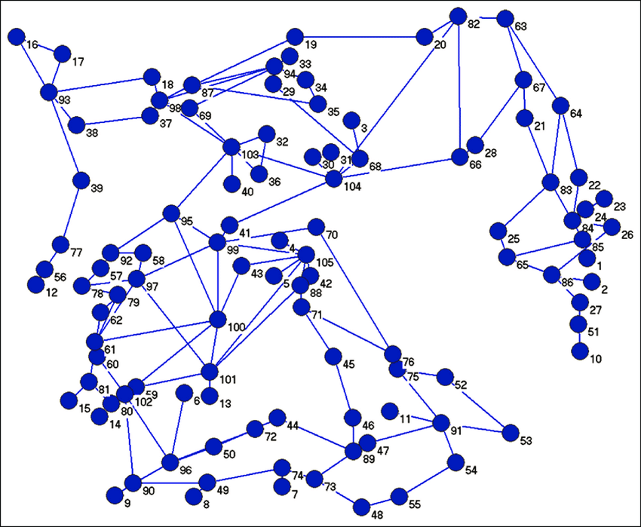
What is our research question?
Given a system using the previous model, what is the most efficient way to disable the most nodes in said model?

Slide 5
Image sources
https://www.researchgate.net/figure/Full-graph-representation-of-Irans-power-grid_fig1_270634108

