Slide 1
Smart Grid Vulnerability Analysis Methods
Nyffeler, Lehman, Ward

Slide 2

Consider, if you Will…
Power interruptions can cripple…
Payment processors
Students submitting homework at the last minute
Sewage pumps
Medical equipment
Significant portions of infrastructure for extended periods
Cellular networks (911 calls)

Slide 3

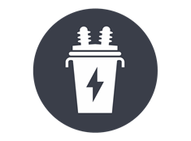
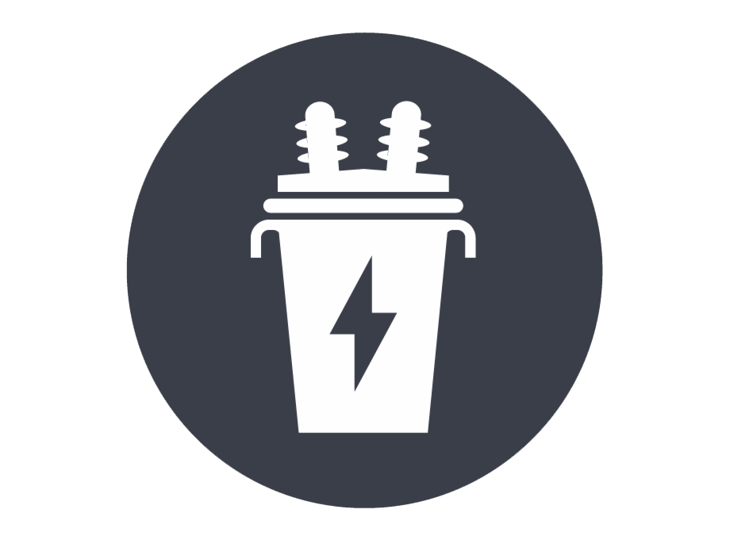



Definitions
A smart grid is a computerized power grid.
In the event of a malfunctioning unit (generator or transformer), power can be automatically redirected from elsewhere.
Transformer
Generator
Consumer

Slide 4


Definitions
A smart grid is a computerized power grid.
In the event of a malfunctioning unit (generator or transformer), power can be automatically redirected from elsewhere.
Transformer
Generator
Consumer

Slide 5



Definitions
A smart grid is a computerized power grid.
In the event of a malfunctioning unit (generator or transformer), power can be automatically redirected from elsewhere.
Transformer
Generator
Consumer

Slide 6
Definitions
A smart grid is a computerized power grid.
In the event of a malfunctioning unit (generator or transformer), power can be automatically redirected from elsewhere.
Transformer
Generator
Consumer

Slide 7
Definitions
A smart grid is a computerized power grid.
In the event of a malfunctioning unit (generator or transformer), power can be automatically redirected from elsewhere.
Transformer
Generator
Consumer

Slide 8
Definitions
A smart grid is a computerized power grid.
In the event of a malfunctioning unit (generator or transformer), power can be automatically redirected from elsewhere.
Transformer
Generator
Consumer
Notes:
Clarify animation: path of electricity.
Show how redirection of power changes the way power will flow.
CHANGE ICONS
Funnel for transformer?

Slide 9
Background Information
Smart grids can be vulnerable to attacks.
If key points are forced offline, the failures can “cascade.”
Cascade happens when the remaining infrastructure fails to meet the burden being placed on it and components begin to fail.

Slide 10
Cascade: an Example
Observe how the marked transformer fails in this scenario:
8
3
1
Load 1
Transformer
Max
1
1
Generator
Total

Slide 11
Cascade: an Example
Observe how the marked transformer fails in this scenario:
8
3
1
Load 1
+ 1
Transformer
Max
1
1
Generator
Total

Slide 12

Cascade: an Example
Observe how the marked transformer fails in this scenario:
8
3
1
Load 1
+ 1
2
Transformer
Max
1
1
Generator
Total

Slide 13
Cascade: an Example
The initial failure causes a domino effect (cascade).
8
3
1
Transformer
Max
2
2
Generator
Total

Slide 14
Research Question
How can we determine the cascading failure point of a system?

Slide 15
Research Problem
What is our problem?
Show animation of identifying min/max.

Slide 16
What Can We Do?
Think like the attacker.

Slide 17
What Can We Do?
Attackers have finite resources
Everything they do has a cost
Systems that can withstand more attacks with almost always cost much more
Notes:
Minnow and whale for importance? (use animation/pictures)

Slide 18
What Can We Do?
Not all attack points are as “valuable”
Houses aren’t as important as hospitals and fire stations.
Notes:
Minnow and whale for importance? (use animation/pictures)

Slide 19
System Model: What’s Important?
With how attackers think in mind, a system model was developed.
How can our system be simplified while staying applicable to the real world?

Slide 20
Simplifications
Consumer demand in an area is implied by how much power passes through a transformer.
2
Consumer
Transformer
Town Hall

Slide 21
Simplifications
Consumer demand in an area is implied by how much power passes through a transformer.
2
Consumer
2
Transformer

Slide 22
Simplifications
Consumer demand in an area is implied by how much power passes through a transformer.
2
Consumer
5
+
Transformer
3

Slide 23
Weight
Individual people might not matter as much as a gas utility company, university, or hospital.
We had to find an objective way to identify structural importance.

Slide 24
Capacity
Parts can only be made to work so hard before they fail.

Slide 25
Cost

Slide 26

System Model
Our system consists of Suppliers, Transformers, and power Lines.
Transformers:
Weight (W)
Capacity:
Cost (C)
Notes:
Weight: value of customer,
MAIN IDEA: Minimize resources while maximizing cost

Slide 27
Image Sources
https://www.kissclipart.com/factory-clipart-car-citron-factory-vvucrf/
https://www.wboi.org/post/pfw-reveals-new-athletic-logo

