Slide 1
Senior Capstone Project II Jan. 17, 2020
Spring 2020

Slide 2
Course Description
P: CS 46000
The second course of a two-semester sequence
Student teams will
Complete the development of a substantial application-oriented or research-oriented software project begun in CS 46000
Conduct review activities and develop artifacts appropriate for the software project and process model chosen
Conduct a final formal review and demonstration to project stakeholders and other interested persons
Emphasis on teamwork, project management, and oral and written communication

Slide 3
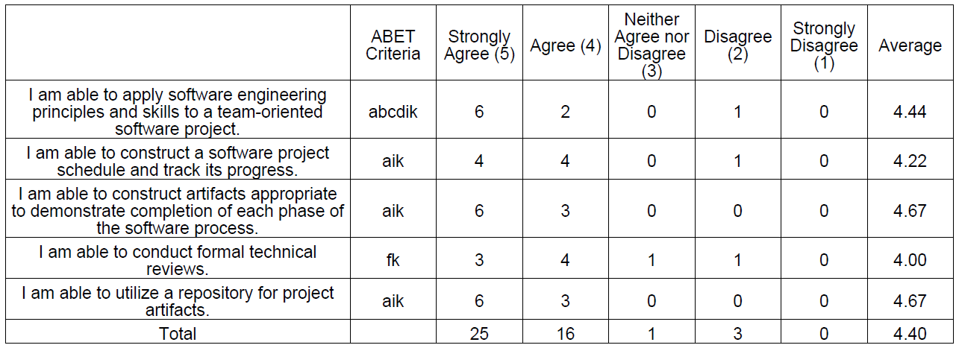
Course Learning Outcomes Survey (Spring 2017)

Slide 4
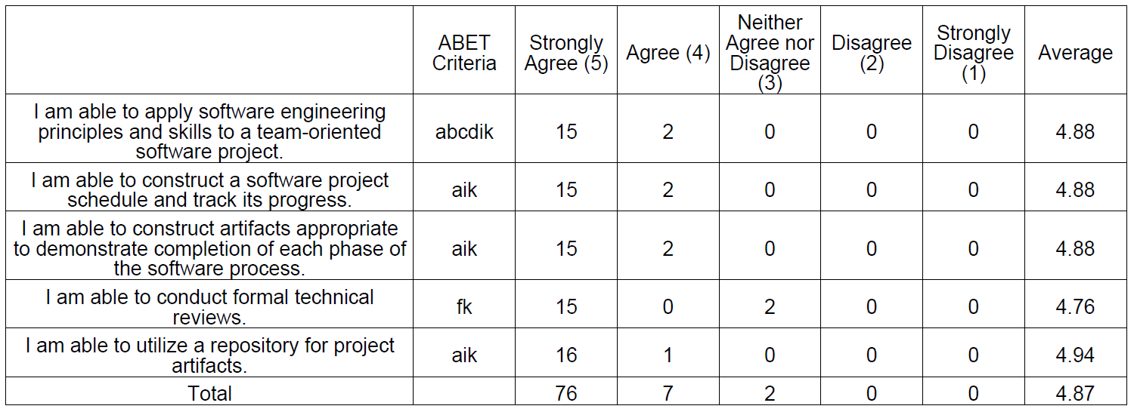
Course Learning Outcomes Survey (Spring 2018)

Slide 5
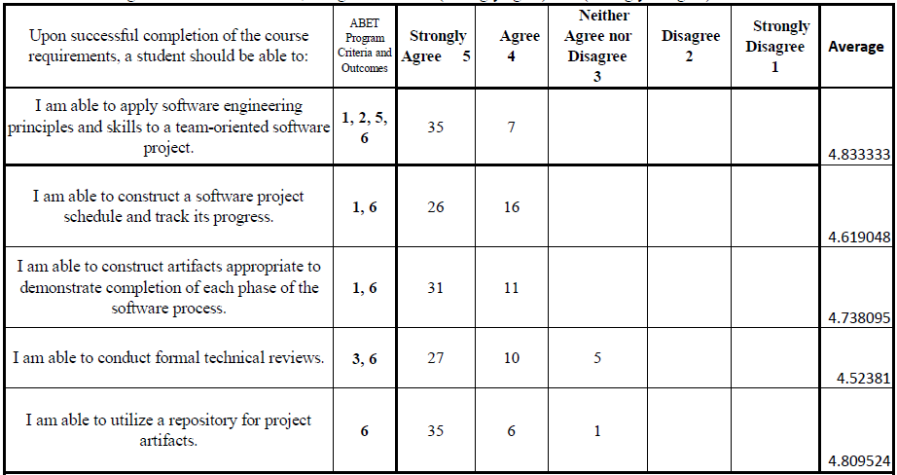
Course Learning Outcomes Survey (Spring 2019)

Slide 6
Course Goals and Learning Outcomes
This course is a continuation of CS46000. The principal goal of this course is to complete the software development project begun in CS46000. Companion objectives include (1) To apply software engineering skills to a large project that is guided by a formal software process model; (2) To further develop teamwork and project management skills; (3) To practice oral and written communication of technical information; and (4) To increase independent learning skills.
Apply software engineering principles and skills to a team-oriented large-scale project
Construct a software project schedule and track its progress
Construct artifacts appropriate to demonstrate completion of each phase of the software process
Gain understanding of the integration of software
Conduct formal technical reviews
Utilize a repository for project artifacts

Slide 7
Introduction
Course Director, Project Advisor of CS46500-01
Name: Beomjin Kim
Office : ET 125B
Office Hours : Tue, Thurs 1:30 – 2:45 p.m.
or call/e-mail to set up an appointment
Phone : (260) 481 - 6180
Email : kimb@pfw.edu
Course Web site
All materials associated with this course are available at https://pfw.blackboard.com/ including the course syllabus, assignments guidelines, and supporting resources.

Slide 8
Grading
Assignment Weight
- Midterm status report and
presentation 35%
- Final project package and
presentation 55%
Participation & Attendance 10%
(Uploaded revised syllabus)
Project artifacts and presentations will be evaluated on completeness, quality of work, and correctness.

Slide 9
Grading
For credit on a given assignment, it must be submitted by the due date. Late submission without advanced approval by the project advisor will be penalized as follows:
1 day late: 10% deduction
2 days late: 20% deduction
3 days late: 25% deduction
Not accept submissions after 3 days

Slide 10
Grading
In general, all members of a team will receive the same evaluation on a given assignment. However, the project advisor reserves the right to assess the work of each individual’s contributions.
Several artifacts produced during a phase will be refined and extended in each subsequent phase.
Conduct a sponsor survey & presentation evaluation
Reflect the project advisor and other stakeholder feedback to improve these artifacts

Slide 11
Assignment Submission
Depending on the type of project and guidelines of the project advisor, assignment requirements at each phase will vary
In addition to the requirements specified below, each project advisor will determine what other artifacts must be submitted for evaluation

Slide 12
Assignment Submission
Phase | Requirements
Midterm status report | Enhanced CS46000 final report Beta-version of software Advisor-defined artifacts Project status presentation
Final project package | Final report including all artifacts created in the senior capstone sequence courses Developed software product Advisor-defined artifacts Project status presentation

Slide 13
Assignment Submission
Require to submit assignments via any or all of the following ways:
Submit a USB flash drive or CD storing all assignments and other supporting files to your project advisor and course director
Compress all files to a single file and e-mail the file to your project advisor and course director
If the file size is smaller than 20 MB, you can compress all files into a single file and upload to Blackboard
Upload all files to a designated cloud location, i.e. Google Drive.

Slide 14
Assignment Submission
All text, graphics, images and diagrams must be created using appropriate software, e.g., Office365
The project advisor reserves the right to make adjustments to the number of assignments, assignment requirements, and weights during the course of the semester.
Be certain to check that any storage device you submit is virus-free.
If requested, you may also be required to submit hard copy of your assignments.

Slide 15
Course Policies
A student who is unable to complete CS 46500 will have to enroll in CS 46000 again during the semester prior to enrolling in CS 46500.
Under very exceptional circumstances, a student who is not able to complete CS 46500 immediately after CS 46000 will be allowed to enroll in CS 46500 if the student is accepted into a team by their other students of the team and the project advisor, according to the project needs/scope and team abilities.

Slide 16
Other Policies
Sponsored Student Class Project Notice
“This course permits you, the student to participate in a class project that has been sponsored by a third party other than the University. The University encourages and supports your participation in this practical learning experience. Although your course requirements may include a practical learning project, you are not required to participate in a project that is sponsored by an outside third party. Prior to your participation in a project sponsored by an outside third party, we would like you to carefully consider that your participation (i) may require you to assign your intellectual property rights to any intellectual property for which a student would retain ownership under the University’s Policy I.A.1 on Intellectual Property and/or (ii) may require you sign a non-disclosure (confidentiality) agreement with the sponsor. If you sign an agreement regarding intellectual property rights or a non-disclosure agreement, you may incur personal liability (with respect to breach of a non-disclosure agreement) or you may lose economic benefits associated with your ownership of intellectual property (with respect to a license or assignment of intellectual property). You are encouraged to retain independent legal counsel for advice on these types of agreements. In addition, if you choose not to sign a non-disclosure or intellectual property rights agreement, your professor will provide you with an alternate project at no penalty to you.”

Slide 17
Other Policies
Using Project Results
The CS department has the right to use project results for demonstrations in various departmental functions, such as student recruitment activities. Purdue intellectual property policies will be observed regarding the products of the projects.

Slide 18
Other Policies
Academic Honesty Policy
All assignments must be done individually unless otherwise noted. The following programming-related activities are specifically prohibited:
Seeking assistance in the development of algorithms
Seeking assistance in the development of code
Seeking assistance in debugging code
Seeking source code of similar problem from the web
In addition, you may not seek assistance in completing written assignments or other related software engineering tasks such as requirements analysis, design, and testing.
Seeking assistance means asking someone to show or tell you how to complete a task, working together to complete a task, or copying someone’s work including solutions that may be found on the internet. The penalty for the first violation of this policy is a score of 0; a subsequent violation will result in a grade of ‘F’ for the class and the placement of a memo describing the infraction in the CS Department’s files. For non-majors the memo will be forwarded to the student’s major department.

Slide 19
Other Policies
Attendance Policy: Class attendance is a University requirement. I will expect you to attend every class. I will be taking attendance and your grade may be adversely affected by any absences. In the event you cannot attend class you are responsible for obtaining any course-related information or materials.
Make-Ups: Make-ups and incompletes will be given only in extreme circumstances. To schedule a make-up presentation/exam you must contact either the instructor or Department office prior to the date and time of the presentation/exam. The instructor reserves the right to either allow a makeup with penalty, a makeup without penalty, or deny a makeup as it relates to the circumstances and the promptness of notice. Expect to provide documentation for the makeup.

Slide 20
Other Policies
Note to Students with Disabilities: If you have a disability and need assistance, special arrangements can be made to accommodate most needs. Contact the Director of Services for Students with Disabilities (Walb Union, Room 113, telephone number 481-6658) as soon as possible to work out the details. The SSD office will provide you with a Disability Accommodation Verification Card attesting to your needs for modification that you need to bring to me. For more information, please visit the web site for https://www.pfw.edu/disabilities/.
Note for Free Personal Counseling Services: PFW and the Department of Computer Science recognize that personal problems can sometimes interfere with a student’s ability to progress in his/her academic program. To help students address such problems PFW makes free personal counseling services available in Walb 113. To schedule an appointment with a PFW/PARKVIEW Student Assistance Program (SAP) counselor call 260- 744-4326.

Slide 21
Other Policies
Dean of Students (https://www.pfw.edu/offices/dean-of-students/index.html): Responsible for implementing the PFW Code of Student Rights, Responsibilities, and Conduct (http://catalog.pfw.edu/content.php?catoid=49&navoid=1457#code). Staff advise students about the student complaint process, grade appeals, and other concerns you may have about the university. The Dean of Students office oversees many resources for our students as part of our student wellness program: https://www.pfw.edu/offices/dean/student-wellness/

Slide 22
Other Policies
Course Evaluation Surveys: (Student Evaluation of Instruction and Course Learning Outcomes Assessment surveys) Course evaluation is an important component of the Computer Science Department’s assessment plan. Data gathered from assessment surveys helps us to evaluate and improve course content and delivery. To ensure that these data reflect the experiences of all students, your participation is required in both the Student Evaluation of Instruction and the Course Learning Outcomes Assessment surveys. These surveys are distributed online via the Purdue Qualtrics system and each takes 2-5 minutes to complete. Approximately two weeks prior to the end of the semester you will receive a link to each survey via your PFW email account. These surveys are anonymous and no results will be released to the instructor until after the end of the semester. The CS Department expects that you complete both surveys before the final exam date. If you have any difficulties accessing a survey, you should immediately notify the instructor or the CS Department administrative assistant, Kaye Pitcher (pitcherk@pfw.edu, 260-481-6803).

Slide 23
Tentative Calendar
Date | Participants | Topics | Deliverables
Jan. 17 | All students | Overview / Requirements
Jan. 24 | Individual team
Jan. 31 | Individual team
Feb. 7 | Individual team
Feb. 14 | All students | Guest lecture / Team leaders meeting
Feb. 21 | All students | CS / IS Day with local companies
Feb. 28 | Individual team
Mar. 6 | Individual team
Mar. 13 | Spring Break

Slide 24
Tentative Calendar
Mar. 20 | All students | Midterm presentation | Midterm report
Mar. 27 | Individual team
Apr. 3 | Individual team
Apr. 10 | All students | Guest lecture / Team leaders meeting
Apr. 17 | Individual team
Apr. 24 | Individual team
May 1 | All students | Capstone project final presentation from 1:00pm in KT 246 | Final project package

Slide 25
Revised CS460 Report
Assignment related guidelines and templates for section 01 will be posted on Blackboard
Consult with your project advisor to use the info
If needed, submit revised the CS460 final report reflecting any changes/revision by Jan 24, 2020
Any revision of design to address all user stories or use-cases, project requirements

Slide 26
Expected Activities at CS465
Guest lectures (All students)
Feb. 14: About presentation skills with Prof. Kevin Stoller
Apr. 10: Professionals from local industry – Any topics?
CS/IS Day (Attendance is mandatory) - Will use travel pass
Feb. 21, 11:30~3:00pm, Alumni Center
Career fair with local industries
The best Senior Capstone Project Competition in mid-April
Students in lower level classes and faculty will evaluate on posters
Place a poster on our hallway by mid-April
Strongly recommend to participate in the 2020 Student Research and Creative Endeavor Poster Symposium on March 27, 2020

Slide 27
Midterm Presentation & Report
March 20: All students must attend class and submit midterm report
Expected requirements
Beta-version of software: Construction of a software system ready for beta testing
Midterm status report
Enhanced version CS46000 final report
Component & deployment diagram(s)
Completed software test cases and plan to ensure that the software meets all user requirements
SW deployment and delivery plan, if applicable
Advisor-defined artifacts
Beta-version of system presentation

Slide 28
Final Presentation & Report
May 1 - All students must attend final presentation from 1:00pm and submit final report
Expected requirements
The software meets all user requirements, is free from defects and operates as expected in the user’s environment
Final report
All artifacts created in senior capstone sequence courses
Testing results, analysis, and report
Component diagram, Deployment diagram
User manual
Developed software product
Advisor-defined artifacts
Final project presentation

Slide 29
Feedback on Presentation
Several representatives & recruiters from local industry attended the CS460 final presentation
Great opportunity to find full-time positions
Comments
Add “Technologies Used” slide showing choice of front-end, back-end, languages, cloud platforms, etc. – This is very helpful to the reviewer
Comment about choice of source control
“Trello” vs. “GitHub” is the dominant source control used in industry that has task tracking capabilities.
Add a slide about team profile
Compliment teams using recorded demo

Slide 30
todo Items
Register for proper CS46500 section
Review feedback on both presentations & evaluation by sponsors, guests, and faculty at the final presentation (Handouts)
30 mins Team-by-team coaching between 2/3~2/11 with Prof. Kevin Stoller (Mandatory meeting)
Complete Doodle poll
Team leader send me an email to get URL to the poll

Slide 31
todo Items
 | Project Proposal | Progress Report 1 | Midterm Report | Midterm Presentation | Progress Report 2 | Final Report | Final Presentation
Team #1 | O | O | O | O | O | O | O
Team #2 | O | O | O | O | O | O | O
Team #3 | O | O | O | X | O | O | O
Team #4 | O | O | O | O | O | O | O
Team #5 | O | O | O | X | O | O | O
Team #6 | O | O | O | O | O | O | O
Team #7 | O | O | O | X | O | O | O
Team #8 | O | O | O | O | O | O | O
Team #9 | O | O | O | X | O | O | X
Team #10 | O | O | O | O | O | O | X
Team #11 | O | O | O | O | O | O | O

Slide 32
To Do List
Record project related activities
Amount of time per phase/workflow, by the team and per member
Expected hours : Min 8 hrs/week * 15 weeks = about 120 hours per student
Should utilize a version control system (Git, Subversion, Mercurial) to maintain code and project artifacts
Presentation order: Drawing or pre-defined order?
Schedule to use ET118

Slide 33
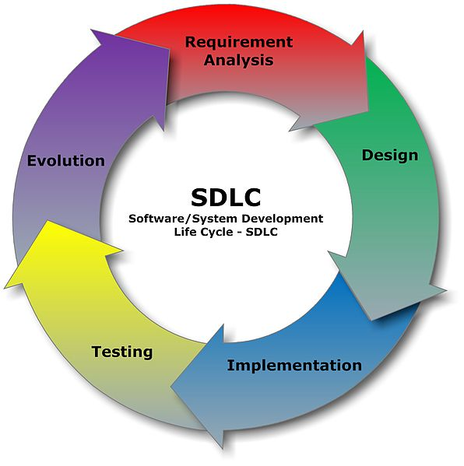
SW Development Life Cycle (SDLC)

Slide 34
Implementation / Integration
Project Scheduling
May necessary to complete in specific manner from task interdependency and strictly within the time allocated
Resource & Risk Management
Human resource, Software libraries, etc.
Changes or misinterpreting requirement
Underestimation of required time and resources
Technological changes
Project Monitoring
Milestones Checklist & Status Reports
Programming style & Software Documentation

Slide 35
Testing
Software Validation: Examining whether or not the software satisfies the user requirements
Software Verification: Ensuring the SW is developed adhering to the proper specifications and methodologies
Software Testing Process
Develop test strategy & test plan
Test design
Test execution
Test reporting & test result analysis
Defect retesting
Test documentation

Slide 36
Testing
Software Testing Methods
Black, white, or Gray Box Testing, Agile Testing
Manual vs. Automated
Testing levels
Unit testing, Integration testing, System testing
Acceptance testing including user interactions before delivery
Alpha testing before midterm presentation
Beta testing by midterm presentation

Slide 37
Deployment & Maintenance
SW delivery
User’s manual
Maintenance
SW evolution & reengineering
Senior capstone project in 2020-2021 AY

