Slide 1
Senior Capstone Project II Feb. 14, 2020
Spring 2020

Slide 2
CS / IS Day with Local Companies
Fri, Feb. 21 from 12:00-3:00pm in Alumni Center - All students attend
Career fair with seven local companies
Aptera, Do it Best, Intellectual Technology Inc., Logikos, Medical Protective, Rural Sourcing, Vocera
Lunch: 12:00 – 1:00 PM
Career Networking: 1:00 – 3:00 PM
Importance of participation as a CS family member
Sign on a sign-up sheet

Slide 3
Announcement
Final presentation @ Neff 101 from 1:00pm
Next class on Apr. 10 from 1:00pm
Guest lecture with professionals from local industry– Any topics?
Recommend to participate in the 2020 Student Research and Creative Endeavor Poster Symposium on March 27, 2020
ETCS Projects Day, Fri., May 8, 2020, noon~2pm

Slide 4
Senior Capstone Competition
The best Senior Capstone Project Competition in mid-April
Prepare a poster (42 * 36) by Weds, April, 20
A Poster template is available at BB
Students and faculty will evaluate posters displayed on the hallway till Apr. 30
Winners are announced at the final presentation and listed on a plaques

Slide 5
Midterm vs. Final Presentation
Midterm presentation
For classmates who are already familiar with projects and having CS background
Mainly focus on presenting technical aspects of the application
Final presentation
A broad range of audience
Audience will have limited understanding about the project and computing technology

Slide 6
Midterm Presentation
Fri, Mar. 20 from 1:00pm in KT246 - All students attend
Main goal
Demonstration of beta version of the system
Demonstrate system functionality promised
Uncover any requirements that might have been missed
Develop test cases and plan
Rehearsal for the final presentation
Prepare about 10mins presentation including 3 mins Q&A
Presentation order: Based on drawing
Developed system demonstration
Testing plan
Any requirements that might have been missed

Slide 7
Midterm Report
Expected requirements
Software system ready for beta testing
Midterm status report
Enhanced version CS46000 final report
Completed software test cases and plan to ensure that the software meets all user requirements
Component (SW architecture) & deployment diagram(s)
SW deployment and delivery plan, if applicable
Advisor-defined artifacts

Slide 8
Midterm Report Guideline
RUP Application Development Team
An operational system (application) code
Completed software test cases & plan
Testing based on functional requirements (use cases) and be limited to system-level testing
Properly determine the extent of testing since it may not be feasible to test everything due to time constraints
If there are any changes after CS460 final report
Final versions of UML Class Diagram(s), UML sequence diagram or similar diagram
Software architecture document(s) or UML component diagram

Slide 9
Midterm Report Guideline
RUP Application Development Team
Revised project plan that details tasks, schedule and resources
Software deployment and delivery plan into the user’s environment, if applicable
Advisor-defined artifacts

Slide 10
Midterm Report Guideline
Scrum Application Development Team
Updated Product Backlog
Continued revision of the Product Backlog and delivery of the most important items in the Backlog
Sprint Goal(s) and Sprint Backlog
For each completed sprint
Set of User Stories addressed by the sprint that has a description of the user’s goal, effort estimate, priority and conditions of satisfaction, i.e., what needs to be tested.
Sprint Backlog including day-by-day record of effort by each team member on tasks associated with each user story
Sprint Burndown Chart

Slide 11
Midterm Report Guideline
Scrum Application development team
Product Increment resulting from most recently completed Sprint
Software Architecture diagram (UML)
Revised overall project plan that details number, duration and goal(s) of remaining sprints
Note: Each user story must have at least one testing task associated with it

Slide 12
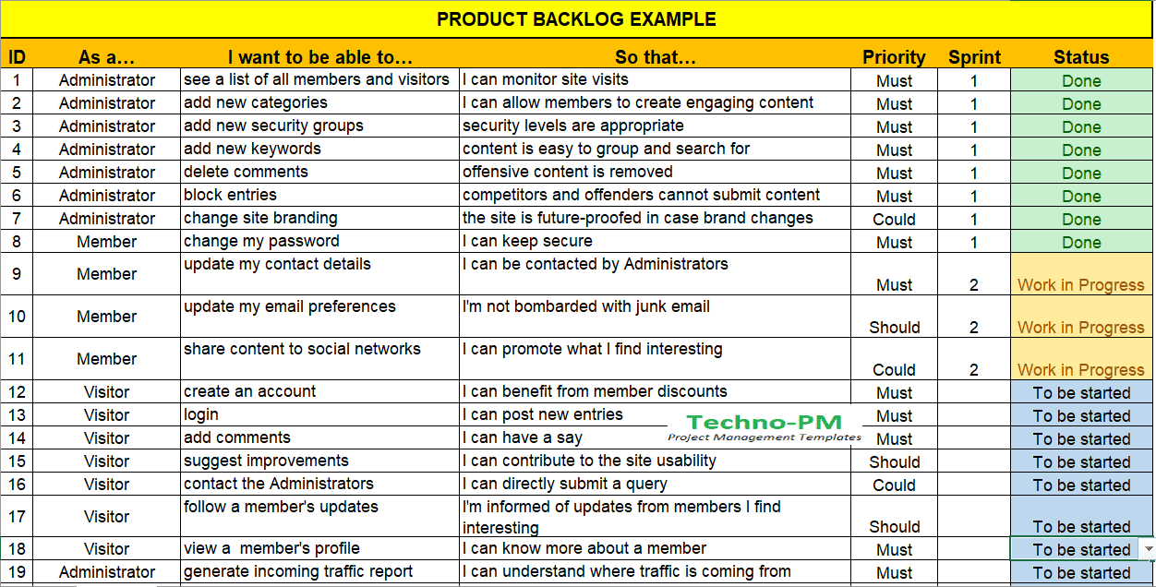
Product Backlog Examples

Slide 13
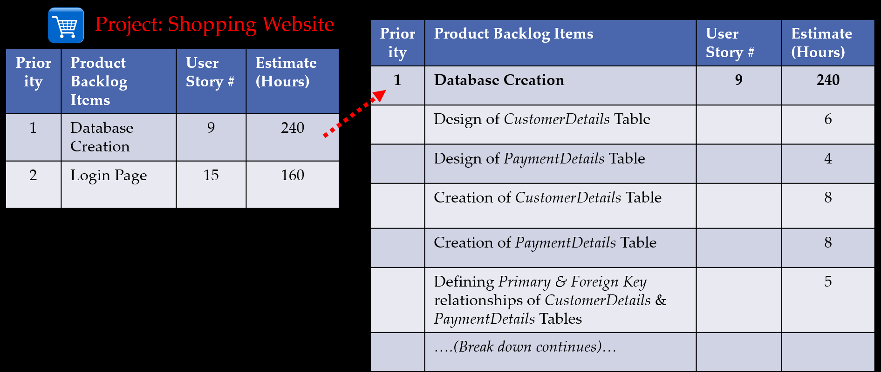
Sprint Backlog Examples

Slide 14
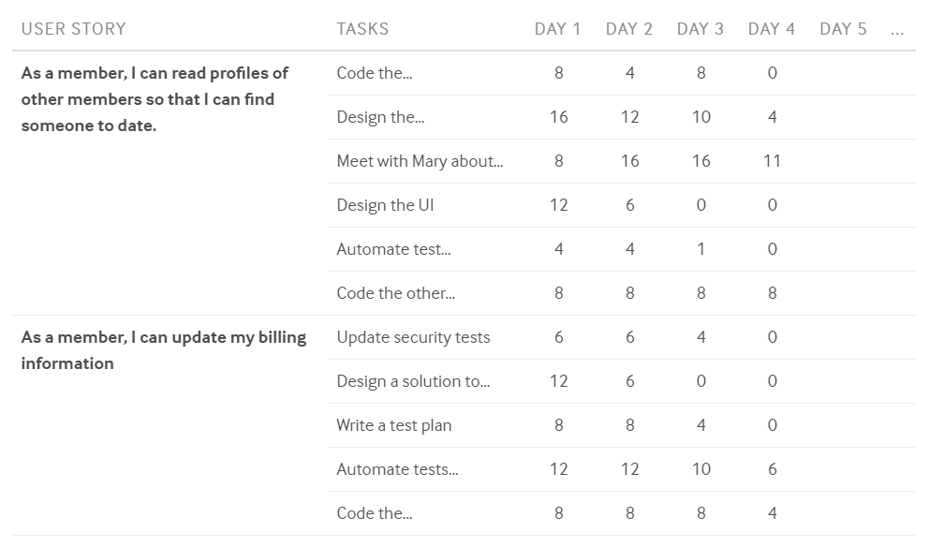
Sprint Backlog Examples

Slide 15
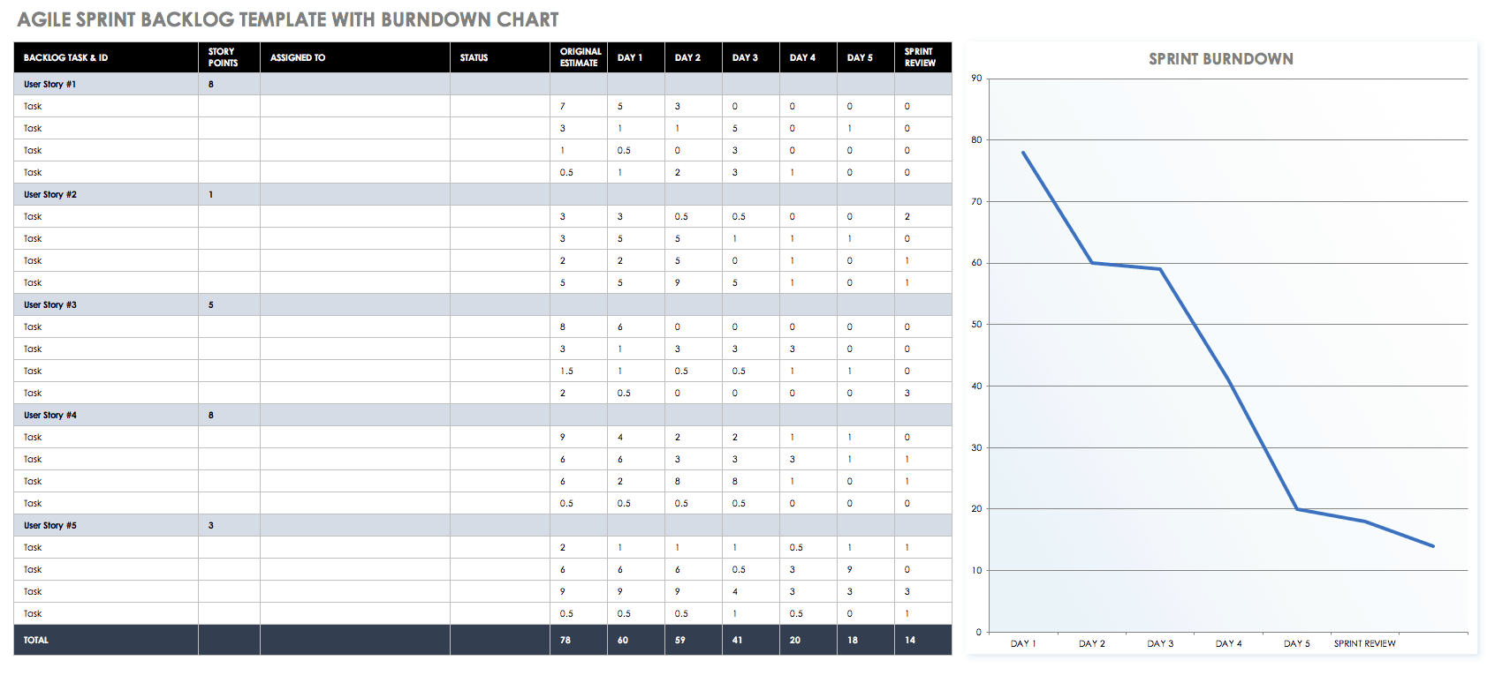
Burndown Chart Examples

Slide 16
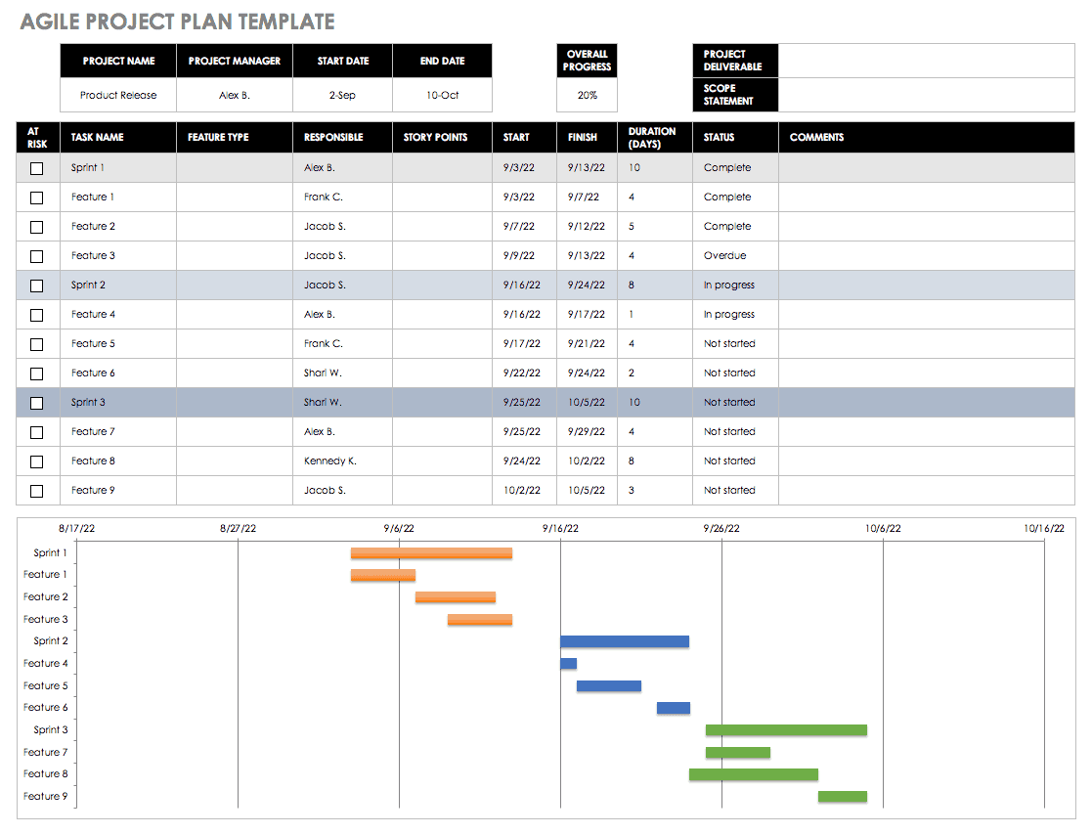
Monitoring Progress Toward a Goal (Sprint Increment)

Slide 17
Midterm Report Guideline
Research Focus Team
An operational system (application) code
Simplified test cases & plan
If there are any changes after CS460 final report
Software design document/diagram for the software construction
Resources/library used
Revised project plan that details tasks, schedule and resources
Completed introduction, background section of the final report
Experimental evaluation plan, if applicable
Advisor-defined artifacts

Slide 18
Midterm Report Guideline
Midterm report guideline for section 01 is available on Blackboard
Consult with your project advisor about using the guideline
Compress all files to a single file on a USB or CD, and submit the file to your project advisor and course director by Mar. 20, 2020

Slide 19
CS465 Final Report
Final presentation on May 1 - All students must attend and stay till the end of the presentation
Expected requirements
The software meets all user requirements, is free from defects and operates as expected in the user’s environment
Final report
All artifacts created in senior capstone sequence courses
Testing results, analysis, and report
Component diagram, Deployment diagram
User manual
Developed software product
Advisor-defined artifacts
Final project presentation

Slide 20
To Do List
Record project related activities
Amount of time per phase/workflow, by the team and per member
Expected hours : Min 8 hrs/week * 15 weeks = about 120 hours per student
Should utilize a version control system (Git, Subversion, Mercurial) to maintain code and a repository for project artifacts

Slide 21
Team Leader Meeting
Drawing presentation order
Progress update

