Slide 1
Project diagram and research question
Wyatt Ward, Andrew Nyffeler, Mitchell Lehman

Slide 2
What is our structure for our model?
Insert diagram here

Slide 3
Definitions of components in model
Resistance - Property of edges that indicate energy lost between two nodes
Voltage - Constant that represents the potential energy of the graph that is being observed
Capacity - Total load that a transformer can handle
Nodes- Points in the grid that are connected by edges
Edges- Connections between nodes
Graph- A collection of nodes and the edges that connect them

Slide 4
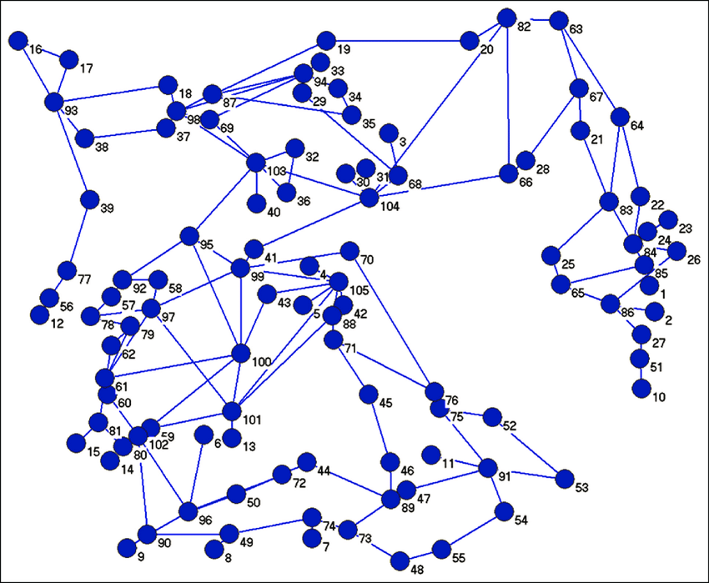
What is our research question?
Given a system using the previous model, what is the most efficient way to disable the most nodes in said model?

Slide 5
Image sources
https://www.researchgate.net/figure/Full-graph-representation-of-Irans-power-grid_fig1_270634108

