Slide 1
San Joaquin basin water quality data inventory
Wyatt Arnold
September 21, 2026

Slide 2
Temperature, salinity, (and flow) records
Purpose: support calibration of ATS/EcoSIM
Station metadata harvested from eight public APIs:
  USGS, Water Quality Portal, CDEC, eSMR, CEDEN, DWR Water Data Library, Reclamation RISE, EDI
Metadata only, no time series
SJR-WQ station inventory, harvest 2026-08-19 to 2026-08-20
2 / 20
Notes:
• Purpose: an inventory of where water quality and streamflow observations exist in the San Joaquin basin, to support calibration of (ATS/EcoSIM).
• Content: station metadata and per-parameter period of record: coordinates, record type, sampling frequency, sample counts, units. No time series were downloaded.
• Target parameters: 31 canonical parameters in four groups (core, major ions, extended water quality, water balance). Each source's own codes and names map to them in config/parameters.yml.
• Key state variables: water temperature and specific conductance. Discharge to convert concentration to a load.

Slide 3
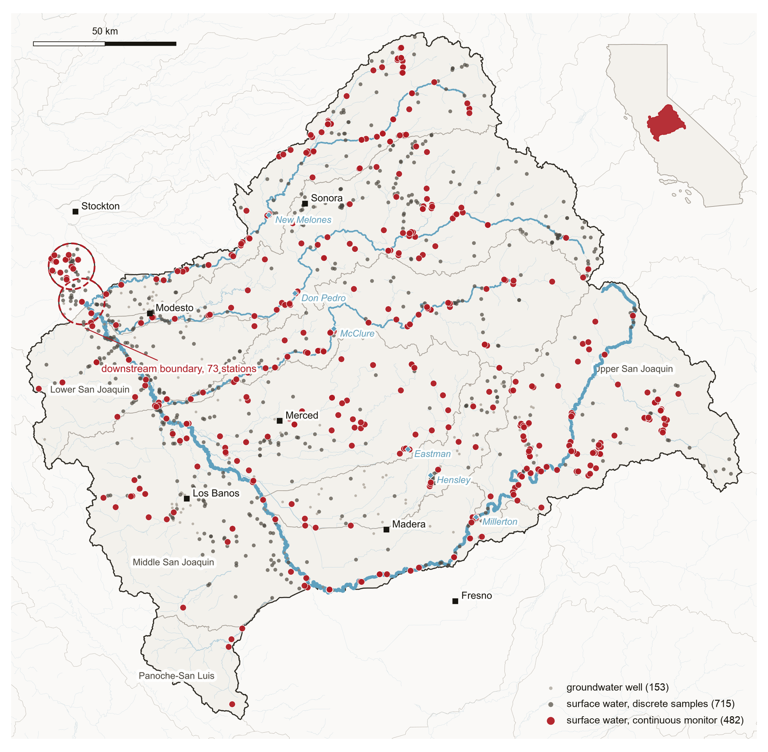
Study area
Eight HUC8 subbasins covering 29,800 km² from Sierra crest to Vernalis
1,350 stations: 482 continuous, 715 discrete, 153 wells.
The downstream boundary is Vernalis and Mossdale, each with an 8 km buffer.
Calaveras is out of scope: it joins the river below Mossdale.
SJR-WQ station inventory, harvest 2026-08-19 to 2026-08-20
3 / 20
Notes:
• Eight HUC8 subbasins of HUC 1804, about 29,800 km2, from the Sierra crest to Vernalis.
• 18040001 Middle San Joaquin-Lower Chowchilla
• 18040002 Lower San Joaquin River
• 18040006 Upper San Joaquin
• 18040007 Fresno River
• 18040008 Upper Merced
• 18040009 Upper Tuolumne
• 18040010 Upper Stanislaus
• 18040014 Panoche-San Luis Reservoir
• Excluded: 18040003 San Joaquin Delta; 18040012 Upper Mokelumne; 18040013 Upper Cosumnes; 18040051 Rock Creek-French Camp Slough; 18040011 Upper Calaveras. The Calaveras joins the San Joaquin at Stockton, below Mossdale.
• Downstream boundary: Vernalis (D-1641 compliance point) and Mossdale (head of Old River split). An 8 km buffer around each is added back to the study area and its stations are flagged boundary = true; 73 stations sit inside.
• Legend: 153 groundwater wells, 715 surface water stations with discrete samples, 482 with a continuous monitor. Among surface stations the class is the finest record type across the station's parameters.
• Coordinates stored in EPSG:4326; distances and areas computed in EPSG:3310 (California Albers).
1,350 primary stations, each measuring at least one target parameter: 1,277 across 8 subbasins and 73 in the downstream boundary buffers, in HUC 18040003. A station takes the first of the three classes it fits: a well draws as a well whatever parameter the well records, so the 27 wells with a continuous record sit in the groundwater class rather than the continuous one. Among the surface stations the class is the finest record type across the station's parameters, so a gage logging discharge every 15 minutes and sampling chloride by hand draws as continuous. Marker size is fixed on this figure, one size per class. Pale hydrography lies outside the study area.

Slide 4
Eight APIs return 1,834 records in the study area; deduplication leaves 1,350 stations
Water Quality Portal = 544 stations
CEDEN = 478 stations
USGS = 307 stations
CDEC = 235 stations
DWR Water Data Library = 67 stations
eSMR = 51 stations
EDI = 15 stations
Reclamation RISE = 8 stations
283 stations appear in more than one source
SJR-WQ station inventory, harvest 2026-08-19 to 2026-08-20
4 / 20
Notes:
Eight APIs, overlapping by design: the Water Quality Portal republishes CEDEN, SWAMP, the irrigated lands coalitions, and USGS discrete samples. Records and stations count source records that report a target parameter inside the study area. Unique: stations no other source reports. Shared: stations another source also reports.
source | endpoint | description| records | stations | unique | shared
Water Quality Portal | waterqualitydata.us/wqx3 | discrete samples from every contributing program, with sample dates | 606 | 544 | 322 | 222
CEDEN | data.ca.gov/api/3/action | state chemistry, water column, one table per year | 509 | 478 | 303 | 175
USGS | api.waterdata.usgs.gov/ogcapi/v0 | continuous and daily sensor records with a stated period of record | 313 | 307 | 210 | 97
CDEC | cdec.water.ca.gov/dynamicapp | the continuous valley network and a dated operator log | 244 | 235 | 142 | 93
DWR Water Data Library | data.cnra.ca.gov/api/3/action | continuous sondes with a published datum and positional accuracy | 75 | 67 | 27 | 40
eSMR | data.ca.gov/api/3/action | NPDES self-monitoring: permitted outfalls and receiving water points | 57 | 51 | 51 | 0
EDI | cn.dataone.org/cn/v2 | Interagency Ecological Program archive; metadata only, no data files | 22 | 15 | 6 | 9
Reclamation RISE | data.usbr.gov/rise/api | reservoir releases and canals as Reclamation reports them | 8 | 8 | 6 | 2
• Clip: stations inside the eight subbasins or inside one of the two anchor buffers.
• Deduplicate across sources. Candidates lie within 600 m. Two records join when they sit within 150 m and their names score 82 or more, within 30 m and score 60 or more, within 600 m and score 92 or more, or when one publishes the other's identifier (rapidfuzz token_set_ratio). Names holding opposing terms, such as above and below, stay apart. 1,834 records collapse to 1,350 stations; 283 appear in more than one source; station_uid links them.
• Channel class from the station name: natural, receiving_water, conveyance, drain, effluent, reservoir, groundwater. Off channel: conveyance, drain, groundwater, effluent. These stay in the inventory as boundary terms.
• Mainstem kilometer: a station within 500 m of the centerline takes its distance upstream from Vernalis.
• record_type is continuous or discrete, from what the source states about the instrument. frequency is sub-daily, daily, weekly, monthly, quarterly, annual, irregular, or unknown, from a stated interval or from the sample count over the period of record.
• Units: no values are converted. Each station-parameter row records the factor and offset to the canonical unit, or a reason for having none. 107 of 8,122 rows do not convert.
• Shortlist rule: 3 years or more of water temperature or specific conductance since 2000, either parameter. Record type, discharge, channel class, currency, and the overlap of the two records are columns on catalog_filtered.csv, not filters.

Slide 5
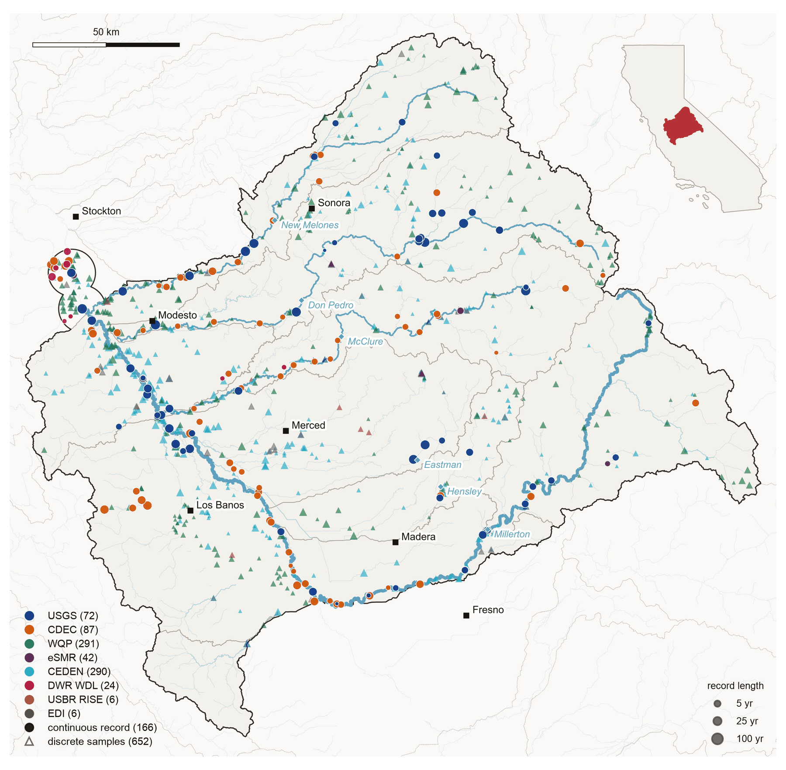
Figure 2. Water temperature monitoring
818 stations report water temperature, 166 from a continuous monitor
652 stations have discrete samples only.
Marker area scales with record length.
SJR-WQ station inventory, harvest 2026-08-19 to 2026-08-20
5 / 20
Notes:
• 818 stations report water temperature at some point in their record: 166 from a continuous monitor, 652 from discrete samples.
• Marker shape and marker area come from this parameter's own record, not the station's.
• Marker area scales with the square root of record length.
• The legend counts stations, not records.
818 primary stations measure water temperature at some point in their record: 166 with a continuous monitor and 652 by discrete samples. Both the marker shape and the marker area come from this parameter's own record rather than the station's, so a gage that logs discharge and samples its conductance by hand draws large and solid on the discharge map and small and pale on the conductance map. Marker area scales with the square root of record length, and the counts in the legend are stations rather than records.

Slide 6
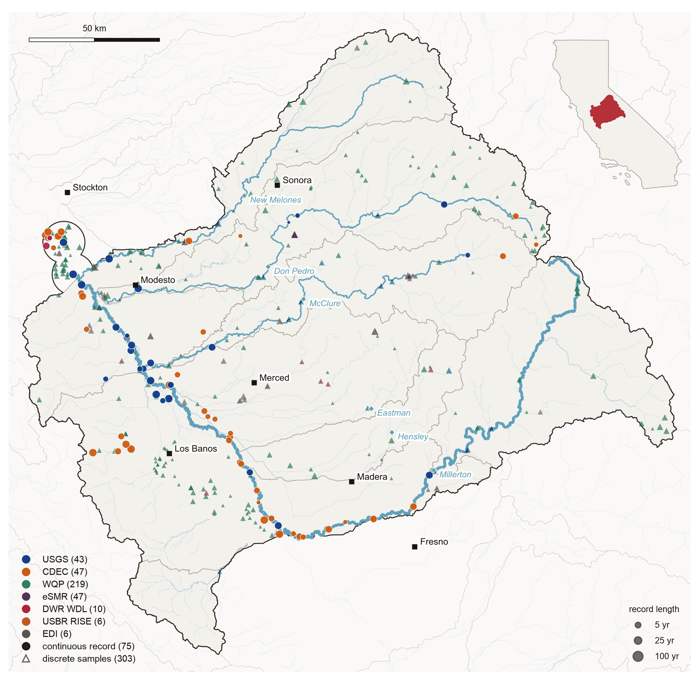
Figure 3. Specific conductance / EC monitoring
378 stations report specific conductance, 75 from a continuous monitor
303 stations have discrete samples only.
Conductance has fewer than half the stations that temperature has.
SJR-WQ station inventory, harvest 2026-08-19 to 2026-08-20
6 / 20
Notes:
• 378 stations report specific conductance at some point in their record: 75 from a continuous monitor, 303 from discrete samples.
• Marker shape and marker area come from this parameter's own record.
• Marker area scales with the square root of record length.
378 primary stations measure specific conductance at some point in their record: 75 with a continuous monitor and 303 by discrete samples. Both the marker shape and the marker area come from this parameter's own record rather than the station's, so a gage that logs discharge and samples its conductance by hand draws large and solid on the discharge map and small and pale on the conductance map. Marker area scales with the square root of record length, and the counts in the legend are stations rather than records.

Slide 7
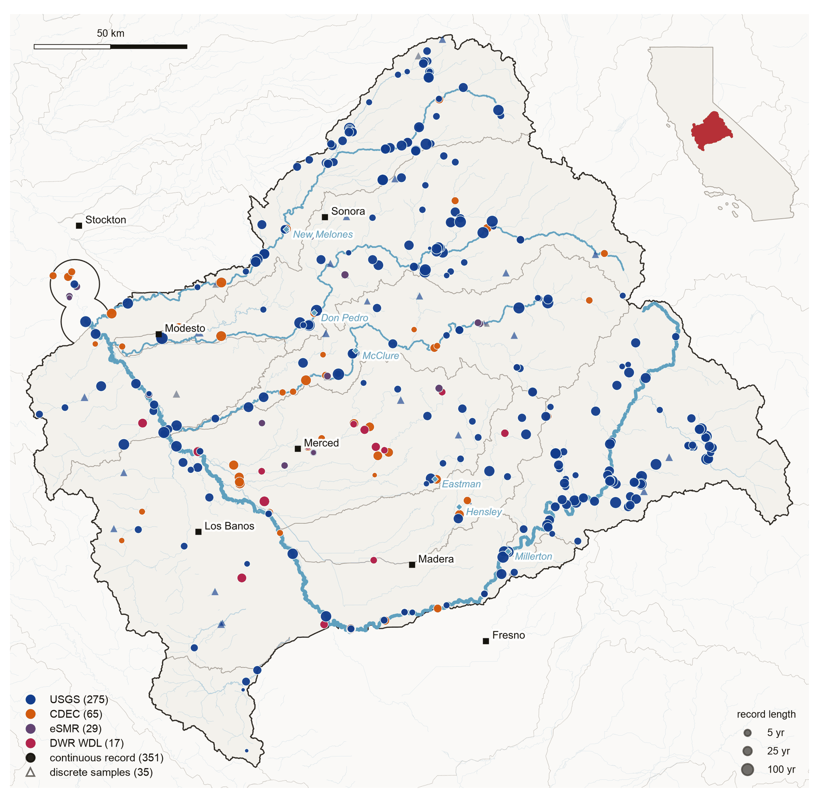
Figure 4. Streamflow monitoring
386 of stations report discharge, 351 from a continuous monitor
35 stations have discrete measurements only.
Continuous discharge stations outnumber continuous temperature (166) and conductance (75).
SJR-WQ station inventory, harvest 2026-08-19 to 2026-08-20
7 / 20
Notes:
• 386 stations report discharge at some point in their record: 351 from a continuous monitor, 35 from discrete samples.
• Marker shape and marker area come from this parameter's own record.
• Marker area scales with the square root of record length.
386 primary stations measure discharge at some point in their record: 351 with a continuous monitor and 35 by discrete samples. Both the marker shape and the marker area come from this parameter's own record rather than the station's, so a gage that logs discharge and samples its conductance by hand draws large and solid on the discharge map and small and pale on the conductance map. Marker area scales with the square root of record length, and the counts in the legend are stations rather than records.

Slide 8
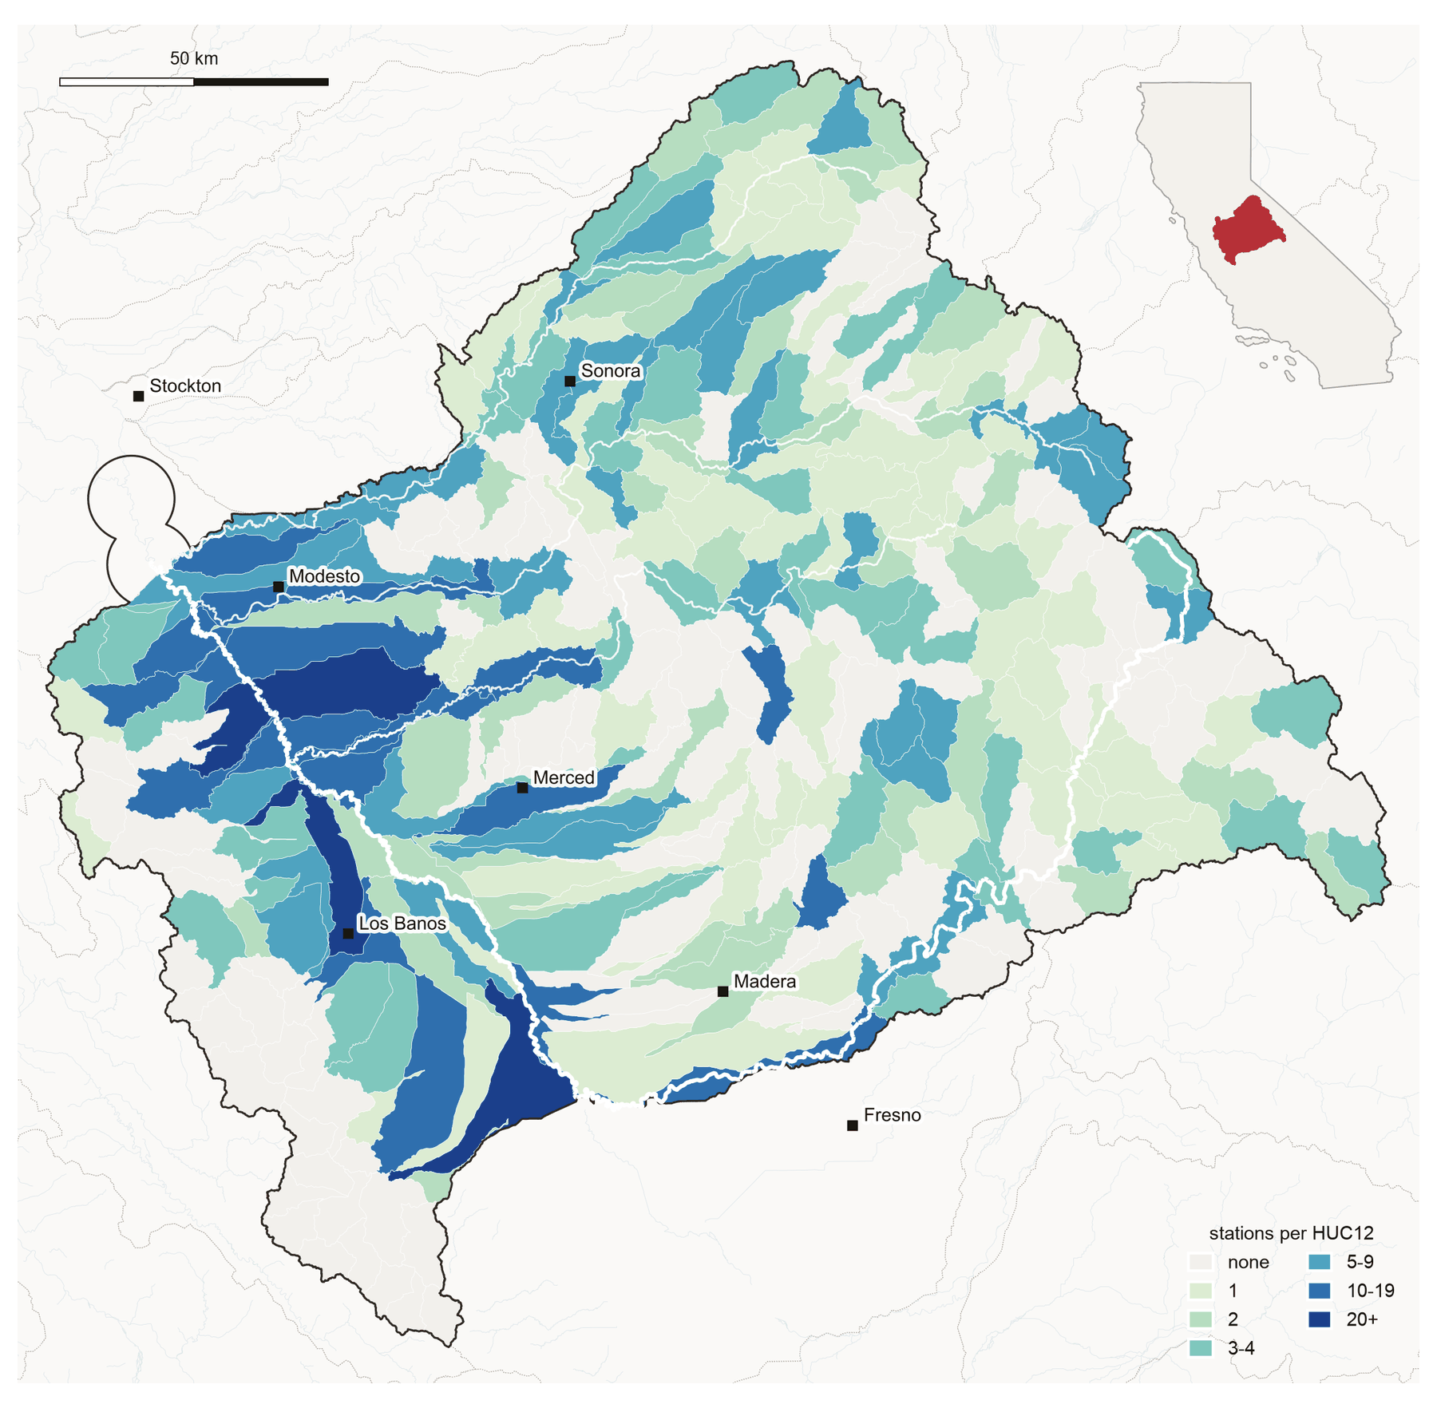
Figure 5. HUC12 station density
195 of 303 HUC-12 watersheds have a temperature or conductance record
786 stations report one or both parameters.
108 subwatersheds have 0 stations reporting either.
SJR-WQ station inventory, harvest 2026-08-19 to 2026-08-20
8 / 20
Notes:
• 786 stations report water temperature or specific conductance, in 195 of 303 HUC12 subwatersheds.
• A shaded subwatershed holds at least one temperature or conductance record at some sampling frequency.
• The two unfilled circles at the downstream end are the 8 km anchor buffers around Vernalis and Mossdale. 72 further stations sit inside them, in HUC 18040003, which the HUC12 layer does not cover.
786 stations measuring water temperature or specific conductance, in 195 of 303 subwatersheds. The count is stations measuring either parameter, so a shaded subwatershed has at least one temperature or conductance record at some sampling frequency. The two unfilled circles at the downstream end are the 8 km anchor buffers around Vernalis and Mossdale: the study area includes the buffers and the HUC12 layer stops short of them. A further 72 stations sit inside the buffers, in HUC 18040003.

Slide 9
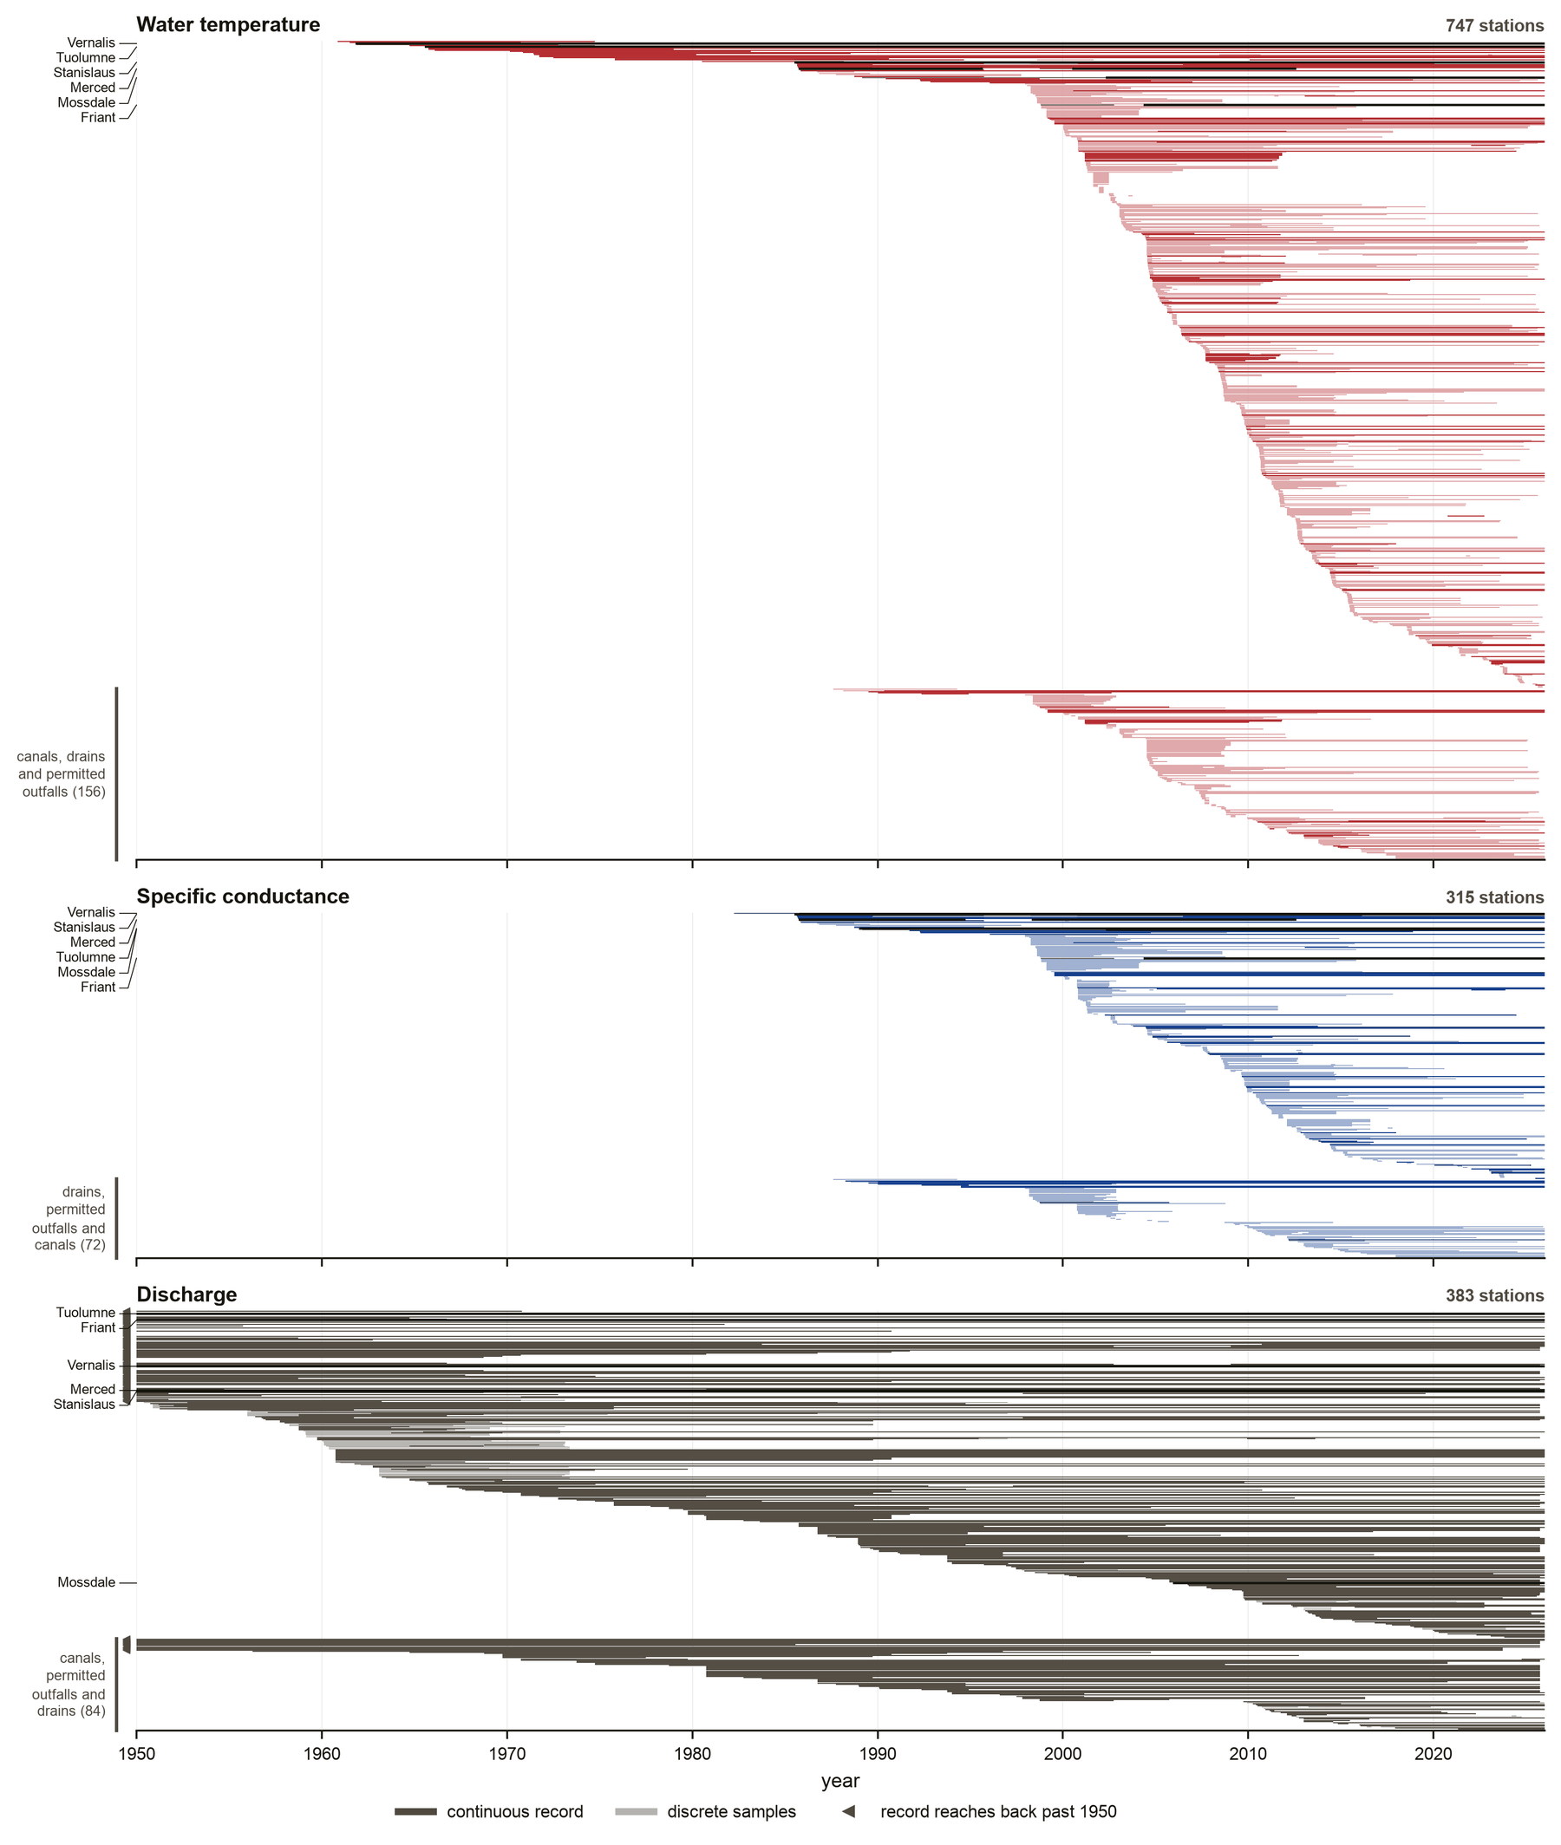
Figure 6. Period of record, one row per station
1,445 station records across three parameters, one row per station
USGS and CDEC publish one start and one end, so an outage inside the period is invisible.
Most specific conductance and water temperature started post-1990
SJR-WQ station inventory, harvest 2026-08-19 to 2026-08-20
9 / 20
Notes:
• 1,445 station records across three parameters, one row per station, sorted by first year within a block.
• Six gages are named in the margin and drawn heavier: Vernalis and Mossdale near the downstream boundary, Friant at the upstream one, and one gage each on the Stanislaus, Tuolumne, and Merced.
• The solid bars reaching into a year on a panel are the count figure 11 plots for that year.
1,445 station records across three parameters, one row per station, sorted by first year within a block. A break is a period longer than 180 days that no source reports covering. Read the two kinds of gap differently: a gap in a WQP, CEDEN or eSMR record comes from the samples themselves, while USGS and CDEC publish a declared start and end, so an outage inside a USGS or CDEC period stays invisible. Rows come from station-scope records, so the EDI package periods that cover a station list rather than a named station stay out, and so do the groundwater wells. A bar is solid across the years a continuous record covers and pale across the years only discrete samples cover, so the number of solid bars reaching into a year on a panel is the count figure 11 plots for that year. Six gages have a name in the left margin and a black line, heavy where the bar is solid and thin where the bar is pale: Vernalis and Mossdale near the downstream boundary, Friant at the upstream one, and one gage each on the Stanislaus, Tuolumne, and Merced.

Slide 10
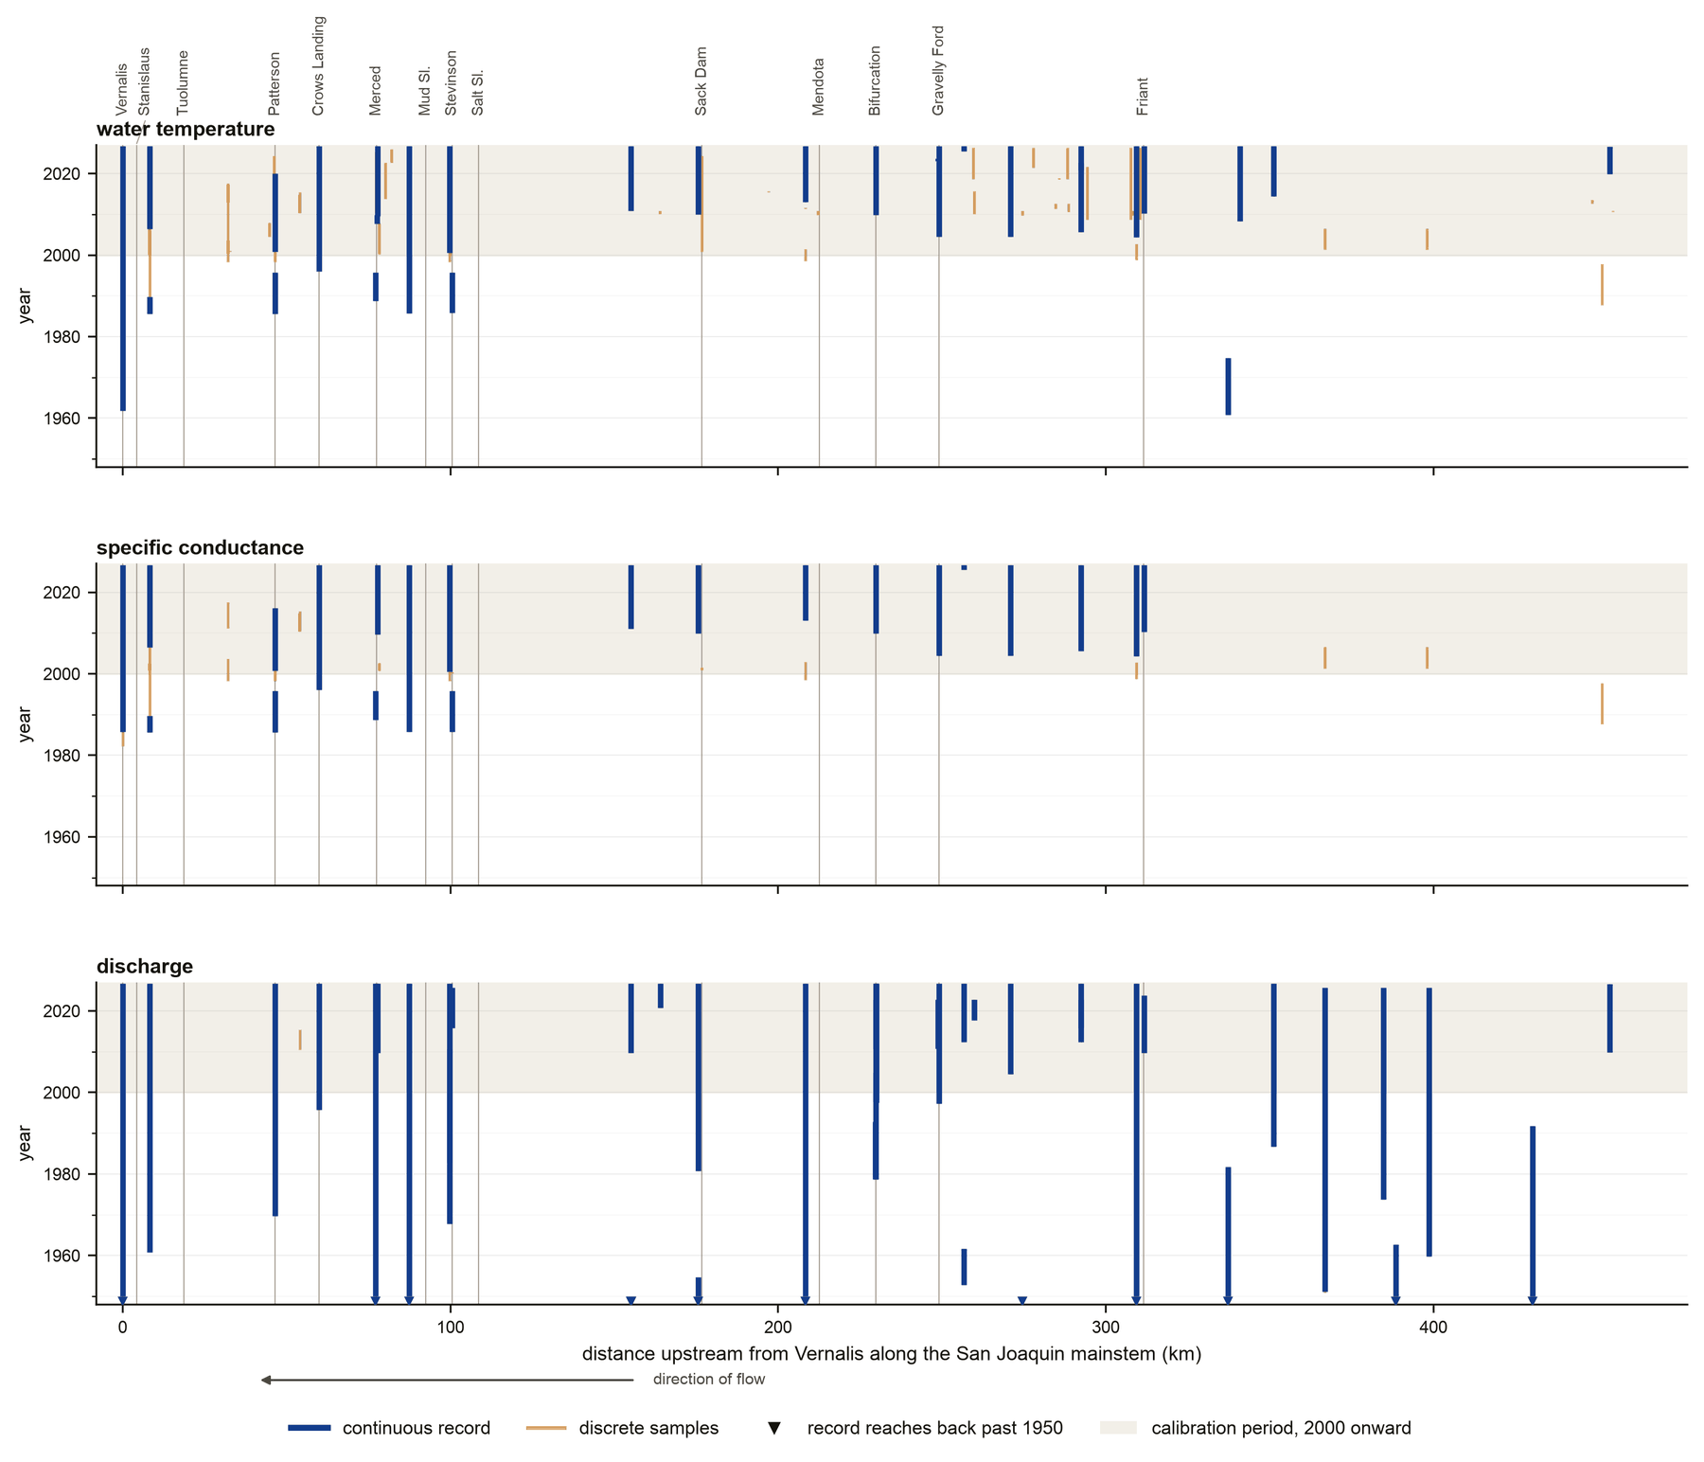
Figure 7. Mainstem coverage in space and time
86 river stations along 475 km of SJ River mainstem, by distance from Vernalis
Each blue line is one station over its period of record.
There are 72 more stations within 500 m of the river.
SJR-WQ station inventory, harvest 2026-08-19 to 2026-08-20
10 / 20
Notes:
• Each line is one station over its period of record, against its distance upstream from Vernalis.
• Stations on a natural channel or a permitted receiving water only. Of the 158 within 500 m of the centerline, 72 are left out: 28 groundwater, 16 reservoir, 16 conveyance, 5 drain, 5 unknown, 2 effluent.
• A vertical band with no lines is a reach with no record of that parameter in those years.
Each vertical line is one station, drawn over its period of record against its distance upstream from Vernalis. A line is heavy and blue across the years a continuous record covers and thin and orange across the years only discrete samples cover, and a break is a period longer than 180 days that no source reports covering. Stations on a natural channel or a permitted receiving water only: of the 158 within 500 m of the centerline, 72 belong to other classes and have no line here (28 groundwater, 16 reservoir, 16 conveyance, 5 drain, 5 unknown, 2 effluent). The three panels share one year axis, so a blank stretch on one of them is an absence rather than a change of scale. A vertical band with no lines is a reach of the mainstem with no record of that parameter in those years.

Slide 11
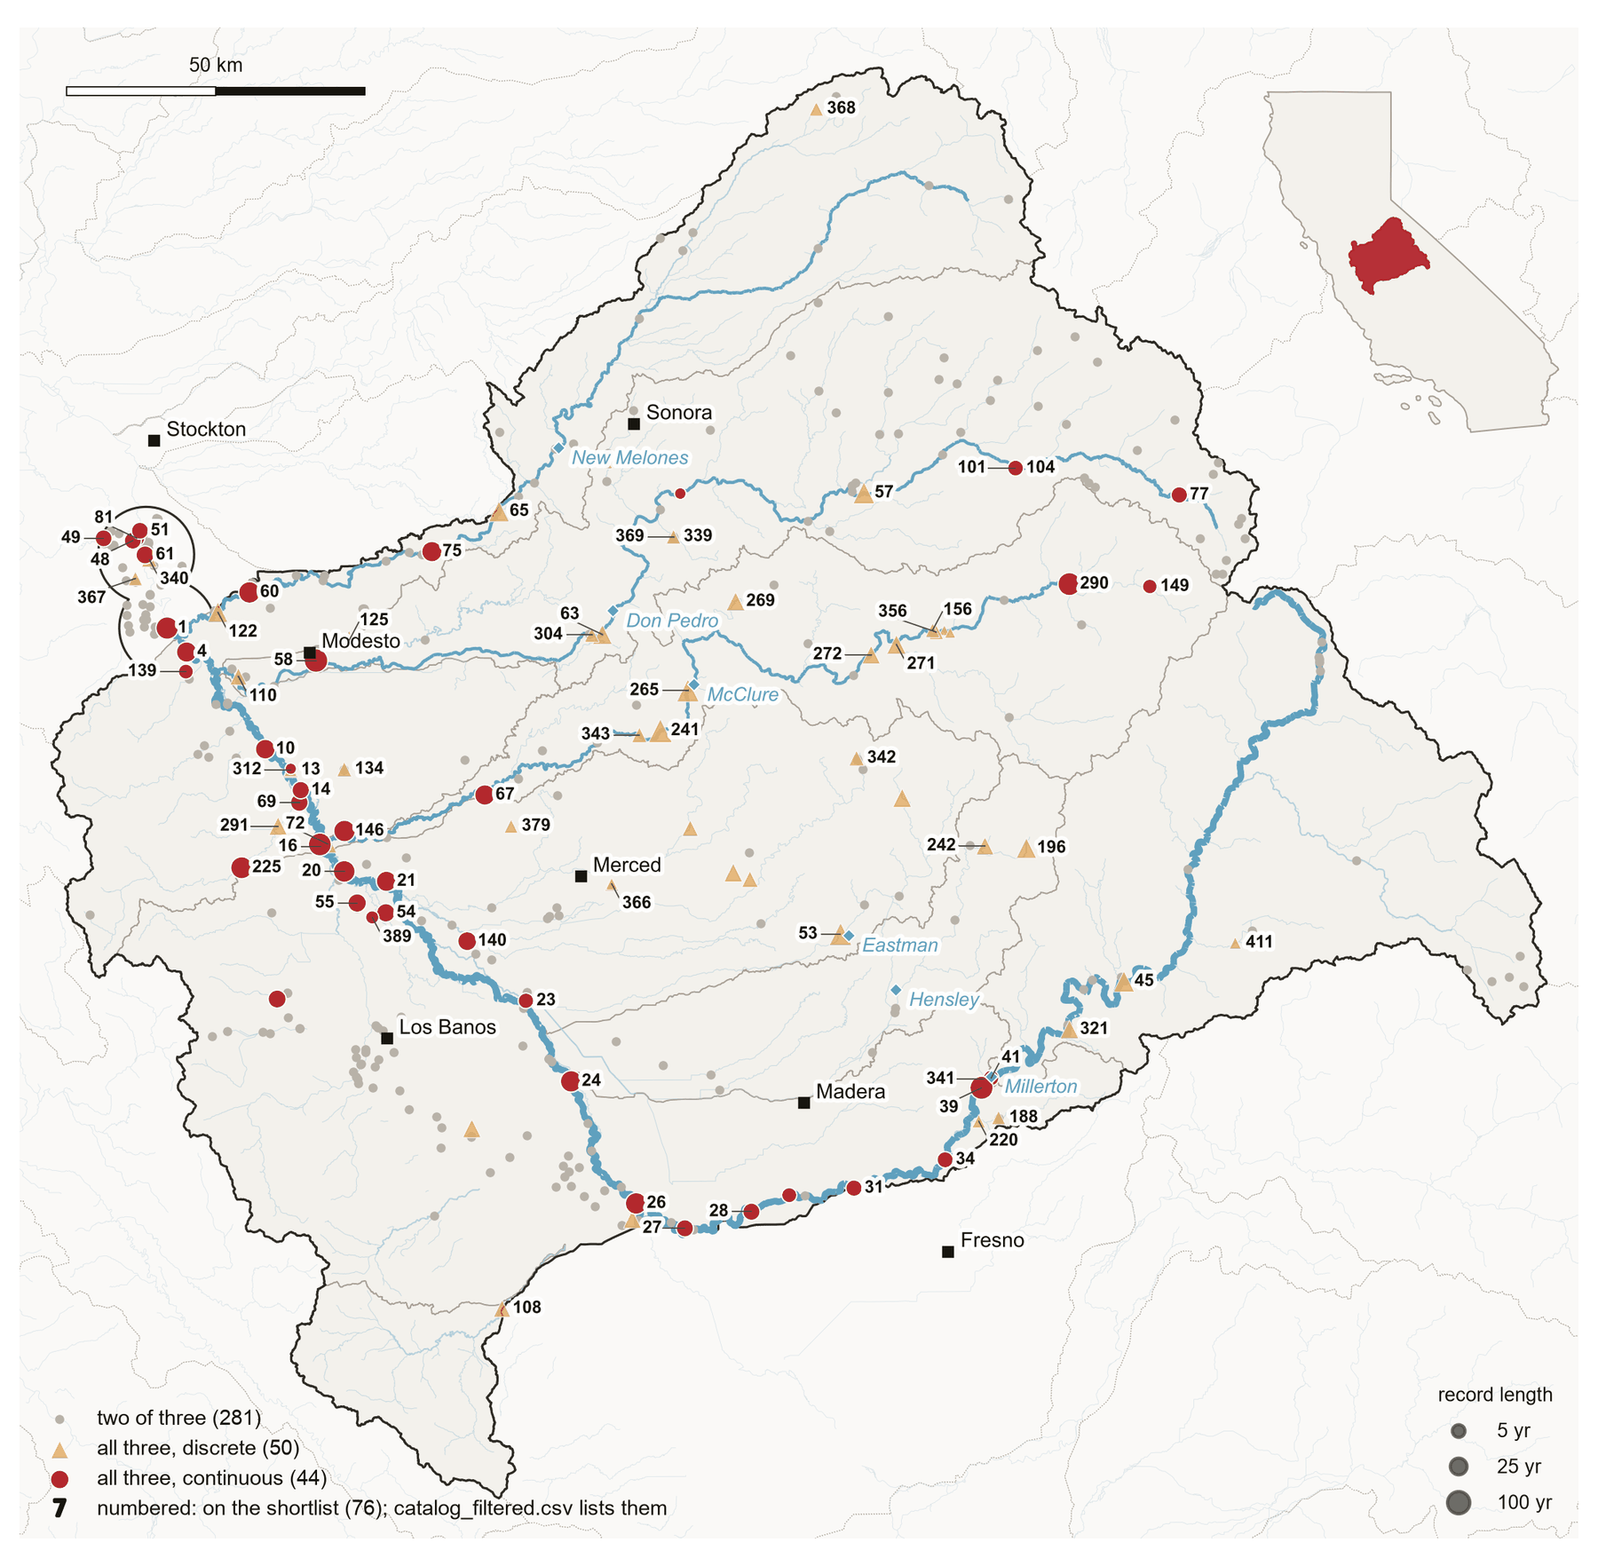
Figure 8. Co-located stations
94 stations measure temperature, conductance, and discharge at one site
44 measure all three with a continuous monitor.
76 are on the shortlist, numbered by rank in catalog_filtered.csv.
Numbers run downstream to upstream along the mainstem.
SJR-WQ station inventory, harvest 2026-08-19 to 2026-08-20
11 / 20
Notes:
• 94 stations measure water temperature, specific conductance, and discharge at one site. 44 of them measure all three with a continuous monitor.
• 76 of the 94 are on the shortlist and are numbered by the rank column of catalog_filtered.csv.
• Numbering runs downstream to upstream along the mainstem, then off mainstem, then off-channel (canals, drains, wells, outfalls), so the sequence on the map is not contiguous.
• The remaining 336 shortlist stations lack at least one of the three: 20 of them gage discharge and 316 don't.
Water temperature, specific conductance, and discharge measured at one site: 94 stations, 44 of them measuring all three with a continuous monitor. 76 of the 94 are on the shortlist and are numbered here, and `data/processed/catalog_filtered.csv` lists those 76 under the same number in its `rank` column. The remaining 336 shortlist stations lack at least one of the three: 20 of those 336 gage discharge and 316 don't. The 151 that measure two of the three draw as unnumbered gray dots, and the other 185 measure one and appear on figure 10 and not on this map. Numbering runs downstream to upstream along the mainstem, then off-mainstem, then the canals, drains, wells, and outfalls, so the sequence on the map isn't contiguous. A leader line marks a label moved clear of a neighbor.

Slide 12
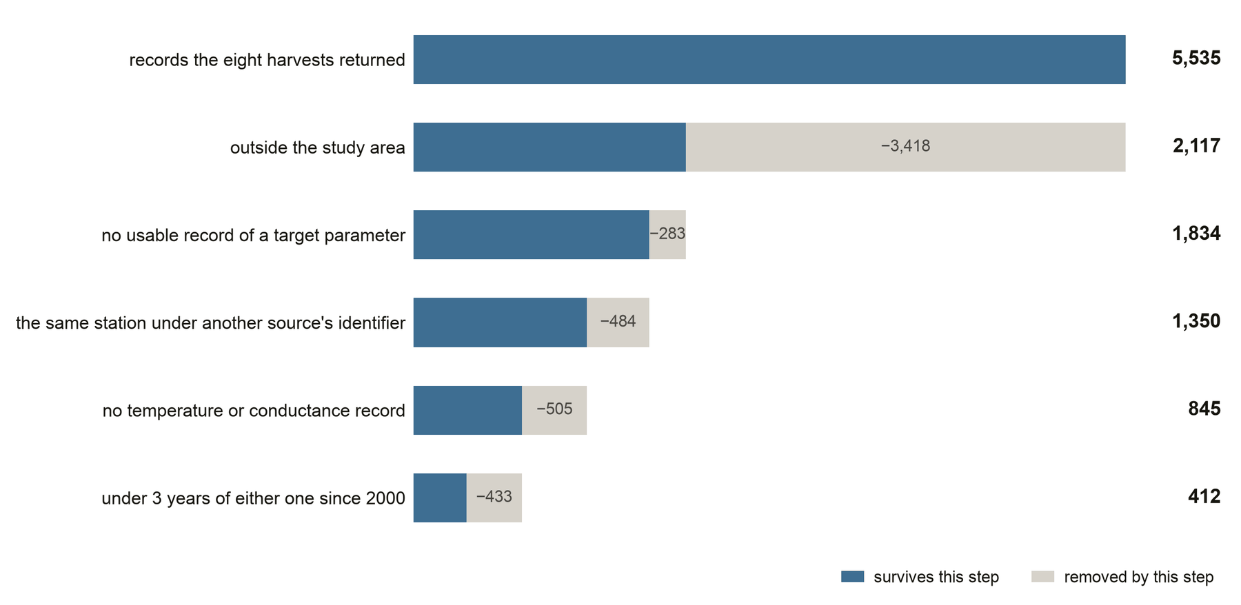
Figure 9. Station prioritization waterfall
412 shortlisted stations
1,350 distinct stations, 845 with temperature or conductance, 412 with 3 years or more complete data since 2000.
SJR-WQ station inventory, harvest 2026-08-19 to 2026-08-20
12 / 20
Notes:
• records the eight harvests returned: 5,535 remain
• outside the study area: 2,117 remain, 3,418 removed
• no usable record of a target parameter: 1,834 remain, 283 removed
• the same station under another source's identifier: 1,350 remain, 484 removed
• no temperature or conductance record: 845 remain, 505 removed
• under 3 years of either one since 2000: 412 remain, 433 removed
• Of the 412 that remain: 207 measure both parameters, 65 measure both with a continuous monitor, 96 gage discharge.
• The chain tests existence and length: whether a station measures a state variable, and whether it measures one for 3 years or more since 2000. The last step reads the longer of the two records, not their overlap.
• Record type, discharge, channel class, currency, and overlap are columns on catalog_filtered.csv rather than steps. A station removed here stays in the inventory.
Each bar is the bar above it, split into what survived the step named on the left and what the step removed, so a reader can subtract two bars and get the gray between them. 412 stations remain: 207 measure both parameters, 65 measure both with a continuous monitor, and 96 of the 412 gage discharge. The chain tests two things, existence and length: whether a station measures a state variable of the model, and whether it measures one for at least 3 years between 2000 and today. The last step tests the longer of the temperature and conductance records rather than their overlap, because a modeler can calibrate the temperature field against a thermograph alone, with no conductance record. Record type, discharge, channel class, currency, and the overlap between the two records are columns on `catalog_filtered.csv` rather than steps here. A monthly conductance sample still constrains a seasonal signal and, against a gaged flow, a salt load. A canal or a well is a boundary term a salt balance needs. A record that ended in 2014 covers fourteen years of the period. A station removed here stays in the inventory. Figure 10 maps what's left.

Slide 13
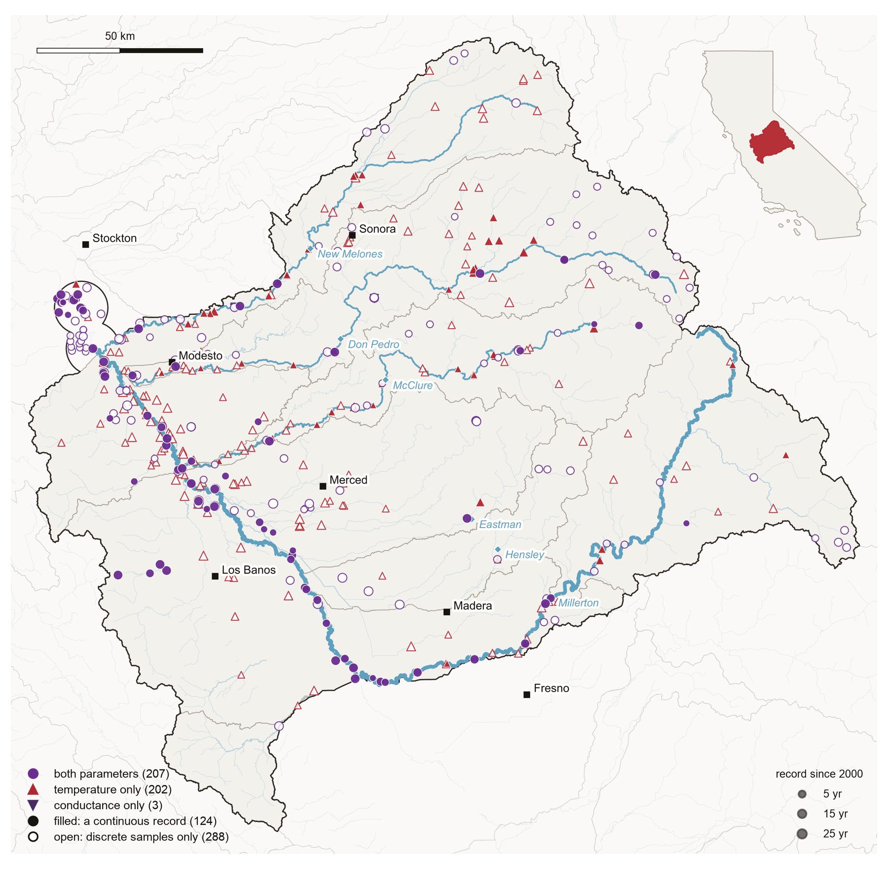
Figure 10. Station shortlist
Station shortlist: 412 stations with 3 years or more of temperature or conductance since 2000
207 measure both, 202 temperature only, 3 conductance only.
124 have a continuous monitor on one of the two.
105 are off the modeled channel
96 also gage discharge.
SJR-WQ station inventory, harvest 2026-08-19 to 2026-08-20
13 / 20
Notes:
• The 412 stations from the last bar of figure 9, named and ranked in catalog_filtered.csv.
• 207 measure both parameters, 202 temperature only, 3 conductance only.
• Marker area is the longer of the two records clipped to 2000 onward. A marker at the smallest size holds close to 3 years.
• A filled marker means one of the two records comes from a continuous monitor: 124 of the 412.
• 105 sit off the modeled channel (canals, drains, outfalls, wells) and 96 also gage discharge.
The 412 stations in figure 9's last bar, listed in `data/processed/catalog_filtered.csv` and ranked there in the order figure 8 numbers them. A station reaches this map on one parameter or on two: 179 hold 3 years or more of both since 2000, and 233 of only one. Marker shape follows the parameters a station has measured in any year: 207 measured both, 202 temperature alone, and 3 conductance alone. Marker area is the longer of the two records clipped to 2000 onward, which is the quantity the rule tests, so a marker at the smallest size stands for a record of close to 3 years. A filled marker means one of the two records comes from a continuous monitor, which is true at 124 of the 412 stations. Record type, discharge, channel class, and currency stay columns on the CSV rather than filters, so 105 stations here sit off the modeled channel, and 96 of the 412 gage discharge.

Slide 14
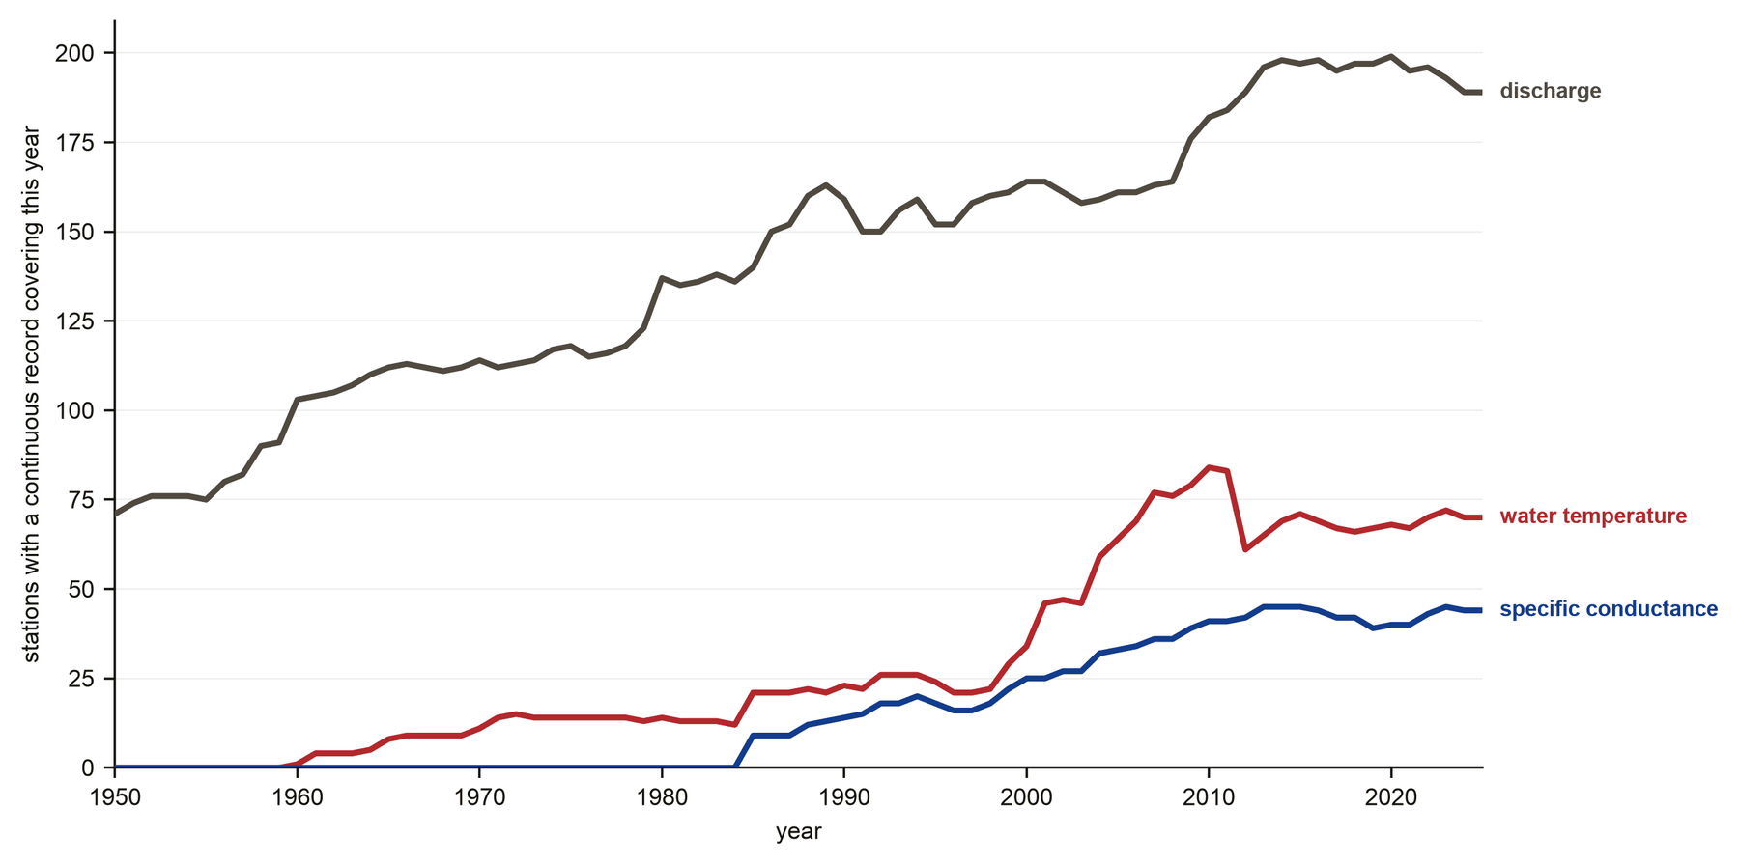
Figure 11. Continuous records in each year
In 2025, 189 stations have a continuous discharge record, 70 temperature, and 44 conductance
SJR-WQ station inventory, harvest 2026-08-19 to 2026-08-20
14 / 20
Notes:
• Stations holding a continuous record covering each year from 1950 to 2025, by parameter.
• A station counts in every year its period of record spans, so the line is the standing network in that year.
• Discrete samples, groundwater wells, and dataset-scope records are out.
• The solid bars reaching into a year on a figure 6 panel are the point this curve plots for that year.
How many stations held a continuous record covering each year from 1950 to 2025, by parameter. A station counts in every year its period of record spans, so the line is the standing network rather than the stations that started that year. Discrete samples are out: a temperature calibration uses a continuous record, and counting monthly samples would flatten the shape. Groundwater wells and dataset-scope records are out too, on the same rule figure 6 uses, so the number of solid bars reaching into a year on a figure 6 panel is the value this curve plots for that year.

Slide 15
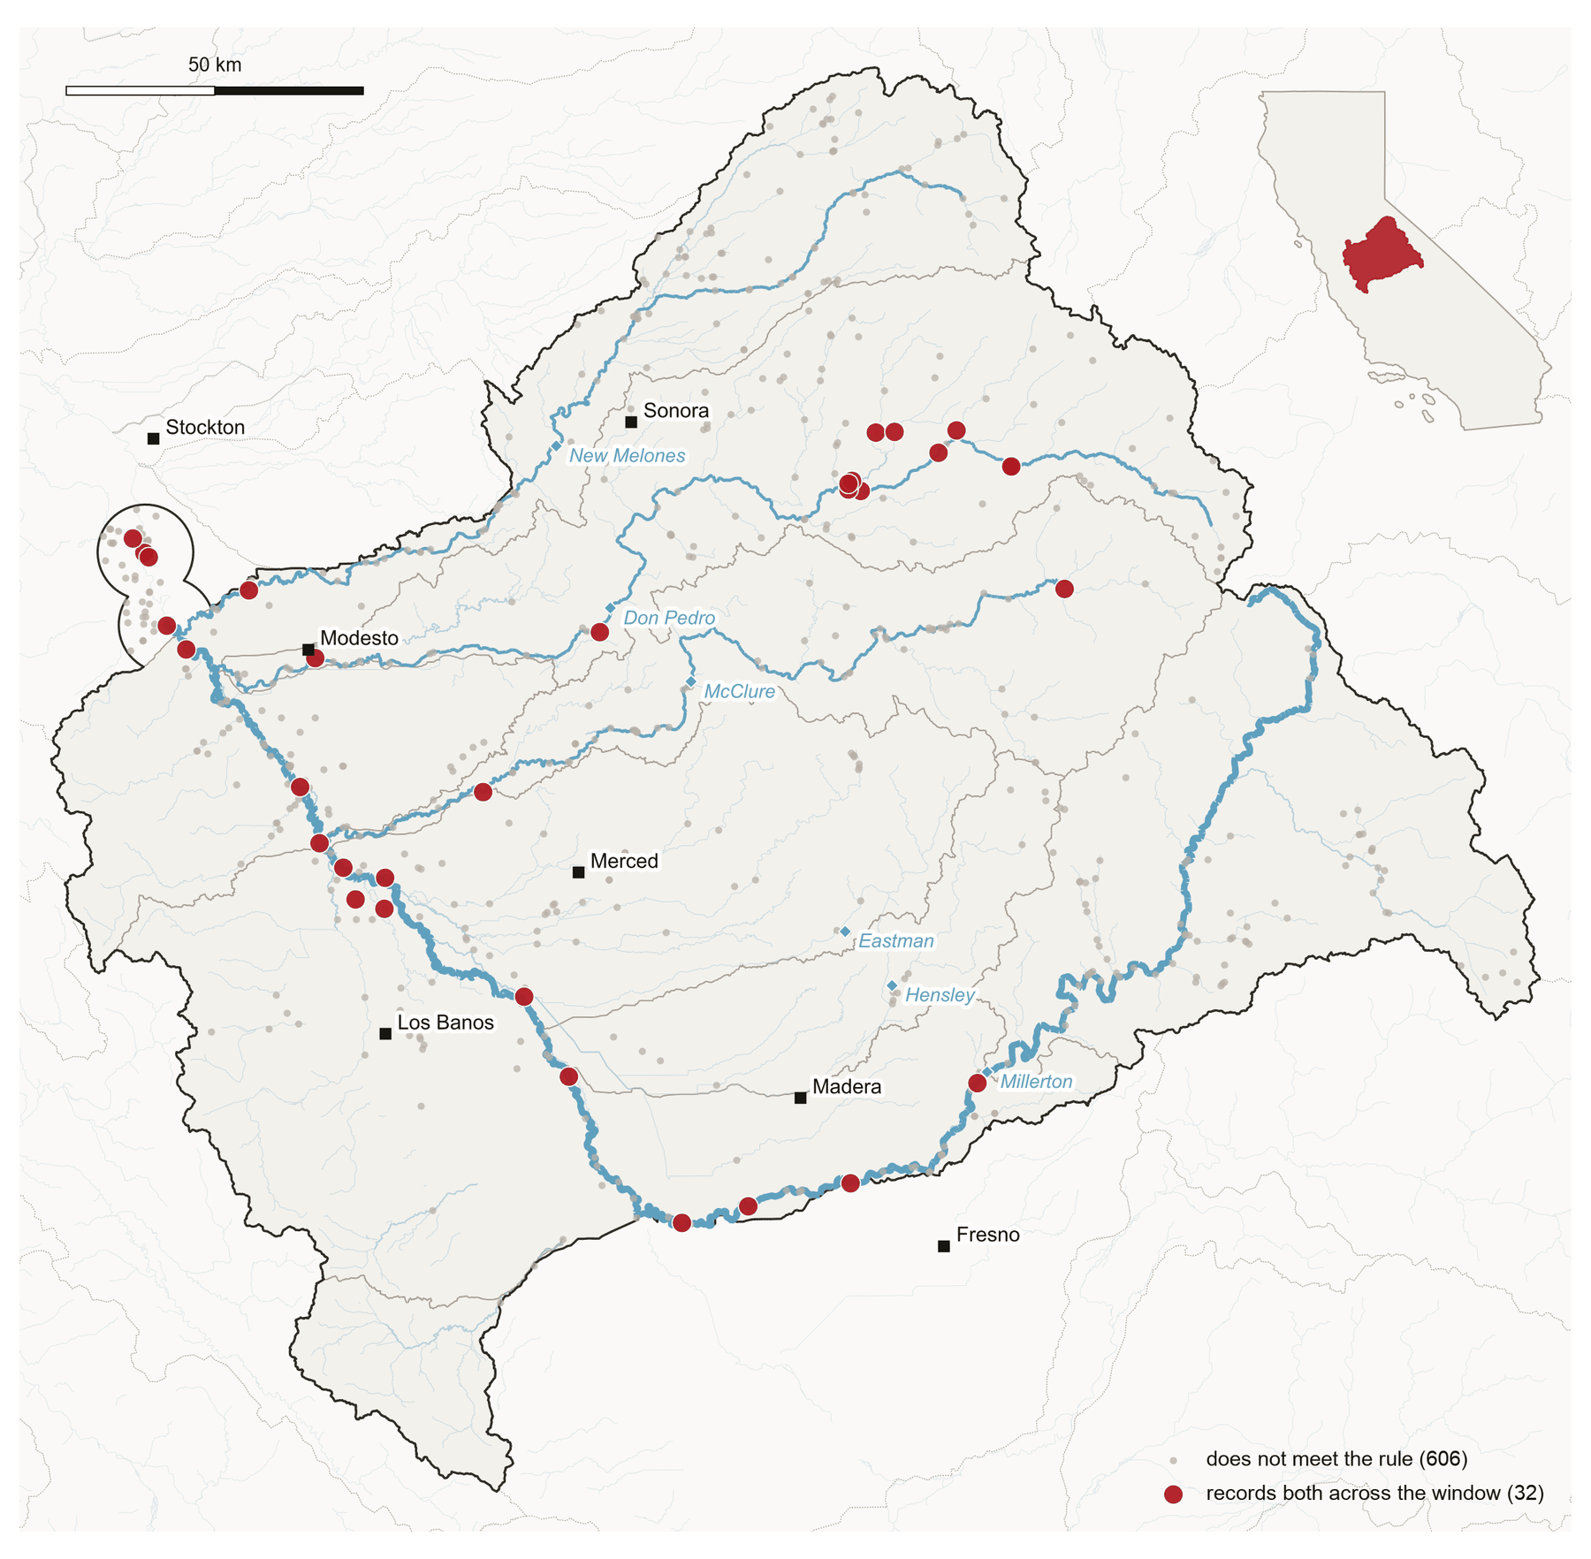
Figure 12. Temperature and flow 2011 to 2025
32 stations have complete and continuous temperature and discharge, 2011 to 2025
56 more measure both but fail on continuity or span.
A window starting 10 years earlier (2001) leaves 14 stations.
SJR-WQ station inventory, harvest 2026-08-19 to 2026-08-20
15 / 20
Notes:
• 32 stations hold water temperature and discharge from a continuous monitor with no break longer than 180 days from the first day of 2011 to the last day of 2025.
• 606 gray stations measure at least one of the two inside the window and do not meet the rule; 56 of them measure both and fail on continuity or span.
• A window starting 10 years earlier leaves 14 stations.
• Figure 13 adds conductance to the same rule. Figure 15 shows the tradeoff across window lengths.
32 stations over 2011-2025. The 606 stations that measure at least one of these parameters in the window and don't meet the rule are gray. 56 of the gray stations measure every parameter in the rule and fail on continuity or on the span instead. Rule: both parameters from a continuous monitor from the first day of the window to the last, with no break longer than 180 days. Extending the window 10 years further back leaves 14 stations. Figure 13 adds conductance to the same rule. Figure 15 shows how the counts on figures 12 and 13 change with the length of the window.

Slide 16
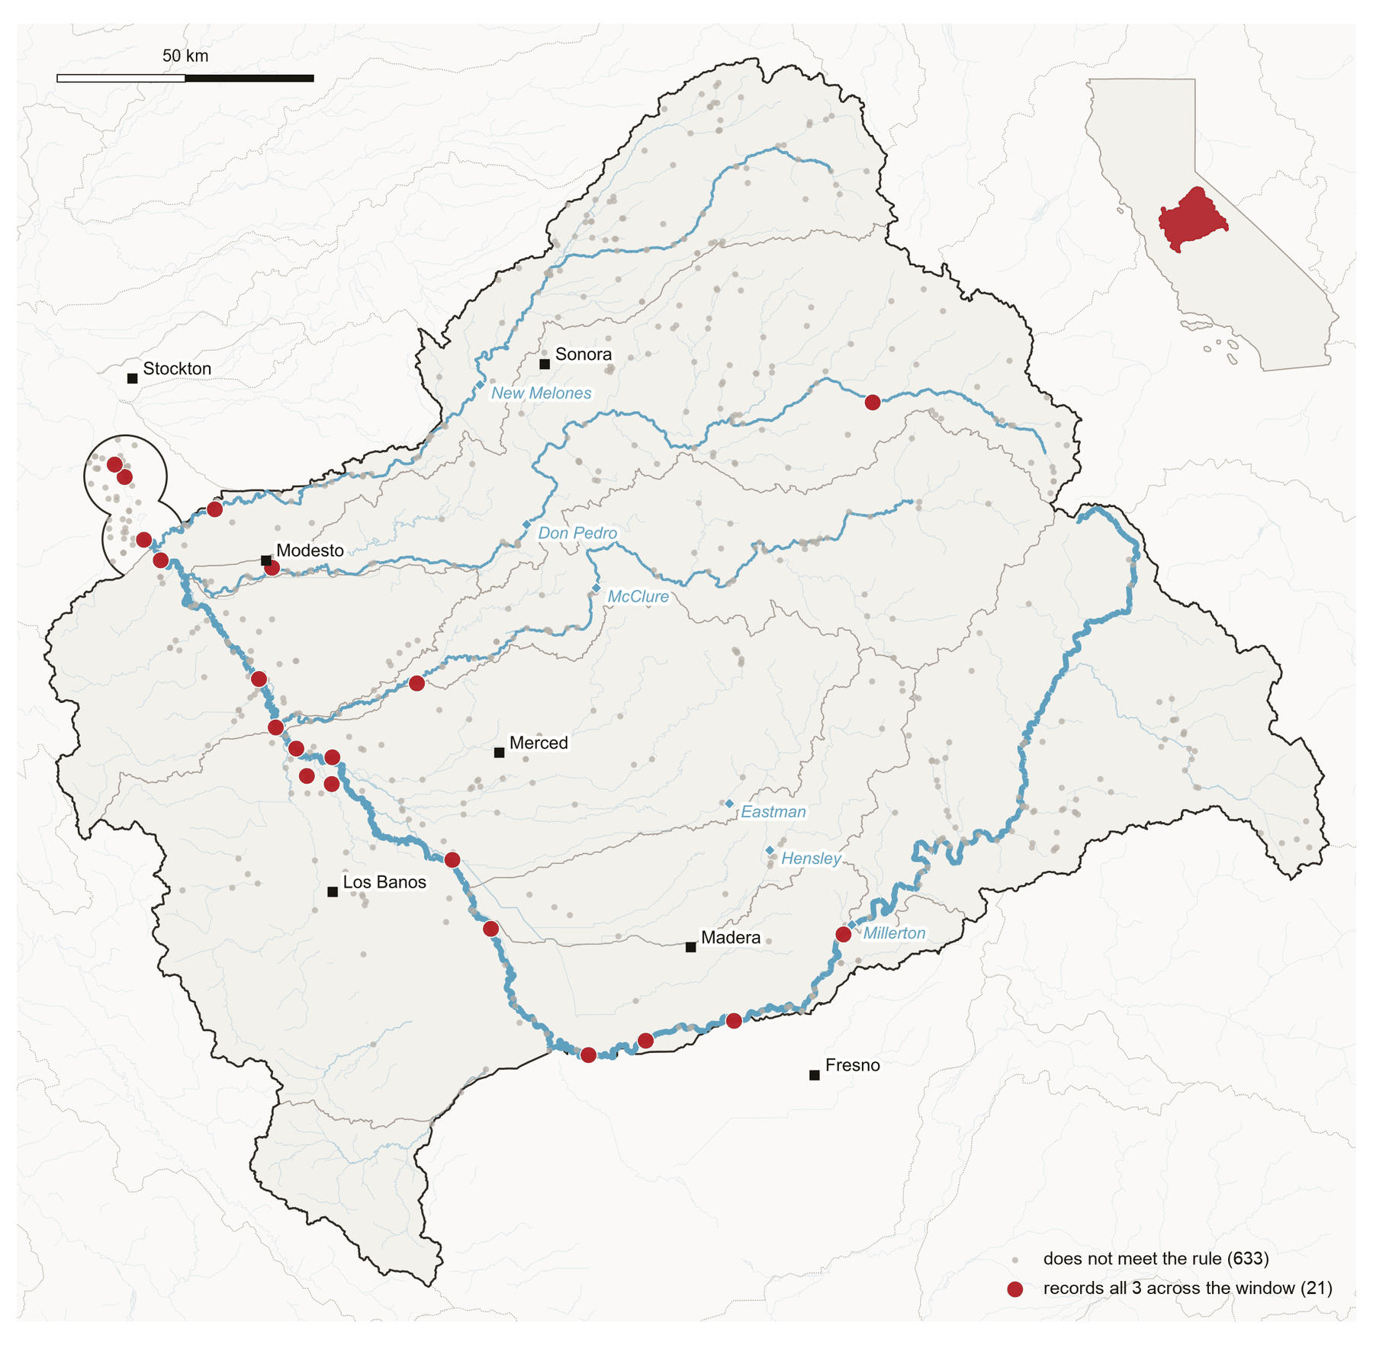
Figure 13. Temperature, conductance and flow measured together
21 stations have complete and continuous temperature, conductance, and discharge, 2011 to 2025
47 more measure all three but fail on continuity or span.
SJR-WQ station inventory, harvest 2026-08-19 to 2026-08-20
16 / 20
Notes:
• 21 stations hold water temperature, specific conductance, and discharge from a continuous monitor across all of 2011 to 2025.
• 633 gray stations measure at least one of the three inside the window and do not meet the rule; 47 of them measure all three and fail on continuity or span.
• 32 stations meet the rule for temperature and flow (figure 12); 21 of those also meet it for conductance.
21 stations over 2011-2025. The 633 stations that measure at least one of these parameters in the window and don't meet the rule are gray. 47 of the gray stations measure every parameter in the rule and fail on continuity or on the span instead. Figure 12's rule with conductance added. Conductance is the scarce measurement: 32 stations meet the rule for temperature and flow, 21 of those 32 also meet the rule for conductance, and adding conductance drops 11 stations. A modeler can calibrate a temperature and salinity model directly against those 21. Figure 15 shows how the counts on figures 12 and 13 change with the length of the window.

Slide 17
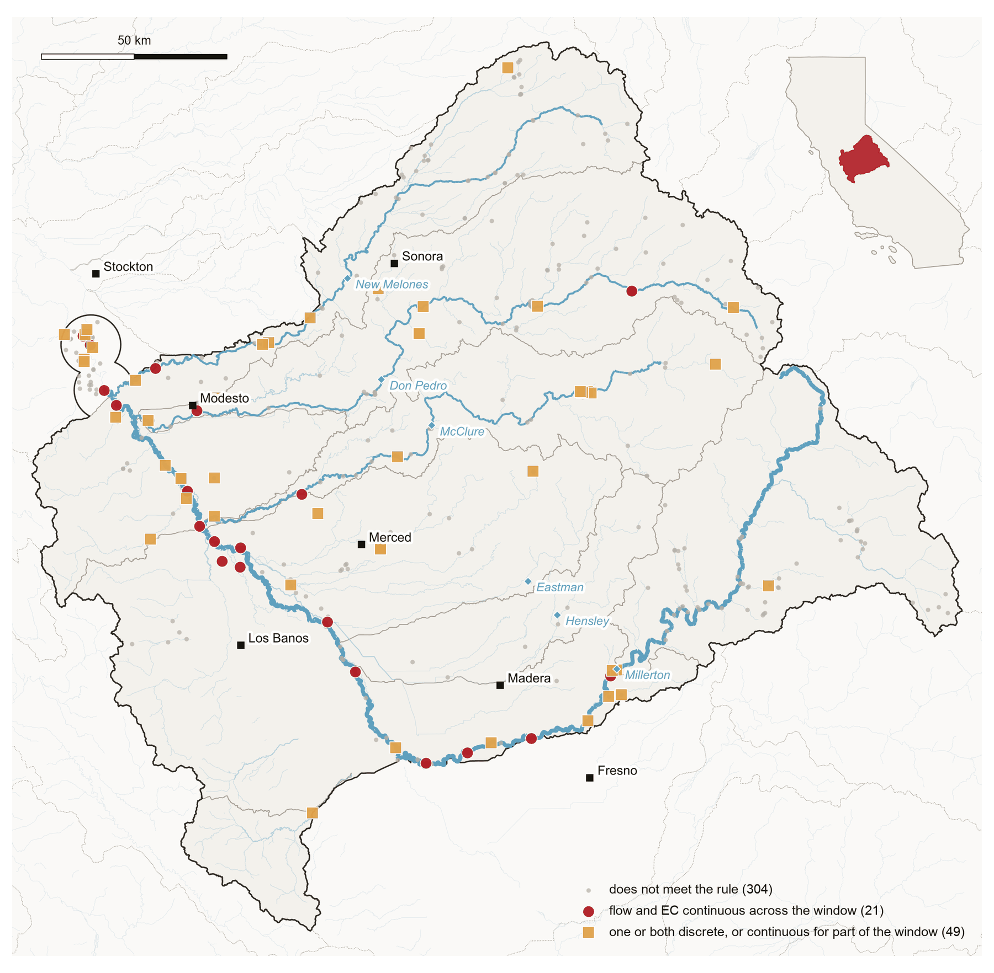
Figure 14. Stations where a salt load can be calculated
70 stations measure discharge and conductance inside 2011 to 2025
Gaged flow and a monthly conductance sample give a monthly salt load.
SJR-WQ station inventory, harvest 2026-08-19 to 2026-08-20
17 / 20
Notes:
• 70 stations measure discharge and specific conductance inside 2011 to 2025, at whatever frequency each source reports, with no requirement that either record spans the window.
• 304 gray stations measure one of the two inside the window and not the other.
• A gaged flow and a monthly conductance sample give a monthly salt load.
• 21 of the 49 stations drawn as squares sit on a natural channel.
70 stations over 2011-2025. The 304 stations that measure at least one of these parameters in the window and don't meet the rule are gray. Rule: flow and conductance both measured inside the window, at whatever frequency each source reports, with no requirement that either spans the window. A gaged flow and a monthly conductance sample produce a monthly salt load, which is what a salt balance needs from a tributary mouth or a permitted outfall. A circle marks a station with both records from a continuous monitor across the whole window. Of the 49 squares, 17 mark stations with both records from a continuous monitor and one or both covering part of the window, and at the other 32 one or both parameters come only from discrete samples inside the window. 21 of the 49 squares mark stations on a natural channel. Figure 15 shows how the counts on figures 12 and 13 change with the length of the window.

Slide 18
9 additional datasets would need specific requests (not available from the 8 public APIs)
By request: reservoir depth profiles and the SJRRP thermograph series.
Public as PDF: FERC relicensing studies, Grassland Bypass reports, CV-SALTS.
Retrievable: diversions, return flows, and the framework layers.
Channel geometry is mixed: HEC-RAS by request, 3DEP public.
SJR-WQ station inventory, harvest 2026-08-19 to 2026-08-20
18 / 20
Notes:
Datasets the basin's modeling needs that the eight APIs do not include. Status checked with a live request on 2026-08-20. Retrievable: a public endpoint or index exists. Retrievable, hard: public, but as PDF or behind a search form. Request: no public route found.
dataset | holder | status | form, and what was checked on 2026-08-20
Reservoir depth profiles at the six rim dams | Reclamation, USACE Sacramento District, Turlock and Modesto Irrigation Districts, Merced Irrigation District | request | monthly to fortnightly forebay profiles of temperature, at some reservoirs DO and conductivity; spreadsheets or PDF appendices. RISE sets hasProfile on 0 of its 136 series in the basin, which sit at 2 of the six dams (Millerton and New Melones)
SJRRP thermograph network | San Joaquin River Restoration Program; field records at CDFW Region 4 | request (atlases retrievable) | 15-minute water temperature, Reaches 1A to 5, autumn 2009 onward; PDF atlases posted on restoresjr.net, raw series not posted
FERC relicensing studies | Turlock and Modesto Irrigation Districts (P-2299), Merced Irrigation District (P-2179), Reclamation and USACE | retrievable, hard | two to five years of sub-hourly temperature and DO above and below each dam, plus profiles; PDF reports on FERC eLibrary, no search API
Grassland Bypass Project, pre-2000 | Reclamation and San Luis and Delta-Mendota Water Authority; reports by SFEI | retrievable, hard | weekly salinity, selenium, and boron at the San Luis Drain, Mud Slough, and Salt Slough since 1996; annual PDF reports with data appendices
Channel geometry and bathymetry | SJRRP (HEC-RAS, Reaches 1 to 5), DWR CVFED LiDAR, USACE surveys, USGS 3DEP | mixed | HEC-RAS geometry and survey point sets by request; the 3DEP ImageServer is public and covers the floodplain rather than the wetted channel
Diversions and return flows | Reclamation Central Valley Operations, SWRCB eWRIMS, DWR Land IQ | retrievable | daily fixed-width text and monthly PDF operations reports; an ArcGIS layer of water-right reports; crop mapping shapefiles
Interagency Ecological Program data files on EDI | EDI and IEP | harvested in part | metadata harvested; the data files that pair station to parameter (Delta_Integrated_WQ.csv, 317,274 rows; edi.2180 station files about 35 MB each) not downloaded
CV-SALTS reports | Central Valley Regional Water Quality Control Board | retrievable, hard | salinity reports and the EC objectives at Vernalis, on the board's site
Framework layers | EPA ECHO (NPDES outfalls), Central Valley Water Board (303(d)), USACE (National Inventory of Dams) | retrievable; NID unverified | ECHO returns the permitted discharge point where eSMR holds the plant coordinate; the NID API paths tried returned 404 and 400

