Slide 1
Page 0
First Letter of your last name:____________________
Your Full Name: _______________________________
I promise I do not cheat on the exam. Your initial:_____
COM S 363: Exam 2
NOTES:
This is an open book open note exam.
You must work by yourself, without discussing with anyone else except TAs or instructors.
You can handwrite, but you are strongly encouraged to type/draw on these slides directly. Some shapes may be given for your convenience. If you do handwrite, write legibly; if the grader can't read, at their sole discretion, you receive no point.
Answer concisely and precisely. One effective way to lose points is to write nonsenses. HINT: The spaces you are given are more than you need.
Submit your file in PDF format.
Problem | Max Points | Points
1 | 15
2 | 25
3 | 20
4 | 15
5 | 25
Total | 100

Slide 2
Page 1
1. (15 points) Suppose a relation is stored in heap files showing below. The slots with “empty” are free space.
(4 points) From the illustration, can you decide if the records are fix length or variable length, packed or unpacked?
Fixe length (2 points) unpacked (2 points)
(2) (6 points) Suppose a user inserts another record. What the result files should look like?
See next page insert into any page remove empty (2 points) update bitmap from 0 to 1 (2 points)
position of the corresponding bitmap (2 points)
(3) (5 points) Suppose a user wants to delete a record. This record is located at the highlighted red slot. What is the procedure? Change bitmap bit from 1 to 0 (3 points) position of the bit (2 points)
empty
0 | 1 | 1 | 1 | 1 | 1 | 6
Header
Page
 | 1
 | 2
 | 3
empty
empty
1 | 0 | 1 | 1 | 0 | 1 | 6
empty
empty
empty
1 | 0 | 0 | 1 | 0 | 1 | 6

Slide 3
(2)
1 | 1 | 1 | 1 | 1 | 1 | 6
Header
Page
 | 0
 | 2
 | 3
empty
empty
1 | 0 | 1 | 1 | 0 | 1 | 6
empty
empty
empty
1 | 0 | 0 | 1 | 0 | 1 | 6
(3)
empty
0 | 1 | 1 | 1 | 1 | 1 | 6
Header
Page
 | 1
 | 3
 | 3
empty
empty
1 | 0 | 0 | 1 | 0 | 1 | 6
empty
empty
empty
1 | 0 | 0 | 1 | 0 | 1 | 6

Slide 4
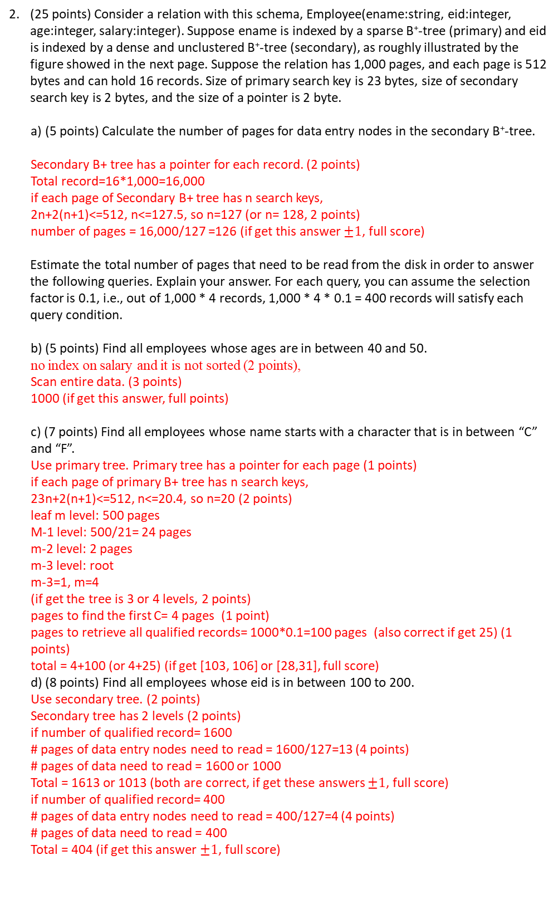
Page 2
(25 points) Consider a relation with this schema, Employee(ename:string, eid:integer, age:integer, salary:integer). Suppose ename is indexed by a sparse B⁺-tree (primary) and eid is indexed by a dense and unclustered B⁺-tree (secondary), as roughly illustrated by the figure showed in the next page. Suppose the relation has 1,000 pages, and each page is 512 bytes and can hold 16 records. Size of primary search key is 23 bytes, size of secondary search key is 2 bytes, and the size of a pointer is 2 byte.
(5 points) Calculate the number of pages for data entry nodes in the secondary B⁺-tree. Secondary B+ tree has a pointer for each record. (2 points) Total record=16*1,000=16,000 if each page of Secondary B+ tree has n search keys, 2n+2(n+1)<=512, n<=127.5, so n=127 (or n= 128, 2 points) number of pages = 16,000/127 =126 (if get this answer $±1$, full score)
Estimate the total number of pages that need to be read from the disk in order to answer the following queries. Explain your answer. For each query, you can assume the selection factor is 0.1, i.e., out of 1,000 * 4 records, 1,000 * 4 * 0.1 = 400 records will satisfy each query condition.
b) (5 points) Find all employees whose ages are in between 40 and 50.
no index on salary and it is not sorted (2 points),
Scan entire data. (3 points)
1000 (if get this answer, full points)
c) (7 points) Find all employees whose name starts with a character that is in between “C” and “F”. Use primary tree. Primary tree has a pointer for each page (1 points) if each page of primary B+ tree has n search keys, 23n+2(n+1)<=512, n<=20.4, so n=20 (2 points) leaf m level: 500 pages
M-1 level: 500/21= 24 pages m-2 level: 2 pages m-3 level: root m-3=1, m=4 (if get the tree is 3 or 4 levels, 2 points) pages to find the first C= 4 pages (1 point) pages to retrieve all qualified records= 1000*0.1=100 pages (also correct if get 25) (1 points)
total = 4+100 (or 4+25) (if get [103, 106] or [28,31], full score)
d) (8 points) Find all employees whose eid is in between 100 to 200. Use secondary tree. (2 points) Secondary tree has 2 levels (2 points) if number of qualified record= 1600 # pages of data entry nodes need to read = 1600/127=13 (4 points) # pages of data need to read = 1600 or 1000
Total = 1613 or 1013 (both are correct, if get these answers $±1$, full score) if number of qualified record= 400 # pages of data entry nodes need to read = 400/127=4 (4 points) # pages of data need to read = 400
Total = 404 (if get this answer $±1$, full score)

Slide 5
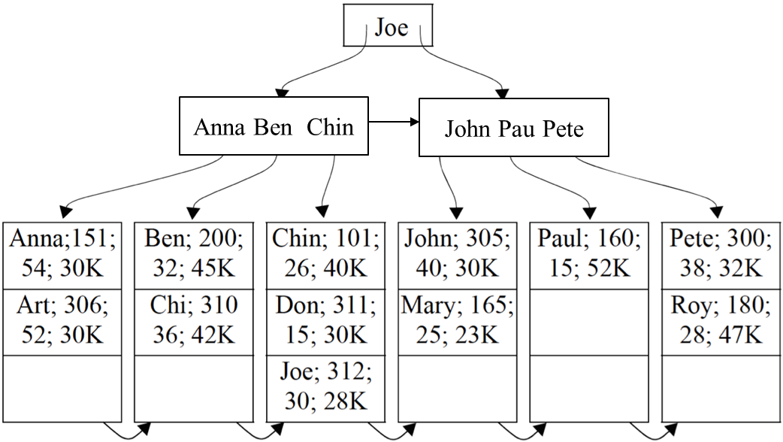
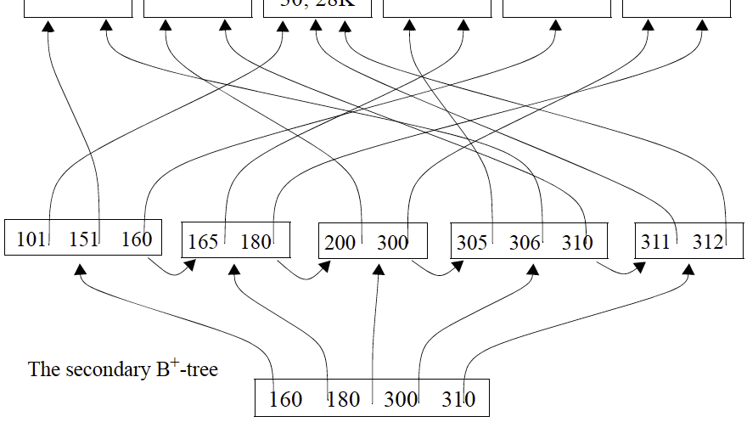
Page 3
The primary B⁺-tree

Slide 6
Page 4
(20 points) Explain how to sort 120 pages of data (e.g., numbers) with 4 pages of main memory in detail (i.e., pass 1, pass 2, ..., until the data is sorted) and estimate the I/O cost. Your algorithm needs to minimize disk I/Os (i.e., the number of pages that need to be read from and written to the disk). When sorting in main memory, you can assume you have the additional memory for swapping two numbers. Pass 1 (3 points)
Load 4 pages into main memory and sort them. This will be L1.
Then load the next 4 pages and sort them. This will be L2.
and so on so forth, until the last 4 pages are loaded and sorted.
This step will produce 120/4 = 30 sorted lists (L1, L2, ..., L30), each having 4 pages.
2) Pass 2 (3 points)
Use 3 pages of main memory to merge and the remaining one page for output.
Merge L1, L2, L3, into one list.
Then merge L4, L5, L6 into one list.
And so on so forth, until the last 3 lists are merged.
This step will produce 30/3 sorted lists (L1, L2, ..., L10), each having 12 pages.
3) Pass 3 (3 points)
Again, perform 3-way merge. This step produce 10/3 = 4 lists (L1, L2, L3, L4)
4) Pass 4 (3 points)
Again, perform 3-way merge. This step produce 4/3 = 2 lists (L1, L2)
5) Pass 5 (3 points)
Merge L1 and L2 into one list. Done.
I/O cost = 5 passes*2 (read and write)*120=1200 (5 points)
For each pass, if the procedure is correct, but number is wrong, -1
For cost, if number is wrong, but thought is correct, 3 points
If the results are good, but not minimizing disk io (e.g., using 2-way merge), reduce 5 points
If procedure is general, check if the answer is copied from internet. If it is copied from internet or a book, report to instructor, give 0
If procedure is general, but the answer is not copied from internet or include citation of the resources, 5 points

Slide 7
Page 5
(15 points) Suppose we have relation R of 120 pages in size, and relation S of size 40 pages, not sorted. We want to join R and S based on their primary keys. The size of main memory is 10 pages. Suppose the hash functions we choose uniformly partition the relation, fudge factor f=1.
(6 points) After the partition phase, (numeric answers) R is divided into _9_ partitions, each of which is about_120/9=14_ pages; (3 points) S is divided into _9_ partitions, each of which is about_40/9=5__ pages. (3 points)
(3 points) In the probing phase, which relation should be further partitioned using the B-2 memory pages?
R
S
Both R and S
Either R or S
Neither R nor S
your answer: ii, because S is smaller (about 5 pages per partition). Each partition of S can fit in 10-2=8 memory. Each partition of R cannot fit in 10-2=8 pages of memory if both choice and explanation are correct, full score. If choice is correct, but explanation is incorrect or empty, 2 points. If choice is wrong, 0.
(3 points) Suppose the memory size is 5 pages instead of 10 pages. Is this change going to affect the I/O cost of Grace Hash Join? Choose your answer and explain why.
Yes, I/O cost is going to increase
Yes, I/O cost is going to decrease
No, I/O cost is going to remain the same
It may or may not affect the I/O cost.
your answer: i
explanation: the memory is not sufficient for probing phase, thus needing to do another round of partition. (3 points) Suppose the memory size is 15 pages instead of 10 pages. Is this change going to affect the I/O cost of Grace Hash Join? Choose your answer and explain why.
Yes, I/O cost is going to increase
Yes, I/O cost is going to decrease
No, I/O cost is going to remain the same
It may or may not affect the I/O cost.
your answer: iii
explanation: the memory is more than enough, but still need two phases.

Slide 8
Page 6
(25 points) Derive the I/O costs of different join algorithms of relations R and S given the following variables, which you may or may not use all of them. Ignore the CPU time costs and the cost of writing the results. Write down steps for partial credits
|R|=10: Number of tuples in R
|S|=20: Number of tuples in S
M=120: Number of pages in R
N=40: Number of pages in S
B=10: Number of available memory in pages
5 points) What is the minimal I/O cost of block nested loop join? if s is outer: N + ceiling[N/(B-2)] * M = 40 + (40/8) * 120 = 40 + 5 * 120 = 640 pages If R is outer: M + ceiling[M/(B-2)] * N=120+(120/8)*40 = 120+15*40 = 720 pages If get 640, full score If get 720, 2 points
(5 points) What is the minimal I/O cost of simple nested loop join? If s is outer: N + N* M*|S| = 40 + 40*20*120 = 96,040 pages If R is outer: M + M*N *|R|=120+120*10*40 = 48,120 pages If get 48120, full score If get 96040, 2 points also correct: If s is outer: N + M*|S| = 40 + 20* 120 = 2,440 pages If R is outer: M + N *|R|=120+10*40 = 520 pages If get 520, full score If get 2440, 2 points
(5 points) What is the minimal I/O cost of indexed nested Loops Join​? (suppose the cost of retrieving a matching tuple is 2, for both R and S) If s is outer: N + N*|S|*2 = 40 + 40*20* 2 = 1640 pages If R is outer: M + M*|R|*2=120+120*10*2 = 2520 pages If get 1640, full score If get 2520, 2 points also correct: If s is outer: N + 2*|S| = 40 + 20*2= 80 pages If R is outer: M + 2 *|R|=120+10*2 = 140 pages If get 80, full score If get 140, 2 points
(5 points) What is the minimal I/O cost of grace hash join? B>sqrt(40), so one pass for partitioning, one pass for probing (40 pages of S + 120 pages of R) * 3 = 480 pages check condition but wrong answer, 4 points get 480 pages, full score
(5 points) What is the minimal I/O cost of Sort-Merge Join​? (suppose the join is on their primary keys which are sorted already) 40+120=160

