Slide 1
Page 1
Construct an ER diagram for a simple database that records the following information for the United Soccer League (USL).
  There are many teams in the league.
  Each team has a name, a city, a coach, a captain, and a set of players
  Each player belongs to only one team.
  Each player has a name, a position (such as left wing striker or goalie), a skill level.
  A player may be injured. Each injury has an ID, a description, and the game when it happens.
  A team captain is also a player.
  A game is played between two teams (referred to as host_team and guest_team) and has a date (such as May 4, 2020) and a score (such as 4 to 2)

Slide 2
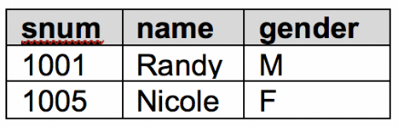
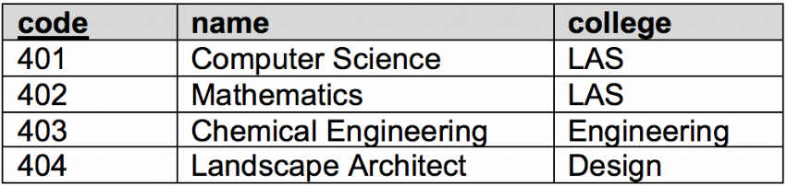
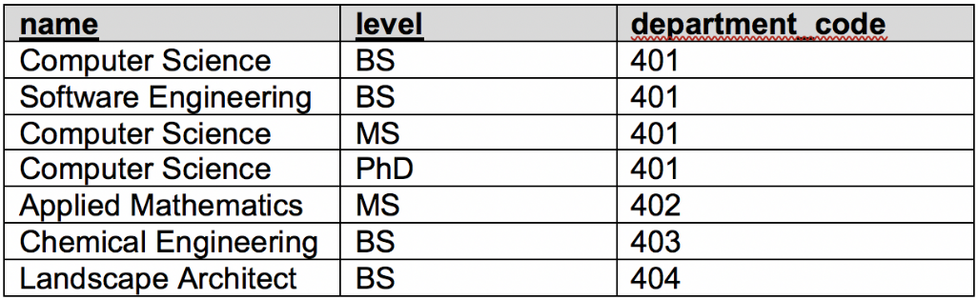
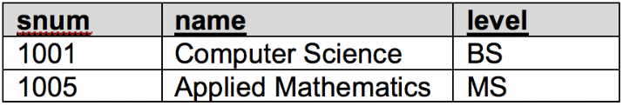
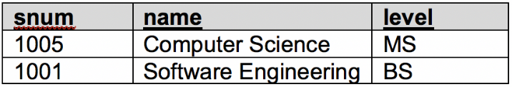
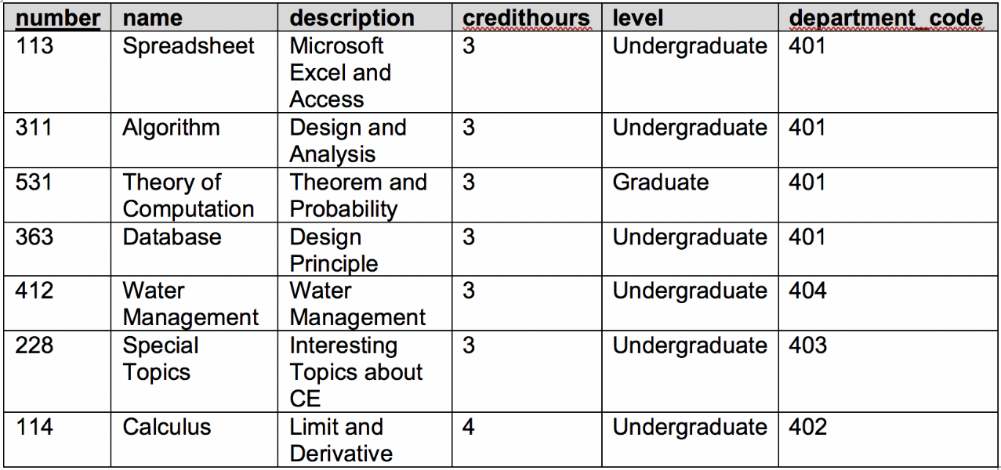
Page 3
2. We have the following relations.
Students
Departments
Degrees
Majors
Minors
Courses
Continue to next page ….

Slide 3
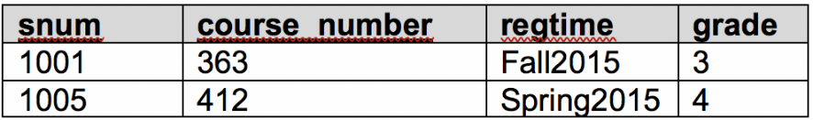




Page 4
(continue from the previous page)
Registers
(7 points) Please show the results for the following relational algebra expressions
Continue to next page ….

Slide 4
Page 5
(continue from the previous page)
Please write the relational algebra expressions and SQL code for the following queries.
  The course numbers and names of all courses offered by Randy’s home department
  The college(s) that have student registered in at least one class.

Slide 5
Page 6
3. For each of the following schedules, determine what schedule(s) it is.
S1
T1
R(A)
W(A)
commit
T2
W(B)
commit
S1 is a serial schedule. Yes[ ] No[ ]
S1 is a strict schedule. Yes[ ] No[ ]
S1 is a serializable schedule. Yes[ ] No[ ]
S2
T1
R(A)
W(A)
commit
T2
R(A)
W(B)
commit
S2 is a serial schedule. Yes[ ] No[ ]
S2 is a strict schedule. Yes[ ] No[ ]
S2 is a serializable schedule. Yes[ ] No[ ]
S3
T1
R(A)
R(B)
W(A)
commit
T2
R (B)
commit
T3
R(A)
commit
S3 is a strict schedule. Yes[ ] No[ ]
S3 is a serializable schedule. Yes[ ] No[ ]

Slide 6
Page 7
4. Strict 2PL uses a lock table to track 1) which data object is locked; 2) which transaction owns which lock; 3) which transaction is waiting for a lock on which object. Consider the following two schedules. For each step of their execution, write down the status of the corresponding lock table. An execution can result in deadlock. When this happens, you write own “deadlock” and ignore the rest steps.
S1
1) T1.X(A)
T1
X(A)
R(A)
W(A)
commit
T2
S(A)
R(A)
commit
Data | Lock | Owner | Waiting
2) T1.R(A)
Data | Lock | Owner | Waiting
3) T2.S(A)
Data | Lock | Owner | Waiting
4) T1.W(A)
Data | Lock | Owner | Waiting
5) T1.commit
Data | Lock | Owner | Waiting
6) T2.R(A)
Data | Lock | Owner | Waiting
7) T2.commit
Data | Lock | Owner | Waiting

Slide 7
Page 8
S2
1) T2.S(A)
T1
S(A)
R(A)
X(A)
W(A)
commit
T2
S(A)
R(A)
X(A)
W(A)
commit
Data | Lock | Owner | Waiting
2) T1.S(A)
Data | Lock | Owner | Waiting
3) T2.R(A)
Data | Lock | Owner | Waiting
4) T1.R(A)
Data | Lock | Owner | Waiting
5) T1.X(A)
Data | Lock | Owner | Waiting
6) T2.X(A)
Data | Lock | Owner | Waiting
7) T2.W(A)
Data | Lock | Owner | Waiting
8) T2.commit
Data | Lock | Owner | Waiting
9) T1.W(A)
Data | Lock | Owner | Waiting
10) T1.commit
Data | Lock | Owner | Waiting

Slide 8
Page 9
5. For better current execution, multiple-granularity locking (MGL) introduces three new types of locks, IS, IX, and SIX. Consider the following tree of objects, where each node contains all its children.
db
f1
f2
p1
p2
p3
r1
r2
r3
r4
r5
r6
r7
(5 points) Transaction T1 needs to read object r5. What lock(s) on which node(s) does it need to acquire?
(5 points) Transaction T2 needs to write object r6 and r7. What lock(s) on which node(s) does it need to acquire?
(5 points) Transaction T3 needs to read r1, r2, and r3, and write r2. What lock(s) does it need to acquire on object p1?

Slide 9
6. Database for COVID-19
We are in need of a database for COVID-19 reports that can answer the following questions
For each day, in each county in IA
How many tests are conducted?
How many additional confirmed cases?
How many additional hospitalized patients?
How many additional death?
How many additional recovered patients?
How many additional discharged patients?
We also need to report the demographic information of those patients including age group, gender, ethnicity, and race. As outbreaks occurred in long-term care facilities, it’s better to know which patients are related with LTC (staff/resident) as well.
This database will have three parties of users: test labs, hospitals, and the government. The test labs will handle all COVID-19 tests. They will enter the test results for every test and the basic demographic information of the testees. A person can get multiple tests. If a person is tested positive, then it is a confirmed case. If a confirmed patient is later tested negative, then this patient is recovered. The hospitals will update their patients’ status (hospitalized/discharged/death). Hospitals also need to query the test labs for the patients’ test results. The government will query the database to update the daily reports: for example https://coronavirus.iowa.gov/.
Q1. Please design a database and explain your design (also any additional assumptions). You can get extra credits if your design is more comprehensive than the basic needs described above. Your design should not require test labs or hospitals to provide summarized numbers everyday so that they can focus on their jobs.
Q2. Please provide examples SQL codes to the test labs and hospitals of how to insert and update records in your designed database.
Q3. Please provide SQL codes for finding the county in Iowa which has the highest number of confirmed patients who are elderly and LTC residents based on your database.
Q4. The hospitals will submit many queries for the test results of their patients, and test labs will update the test results very frequently. Please explain what you plan to choose for file format and indexing to improve the query responding time?
Q5. Different users may access your database concurrently. Please explain how will you handle concurrency?

