Slide 1
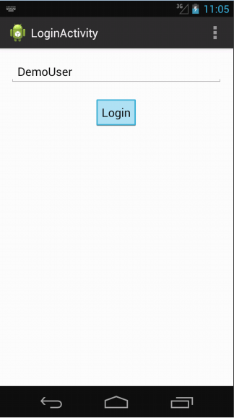

The app launches to a log in screen. Here the user can choose a user name which will be shown on the home page and as the name of the author for all posts the user creates.

Slide 2
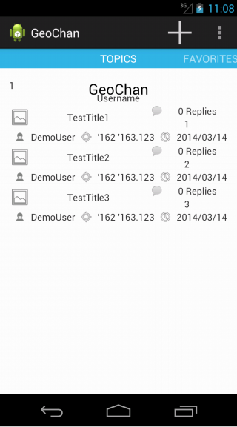
After logging in, the user will see all the latest and greatest top level comments, or topics (sorted by default). Each post displays a thumbnail of the photo (if any), the title, the number of replies (not nested), the rating of the topic, the author of the topic, the location of the topic, and the date the topic was created.

Slide 3
On the menu bar the user can select the options icon to view an options screen as shown in the following page.

Slide 4
Log In Page
Sort By...
Proximity
Proximity To:
After clicking on the select menu, the user has various options. Here the user can choose to log in as a different user, or sort the top level comments by various criterion.
Pictures
Date/Proximity
Rating
Default

Slide 5
On the top of the page, the add icon can be selected to create a new topic as is shown in the following image.

Slide 6
This is the page where a user can create a new top level comment. The user can create a title, message text, or optionally edit a location (it will default to the phone's current location). If the user wishes there is also the option to add a photo from an album or take one with the built in camera.
Once the user is finished, the post button will add the topic to the previous screen.

Slide 7
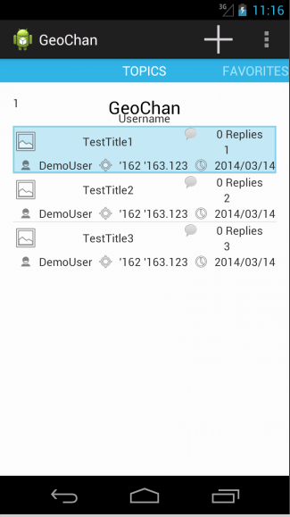
The user can also view a full screen display of a comment by selecting it from the list as is shown in this image. A full screen view of a comment is shown on the following page.

Slide 8


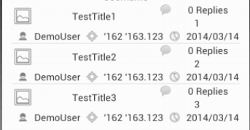

Title
Comment
Score
Here, a full screen view of the topic can be seen. A user can vote on the topic by using the up and down thumbs, or toggle the topic as a favorite by clicking the star icon.
Or the user can choose to view a full screen view of one of the topic's replies by tapping on it; this is shown on the following page.
Picture
Author
Location
Age

Slide 9
Comment
Score
Picture
Here, a reply to a topic can be seen. It is almost identical to viewing a topic, but since replies do not have titles, there is not one shown. Furthermore, because replies do not have titles the first characters of the message body are displayed instead.
Author
Location
Age

Slide 10
Edit Comment
Title
Sort By...
Comment
While viewing a topic or a reply, the user may have the option to edit a comment. If the user did not create the message he is trying to edit, they will be notified. The user can also sort the replies of the comment they are viewing through this screen.
The edit screen for a topic and reply are shown on the following page.
Proximity
Score
Proximity To:
Pictures
Picture
Date/Proximity
Rating
Default
Author
Location
Age

Slide 11
EDIT
If the user is the original author of the topic, he has access to edit it. Here, the title of a topic will be shown. If the user is editing a reply, this title will not be displayed.
The user can change the picture, the title, the message body, or the location from this screen. Once the user is finished he selects the post button as before.
Previous Title (if any)
To Be Edited
Previous Comment Text
Display To Be Edited
Previous Location To Be Edited

Slide 12
From the main screen, the user can also view a list of his favorites by swiping from right to left.

Slide 13
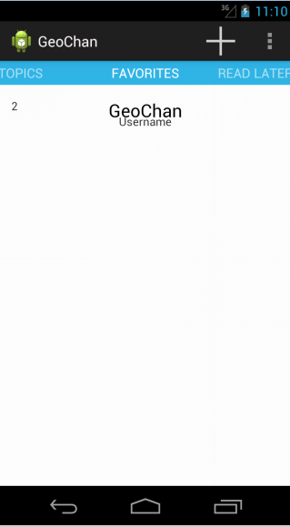
The favorites view is almost identical to the topics view, but only the topics or replies chosen as a favorite by the user are shown.
Additionally, these posts can be viewed regardless of internet connectivity.
By swiping left, the user can view their read later posts.

Slide 14
The read later posts are added automatically when a user enters a full screen view of a post.
These posts are also viewable regardless of internet connectivity.
To return to the previous views, the user can simply swipe from left to right.

